Slide 1
DCF 58 Kinship Care
Program Funding
2026
Notes:
Welcome & Intros, Review Handouts: Agenda, Crosswalk & PPT

Slide 2
What is Kinship Care?
Kinship Care is an alternative to Foster Care for children whose relatives & like-kin caregivers may better meet their needs due to abuse & neglect.
Federal TANF Funded
Managed by local tribal & county agencies

Slide 3
What is Kinship Care?
All kinship care agencies are required to follow DCF 58 policy.
No additional eligibility criteria can be added
Kinship Care has it’s own barred offense policy

Slide 4
Eligibility:
No Simultaneous Payments
58.04(3)
  A child may not simultaneously receive:
  KC and LTKC payments
  KC/LTKC and FC payments
  KC/LTKC for a child receiving SS due to the child’s own disability
Notes:
Duplicate payment for the same child from any agency not allowable

Slide 5
DCF Ch. 58.03 Types of Relative Caregiving
Kinship Care is an alternative for children whose needs are better met by relatives & like-kin due to abuse or neglect .
There are three types of Kinship Care:
DCF Ch.58.03(1)
Court Ordered
(CHIPS/JIPS)
DCF Ch. 58.03(2)
Voluntary
(Informal or 48.9795 Guardianship)
DCF Ch. 58.03(3)
Long-Term
(48.977 Guardianship & Tribal equivalent)
Notes:
Tribes are exempt from Licensing COKC homes- ALL funded with same contract (TANF)

Slide 6
Application Requirements
Application
Background Checks on all Adults in Home
Home Visit
Eligibility Determination & Documentation

Slide 7
Kinship Care Funding:
Tribal Kinship Care contracts run 10/1/25 - 9/30/26.
There are two separate funding streams:
- KC Benefits: May only be used to pay the monthly KC payment($384).
-KC Assessments: These funds may only be used for costs related
to the agency assessment of the KC “case”. ( for example: BGC fees,
assisting families with safe sleeping arrangements for infants, home visit,
KC Staff Training and KCTS documentation time.)

Slide 8
Kinship Care Appendix B: Use of Funds
  C. Kinship Care Benefits SPARC Line 5377. These funds are for monthly Kinship Care Benefit payments to eligible caregivers as set forth in s. 48.57(3m) Wis. Stats and Administrative Rule DCF 58. The funds may only be used to make benefit payments.
The benefit allocations are based on the projected caseload using actual caseload counts of both enrolled and waitlisted. The Department may conduct surveys to determine caseload trends and make adjustments to benefit funding during the contract period. The Department may also keep benefit funds in reserve. To the extent that funds are available, the Department will reimburse the Tribe for benefit costs in excess of the contract amount during the contract closeout period.
  D. Kinship Assessments SPARC Line 5380. These funds are for costs associated with conducting Kinship Care Assessments, including, but not limited to, doing program outreach, accepting applications, conducting background checks, assessing the homes of caregivers, determining initial eligibility, and doing annual eligibility redeterminations. These funds may also be used towards bassinets, cribs or playpens for Kinship Care families without safe sleeping arrangements.
The assessment allocations are based on the projected caseload.
The Tribe will be reimbursed up to the contract amount.
Notes:
Annually the Tribal contracts include Appendix B for KC

Slide 9
Kinship Care Funding Timeline
1st SPARC 2nd SPARC
reporting due 7/31 reporting due 11/30
10/1/2025--------------5/30/26----------------7/15/26*-------------------9/30/26---------------------------11/30/26
KC Contract start date (60 days to report in SPARC) KC Contract end date (60 days to report in SPARC)
The next KC contract allocation is based on the agency’s KCTS & SPARC reporting
Re-obligation amounts (reimbursement) are based on agency reporting in KCTS & SPARC
Re-obligation payments are provided a few month after closeout and may be delayed due to agency missing the deadline or audit
* Early due date , due to contract funding period

Slide 10
Kinship Care Funding:
Tribal Kinship Care contracts run 10/1/25 - 9/30/26.
Re-obligation Process:
- DCF provides annual reimbursement for KC payments going over contract amount.
- These “reobs” occurs after contract close out
(60 days after contract end dates of 5/30 & 9/30).
- Expenditures must be reported in SPARC by 7/15 & 11/30, this data is used to determine your
agency’s need/amount for kinship reimbursement.

Slide 11

Reporting:
The importance of KCTS and SPARC

Slide 12
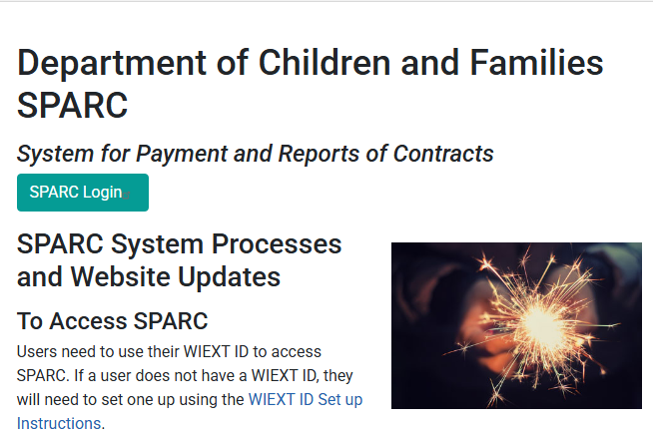
https://dcfsparc.wisconsin.gov/
SPARC Home Page: https://dcfsparc.wisconsin.gov/

Slide 13
SPARC Reporting Requirements:
SPARC is the DCF contracts database used by all agencies to report their contract expenditures.
SPARC is used to determine a Kinship Care agencies need for additional funds during the contract period. Your agency reob amount is based on your timely reporting (60 days after each allocation period).
Generally, additional Kinship Care funds will be provided to agencies at contract closeout, but may be provided earlier based on need of the agency and available funding.
Final 2026 reimbursements will be processed in January.

Slide 14
Agency Procedures:
Ch. DCF 58.08 (16)
  Overpayments
  An agency may recover an overpayment of Kinship Care from a caregiver by any of the following means:
  1. Reducing the amount of the caregiver’s monthly Kinship Care payment.
  2. Requesting payment within a specified time period.
  3. Negotiating a payment plan.
  (b) 1. A county department of social services, a county department of human services, or a tribal agency that recovers an overpayment may retain the amount recovered.
  2. Funds retained may only be spent on the agency’s Kinship Care program.
  3. If the agency has not spent the retained funds by the end of the contract period, the department shall recover the funds through the contracting process.

Slide 15
Kinship Care Tracking System Reporting Requirements:
KCTS is the DCF database used by all tribal agencies to report their monthly KC caseload detail (new & revised).
KCTS is used to help determine a Kinship Care agency’s need for additional funds during the contract period.
Agencies are required to enter all new or revised KC case details into KCTS by the 10th of each month.
Staff are required to monitor the data to ensure accuracy.

Slide 16
Kinship Care Resources:
Click to access DCF 58: https://docs.legis.wisconsin.gov/code/admin_code/dcf/021_099/58
DCF- KC Worker Site (KC Forms):
https://dcf.wisconsin.gov/cwportal/kinship
Kinship Navigator Portal: Resource for WI Relative Caregivers
https://dcf.wisconsin.gov/kinship/navigator
Kinship Care Training Contact
Next Training 10/21/26, register at the link below!
Professional Development System (PDS) office@wcwpds.wisc.edu
Please register online at PDS:
https://pdsonline.csod.com/LMS/catalog/Welcome.aspx?tab_page_id=-67
Please note only those who do not have an active account within the eWiSACWIS system should create a self-registration account:
https://pdsonline.csod.com/selfreg/register.aspx?c=self_reg_default

Slide 17
Contact Information:
Holly Telfer
Kinship Care Specialist
(608)422-6921
Holly.Telfer@Wisconsin.gov

