Slide 1
DCF's YoungStar
Analysis & Update
Background and Overview
Notes:
Daria

Slide 2
DCF's Overarching Goal
Increase access to quality, affordable child care for Wisconsin families​
Notes:
Daria

Slide 3
Why does child care quality matter?
Workforce participation for the parents of young children
Improved K-12 education outcomes
Better long-term health outcomes
Improved public safety
Family stability and prosperity
Notes:
Daria
Lived experience AND rigorous longitudinal research – including from Nobel Laureate economist Dr. James Heckman – tells us that quality child care matters for a range of important outcomes for you state and communities.
And, as Terra will tell you more about next, a wide range of Wisconsin stakeholders also prioritized child care quality in directing and guiding the development of YoungStar.

Slide 4
What is YoungStar?
Wisconsin’s Child Care Quality Rating & Improvement System
Notes:
Daria
Terra will give you much more information on how YoungStar functions momentarily. But before she does, I want to place YoungStar in the context of DCF’s overarching goals for child care

Slide 5
What YoungStar does
​
Sets consistent standards for child care quality
Objectively measures program quality against quality standards
Rates providers on a scale of 1-5 Stars
Supports providers to meet quality standards
Gives families information to use in their child care decisions ​
Notes:
Terra
Since 2010, YoungStar has continued to … read slide

Slide 6
How programs are rated
YoungStar’s rating system gives parents and providers a snapshot of a program’s overall quality by evaluating four important areas of care:​
The child care staff’s education and training​
The learning environment and curriculum​
The program's business and professional practices​
The child's health and well-being​
Notes:
Terra
All providers who participate in YoungStar receive a YoungStar rating.
This rating gives parents and providers a snapshot of a programs overall quality by evaluating 4 important areas of care:
The education and training of the staff at the program
Various aspects of the learning environment and curriculum
If program demonstrates effective business and professional practices
And what policy and practices are in place to promote a child’s health and well-being

Slide 7
YoungStar participation
As of 12/29/2023 | 1 Star | 2 Star | 3 Star | 4 Star | 5 Star | Total
Providers rated by Youngstar | 9 | 1,748 | 1,070 | 178 | 499 | 3,381
Children using WI Shares attending YoungStar providers | 0 | 13,766 | 11,473 | 1,807 | 5,432 | 32,478
85% of the roughly 4,500 regulated
providers participate in YoungStar
Notes:
Terra
In Wisconsin, approximately 85% of regulated providers participate in YoungStar and receive a YoungStar rating. That equates to approximately 3,400 out of the 4,500 total providers.
Along with overall participation in YoungStar, the department also monitors the number of children whose families utilize WI Shares subsidy that attend YoungStar rated programs and the star rating for those programs.
Providers that want to receive WI Shares payments from families, must participate in YoungStar. And YoungStar participating providers cannot deny care for those families.

Slide 8
Notes:
Terra
Most decreases or increases are by 1 Star level
1% or less saw an increase by 2 Star levels
Another area of close monitoring is the movement in star level providers experience over time. This graph shows the star level movement in the various regions of the state from 2018-2022. The blue section represents no change, the green represents an increase in star level, and the red represents a decrease. This data tells us that across the state, most providers have stayed at the same star level over a four-year period.
This also tells us that while our data shows that the majority of providers are at the 3 to 5 Star level, most providers have not been able to increase their star level over time. This data raises the question of how YoungStar can better support a programs continuous quality improvement efforts.

Slide 9
Supports available to providers
One-on One Individualized Coaching
Targeted Group-Based Coaching
On-Demand Resources & Training
Help Desk
Notes:
Terra
Here are some of the ways YoungStar supports providers. Providers who participate in YoungStar have access to…
One on One Individualized Coaching where a YoungStar coach provides support to administrative and/or classroom staff
Targeted Group Based Coaching where a coach provides support to a set of individuals who are interested in the same topic
Both coaching options are available virtually or in person or both, whatever method best meets the provider’s needs
Providers also have access to on-demand resources and training that are created and curated based on provider interest or need
And a help desk available during regular business hours to answer questions and connect them to additional supports

Slide 10
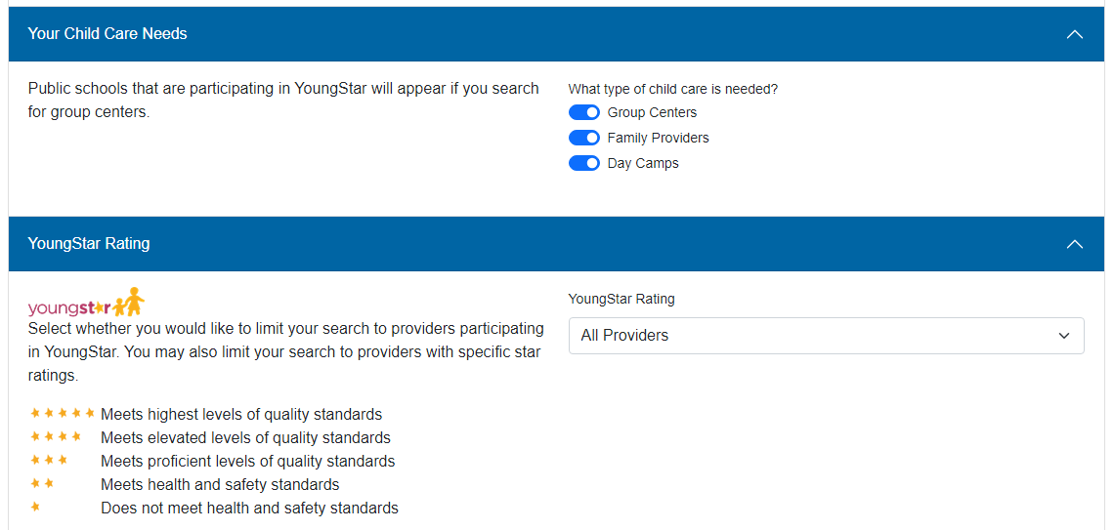
Supports available to parents
Notes:
Terra
Here are some of the ways YoungStar supports parents …
The Child Care Finder website is available for families to compare YoungStar rating and other important details of a program when looking for child care, such as if a provider offers infant care, transportation, or programming in languages other than English. Parents can also search by location to find providers specific to their community.

Slide 11
Intersection of child care programs
YoungStar
Regulation
Wisconsin Shares
Helps eligible families afford care
Quality of learning environment
Health & safety
Notes:
Terra
YoungStar works closely with other the DCF bureaus and teams whose programs overlap with child care quality initiatives.
The health and safety standards set by child care regulation are the foundation on which YoungStar’s quality standards are built upon.
WI shares helps families pay for child care and all YoungStar providers must be willing to serve children whose families utilize Shares.
While each of these programs have their unique purpose, they work hand in hand to promote quality child care in partnership with YoungStar.
And with that I am going to turn it back over to Daria to tell us more.

Slide 12
Updating YoungStar
What is our intent & how stakeholders can get involved
Notes:
Daria

Slide 13
Why now?
Timely review of standards – using updated research on child development ​
Utilize current data and trends to implement new policies/practices that drive measurable improvement ​
Opportunity to address current realities
Stronger alignment with other DCF systems (subsidy & regulation)​
Notes:
Daria
In short – it’s time. YoungStar has been in place for well over a decade, and we know a lot more now, and the context for child care is different now

Slide 14
Our intent
To solicit and act on stakeholder input on the following:
What does “quality” mean?
How can YoungStar support child care programs to provide quality?
How can YoungStar support families to access quality?
Notes:
Daria

Slide 15
Who will we be engaging?
Legislature
Additional Stakeholders
Child development experts
K-12
Higher education
Business community
People Most Impacted
Families
Child care providers
Early educators
Notes:
Daria

Slide 16
How will we engage?
Presence at Existing Events
Meetings
Conferences
Listening Sessions
In-person
Surveys
Virtual
Notes:
Daria

Slide 17
How will we communicate?
Child Care Listserv
YoungStar Listserv
Tuesday Talks
Website & social media
Notes:
Daria

Slide 18
Questions
DCFYoungStarUpdates@wisconsin.gov
Notes:
Daria

