Slide 1
Accessibility 101:
Making our digital training more accessible

Slide 2
What is Accessibility?
“…person with a disability is afforded the opportunity to acquire the same information, engage in the same interactions, and enjoy the same services as a person without a disability…”
- Office of Civil Rights and the U.S. Department of Education
Notes:
According to the Office of Civil Rights and the U.S. Department of Education, accessible means that a person with a disability is afforded the opportunity to acquire the same information, engage in the same interactions, and enjoy the same services as a person without a disability in an equally effective and equally integrated manner, with substantially equivalent ease of use. The person with a disability must be able to obtain the information as fully, equally, and independently as a person without a disability.
When considering digital content, this means it is considered accessible only if it can be used just as effectively by people with disabilities as it can by those without.

Slide 3
What is Accessibility?
Notes:
This includes making digital material accessible for those who are *blind and/or visually impaired, *deaf and/or hearing impaired, *color blind, those prone to seizures, and people with *physical limitations that require keyboard navigation.

Slide 4
Accessibility vs. Accommodations
Notes:
Accessibility is not the same as accommodations. Martin LaGrow has an excellent example in his article “The Section 508 Refresh and What it Means for Higher Education”. In the article, LaGrow states “For example, instructors may believe that it isn’t *their responsibility to provide transcripts or captions to students viewing a video in an online course. Instead, they might direct *students to the campus accommodations office to provide the content in a modality that they can use more effectively. However, providing alternative text for videos is an issue of accessibility, not accommodation.”

Slide 5
Accessibility vs. Accommodations
Notes:
Basically, an accommodation is provided based on specific needs of *one learner. Accessibility is the responsibility of the creator and is provided to *all learners.
By making our materials more accessible, it reduces the need for accommodations and ensures an equivalent experience for all learners regardless of disability.

Slide 6
508 Compliance
Rehabilitation Act of 1973
Focused on digital material.
Notes:
The article by LaGrow focused on section 508. Section 508 was added as an amendment of the *Rehabilitation Act of 1973 in the late 90s. It requires that information and communication technology that the Federal government develops, procures, or maintains is accessible to people with disabilities. It has undergone changes since then to adapt with new technology. While it goes along with the Americans with Disabilities Act (ADA), which prohibits discrimination against individuals with disabilities, it is not the same. Essentially, 508 is *focused on digital materials.
508 compliance has become the standard for any organization operating under the permission of the federal government. As a portion of our funding comes from the federal government in one way or another, we should be adhering to section 508.

Slide 7
W3C Web Accessibility Initiative
Notes:
There are resources available to help us determine what we need to do to comply with section 508. Perhaps the biggest resources is the World Wide Web Consortium (W3C) Web Accessibility Initiative. They provide an introductory video on their website explaining this initiative a bit more.*

Slide 8
Meeting WCAG Guidelines
Notes:
As the video mentioned, W3C created Web Content Accessibility Guidelines (WCAG) surrounding the four major principles of accessibility: perceivable, operable, understandable, and robust. Guidelines were created within each of those principles with three varying levels of conformance: A, AA, and AAA. A is the lowest standard and AAA is the highest. Most professionals try to meet AA conformance. You can view a customizable quick reference guide online.

Slide 9
Accessibility in our Digital Training
Notes:
Based on the quick reference guide, I found a few areas that I believe we should focus on. More information on these areas are available in the provided handout. I am going to focus the rest of our discussion on just three: *text alternatives, *captioning, and *readability.

Slide 10
Text Alternatives
Teacher pointing at laptop screen to two teenage students.
Notes:
A text alternative is text provided for non-text content. We must provide text alternatives so that it can be changes into other forms people may need, such as large print and speech. This includes providing alt text for images so that they can be read by a screen reader. We are going to walk through a demonstration of the information you hear when using a screen reader. If you are willing, please close your eyes. I will play an audio clip and then we will discuss it.

Slide 11
Text Alternatives
Notes:
*(play audio)
What do you think the slide looked like?
You may be surprised to learn there are images on the slide. However, because no alt text was entered for the images, the screen reader did not pick up on it. If a learner uses a screen reader and we do not use alt text, they are missing out on content.

Slide 12
Text Alternatives
Notes:
Let’s listen to another example. *(play audio)
Now, what do you think the slide looked like?
Because we entered alt text, the screen reader was able to tell us there were two images on the slide. The developer of the alt text provided a basic text description, but it is still difficult to get a full understanding of what is happening in the images.

Slide 13
Text Alternatives
Notes:
Let’s listen to one last example. *(play audio)
How did this example differ from the last one?
This example is much closer to what we want to include. It provides enough of a description for learners to understand what is happening on the slide without getting into too much detail.

Slide 14
Text Alternatives
Notes:
Here are the images. How do these images differ from the ones you were envisioning from the screen reader?
How did you feel not knowing what the screen looked like, especially in the first example?
What benefits can you think of to adding alt text to images while developing presentations?

Slide 15
Alt Text Tips
Notes:
When writing alt text, there are a few general tips to keep in mind. *First, be as descriptive and specific as possible. The description you include should paint the picture for learners who are unable to see them. *Second, be concise. Depending on the screen reader being used by a learner, the description you enter for alt text could get cut off at 125 characters. Try to keep your description at or below that. *Finally, don’t include the obvious descriptors of “image of” or “photo of”. Because you are entering alt text, it is assumed that it is some sort of an image being display. Only include these descriptors to differentiate between different types of images. For example, if it is a photo icon or a button. What questions do you have regarding text alternatives?

Slide 16
Captioning
Notes:
We must provide alternatives for audio and video to adhere with section 508. This could be captions or other text alternatives. We are sufficient in captioning our independent, online trainings available in the Learning Center. We ensure that we provide closed captioning in our CBTs and transcripts to our videos. However; we typically don’t provide alternatives for our live, online trainings.

Slide 17
Closed Captioning in PowerPoint
Notes:
There is closed captioning available within PowerPoint. To turn on closed captioning, go to the Slide Show Tab. Check Always Use Subtitles. You can change where the subtitles display by going into the Subtitle Settings. This captioning will only work if you are showing the PowerPoint for the entire training.

Slide 18
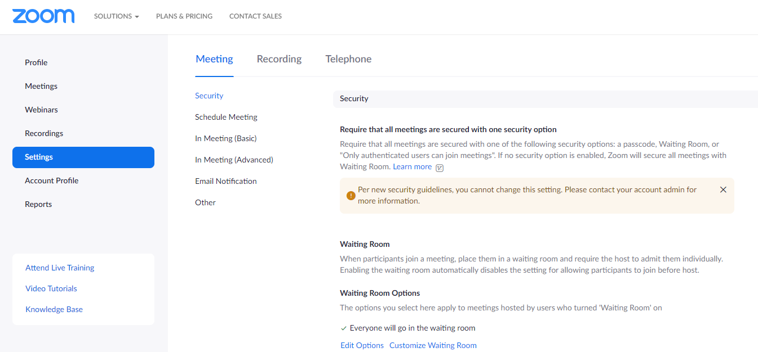
Closed Captioning in Zoom
Notes:
There is also live closed captioning feature in Zoom. This feature is only available for paid accounts and must be enabled in your settings. To enable closed captioning, log in via the web. *Click Settings. In the Meetings tab, *click In Meeting (Advanced). *Scroll down to Closed Captioning and toggle it on. After it is on, you can click the checkbox to enable live transcription.
*After enabling closed captioning, you turn it on within the meeting. At the bottom of the window, *click the Live Transcript button. Then, select *Enable Auto Transcription. Learners will have the same Live Transcript button on their screens and can enable/disable captioning.
We used Live Captioning in the WWP Phase 2 classes, and it was very successful. The auto transcription was surprisingly accurate and eliminated ums and ahs. It also had a secondary benefit of providing learners something to follow along with when they lost audio connection.

Slide 19
Closed Captioning Tips
Closed Captioning
Notes:
Of course, auto-transcription is not perfect and does lag a bit. It is recommended that you should talk slowly to give the *computer time to turn your speech into text and give the *learner time to read the captions. Additionally, be sure to enunciate your words for the best results. What questions do you have regarding closed captioning?

Slide 20
Readability
If you had Irlen Syndrome the text may move on the screen because the contrast is too high. It could also cause various other distortions when attempting to read the information.
This is a bit difficult for anyone to read, but impossible for someone who is color blind.
Notes:
Readability refers to the text content in a training to be readable and understandable. Not only must the content be readable and understandable to you, but it must also be readable and understandable for learners with disabilities such as color blindness and Irlen Syndrome.
For example, take a look at the text on this screen. That text box is difficult for anyone to read. However, if you had the Green-Blind type of color blindness, *this is what it would look like.
Likewise, to you it may seem like *this text box is great contrast and easy to read. *However, if you had Irlen Syndrome which causes extreme contrast sensitivity, the black text on a white background would cause the text to move making it difficult to read.

Slide 21
Readability
While this background is visually appealing, it makes it hard to read the content on the screen.
Even changing the font color doesn’t help much.
Adding a semi-transparent shade to your text can help.
Notes:
Here is another example of poor readability. While the background is visually appealing, it makes it hard to read the content on the slide. You can try changing the color of the font, but even that doesn’t help much. *Adding a semi-transparent background shade to your text can help.

Slide 22
Readability
www.accessible-colors.com
Notes:
There are a variety of resources available to check your readability. One resource I highly recommend to use at the beginning of development is accessible-colors.com. You can input your text color, text size and weight, background color, and choose which level of WCAG conformance you are aiming for. It then gives you a pass or fail. If the colors you input fail, the website provides recommendations to get it to pass.
There are also a variety of color blindness simulators available online to check your colors. What questions do you have regarding readability?

Slide 23
PowerPoint Accessibility Checker
Notes:
That is a lot of information to keep track of and remember to check! Lucky for us, there is an accessibility checker within PowerPoint. The checker is located in the Review tab. Click the icon to tell PowerPoint to start the check. After the check is complete, an Accessibility pane opens. Within this pane, you can review and update your errors, warnings, and tips. It also provides additional information on how to fix anything that is needed. I am going to do a live demo of using the Accessibility checker. There are various things wrong with this presentation. Let’s take a look at a few of them together.

Slide 24
Accessibility Next Steps
1. What stood out to you about what we have covered so far?
2. What were you surprised to learn?
3. What did you see and/or experience that changed your thinking about accessibility?
4. How might you begin to make the courses you are working on more accessible?
5. What steps can we, as the Partner Training Team, take to ensure content is accessible for all learners?
Notes:
Now that we have covered the basics of accessibility, I have a few questions for you. Grab a piece of scratch paper to jot down your responses. We are going to do the classic 1-2-4-All, so you don’t need to share your responses yet. *What stood out to you about what we have covered so far? *What were you surprised to learn? *What did you see and/or experience that changed your thinking about accessibility? *How might you begin to make the courses you are working on more accessible? *What steps can we, as the Partner Training Team, take to ensure content is accessible for all learners? After you have jotted down a response to these questions, put your preferred level of toastiness for s’mores in the chat.
Next, I am going to send you into a breakout room with another person. Compare what stood out to you, what you were surprised to learn, and what changed your thinking. Then compile a list of how you can begin to make courses more accessible and the steps we can take as a team. The person who lives closest to a body of water will by your designated reporter outer and scribe. You will have five minutes. After five minutes have passed, I will send your duos into another group to repeat the same steps. Again, you will have five minutes. Is there anything I can clarify before opening the rooms?
Superior: Lynda, Kim
Michigan: Mai See, Sara B
Erie: Bob, Emmi
Huron: Eura, Frankie
Ontario: Danni, Cheryl (goes into Superior)
Atlantic: Rachel, Nikie (goes into Superior)
Pacific: Paula, Dave (goes into Michigan)
Arctic: Sally, Sue, Heather (goes into Erie)
Antarctic: Sarah, Mark (goes into Huron)

Slide 25
Accessibility Next Steps
Individual Steps
Partner Training Team Steps
Notes:
Welcome back! Please share any common threads you discussed from the first three questions. Then, share your groups individual steps and PTT steps. We will start with Superior. (Then do Huron, Erie, and Michigan.)

Slide 26
Accessibility Next Steps
Notes:
Thank you all for coming up with some excellent next steps! It will take all of us working together to make our training materials accessible to all learners. Here are some of the next steps I came up with. *Prior to storyboarding and interface development, make sure the color combinations are accessible. *Likewise, use the Accessibility Checker in PowerPoint to make sure everything will be accessible. *Even if the course is going to be put into Adobe Captivate, enter Alt Text for all images so that the Captivate developers know what to include.
Additionally, I recommend including a review for accessibility at some point in our review process as part of the PMT.

Slide 27
Resources
Alt Text. (n.d.). Retrieved March 16, 2021, from https://moz.com/learn/seo/alt-text
Bigby, G. (2019, August 09). What Is Section 508 And Who Needs to Be Compliant? Retrieved February 02, 2021, from https://dynomapper.com/blog/27-accessibility-testing/552-what-is-section- 508-and-who-needs-to-be-compliant
Burgstahler, S. (2017, January 30). ADA Compliance for Online Course Design. Retrieved February 02, 2021, from https://er.educause.edu/articles/2017/1/ada-compliance-for-online-course-design
Eggert, E., & Abou-Zahra, S. (2019, October 04). How to Meet WCAG (Quick Reference). Retrieved February 02, 2021, from https://www.w3.org/WAI/WCAG21/quickref/?versions=2.0
Hogan, Stephy. (2020, August 10-11). Brainstorming: Accessibility [Conference presentation]. Presentation Summit, United States.
LaGrow, M. (2017, December 04). The Section 508 Refresh and What It Means for Higher Education. Retrieved February 02, 2021, from https://er.educause.edu/articles/2017/12/the-section-508- refresh-and-what-it-means-for-higher-education
Lawton Henry, S., & Brewer, J. (Eds.). (2020, March 10). About W3C WAI. Retrieved February 02, 2021, from https://www.w3.org/WAI/about/

