Slide 1
Refugee Cash Assistance/ Refugee Medical Assistance
Policy, Processes, and Case Management

Slide 2
Introductions
Name
Agency
Job Function
Length of time in current position with Refugees
Other experience with Refugees
The Learning Objective that piqued your interest

Slide 3
TEDTalk Video
What does it mean to be a refugee?
Benedetta Berti and Evelien Borgman (5:42) 6/16/16
https://www.youtube.com/watch?v=25bwiSikRsI

Slide 4
10 Minutes to Leave - WTAP
Check out the Welcome to America Project
www.wtap.org

Slide 5
10 Minutes to Leave - Activity
Work independently and write down your list of what you would grab if you had 10 minutes to leave, with no realistic possibility to ever return.
Partner with someone at your table to compare your lists and share your reasons for your choices.
As a pair, pick another pair to share highlights of your pair share.

Slide 6
10 Minutes to Leave – Group Debrief
What surprised you about your own lists and why?
Did hearing other people’s lists and whys make you rethink your list?
What surprised you about other people’s lists and why (ask their permission before disclosing)?
How would you use what you chose to take with you as you resettled in a different country?

Slide 7
What they took with them
What they took with them
UNHCR (5:24) 9/12/16
https://www.youtube.com/watch?v=xS-Q2sgNjl8
How does their list compare to yours?

Slide 8
United Nations Definition: Refugee
“Someone who has fled his or her country because he/she fears persecution based on race, religion, nationality, social group, or political opinion.”

Slide 9
United Nations Definition: Refugee
The definition is often expanded to include people fleeing war or other armed conflict. Refugees generally do not choose to leave their homes, but are forced to flee for their lives. Many refugees who are resettled in the United States or other countries desperately wait for their refugee spouses, parents and children who are still trapped in life-threatening situations overseas. We want them to know that the USA is a hopeful place of liberty and peace.

Slide 10
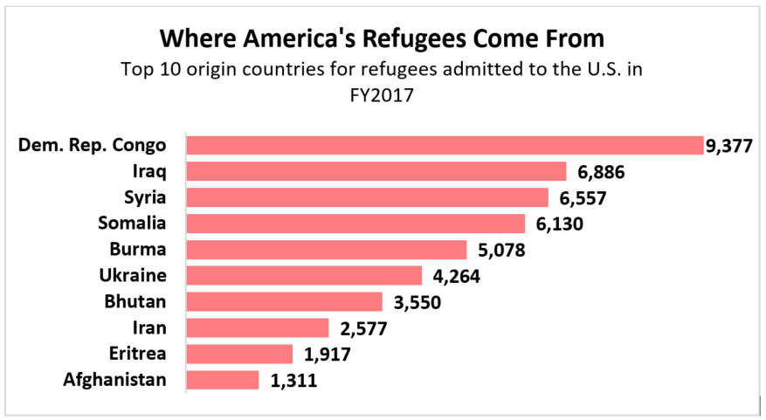
Refugees in the United States
Source: Refugee Processing Center

Slide 11
Where in the world?
This Photo by Unknown Author is licensed under CC BY-SA

Slide 12
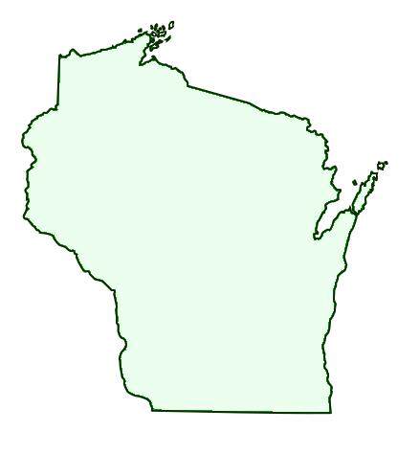
Refugees in Wisconsin
In Wisconsin, FFY 2017
10/1/17 -7/11/18
Total Refugees in WI—309
Burma—221
Democratic Republic of Congo—48
Somalia—17
Afghanistan—7
Eritrea—1
This Photo by Unknown Author is licensed under CC BY-SA

Slide 13
How do you prepare?

Slide 14
Identification of Refugee Status
SAVE: Systematic Alien Verification for Entitlements
A Guide on Immigration Documents Commonly Used by Benefit Applicants
https://save.uscis.gov/web/media/resourcesContents/SAVEGuideCommonlyusedImmigrationDocs.pdf

Slide 15
Defining RCA/RMA
RCA
RMA
RCA is a cash benefit, entirely federally funded.
Administered by the W-2 Agencies, not eligible for W-2.
RMA is federally funded.
In Wisconsin, RMA provides the same level of benefits as Medicaid/BadgerCare Plus, not eligible for Medicaid/BadgerCare Plus.

Slide 16
RCA/RMA Program Time Limits
Only for eight consecutive months after their arrival date in the US.
Exceptions are asylees begin date of RCA/RMA eligibility is the date he or she is granted asylum; victim(s) of trafficking eligibility of RCA/RMA is the certification date found on letter issued by DHHS Office of Refugee Resettlement.
Reviews not required because they are only eight month programs.
How does your agency track this eight month time limit?
This Photo by Unknown Author is licensed under CC BY-SA-NC
16

Slide 17
Verification Items needed for RCA/RMA
This Photo by Unknown Author is licensed under CC BY-SA-NC

Slide 18
RCA Eligibility
Non-Financial
Financial
Assistance Group
This Photo by Unknown Author is licensed under CC BY-NC
This Photo by Unknown Author is licensed under CC BY-SA

Slide 19
RMA Eligibility
Non-Financial
Financial
This Photo by Unknown Author is licensed under CC BY-NC
This Photo by Unknown Author is licensed under CC BY-SA

Slide 20
Knowledge Check – Fill in the blank
Voluntary Agency
A VOLAG is a ________________ that assists in the resettlement of refugees.
On the date the agency received a __________________ , the RCA application process begins.
Foodshare Employment and Training (FSET) is one of the programs in which an RCA client can participate in order to meet his/her RCA _________________________ requirements.
Signed Application
Employment and Training

Slide 21
Knowledge Check – cont.
Some refugee assistance groups may and do qualify for _____.
The ___________ time limit for RCA and RMA applies to each person, not to each case.
The initial RCA payment must be made within ______ working days of determining eligibility.
W-2
8 month
5

Slide 22
Knowledge check – cont.
Changes within an assistance group receiving RCA must be reported within _______ calendar days.
____________ reviews are not required for RCA.
If a refugee received ____________ from a relative, you count the income from that relative in determining financial eligibility.
With limited exceptions, full-time students in higher education ___________ receive RCA.
10
Eligibility
money
cannot

Slide 23
Action Plan: What can you do?
What can you do to increase your knowledge/awareness of the refugees you serve?
Use the space in your participant guide to identify three things you can do.
Assign each item on your list a time frame.

Slide 24
Story of a Refugee
I Am A Refugee (PBS)
https://www.youtube.com/watch?v=Z3THtcucQfA

Slide 25
The End
Please take some time to complete the evaluation.
Thank you for attending and participating.

