Slide 1
Practical Applications in CWW

Slide 2
Network with Someone Who…
$0 income
Resources
Trouble spot
Absent Parent page
Tip or trick
Adverse Action
Override Converted Amount
Begin Month
Excited for training
C – Completed Requirements

Slide 3
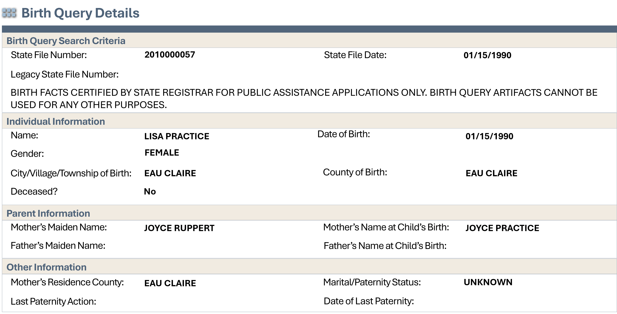
Birth Query

Slide 4
Mother
Adjudicated Father
Child (2)
0

Slide 5
Mother
Claimed Father
Child (2)
1

Slide 6
Mother
Adjudicated Father
Child (6)
Child (2)
1

Slide 7
Mother
Claimed Father
Child (6)
Child (2)
2

Slide 8
Mother
Adjudicated Father
Baby
Child (6)
Child (2)
1 or 2

Slide 9
LaToya
Paid semi-monthly
Works 20 hours per week
1
2
3
4
5
6
7
8
9
10
11
12
20 x 2.15 = 43
13
14
15
16
17
18
19
20
21
22
23
24
25
26
27
28
29
30
31

Slide 10
Frank
Paid weekly
Works 32 hours per week
1
2
3
4
5
6
7
8
9
10
11
12
32 x 1 = 32
13
14
15
16
17
18
19
20
21
22
23
24
25
26
27
28
29
30
31

Slide 11
Belle
Paid bi-weekly
Works 8 hours per week
1
2
3
4
5
6
7
8
9
10
11
12
8 x 2 = 16
13
14
15
16
17
18
19
20
21
22
23
24
25
26
27
28
29
30
31

Slide 12
Kara
Paid monthly
Works 35 hours per week
1
2
3
4
5
6
7
8
9
10
11
12
35 x 4.3 = 150.5
13
14
15
16
17
18
19
20
21
22
23
24
25
26
27
28
29
30
31

Slide 13
Today is March 10
Eve is in your office to complete her initial eligibility appointment.
1
2
3
4
5
6
7
8
9
10
11
12
1
13
14
15
16
17
18
19
20
21
22
23
24
25
26
27
28
29
30
31

Slide 14
Today is March 19
Tamara reports she started a job two days ago and will receive her first paycheck next week.
1
2
3
4
5
6
7
8
9
10
11
12
3
13
14
15
16
17
18
19
20
21
22
23
24
25
26
27
28
29
30
31

Slide 15
Today is March 3
Barb is an ongoing parent and reports having a baby yesterday. She comes in today and you add her baby to the case.
1
2
3
4
5
6
7
8
9
10
11
12
13
14
15
16
17
18
19
2
20
21
22
23
24
25
26
27
28
29
30
31

Slide 16
Today is March 31
Jacqueline, an ongoing parent, reports her daughter’s legal father, Ronald, moved into the household three weeks ago. They both come in today to see if they’re still eligible for W-2.
1
2
3
4
5
6
7
8
9
10
11
12
13
14
15
16
17
18
19
20
21
22
23
24
25
26
3
27
28
29
30
31

Slide 17













Placement
Rebus Puzzles
Absent Parent
Household Members
CS2
Social Security Numbers
Driver Flow
CSJ
CSJ
CSJ
CSJ
- a
12345678910
i = e
+
Mem +

Slide 18
Paystubs
Angela Parent | Fed. Filing Status | S/0 | Check Date | 05/08/26
 | Number of Allowances | 0/0 | Period Beginning | 04/18/26
Eau Claire, WI 54701 | Federal Taxable Income | 1221.60 | Period Ending | 05/01/26
 | Net Pay | 1013.40
Earnings | Hours/Rate | Amount | YTD Amount | Taxes/Deds | Taxable | Amount | YTD Amount
Regular | 56/16.30 | 912.80 | 5785.60 | Fed Income Tax | 1221.60 | 116.70 | 975.80
Weekend | 16/19.30 | 308.8 | 1830.40 | Social Security | 1221.60 | 56.02 | 456.96
Overtime | 0/24.95 | 0.00 | 997.50 | Medicare | 1221.60 | 12.14 | 99.04
 |  |  |  | State Income Tax | 1221.60 | 23.34 | 190.40
Total Gross |  | 1221.60 | 8613.50 | Total Withholding |  | 208.20 | 1722.20

Slide 19
How many paystubs would we need to use?
Paystub #1:
  4/18 to 5/1 = 14 days
Paystub #2
  5/2 to 5/15 = 14 days
Paystub #3
  5/16 to 5/29 = 14 days
3

Slide 20
How many Regular hours did this parent work on paystub #1?
Angela Parent | Fed. Filing Status | S/0 | Check Date | 05/08/XX
 | Number of Allowances | 0/0 | Period Beginning | 04/18/XX
Eau Claire, WI 54701 | Federal Taxable Income | 1221.60 | Period Ending | 05/01/XX
 | Net Pay | 1013.40
Earnings | Hours/Rate | Amount | YTD Amount | Taxes/Deds | Taxable | Amount | YTD Amount
Regular | 56/16.30 | 912.80 | 5785.60 | Fed Income Tax | 1221.60 | 116.70 | 975.80
Weekend | 16/19.30 | 308.8 | 1830.40 | Social Security | 1221.60 | 56.02 | 456.96
Overtime | 0/24.95 | 0.00 | 997.50 | Medicare | 1221.60 | 12.14 | 99.04
 |  |  |  | State Income Tax | 1221.60 | 23.34 | 190.40
Total Gross |  | 1221.60 | 8613.50 | Total Withholding |  | 208.20 | 1722.20

Slide 21
How many Regular hours did this parent work on paystub #2?
Angela Parent | Fed. Filing Status | S/0 | Check Date | 05/22/XX
 | Number of Allowances | 0/0 | Period Beginning | 05/02/XX
Eau Claire, WI 54701 | Federal Taxable Income | 1476.75 | Period Ending | 05/15/XX
 | Net Pay | 1224.37
Earnings | Hours/Rate | Amount | YTD Amount | Taxes/Deds | Taxable | Amount | YTD Amount
Regular | 64/16.30 | 1043.20 | 6828.80 | Fed Income Tax | 1476.75 | 141.47 | 1117.27
Weekend | 16/19.30 | 308.80 | 2139.20 | Social Security | 1476.75 | 67.91 | 524.87
Overtime | 5/24.95 | 124.75 | 1122.25 | Medicare | 1476.75 | 14.71 | 113.75
 |  |  |  | State Income Tax | 1476.75 | 28.29 | 219.29
Total Gross |  | 1476.75 | 10090.25 | Total Withholding |  | 252.38 | 1975.18

Slide 22
How many Regular hours did this parent work on paystub #3?
Angela Parent | Fed. Filing Status | S/0 | Check Date | 06/05/XX
 | Number of Allowances | 0/0 | Period Beginning | 05/16/XX
Eau Claire, WI 54701 | Federal Taxable Income | 1526.65 | Period Ending | 05/29/XX
 | Net Pay | 1268.94
Earnings | Hours/Rate | Amount | YTD Amount | Taxes/Deds | Taxable | Amount | YTD Amount
Regular | 64/16.30 | 1043.20 | 7872.00 | Fed Income Tax | 1526.65 | 144.46 | 1261.73
Weekend | 16/19.30 | 308.80 | 2448.00 | Social Security | 1526.65 | 69.34 | 594.21
Overtime | 7/24.95 | 174.65 | 1296.90 | Medicare | 1526.65 | 15.02 | 128.77
 |  |  |  | State Income Tax | 1526.65 | 28.89 | 248.18
Total Gross |  | 1526.65 | 11616.90 | Total Withholding |  | 252.38 | 2232.89

Slide 23
What is this parent’s average hours for their Regular pay?
Paystub #1 (56) + Paystub #2 (64) + Paystub #3 (64) = 184
184 hours ÷ 3 paystubs = 61.3333333333

Slide 24
What is this parent’s average hours for their Weekend pay?
Paystub #1 (16) + Paystub #2 (16) + Paystub #3 (16) = 48
48 hours ÷ 3 paystubs = 16

Slide 25
What is this parent’s average hours for their Overtime pay?
Paystub #1 (0) + Paystub #2 (5) + Paystub #3 (7) = 12
12 hours ÷ 3 paystubs = 4

Slide 26
The Key to Remember
A
C
E
I
M
2
86
04
226.68
18
P
R
S
T
U
10
0.00
3
230.72
30

