Slide 1
How Do I…
Decipher the Time Limit page

Slide 2
Time Limit Page
Eligibility review
Employability plan review
Assigning participant to new paid placement

Slide 3
Gray Month

Slide 4
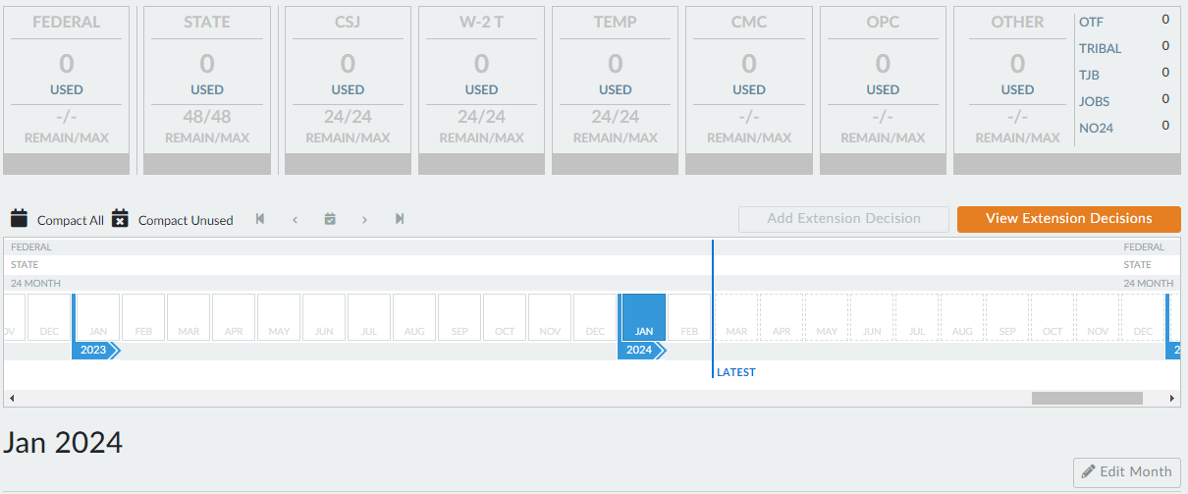
Blue Month

Slide 5
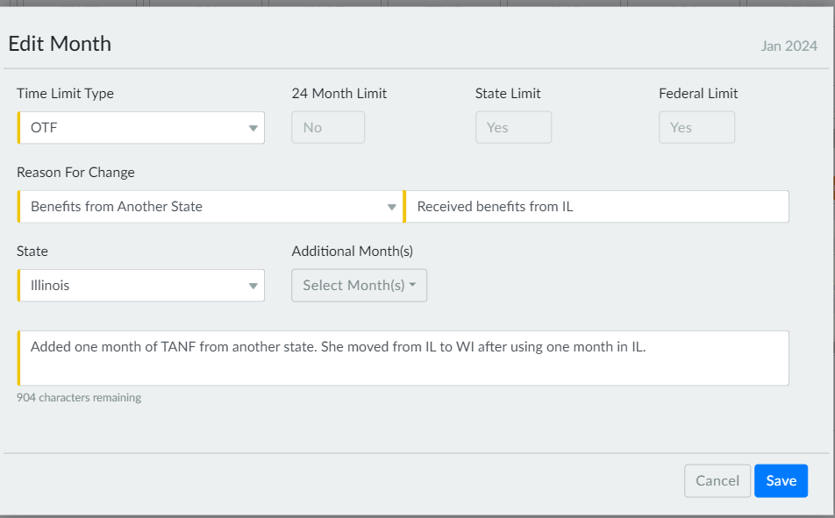
Blue Month – Edit Month

Slide 6
Gray Month with White Triangle

Slide 7
Blue Month with Gray Triangle
W-2 Manual 2.10.5

Slide 8
Extensions

Slide 9
Yellow on State or Placement

Slide 10
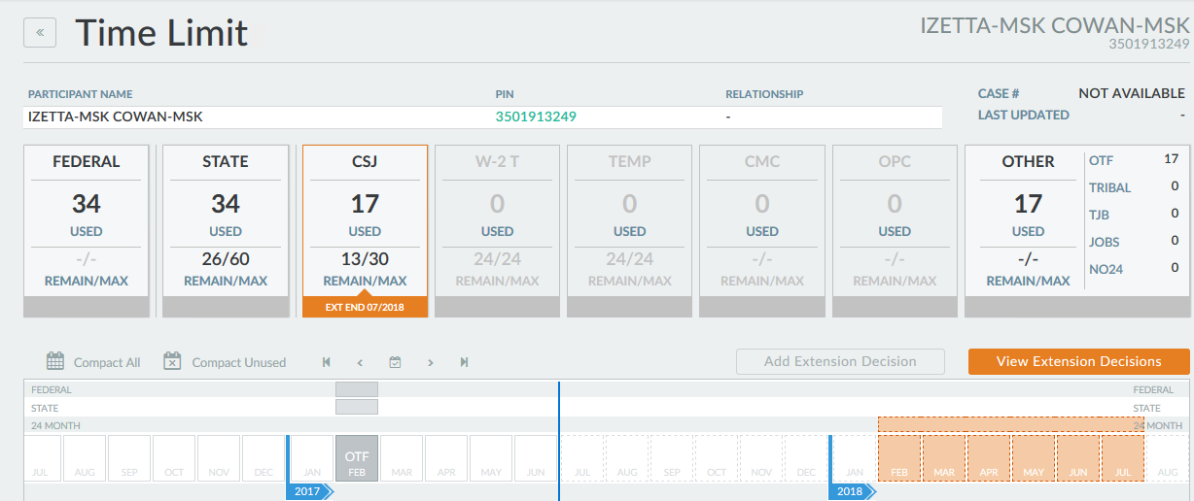
Orange State or Placement

Slide 11
Red State or Placement

Slide 12
Resources
Training on Demand: Adding, Editing, and Subtracting Time Limit Months
Training on Demand: Time Limit Extensions
Training on Demand: Time Limits
Desk Aids on Time Limits
W-2 Manual 2.10 Time Limits

