Slide 1
How Do I…
Assign Assessment Activity Codes?

Slide 2
Why We Use Activity Codes
Categorize Activities
Track TANF WPR

Slide 3
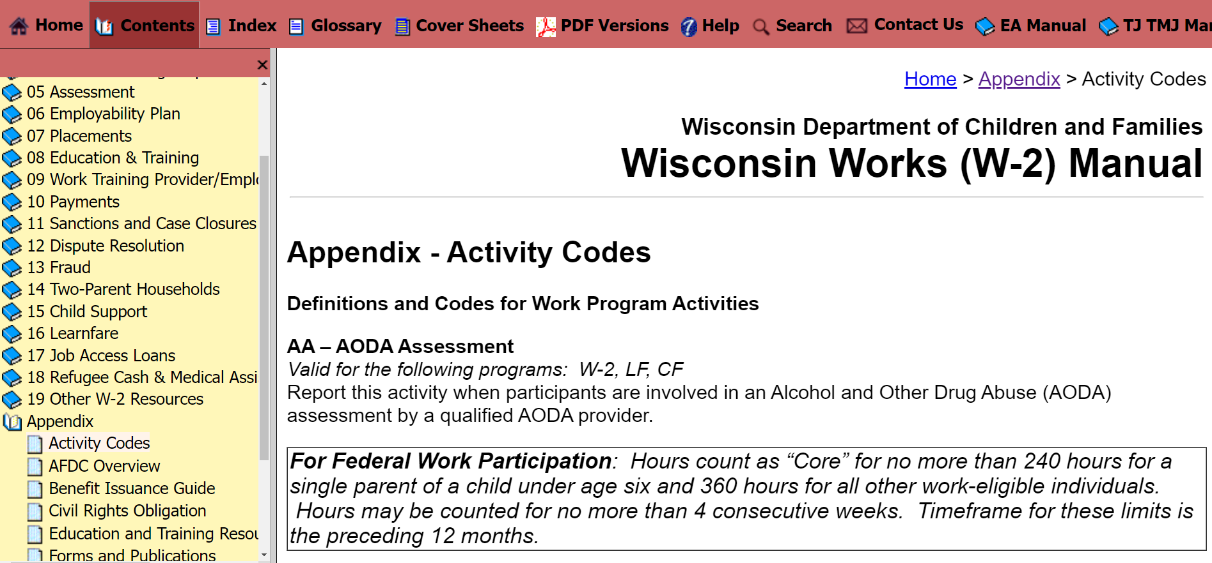
Activity Codes List
40+

Slide 4
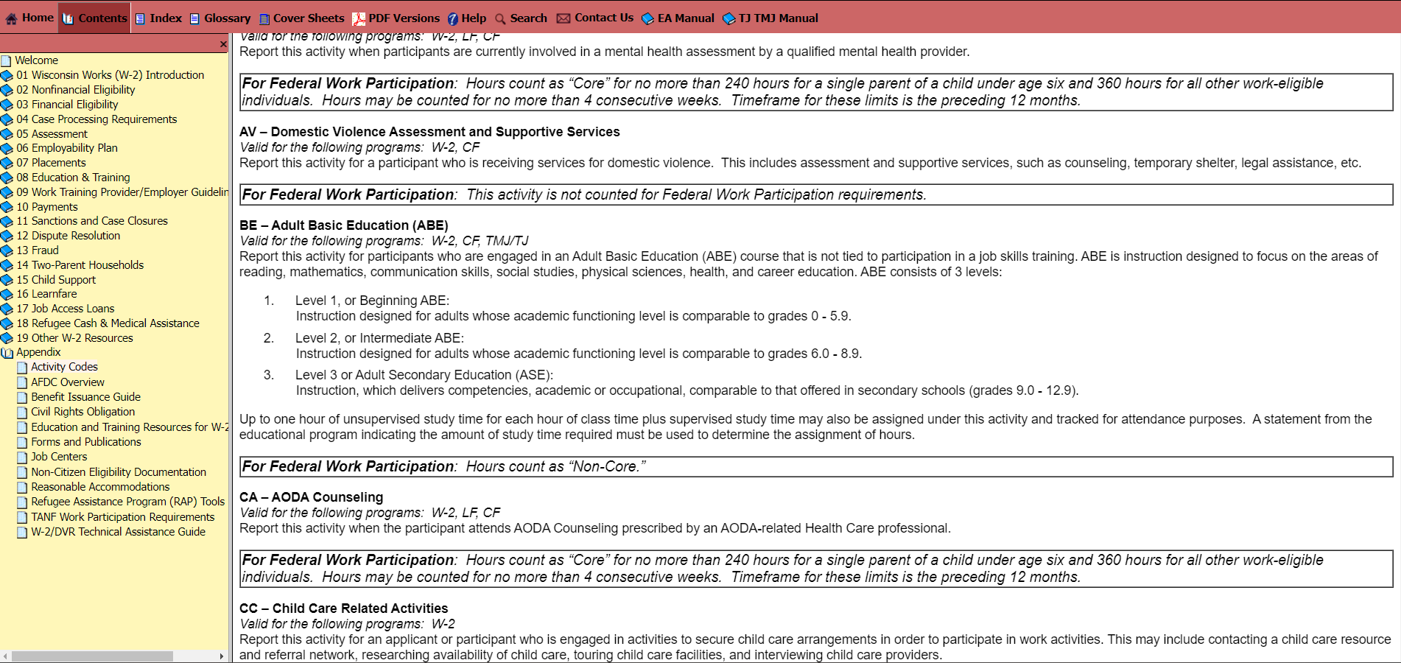
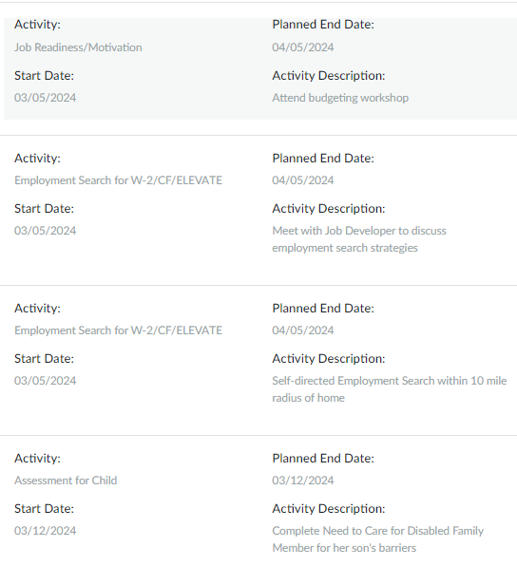
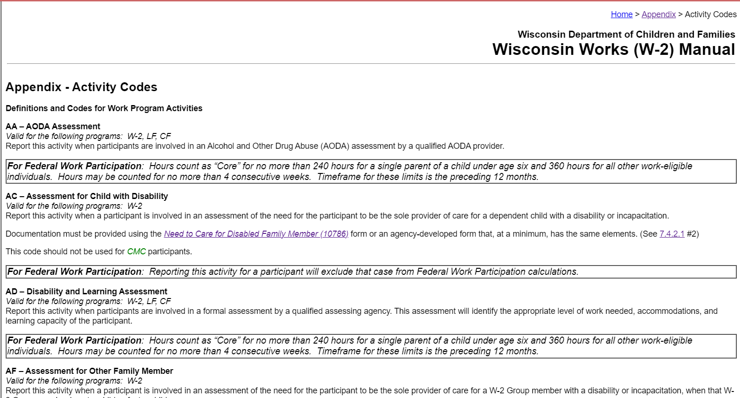
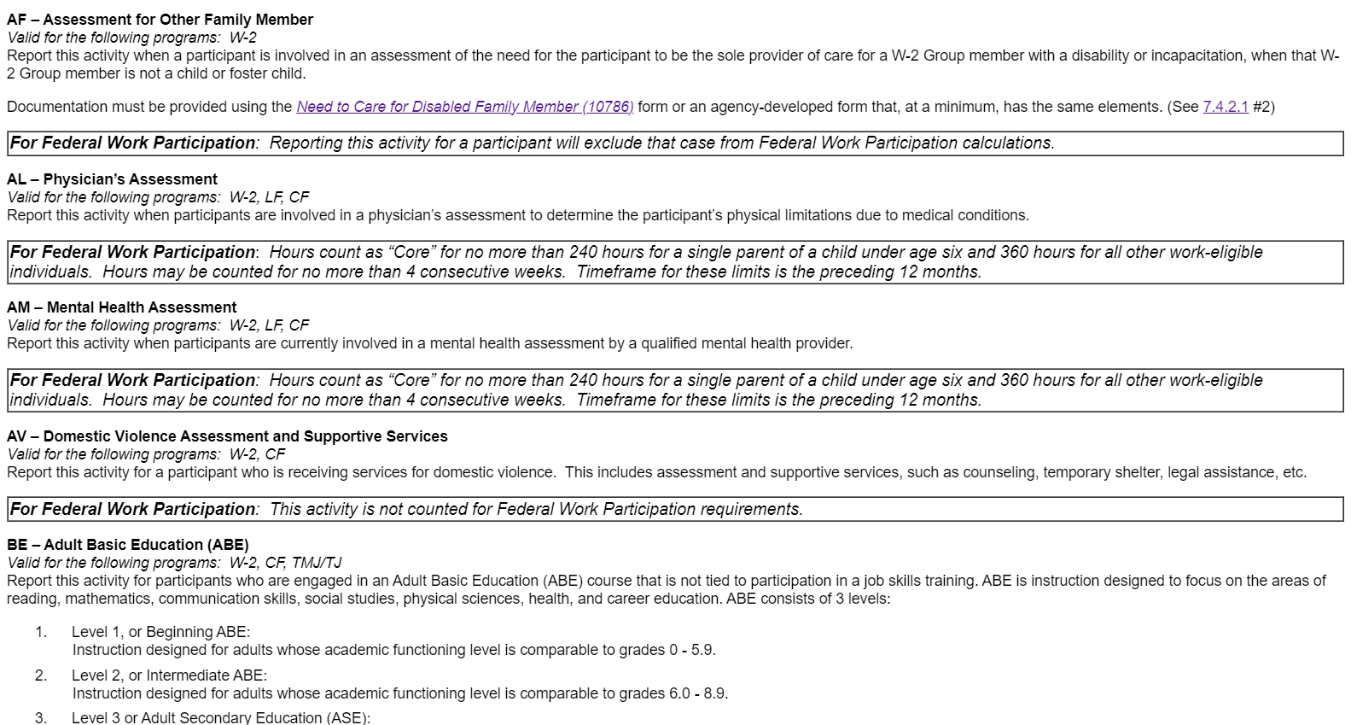
Assessment Activity Codes

Slide 5
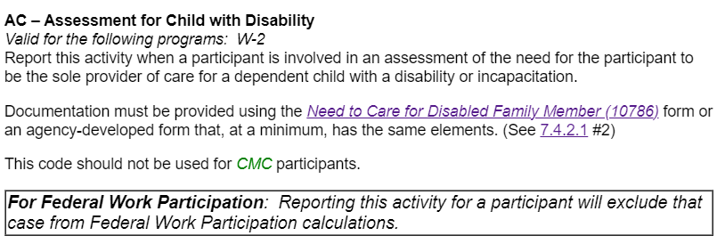
Other W-2 Group Member

Slide 6
Specific to Participant
Qualified Professional
Exception: AV

Slide 7
Penny
Penny’s 8-year-old son has special needs that requires her to care for him daily. She thinks his care will interfere with W-2 activities.
AA
AC
AD
AF
AL
AM
AV

Slide 8
Rowan
Rowan was recently released from the hospital for complications from diabetes. Rowan has a lot of medical appointments and restrictions that may affect participation in W-2 activities.
AA
AC
AD
AF
AL
AM
AV

Slide 9
Amari
Amari had a baby a couple months ago. She said she hasn’t been feeling like herself and is worried about Post Partum Depression.
AA
AC
AD
AF
AL
AM
AV

Slide 10
Naia
Naia currently is staying at a domestic abuse shelter and is working with advocates.
AA
AC
AD
AF
AL
AM
AV

Slide 11
Jia
Jia’s partner was in a car accident, resulting in long-term disabilities. Jia is the caretaker and is worried about missing activities.
AA
AC
AD
AF
AL
AM
AV

Slide 12
Sasha
Sasha did not finish high school and is very nervous about working toward an HSED. Sasha always needed a lot of extra help to get through schoolwork.
AA
AC
AD
AF
AL
AM
AV

Slide 13
Alex
Alex discloses that he has been dealing with drug dependency and alcohol issues for a while now and would really like help with it.
AA
AC
AD
AF
AL
AM
AV

