Slide 1
How Do I…
Use the Activity page to my Advantage

Slide 2
Fields/Sections for Participants
Activity Description
Activity Location
Activity Contact
Additional Information
Activity Scheduler

Slide 3
What
Why

Slide 4
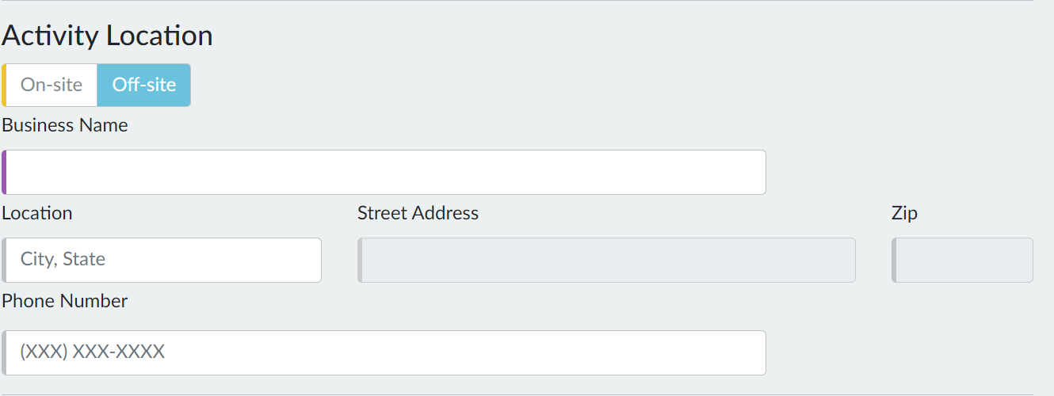
Where

Slide 5
Who

Slide 6
What
How

Slide 7
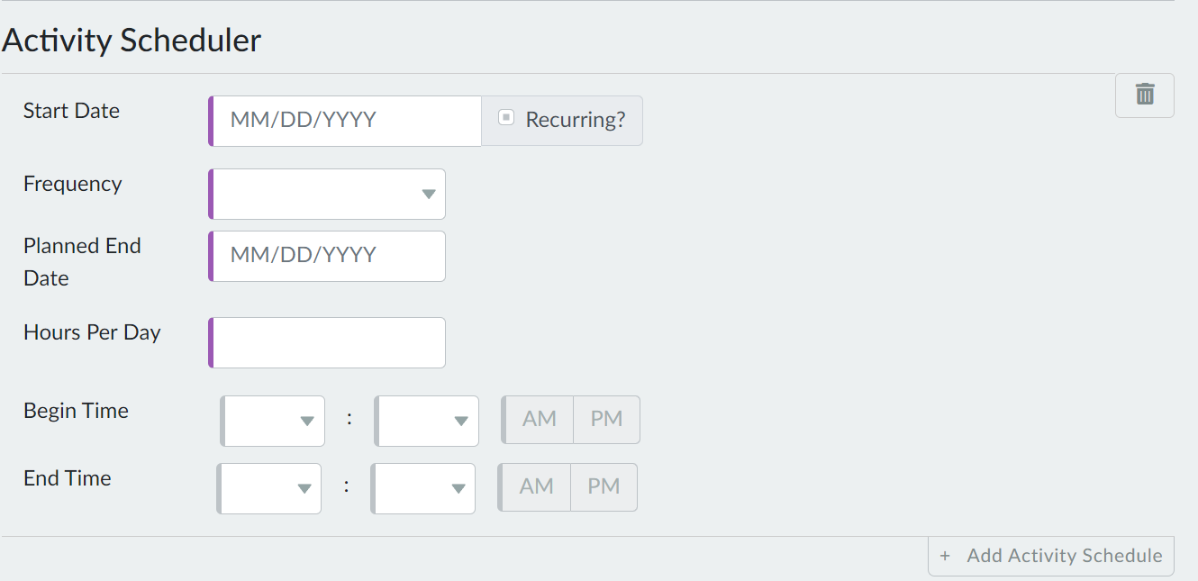
When

Slide 8
Write for Participants
Need to know information
What they’ll gain
Which field/section it fits

Slide 9
Job Search
Complete independent job search. Focus on positions in an office setting within a 10 mile radius.
Job Search
Look for/apply to jobs
Agency’s computer lab is open everyday from 8am to 10am if you want application assistance.
Any time you spend updating your resume and cover letter for a specific position counts toward your hours.

Slide 10
Workshops
Job Club
Attend Job Club to obtain job search assistance, practice interview skills, and learn more about the labor market.
Bring an updated resume with you.
Dress professionally because employers attend.
What?
Why?

Slide 11
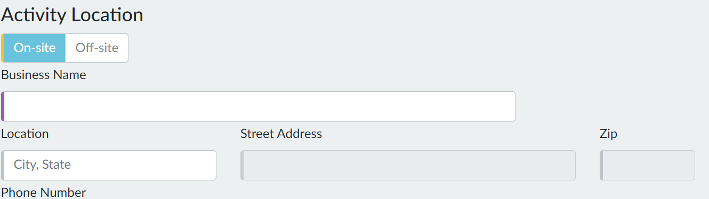
Workshops
EQUUS, Room 304
Zoom; https://us06web.zoom.us/j/82363496747

Slide 12
Work Experience
Work experience
Complete work experience at Our Neighbors to gain basic office skills.
Remember to wear business casual attire.

Slide 13
Online Courses
Complete personal finance related courses to improve your money management.
Go to https://education.gale.com and sign in using your library login information. Complete the Personal Finance Course first. Then, complete the Keys to Successful Money Management and Where Does All My Money Go? courses.

Slide 14
Online Courses
Library or Job Center

Slide 15
Online Courses

