Slide 1
Emergency Assistance
Policy and Processes

Slide 2
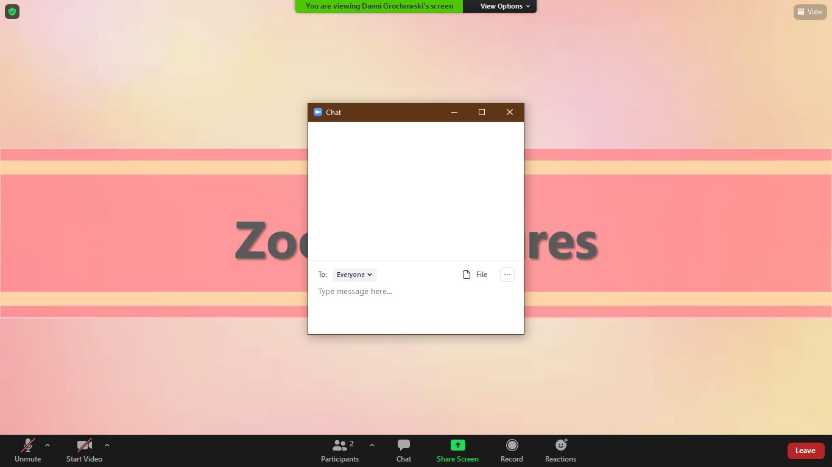
Using Zoom

Slide 3
Using Zoom: Chat

Slide 4
Using Zoom: Participants/Reactions

Slide 5
Using Zoom: Annotations

Slide 6
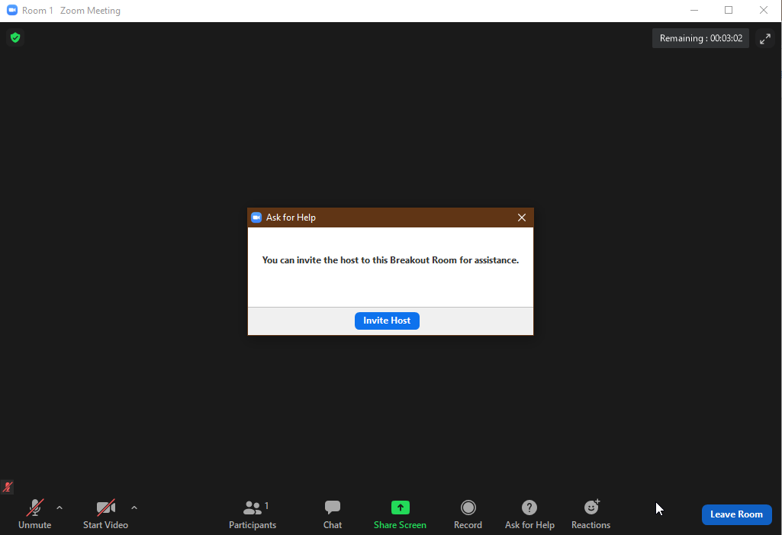
Using Zoom: Breakout Rooms

Slide 7
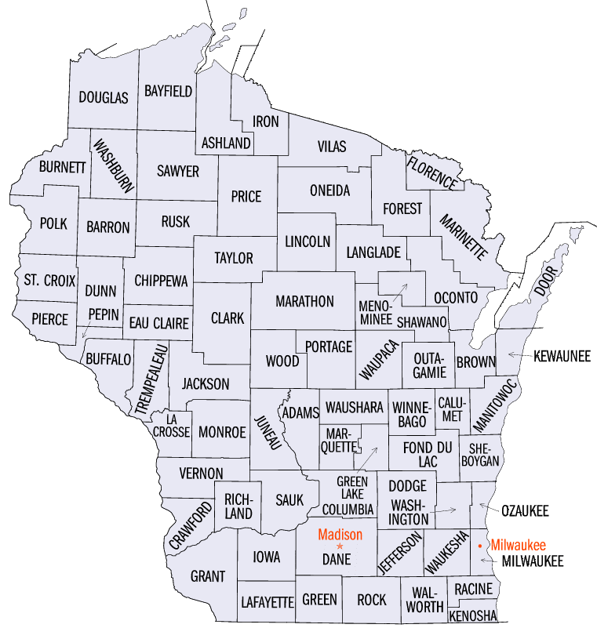
Where is your
office?

Slide 9
EA Payment Amount
Group size: 2 – 4 $516
Group size: 5 $645
Group size: 6 or more $110 per group member
$500 for Energy Crisis regardless of group size

Slide 11
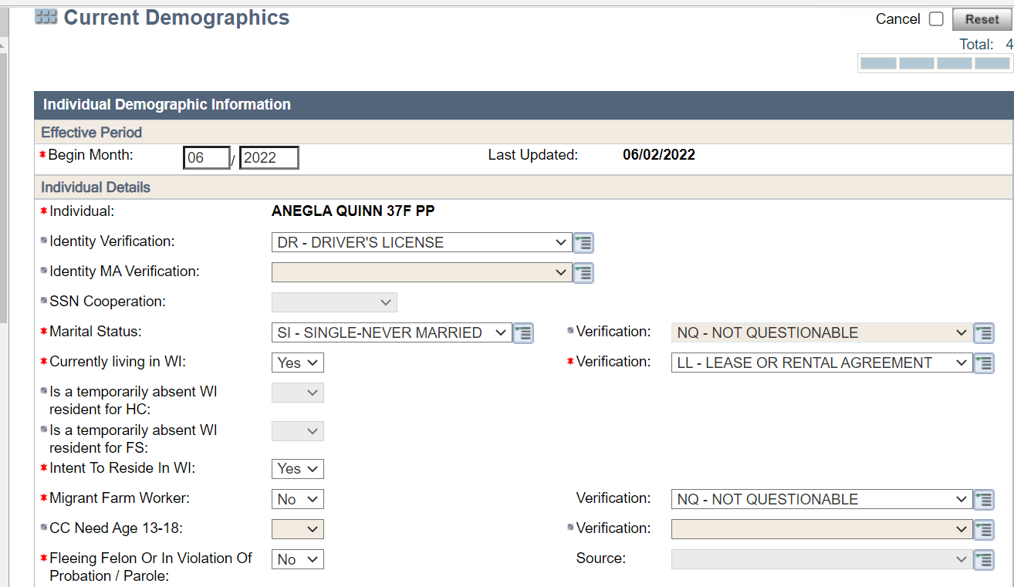
Resident

Slide 12
Citizen or Qualified Non-Citizen

Slide 13
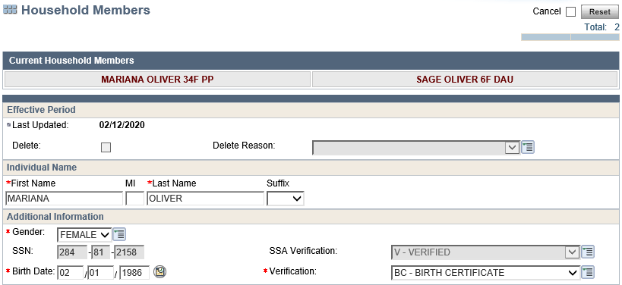
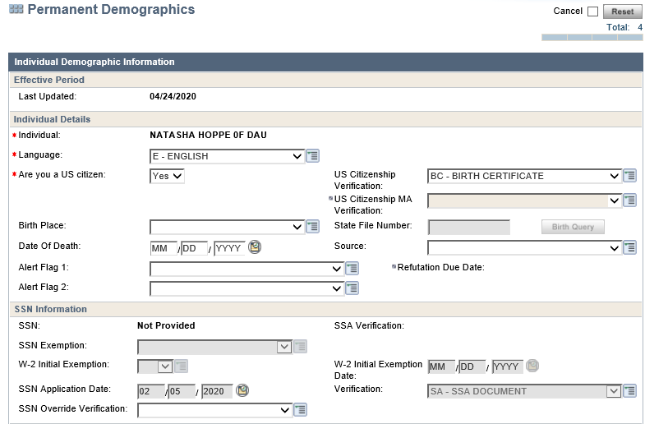
Household

Slide 14
12 Month Time Frame

Slide 15
minor
relative
live
home
physical
emotional
evidence
guardian

Slide 16
WWP

Slide 18
Schedule appointments
Problem solving
Case Management
Referrals to other agencies
Paperwork

Slide 19
Non-Financial Eligibility
EA group information
No EA Payment in 12 months
Qualifying Emergency
Financial eligibility
Financial Crisis

Slide 20
Income | Assets
Counted: | Counted:
Disregarded: | Disregarded:

Slide 21
Verification of Eligibility
EA
qualifying
12
beyond
beyond
eligibility
caretaker
relative

Slide 22
Qualifying Emergencies

Slide 23
Verifying Fire, Flood, or Natural Disaster
Emergency Management Agency
Photos of damage
Signed statement
Reliable report
Visit the scene
Newspaper article

Slide 24
Homelessness Definition
Temporary Living Accommodations Including “Doubled-Up” Housing.
Homelessness due to Uninhabitable Housing.
Homelessness due to Domestic Abuse.

Slide 25
Verify Homelessness
Contact the Shelter
Contact Hotel/Motel
Signed Statement
Lease (doubled up)
Statement from applicant is residing (doubled up)
Statement from inspector(uninhabitable)
Available verification

Slide 26
Impending Homelessness
Due to Uninhabitable housing.
Due to Domestic Abuse.
Due to Foreclosure of Rental housing.
Notice to Terminate Tenancy: Eviction Notice.
Notice to Terminate Tenancy: Home Foreclosure.

Slide 27
Verifying Impending Homelessness
Same as Homelessness
Online Foreclosure Notice
Written, Dated, Failure to Pay Rent
Foreclosure Notice

Slide 28
Verifying a Financial Crisis
Employer Documentation
Paystubs
Reduced Child Support in KIDS
Unemployment Insurance Reduction
Medical Receipts
Mechanic Receipts
WWP or CARES Screens

Slide 29
Energy Crisis
Exhausted available resources
Need to obtain heat, electricity, water, or sewer service
Lack of, heat, electricity, water, or sewer service
Reasons beyond the caretaker’s control or good cause

Slide 30
Verifying Energy Crisis
Exhausted Resources
Document in EA Comments
Verify Financial Crisis

Slide 31
What did you…
L
LIKE
What did you like most?
E
EXCITE
What excited you most?
A
ANXIETY
What created the greatest anxiety?
R
REWARD
What can we celebrate about this session?
N
NEED
What are the next steps to stay on track?

Slide 32
Emergency Assistance
Policy and Processes

Slide 33
Steps for Processing Application

Slide 34
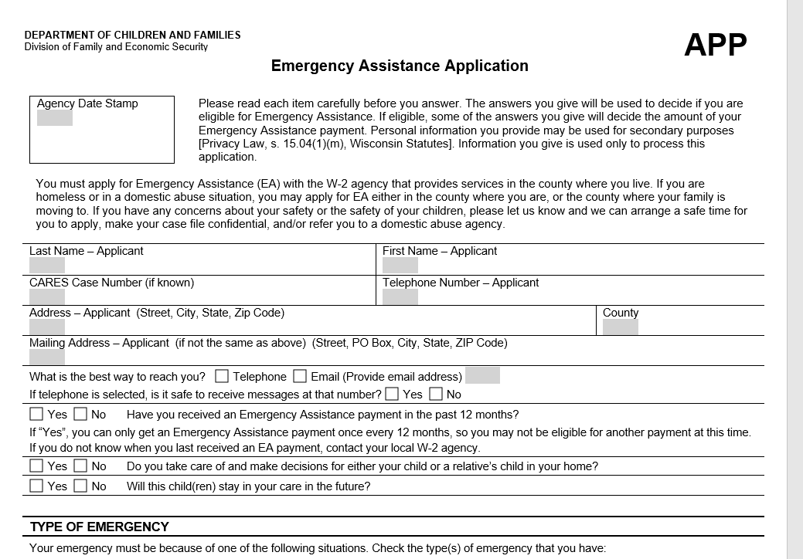

Slide 35
Emergency Assistance Notice of Eligibility)

Slide 36
Payment Delays
Homelessness or impending homelessness with relocation to a new home, but no new permanent residence at the time of application.
Impending homeless, plan to remain in current housing, but confirmation agreeing to waive any right to proceed with an eviction or foreclosure not received.

