Slide 1
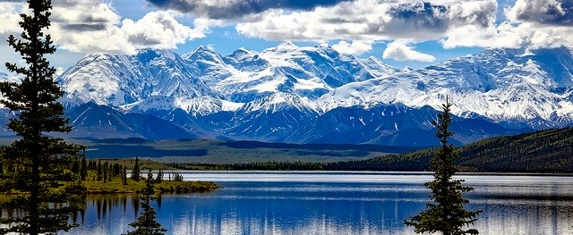

Slide 2
Caseload Documentation
The What
The why
The where

Slide 3
How do I document so that anyone looking at my case will understand what I’m doing and why I am doing it and..
it doesn’t take forever to do it and…
it satisfies W-2 policy requirements and..
I’m serving my participants as best as I can.

Slide 4
FEP
Participant
Agency
It’s Required by W-2 Policy
Benefits of Comments and Documentation

Slide 5
Case comments

Slide 7
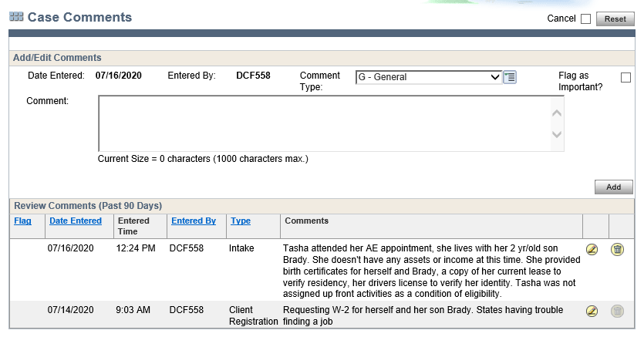

Slide 9
Tasha attended intake appointment, she has one child, provided all verification items. Open and passing for W-2.
Tasha attended intake appointment, she has one child, provided all verification items. Open and passing for W-2.

Slide 10
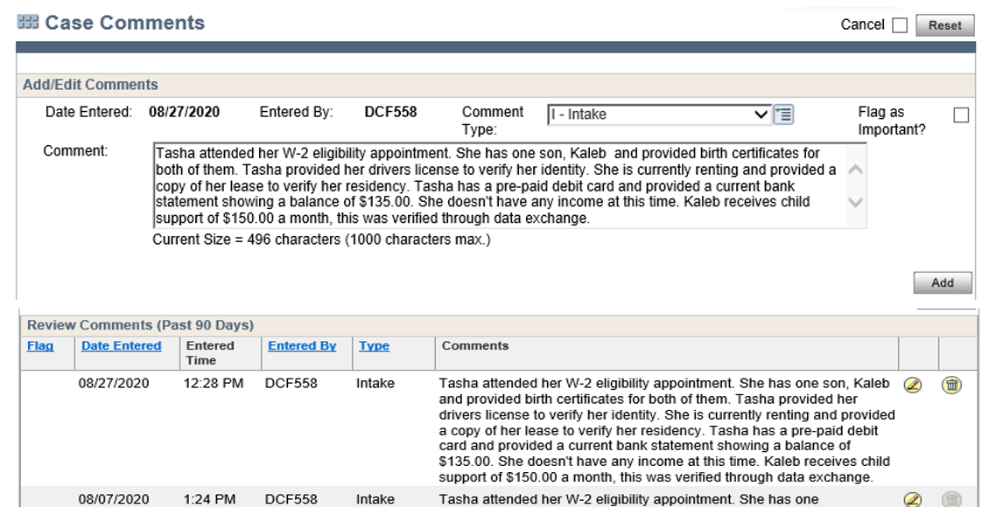

Slide 11
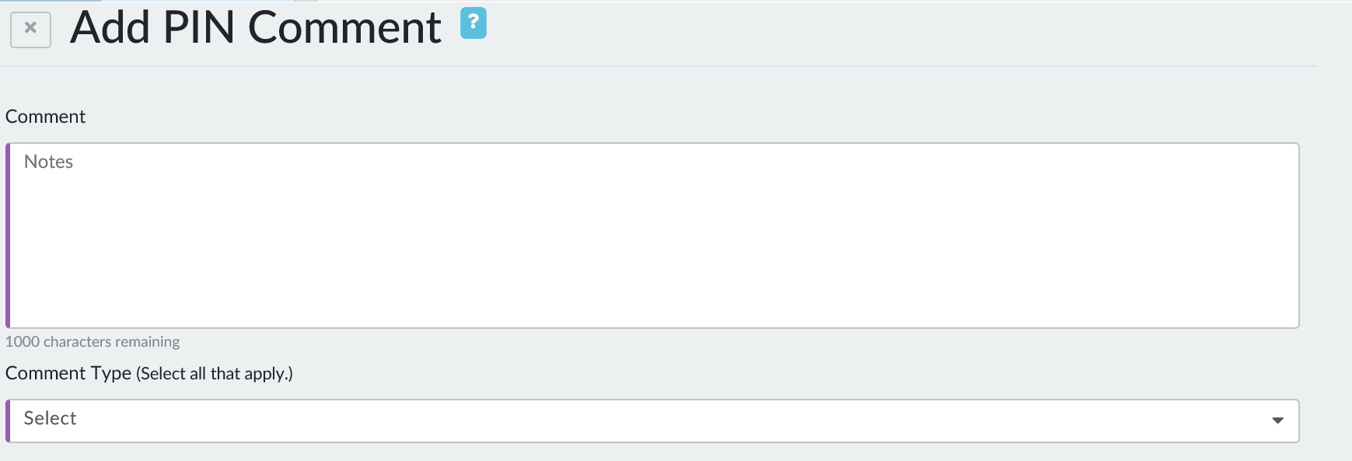
PIN comments

Slide 12
Justification for
actions
Placement
Change in Placement
Assigned Activities
Referrals
The Need for Accommodation
W-2 Extension Information

Slide 13
Document information regarding
Summary of Assessments
Day-to-Day Events
Appointments
Communication
Other Information
Good Cause Determination

Slide 14
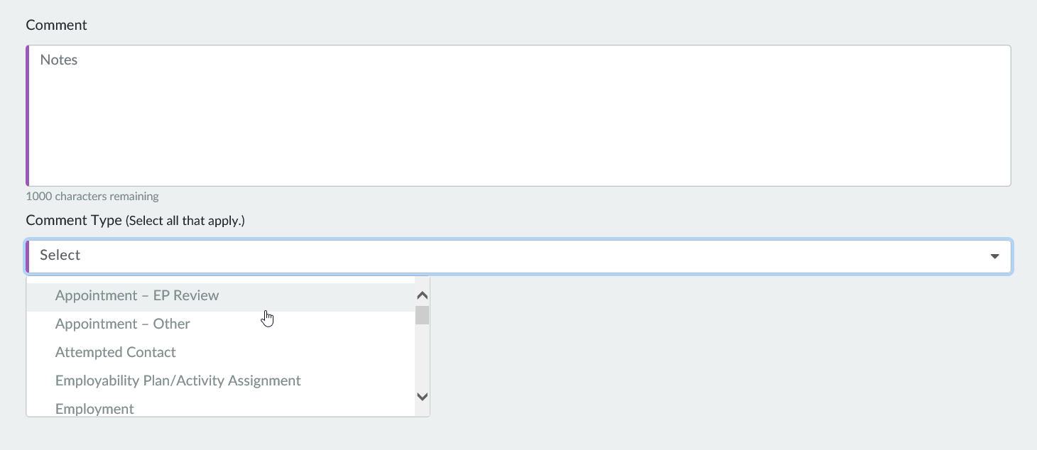

Slide 15
Employment
Work with Partner Agencies
Fraud
Overpayments or Auxiliary Payments
Appointment-Other
Performance Claims
Good Cause Determination
Attempted
Contact
Placement
Decision
Comment Types
Employability Plan/Activity Assignment
Program
Completion
General
Participation Tracking
Informal Assessment
Non-health Barriers
Appointment-EP Review
Phone Contact
Missed Appointment
Time-Limit/Extensions
Third Party Contacts

Slide 16
PIN COMMENTS
CASE COMMENTS
Caroline called this afternoon to let me know that the reason she missed Job Club this morning is because she had a car accident. There were no injuries.

Slide 17
PIN COMMENTS
CASE COMMENTS
A change report was received from Jackson today stating that he had opened a savings account last month. He included a statement from the bank.

Slide 18
PIN COMMENTS
CASE COMMENTS
Chandra called today to inform us that she started work at National Bank yesterday. She will be working 35 hours a week and making $15.00/hour.

Slide 19
PIN COMMENTS
CASE COMMENTS
James dropped off his career assessment results from Halfway Technical Institute today.

Slide 20
PIN COMMENTS
CASE COMMENTS
Maria called to report that her boyfriend has moved back into the household. He is her minor son’s father.

Slide 21
PIN COMMENTS
CASE COMMENTS
Enrollment
Client Registration
Placement
Informal Assessment
Financial Eligibility (Income, Assets, etc.)
Placement Determination
Career Assessments
Job Readiness
Goals
Employment
Non-Financial Eligibility (Citizenship, Date of Birth, etc.)
Employability Plan Review
Household Changes (person add, etc.)
Case Closure
Activity Assignment
Participation Tracking
Discrepancy (Prisoner, SOLQ-I, SWICA, UIB)
6-month Eligibility Review
Good Cause Determination
Supportive Services
Fraud (Overpayment, IPV, etc.)
Disenrollment

Slide 23
What belongs in comments
Helena came into the appointment and stated she had to drive 150 miles
Out of town to pick up her 16-year-old daughter and new
granddaughter. She almost ran out of gas. They will be living with her
now. Her granddaughter is only a few days old and she really is adorable.
Helena said her daughter is bi-polar and she’s not sure if she can take
care of the baby. The baby’s father is a bum with no job.

Slide 24
Objective
vs
Subjective comments

Slide 25
Make the subjective comment objective
“It looks like Melinda’s boyfriend gave her another black eye today.”
Subjective:
Bias
Opinion
Assumptions
Conclusions
“Melinda came to her appointment with a black eye.”
Objective:
Facts
Behaviors
Actions

Slide 26
Make the subjective comment objective
“Latrice doesn’t want that job at Menards because she didn’t show up for 2 interviews.”
Subjective:
Bias
Opinion
Assumptions
Conclusions
“Latrice missed 2 interview appointments for a job at Menards.”
Objective:
Facts
Behaviors
Actions

Slide 27
Make the subjective comment objective
“Maria says her back is still painful and can’t look for work right now, but she was carrying her chunky 3-year-old son and didn’t seem in pain.”
Subjective:
Bias
Opinion
Assumptions
Conclusions
Objective:
Facts
Behaviors
Actions
“Maria says her back is still painful and can’t look for work right now.”

Slide 28
CWW Verification and ECF

Slide 29
CWW Verification and ECF

Slide 30
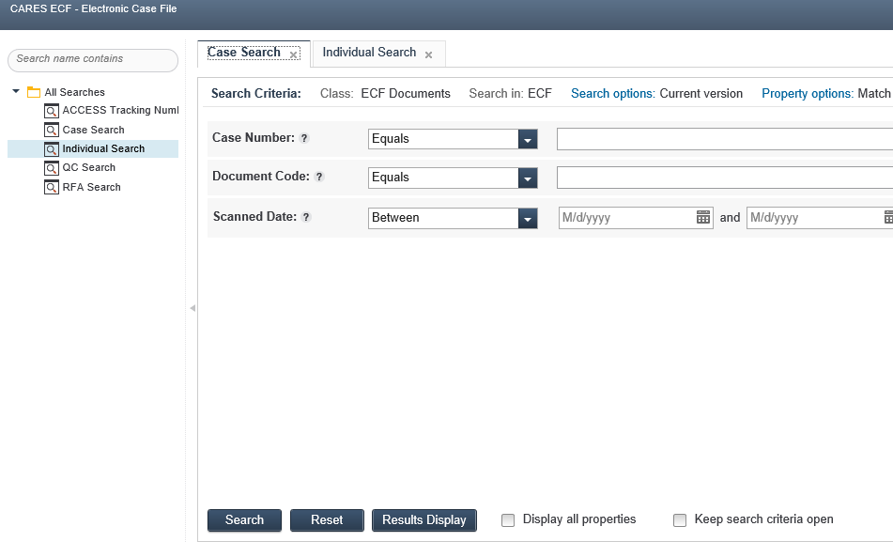

Slide 32
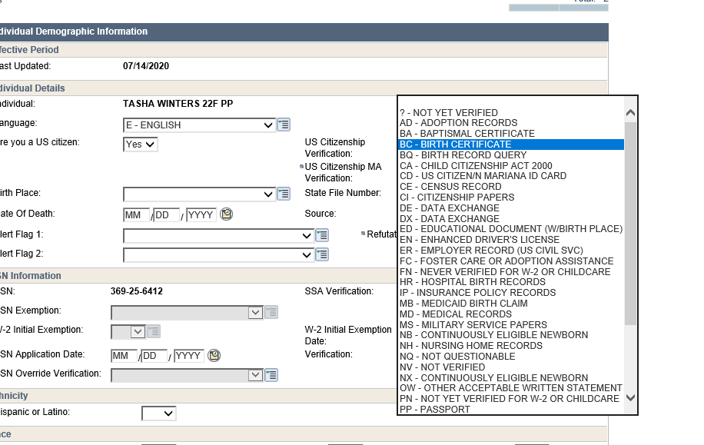

Slide 33
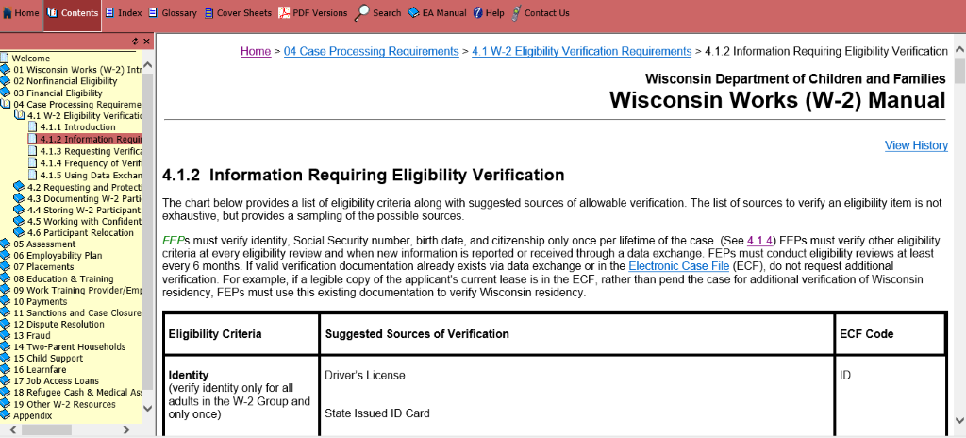

Slide 34
Identity | Birth Date | Wisconsin Residency | US Citizenship

Slide 35
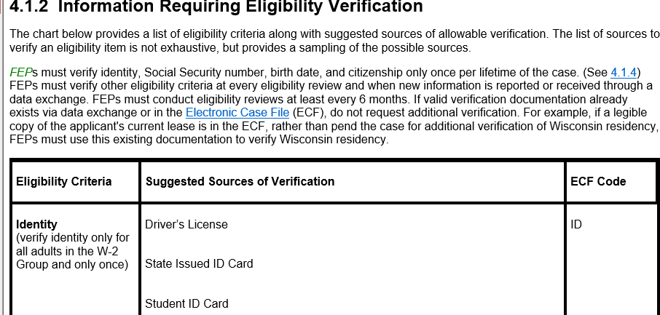

Slide 36
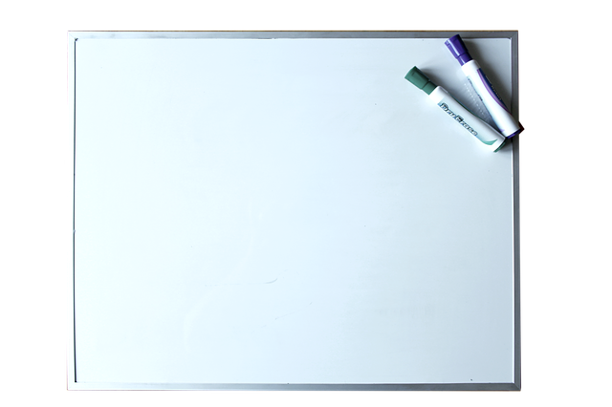
What’s In It For You?

Slide 37
Share your Take-a-Way or Aha Moment from today
ECF
CWW
Comments
PIN
Comments
CWW Verification
Codes

