Slide 1













Last Updated:
07/01/25
W-2
New Worker Training (NWT) Hub
Where you go to be in the know!

Slide 2

Use the annotation tools to mark your favorite way to take a break.

Slide 3
Name & Agency
Where You Are At In NWT
Questions
America Works
EQUUS
FSC
Maximus
Ross
UMOS
WCI
WRI
Introduction
Requesting
Applying
Initial Assessments
Initial Placement
Employability Plan
Ongoing
Building on Assessment
Two-Parent
Employment
Review
Employment changes
Closure
Successes
Challenges

Slide 4




Announcements
and
Updates

Slide 5
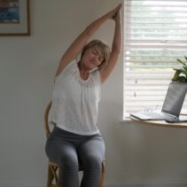
Stretch At Your Desk
Seated Crescent Moon
Lift arms overhead
Connect palms
Stretch fingers wide
Lean to one side
Take 2-3 deep breaths
Switch sides and repeat

Slide 6
Desk Aids
Desk Aids
Podcasts
Reference Guides
Training on Demand Videos

Slide 7
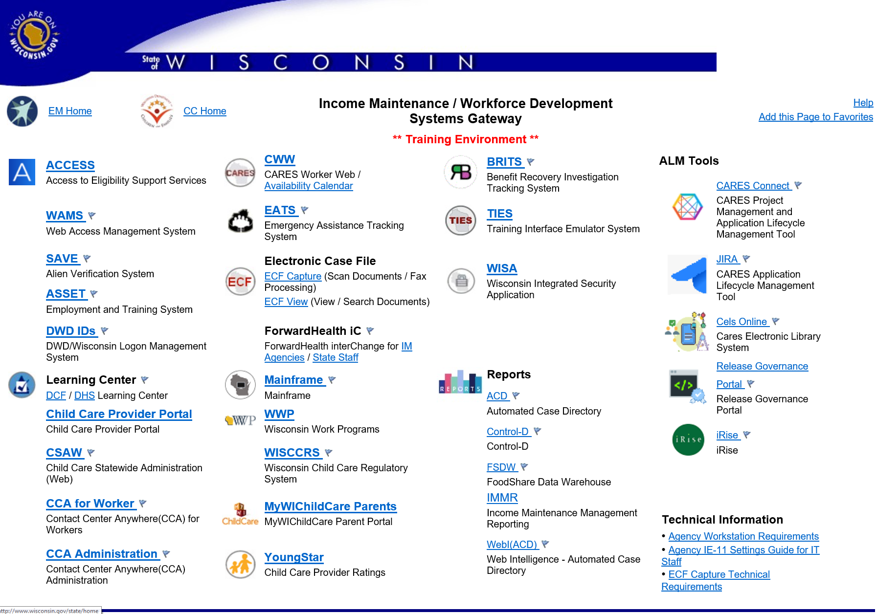

Slide 8
Open
Q & A

Slide 9
Takeaway
from today
What’s Your TIP?
Improvement
I want to make
Practice
I plan to add

Slide 10










This or That?
Use your stamp annotation tool to indicate your preference
Summer
Winter
Dogs
Cats
Pizza
Tacos
Coffee
Juice
Morning
Night

Slide 11
Name & Agency
Where You Are At In NWT
Questions
America Works
EQUUS
FSC
Maximus
Ross
UMOS
WCI
WRI
Introduction
Requesting
Applying
Initial Assessments
Initial Placement
Employability Plan
Ongoing
Building on Assessment
Two-Parent
Employment
Review
Employment changes
Closure
Successes
Challenges

Slide 12
Announcements
and
Updates

Slide 13
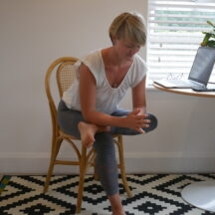
Stretch At Your Desk
Chair Pigeon
Place one leg over other
Flex foot
Remain in upright position
Hold for 5 breaths
Repeat on other side

Slide 14
Comments,
Case Numbers, and PINs
W-2 Manual:
4.3.3 Comments
Desk Aids:
PIN and Case Comments

Slide 15


Comments
Required
Detailed History of the Case
Parent’s Story

Slide 16


PIN Comments
Case Comments
Assessments – including informal, formal, career, and job readiness
Case Reviews
Financial Eligibility (Income, Assets, etc.)
Employability Plan Review
Non-Financial Eligibility (Citizenship, Date of Birth, etc.)
Activity Assignment
Participation and Good Cause Determination
Verification Items

Slide 17
PIN Comments
Case Comments
Assessments – including informal, formal, career, and job readiness
Case Reviews
Placement
Financial Eligibility (Income, Assets, etc.)
Employment
Employability Plan Review
Household Changes (person add, change of address, etc.)
Non-Financial Eligibility (Citizenship, Date of Birth, etc.)
Activity Assignment
Participation and Good Cause Determination
Case Closure
Verification Items

Slide 18

Placement
PIN Comments
Erin is placed as a CSJ and is eligible to earn up to $653 per month based on participation and cooperation with W-2.
Based on Erin’s informal assessment, she is most appropriate for a CSJ placement at this time. She has recent work history and employment skills. Erin stated she is motivated to find new employment.
Case Comments

Slide 19
Employment
PIN Comments
Kevin obtained full-time employment at Chili’s Grill and Bar as a line cook. His job duties include preparing food for customers, adhering to safety and sanitation policies and procedures, and maintaining cleanliness throughout the restaurant.
Kevin obtained full-time employment at Chili’s Grill and Bar as a line cook, earning $14.00 per hour, working 40 hours per week, and is paid bi-weekly. His prospective income is $2,408
($14 x 40 = $560 x 4.3 = $2,408).
Case Comments

Slide 20
Household Changes
Kelly reported her boyfriend, Darryl, moved into the home. He is the father of her minor child. Initiated the Add Person driver flow. Darryl provided his birth certificate to verify US Citizenship and date of birth. Provided Driver’s License to verify identity and WI residency. Provided bank statement for checking account. Darryl has no other assets or income. Ran eligibility, case is open and passing.
PIN Comments
Kelly reported her boyfriend, Darryl, moved into her home. He is the father of her minor child. Added Darryl to her case. Completed eligibility and informal assessment with Darryl. Based on the results, Kelly is more employable and remains the placed parent.
Case Comments

Slide 21
Case Closure
Jada’s had no contact with the W-2 agency for the last 30 days, despite multiple, varied attempts to contact her. Entered the work program end date using today’s date and indicated it is due to Loss of Contact with the Agency. Ran eligibility, case is failing for loss of contact. Confirmed fail. W-2 case is closed.
PIN Comments
Jada had no contact with the W-2 agency for the last 30 days, despite multiple, varied attempts to contact her. Entered participation tracking information without good cause, ended activities and activity codes using today’s date, and disenrolled Jada from W-2.
Case Comments

Slide 22
Open
Q & A

Slide 23
AHA Moment
Apply
What information from today do you plan to apply moving forward?
Happen
How do you plan to make this happen?
Action
What is the first action step you plan to take?

Slide 24
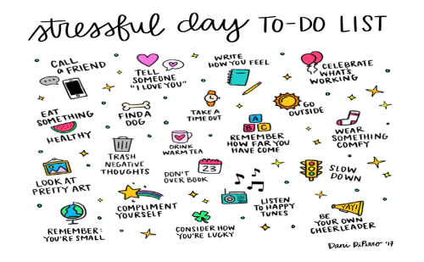
Use the annotation tools to mark a technique you use or plan to start using to deal with stressful days.
Notes:
Opener idea
Aske learners to check an tactic they use or can use?

Slide 25
Name & Agency
Where You Are At In NWT
Questions
America Works
EQUUS
FSC
Maximus
Ross
UMOS
WCI
WRI
Introduction
Requesting
Applying
Initial Assessments
Initial Placement
Employability Plan
Ongoing
Building on Assessment
Two-Parent
Employment
Review
Employment changes
Closure
Successes
Challenges

Slide 26
Announcements
and
Updates

Slide 27
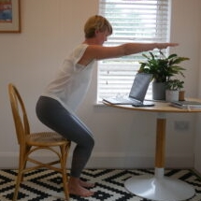
Stretch At Your Desk
Sit and Stand
Begin in seated position; feet flat on floor; knees at 90° angle
Press down heels
Use legs and glutes only to stand
Sit down slowly

Slide 28
Matching Activities and Codes
W-2 Manual:
6.1.1 Parts of the Employability Plan
Appendix – Activity Codes

Slide 29

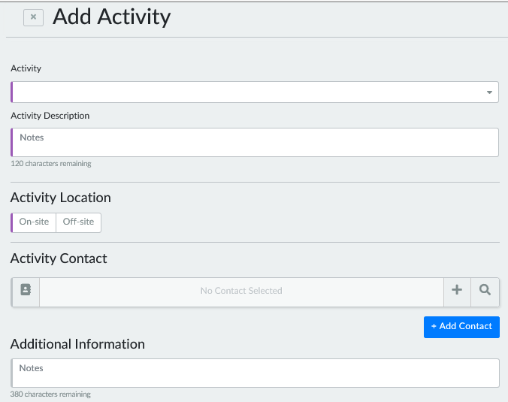

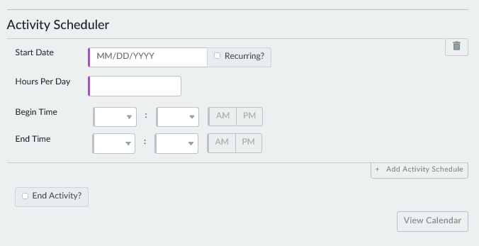

Slide 30
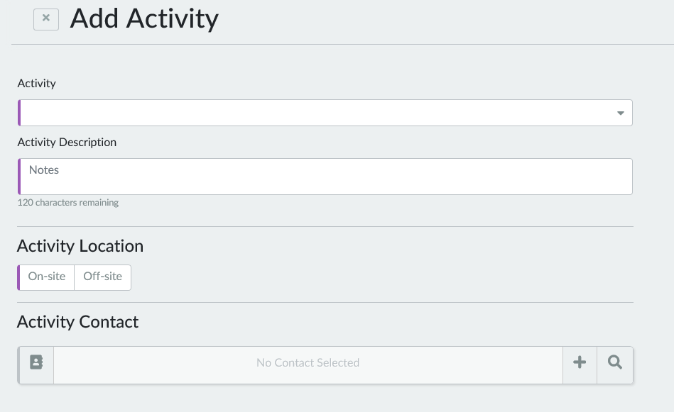
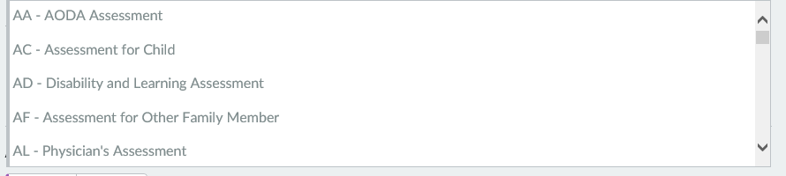

Slide 31
Job Readiness/ Motivation (MO)
Employment Search
(ES)
Career Planning and Counseling (CE)
Weekly appointment with Job Developer, Gabe Michaels
Job shadow various welders
Apply for first shift customer service jobs
Create resume on Job Center of WI website

Slide 32
AODA Counseling (CA)
Personal Development (PD)
Life Skills
(LF)
Attend bi-weekly AA meetings
Attend time management workshop
Read book: The Power of Positive Thinking
AODA group therapy and individual counseling

Slide 33
Career Planning and Counseling (CE)
Technical College Activities (TC)
GED
(GE)
Job Skills Training
(JS)
Take the TABE test
Research requirements for the welding program at the technical college
Attend GED prep sessions at the technical college
Attend full time classes as part of the Office Assistant Certificate

Slide 34
Open
Q & A

Slide 35

Traffic Light Review
Stop Doing
Improve/Be Aware Of
Start Doing

Slide 36

Use the annotation tools to mark something that makes you feel happy.

Slide 37
Name & Agency
Where You Are At In NWT
Questions
America Works
EQUUS
FSC
Maximus
Ross
UMOS
WCI
WRI
Introduction
Requesting
Applying
Initial Assessments
Initial Placement
Employability Plan
Ongoing
Building on Assessment
Two-Parent
Employment
Review
Employment changes
Closure
Successes
Challenges

Slide 38
Announcements
and
Updates

Slide 39
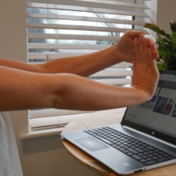
Stretch At Your Desk
Wrist & Finger Stretches
Part One
Extend arms overhead
Draw 5-10 circles inwards and outwards using wrists
Quickly spread fingers and close fists

Slide 40
Stretch At Your Desk
Wrist & Finger Stretches
Part Two
Place arms in front of you, palms facing upward
Apply downward pressure on each palm
Switch the palms to face downward
Hold for 5-10 breaths

Slide 41
Employment Page in CWW
Desk Aids:
Employment Reporting
Prospective Budgeting
Training on Demand Videos:
Employment Page in CWW
Ending Employment in CWW
Entering $0 Income
Multiple Rates of Pay

Slide 42
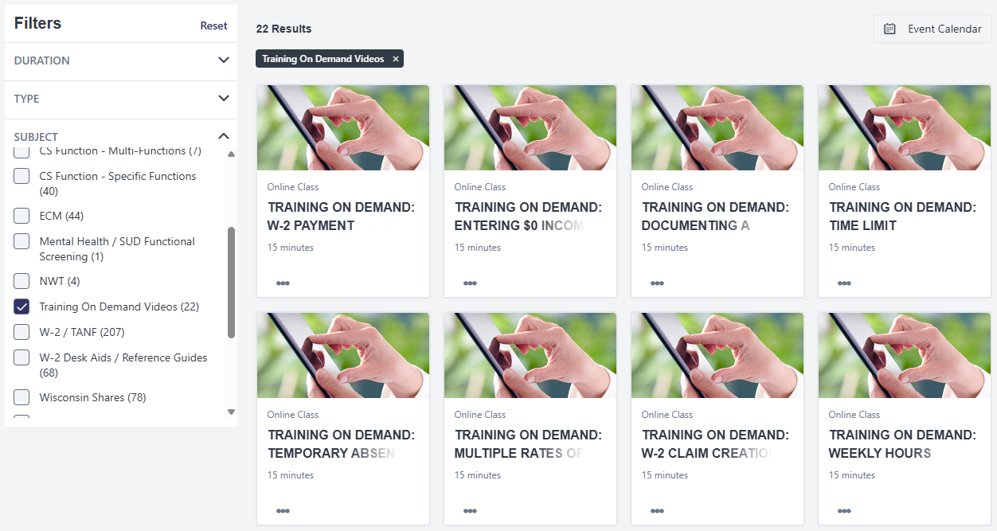

Slide 43
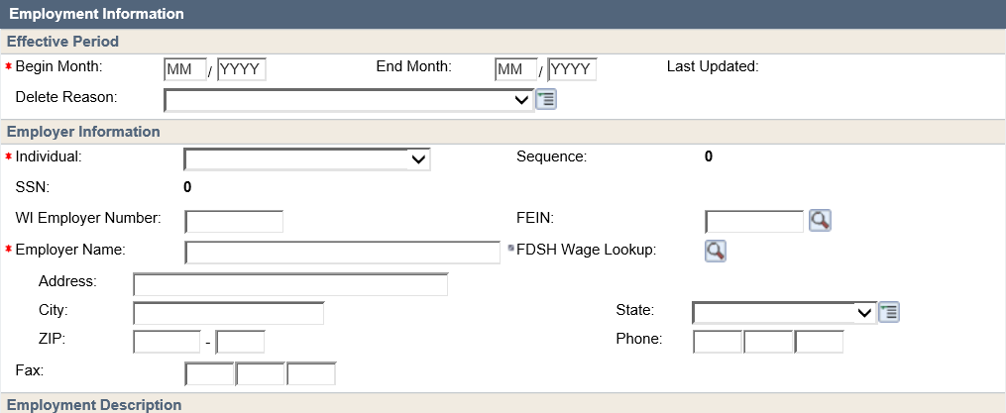
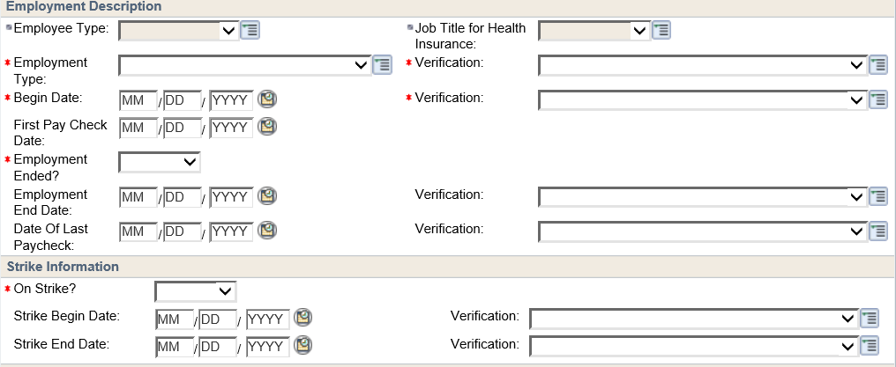
06
2020
Tisha’s New Job
Starts 5/16
Paid semi-monthly on the 1st and 16th
40 hrs/wk, $11/hr
First check on 6/1

Slide 44
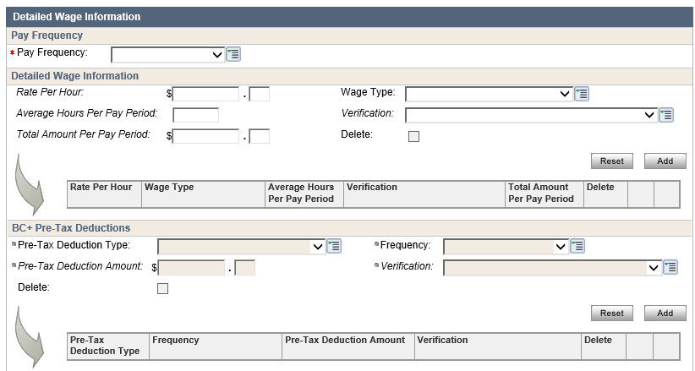
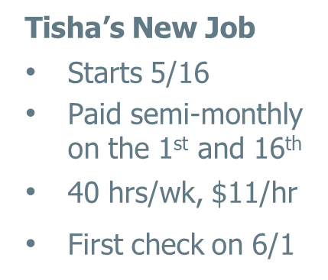
SEMI-MONTHLY
11
00
86

Slide 45
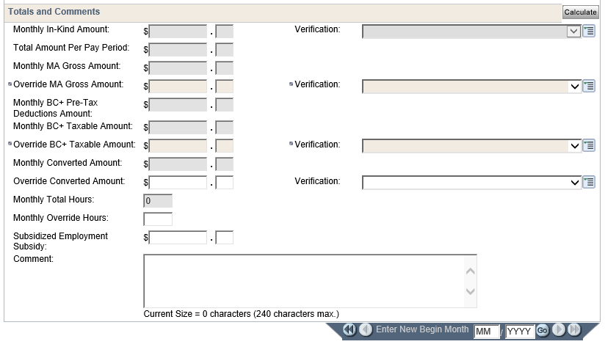
1892
00
946
00
Tisha will be earning a full month’s wages for June based on her pay periods and starting the job in May.
Tisha will receive one check this month. She is paid semi-monthly. Monthly income of $1892/2 = $946 override.

Slide 46
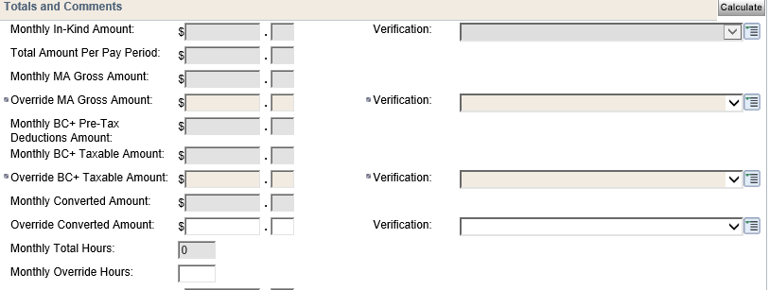

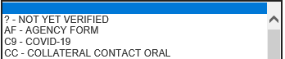
No Income
1892
00
00
AF – AGENCY FORM
00
Full Income
1892
00
946
00
AF – AGENCY FORM

Slide 47
How Many Months Do You Need?
1
2
Patrice started her job on 3/1. She is paid
bi-weekly and will receive her first check on 3/15.
3

Slide 48
How Many Months Do You Need?
1
2
Autumn started her job on 10/15. She is paid
bi-weekly and will receive her first check on 10/29.
3

Slide 49
How Many Months Do You Need?
1
2
Jamal started his job on 6/25. He is paid weekly and will receive his first check on 7/2.
3

Slide 50
How Many Months Do You Need?
1
2
Tori started her job on 8/25. She is paid monthly on the 1st of the month. She will receive a check for her first week of work on 9/1.
3

Slide 51
Open
Q & A

Slide 52




What do you know today that you did not know yesterday, and that will help you tomorrow?
What will you do differently as a result of what you learned?
What is a takeaway you plan to share with others you work with?

Slide 53
ne
w
rd
Use your text annotation tool to share one word, that starts with the first letter of your first name, to describe a quality you have that helps you navigate learning a new job.

Slide 54
Name & Agency
Where You Are At In NWT
Questions
America Works
EQUUS
FSC
Maximus
Ross
UMOS
WCI
WRI
Introduction
Requesting
Applying
Initial Assessments
Initial Placement
Employability Plan
Ongoing
Building on Assessment
Two-Parent
Employment
Review
Employment changes
Closure
Successes
Challenges

Slide 55
Announcements
and
Updates

Slide 56
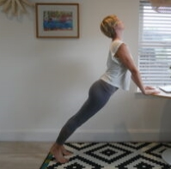
Stretch At Your Desk
Upward Dog
Place hands shoulder-width apart on edge of sturdy desk
Walk feet backward so chest is diagonal to the floor.
Keep arms straight; lean hips toward desk
Hold for 5-10 breaths

Slide 57
Navigating the W-2 Manual
W-2 Manual:
https://dcf.wisconsin.gov/manuals/w-2-manual/Production/default.htm

Slide 58
W-2 Manual Scavenger Hunt
Reasonable Accommodations
Working with Confidential Cases
CMC Placement Payment Amount
W-2 Supportive Service Plans
Aggregating Education Hours
Two-Parent Household 2nd Parent Requirements
Pro-Rated CSJ Placement Hours
Job Access Loans
Activity Codes
Fact Finding
Storing Information
Reporting Changes
W-2 Time Limits
Career Assessment

Slide 59
Open
Q & A

Slide 60
Takeaway
from today
What’s Your TIP?
Improvement
I want to make
Practice
I plan to add

Slide 61
Avoid negative sources people, places, & habits
Believe in yourself
Consider things from every angle
Don’t give up & don’t give in
Everything you’re looking for lies behind the mask you wear
Family & Friends are hidden treasures, seek them & enjoy their riches
Give more than you planned to
Hang on to your dreams
If opportunity doesn’t knock, build a door
Judge your success by what you had to give up in order to get it
Keep trying no matter how hard it seems
Love yourself
Make it happen
Never lie, steal or cheat
Open your arms to change, but don’t let go of your values
Practice makes perfect
Quality not quantity in everything you do
Remember that silence is sometimes the best answer
Stop procrastinating
Take control of your own destiny
Understand yourself in order to better understand others
Visualize it
When you lose, don’t lose the lesson
Xcellence in all your efforts
You are unique, nothing can replace you
Zero in on your target & go for it
A to Zen
Use your stamp annotation tool to indicate which phrases resonate with you

Slide 62
Name & Agency
Where You Are At In NWT
Questions
America Works
EQUUS
FSC
Maximus
Ross
UMOS
WCI
WRI
Introduction
Requesting
Applying
Initial Assessments
Initial Placement
Employability Plan
Ongoing
Building on Assessment
Two-Parent
Employment
Review
Employment changes
Closure
Successes
Challenges

Slide 63
Announcements
and
Updates

Slide 64

Stretch At Your Desk
Eagle Arms
Place arms at a 90° angle in front of you
Cross one arm over the other, interlocking; palms together
Lift elbows; Stretch fingers
Hold for 3-5 breaths
Switch sides and repeat

Slide 65
Income vs. Assets
W-2 Manual:
3.2 Income
3.3 Assets
Desk Aids:
Income or Asset

Slide 66
Employment
Child Support
Autos
Boats
Savings Account
Unemployment
Self-Employment
Tax Returns
SSI/SSDI
Checking Account
Property (House, Land)
JAL and W-2 Payments
Camper
Income
Assets
Employment
Earnings from a minor
Unemployment
Adult SSI/SSDI
Child SSI/SSDI
Self-Employment
Tax Returns
Child Support
Non-Regular Child Support (Arrears)
Tax Returns
JAL and W-2 Payments
Checking
Savings
Autos
Boat
Camper
Property

Slide 67
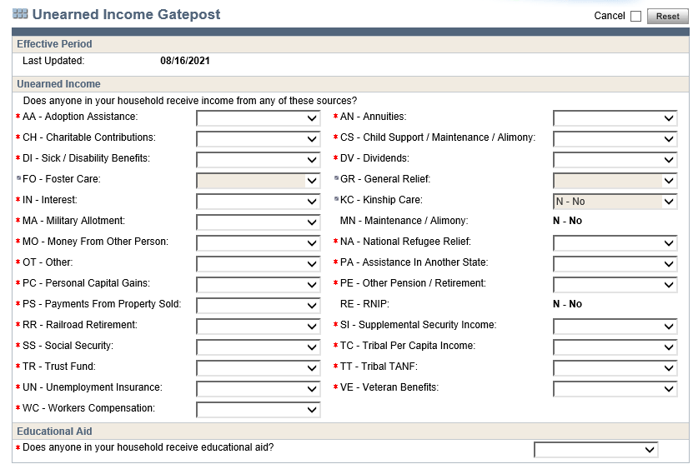
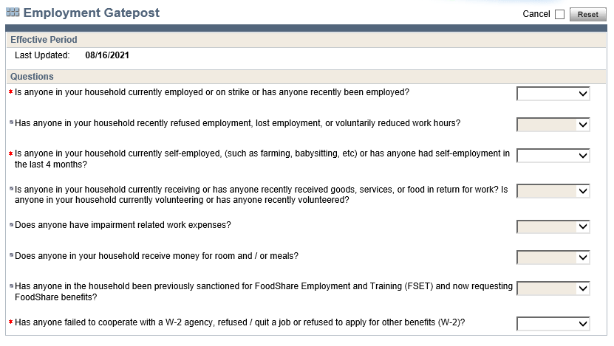

Slide 68
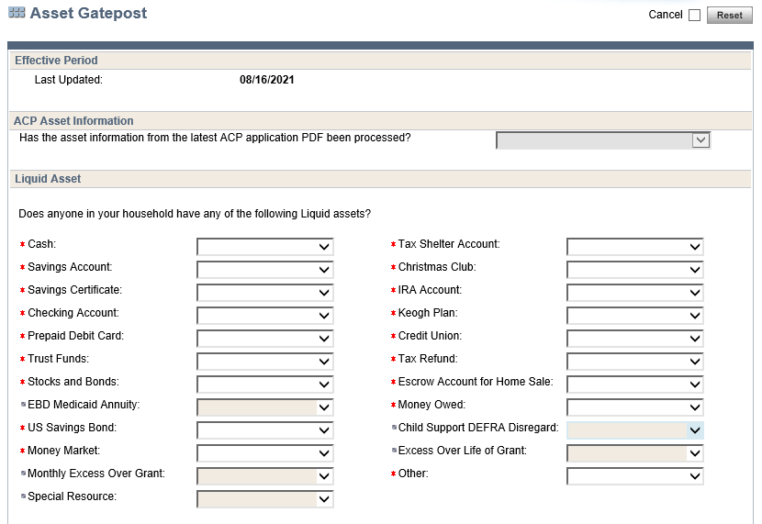
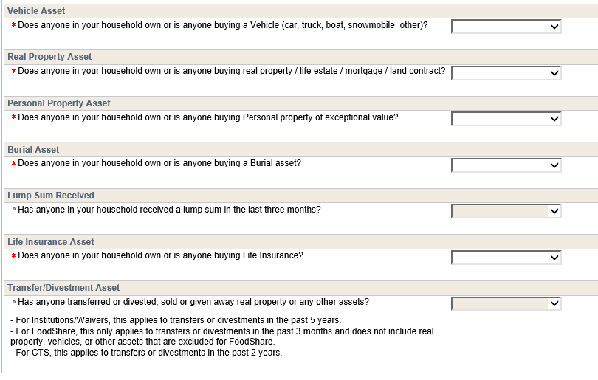

Slide 69
Income Type
Counted
Disregarded
Employment
Earnings from a minor
Unemployment
Adult SSI/SSDI
Child SSI/SSDI
Self-Employment
Tax Returns
Child Support
Non-Regular Child Support (Arrears)
JAL and W-2 Payments

Slide 70
Counted Income
Income
Employment
Unemployment
Adult SSI/SSDI
Self-Employment
Non-Regular Child Support (Arrears)
Employment
Earnings from a minor
Unemployment
Adult SSI/SSDI
Child SSI/SSDI
Self-Employment
Tax Returns
Child Support
Non-Regular Child Support (Arrears)
Tax Returns
JAL and W-2 Payments
Disregarded Income
Earnings from a minor
Child Support
Child SSI/SSDI
Tax Returns
JAL and W-2 payments

Slide 71
Asset Type
Counted
Disregarded
Checking
Savings
Autos
Boat
Camper
Property

Slide 72
Counted Assets
Checking
Savings
Autos
Boat
Camper
Property
Assets
Checking
Savings
Autos
Boat
Camper
Property
Disregarded Assets
$10,000 combined vehicle equity
Homestead (if primary residence and no more than 200% of median value)

Slide 73
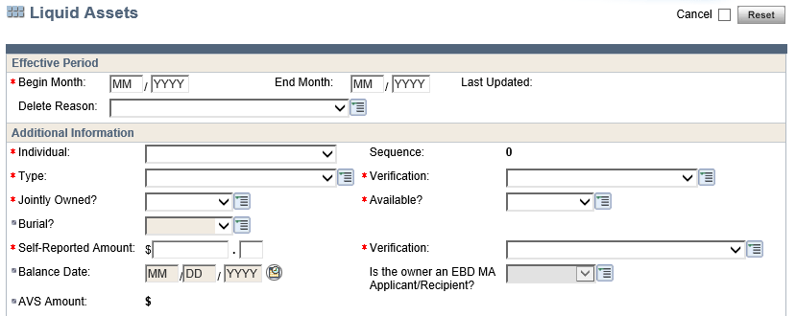

Slide 74
Income
Asset
Katie is a 22-year-old single mother with an infant son, Josh, who is 4 months old. She has a pre-paid debit card and is not working at this time. Josh’s father helps her when he can and pays child support. Katie reports Josh has a savings account her parents started for him. Katie says she borrows her mother’s car, and is living at her parents’ in the apartment they made for her above the garage. She doesn’t pay any rent.

Slide 75
Income
Asset
Celeste is single mother with two children: Sammy, age 10, and Johnny, age 7 months. Her brother, Ethan, age 20, lives with her. He has a part time job. Celeste has a pre-paid debit card and a checking account. She also has a 2015 Chevy Malibu that was a gift from her grandfather. She doesn’t owe anything on the car. Celeste is getting unemployment. Sammy and Johnny are getting child support from their father.

Slide 76
Income
Asset
Hector and Maria have 4 children: Sava, 17, Jose, 12, Selena, 10, and Juan, 5. Hector lost his job due to an injury, and Maria is getting SSDI. Juan also gets SSI. Hector and Maria have a joint checking account and savings account. Hector exhausted his short-term disability from his job, and is not able to return. He is receiving unemployment. They have two cars. Hector has a 401K. They own their home. Sava has a part time job and an
X-Pro Moped scooter. Maria said he saved and paid cash for it.

Slide 77
Open
Q & A

Slide 78
AHA Moment
Apply
What information from today do you plan to apply moving forward?
Happen
How do you plan to make this happen?
Action
What is the first action step you plan to take?

Slide 79

Share additional ways you stay motivated by typing in the chat

Slide 80
Name & Agency
Where You Are At In NWT
Questions
America Works
EQUUS
FSC
Maximus
Ross
UMOS
WCI
WRI
Introduction
Requesting
Applying
Initial Assessments
Initial Placement
Employability Plan
Ongoing
Building on Assessment
Two-Parent
Employment
Review
Employment changes
Closure
Successes
Challenges

Slide 81
Announcements
and
Updates

Slide 82
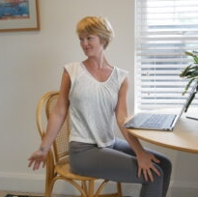
Stretch At Your Desk
Seated Twist
Place hands on back of chair
Gently twist your chest and abdomen to one side
Hold for 4-5 breaths
Switch sides and repeat

Slide 83
Goal Setting
W-2 Manual:
6.1.1 Parts of the Employability Plan
Desk Aids:
SMART Goals

Slide 84

S
M
Specific
A
R
T
Measurable
Attainable
Relevant
Time-Based
84

Slide 85
Why set
SMART goals?
Gain buy-in.
s more likely to achieve their goals.
Help s stay on track.
85

Slide 86
Goal Types
Primary Employment
Chosen Field of Interest
Secondary Employment
Back-up Field of Interest
Other Program
Related to Education Skills or Training
Long Term Career
Aligns with Career Assessment
Personal
Non-Program Related

Slide 87
Accountant - Sue likes working with numbers and would like to become an accountant in the future. She knows she will need to complete several other steps before this can happen, including going back to school to complete her degree.
Reduce stress – Sue knows she has a lot of stress in her life and needs to find ways to deal with it. She will try various coping strategies, such as drawing, journaling, yoga, and exercise to reduce her stress levels.
Factory Worker - Bob wouldn’t mind working in a factory if he can move around and doesn’t have to stay in the same place all the time.
Mechanic - Bob likes working on vehicles. He has experience fixing cars and likes working with his hands.
Cashier/Customer Service - Sue is willing to take a job as a cashier or in the customer service field if needed. She likes to work with people and has good customer service skills.
Spend quality time with kids– Bob wants to spend more quality time with his kids. He would like to take them on a trip to the zoo.
Own a Business - Bob would like to own an auto repair shop someday. He thinks he would be a good and fair boss. He needs to learn more about being a small business owner and save money for business start-up.
Office Assistant - Sue has attention to detail and likes assisting others. She wants full-time, first shift work. Her career assessment results show her workstyles and interests are a good match for this type of work.
Obtain Driver’s License – Sue has never had a DL and wants one because the bus takes too long. She would like to pass the temporary licensing test by the end of next month.
Complete an automotive certificate course – Bob would like to complete the Automotive Quick Service Technician certificate offered by the local tech college, as he knows this is important for his future.
Primary Employment
Secondary Employment
Other Program
Long Term Career
Personal

Slide 88
Spend quality time with kids– Bob wants to spend more quality time with his kids. He would like to take them on a trip to the zoo.
Plan for the trip to the zoo. Figure out the schedule (travel, activities), what you will need to bring, etc.
Choose a day to go to the zoo. Consider how long it will take to save money, schedules (work/school), and weather.
Determine how much it will cost to go to the zoo (transportation, parking, admission, food, souvenirs, special attractions, etc.)
Look up information on the zoo, including hours, location, and cost.

Slide 89
Open
Q & A

Slide 90

One Meaningful…
Idea
Goal

Slide 91
G | L | T | N | E | M | E | C | A | L | P | A | B | C | A | S | E | L | C | A
O | A | C | C | O | M | M | O | D | A | T | I | O | N | S | D | E | A | F | C
O | U | T | D | G | H | P | A | R | T | I | C | I | P | A | T | I | O | N | T
D | N | I | E | J | W | K | L | L | M | Z | B | P | I | G | S | M | G | N | I
C | A | U | S | W | S | K | R | O | W | N | I | S | N | O | C | S | I | W | V
A | M | Y | K | K | A | I | V | W | Y | A | O | W | Z | C | H | X | U | M | I
U | Q | T | A | J | Q | Y | C | E | K | M | L | G | N | I | N | I | A | R | T
S | Y | T | I | L | I | B | I | G | I | L | E | V | X | K | P | H | W | F | I
E | F | X | D | N | S | P | H | U | T | S | T | N | E | M | M | O | C | R | E
U | Z | L | E | A | R | N | I | N | G | C | E | N | T | E | R | E | R | D | S
Wisconsin Works
Learning Center
Gateway
Manual
Desk Aid
Training
Comments
Goal
Activities
Employment
Accommodations
Eligibility
Placement
Participation
Good Cause
CWW
WWP
Case
PIN
ECF

Slide 92
G | L | T | N | E | M | E | C | A | L | P | A | B | C | A | S | E | L | C | A
O | A | C | C | O | M | M | O | D | A | T | I | O | N | S | D | E | A | F | C
O | U | T | D | G | H | P | A | R | T | I | C | I | P | A | T | I | O | N | T
D | N | I | E | J | W | K | L | L | M | Z | B | P | I | G | S | M | G | N | I
C | A | U | S | W | S | K | R | O | W | N | I | S | N | O | C | S | I | W | V
A | M | Y | K | K | A | I | V | W | Y | A | O | W | Z | C | H | X | U | M | I
U | Q | T | A | J | Q | Y | C | E | K | M | L | G | N | I | N | I | A | R | T
S | Y | T | I | L | I | B | I | G | I | L | E | V | X | K | P | H | W | F | I
E | F | X | D | N | S | P | H | U | T | S | T | N | E | M | M | O | C | R | E
U | Z | L | E | A | R | N | I | N | G | C | E | N | T | E | R | E | R | D | S
Wisconsin Works
Learning Center
Gateway
Manual
Desk Aid
Training
Comments
Goal
Activities
Employment
Accommodations
Eligibility
Placement
Participation
Good Cause
CWW
WWP
Case
PIN
ECF

Slide 93
Name & Agency
Where You Are At In NWT
Questions
America Works
EQUUS
FSC
Maximus
Ross
UMOS
WCI
WRI
Introduction
Requesting
Applying
Initial Assessments
Initial Placement
Employability Plan
Ongoing
Building on Assessment
Two-Parent
Employment
Review
Employment changes
Closure
Successes
Challenges

Slide 94
Announcements
and
Updates

Slide 95

Stretch At Your Desk
Restorative Stretch
Place feet flat on the floor
Cross your arms on your desk
Lay forehead onto your arms
Breathe deeply for up to five minutes

Slide 96
Participation Tracking and Good Cause
W-2 Manual:
11.2 Hourly Payment Reductions
11.3 Good Cause
Desk Aids:
W-2 Participation Tracking

Slide 97
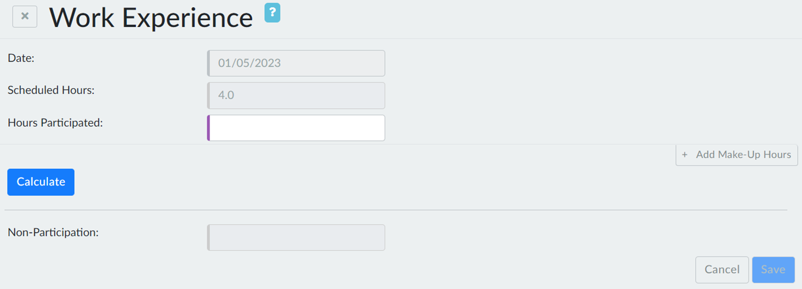
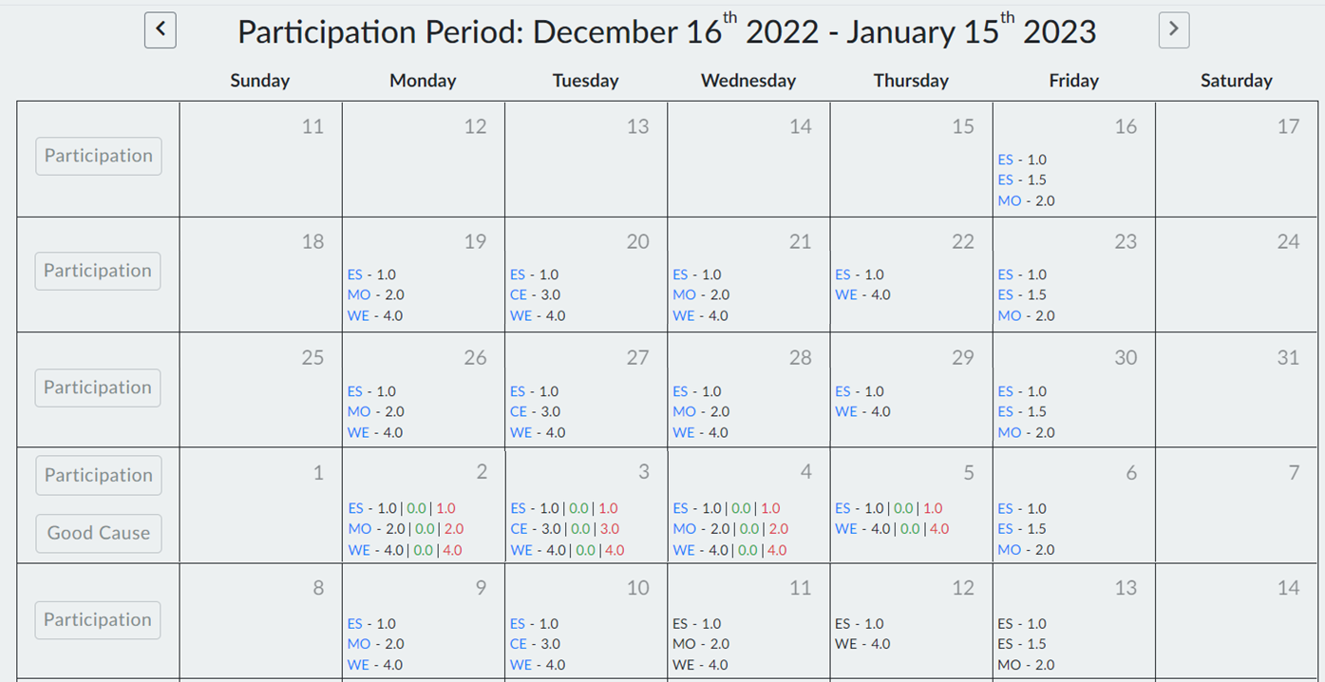
Make-up Hours

Slide 98
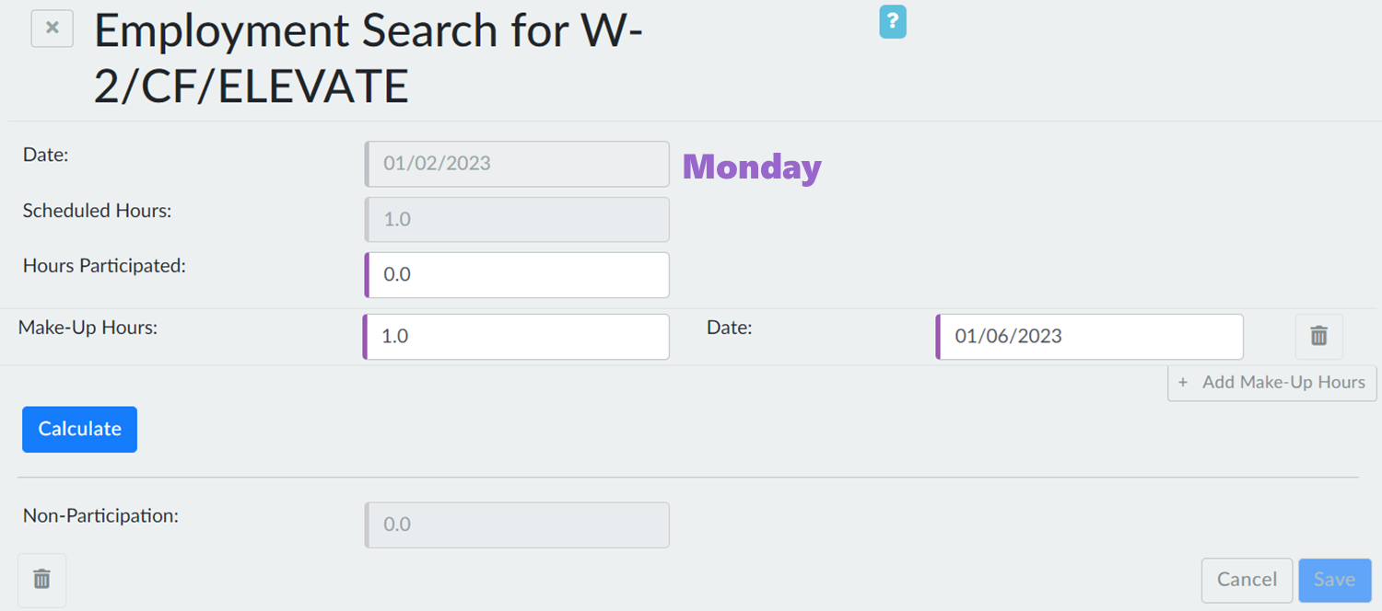

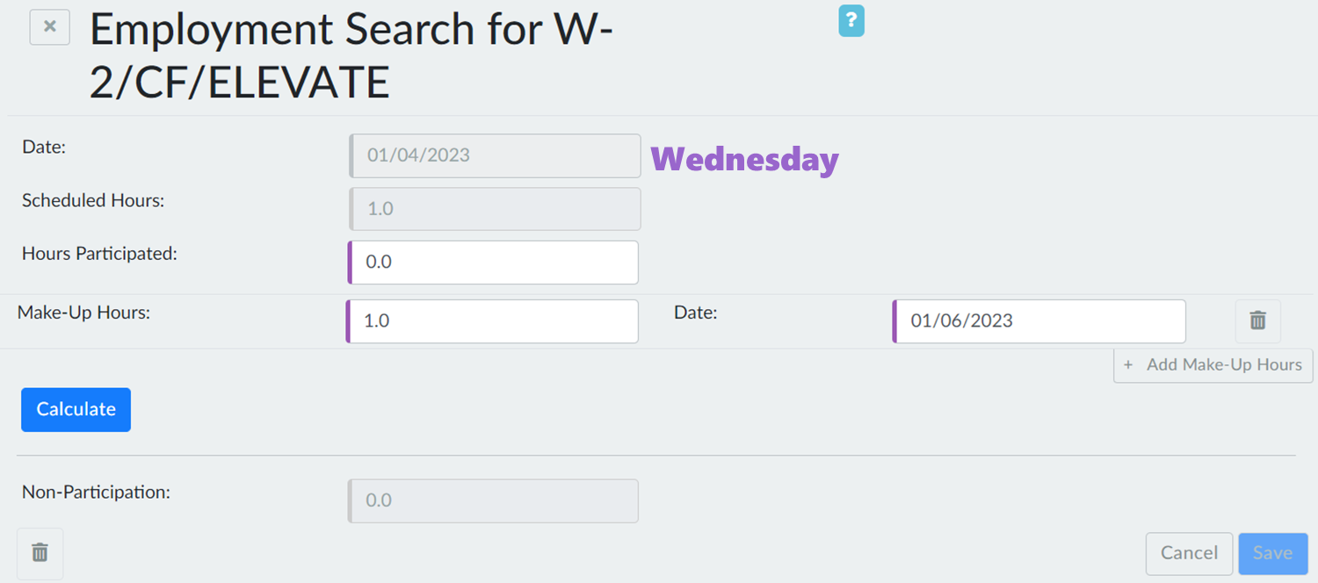

Entering Make-up Hours

Slide 99
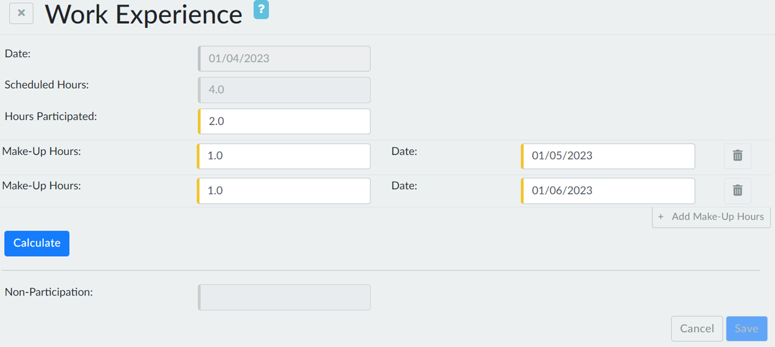
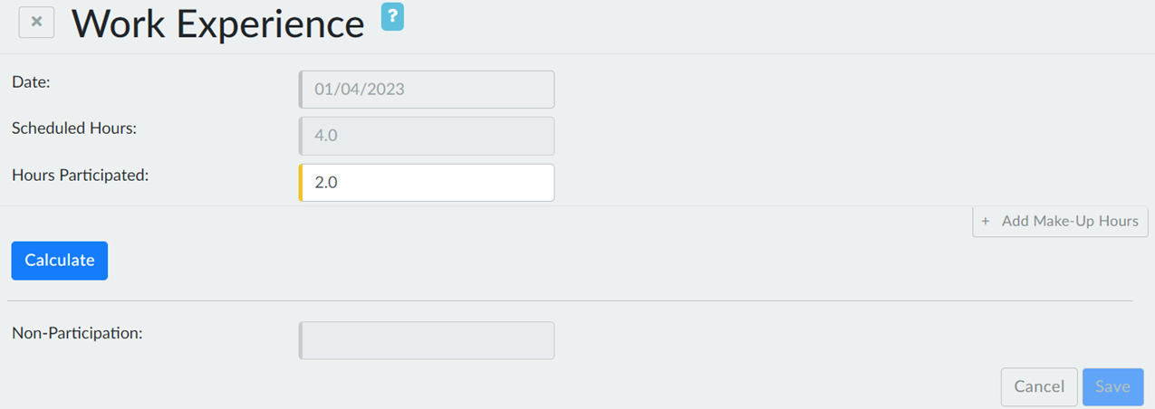
x2

Slide 100
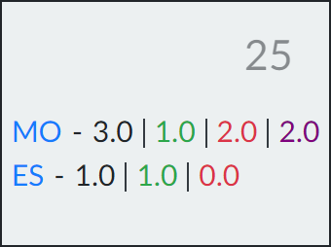
Participation Hours
Scheduled Hours
Good Cause Hours
Non-Participation Hours

Slide 101
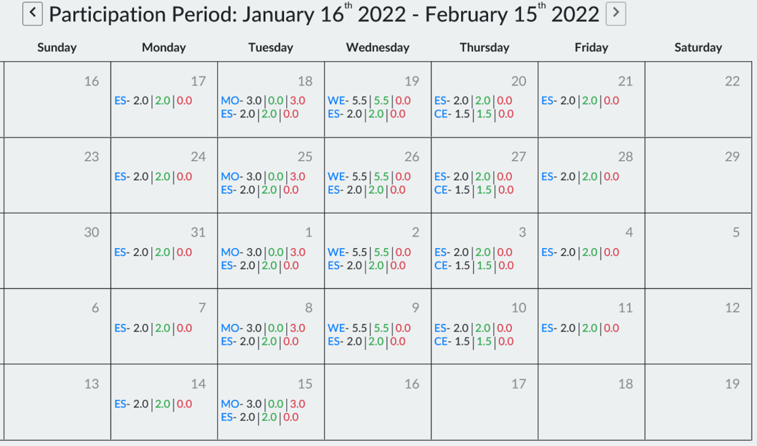
Patterns of Participation #1

Slide 102
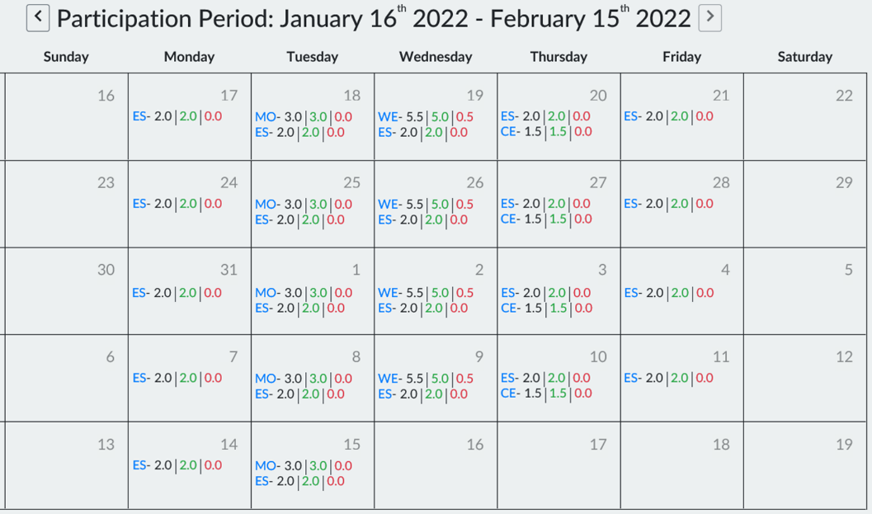
Patterns of Participation #2

Slide 103
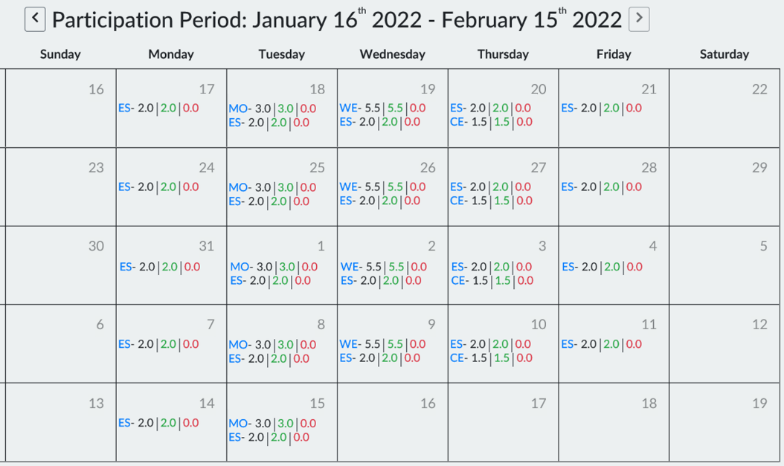
Patterns of Participation #3

Slide 104
Participation and
Good Cause Buttons

Slide 105
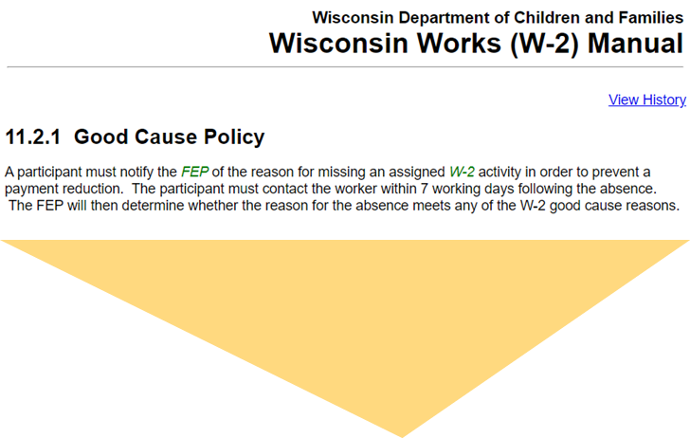
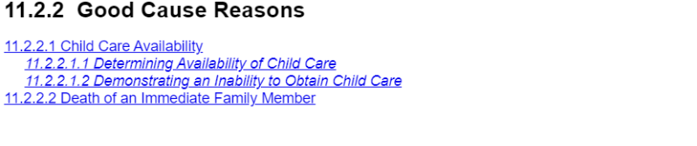


Slide 106


Good Cause Determination
Approve
Deny

Slide 107
Open
Q & A

Slide 108
What do you know today that you did not know yesterday, and that will help you tomorrow?
What will you do differently as a result of what you learned?
What is a takeaway you plan to share with others you work with?

