Slide 1
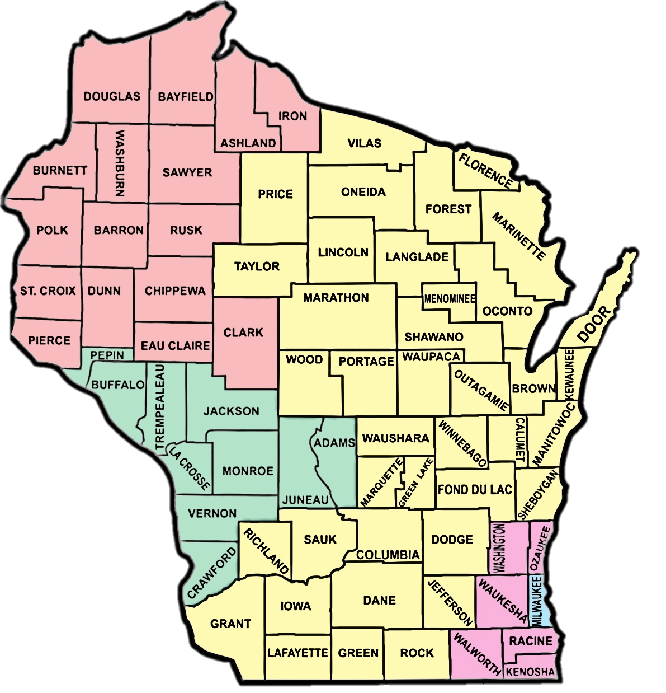
Use your stamp annotation tool to mark where your office is located on the map
Forward Service Corporation (FSC)
EQUUS
Workforce Connections, Inc. (WCI)
Workforce Resources, Inc. (WRI)
Milwaukee Area
America Works
Maximus
Ross
UMOS
AMERICA WORKS

Slide 2
Welcome to W-2 New Worker Training!
2

Slide 3
Explore
Review
Discuss
New Worker Training Guide
Computer Systems and Settings
Best Practices
New Worker Orientation

Slide 4
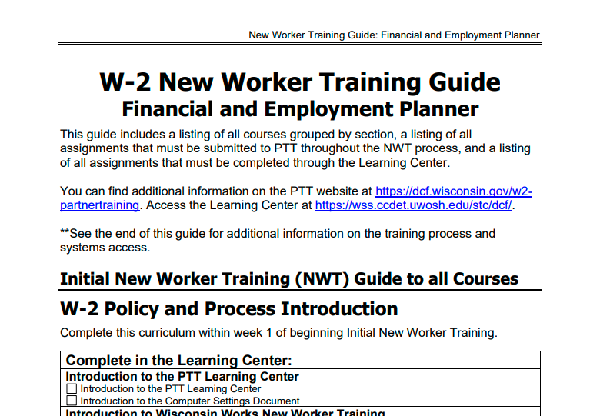

Slide 5
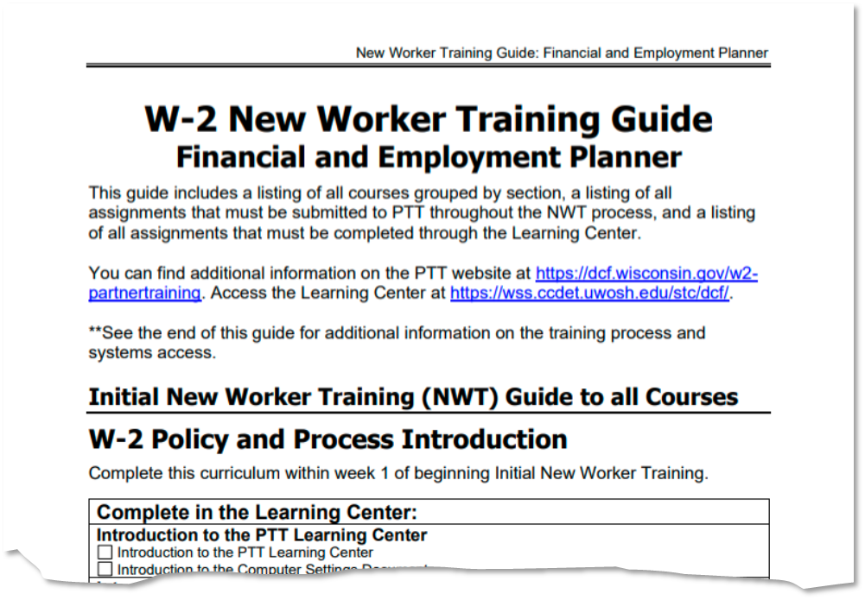

Slide 6
Computer Based Training (CBT)
Documents
Reference Guides
Desk Aids

Slide 7
Quizzes outside Learning Center
Link opens new window
80%

Slide 8
Case related – application, eligibility
Hands-on experience
Participant focused – assessment, goals, activities

Slide 9
Complete in Classroom
Required – within 12 months
Virtual
In-person

Slide 10
Best Practices
Quiet environment
Take your time
Use and update New Worker Guide
Bookmark and save resources
Include PIN and/or case numbers
Update email subject lines:
System Entry vs. HELP
Ask for help
Organize training materials
Technology compatible

Slide 11
Carmen
Guides you through training
Step-by-step instructions
Haylee
Practice on your own
Builds on knowledge

Slide 12
Reinforcing W-2 in the Classroom
W-2 NWT Completion
Ongoing Processes: Parts 1-4; Reviews
FEP
Employability Plans
Resource Specialist
Assessment
Reinforcing W-2 in the Classroom
Eligibility
W-2 NWT Completion
Client Registration
Client Registration
W-2 Policy and Process Introduction
W-2 Policy and Process Introduction

Slide 13
Network with trainers and other new workers
Discuss challenges and successes
Open Q & A
Practice self care
Rotation of topics

Slide 14
Questions?
14

Slide 15
Use your stamp annotation tool to indicate how
you are feeling about
W-2 New Worker Training

Slide 16
Be Patient
Take Your Time
Ask for Help
We’re Here for You!
New Worker Orientation

