Slide 1

W-2 T Employment Focused Engagement Strategies

Slide 2

Understanding Change
Think of a time when you had to make a change.
Find a partner and discuss this change experience with him or her.
4

Slide 3

Assessment
Collaboration
Engagement Strategies
Accommodation

Slide 4

Making a Difference
What specific ways can using assessment results benefit you and the participant?
5

Slide 5
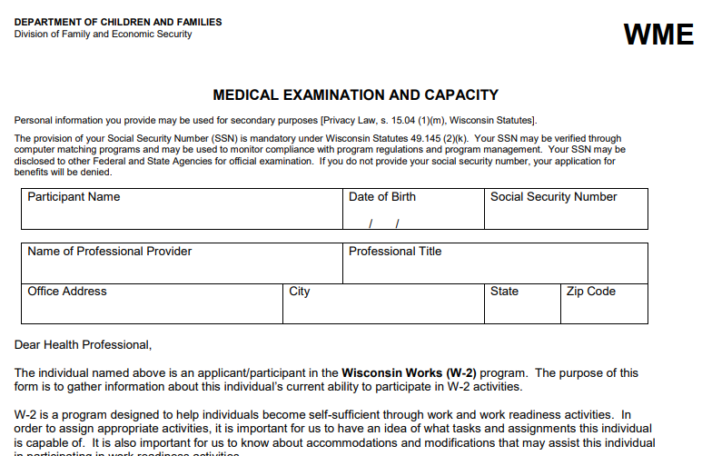

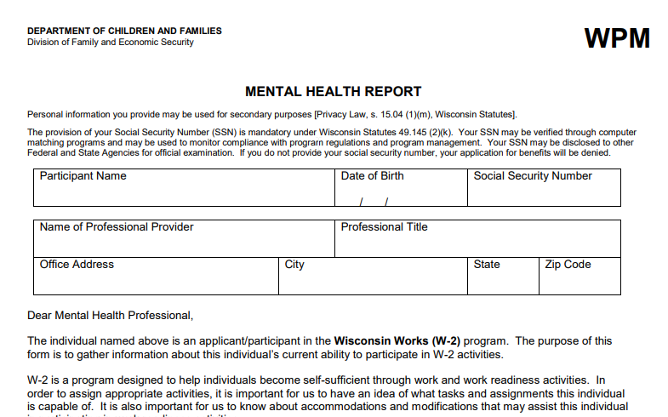

Assessment Types
Formal
Informal
6

Slide 6
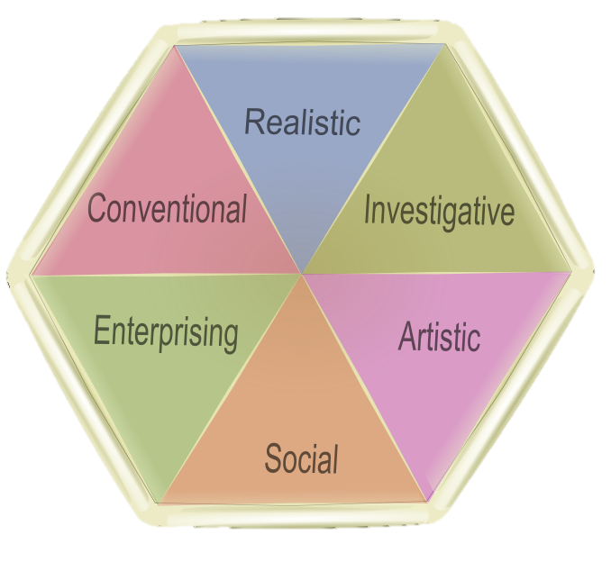

Assessment Types
Vocational
Career
7

Slide 7

Review scenario and corresponding assessment results. Then answer the questions in your Participant Guide. Be prepared to share your responses.

Slide 8
Realistic
Focus
on data
not ideas,
following
guidelines
Practical, hands-
on outside
work
Thinking,
searching for
facts and ideas
Conventional
Investigative
Enterprising
Artistic
Making decisions and carrying
out
projects
Self-expression, freedom to
work
without
rules
Working
and
communicating
with people
Social

Slide 9

Identifying Accommodations
Provider
Assessment
Observations
DVR
JAN
Co-workers
Participant
8

Slide 10
Self-Advocacy
Know When
Know Who
Know How
Know Type
8

Slide 11
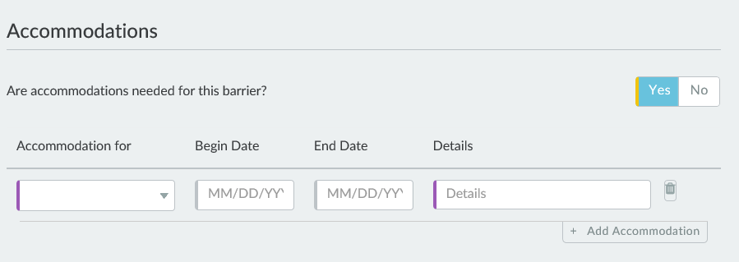
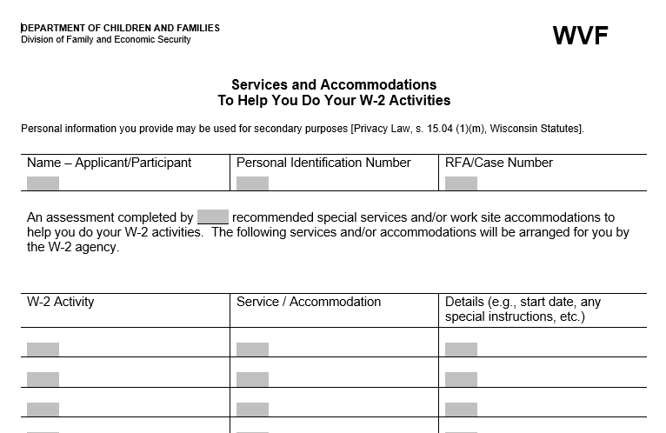
Accommodations in W-2
9

Slide 12
Roll the dice and come up with as many accommodations as you can, recording what you come up with as you go. Repeat until time is called. Unique answers will earn you a point, and the team with the most points wins!

Slide 13

Your Project
Think back to a time when you had a big group project…
10

Slide 14
Collaboration
WIOA
FSET
W-2
With whom do you currently collaborate?
ADRC
DVR
Participant
11

Slide 15





Preparing Participants
12

Slide 16

Collaboration In Practice
Video 1
13

Slide 17
Collaboration In Practice
Video 2
13

Slide 18
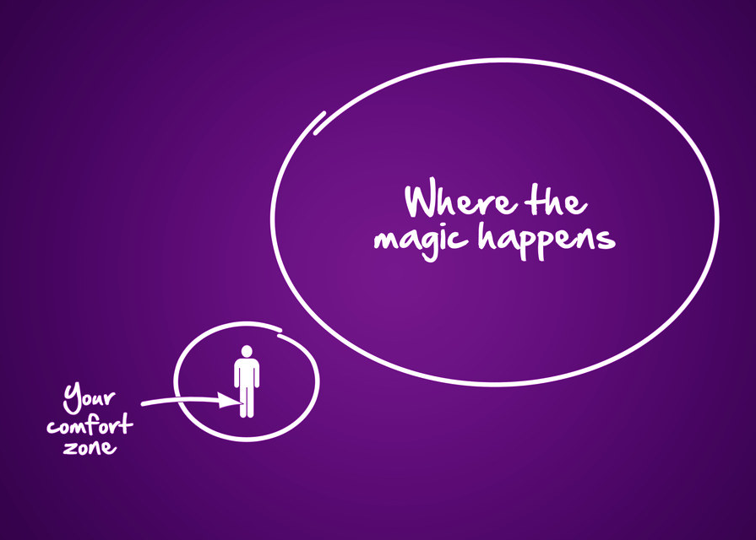
Where change happens
14

Slide 19

Motivational Interviewing
O – Open Questions
A – Affirmations
R – Reflections
S – Summarizing
14
15
16

Slide 20

Keep in mind…
You are not alone!
Community resources
Process → you
Outcomes → participants
Ongoing adjustments
16

Slide 21





Activity Engagement
Work Experience
Career Assessments
Education & Training
Job Readiness & Motivation
Job Search

Slide 22

Trial Employment Match Program (TEMP)
How can participants benefit from TEMP?
How can you prepare participants who may be transitioning into a TEMP position?
17

Slide 23
Remember…
Overcoming barriers is a process
You → process
Participant → outcomes
Baby steps are needed
Adjustments will be needed
17

Slide 24
Starting with Decision 1, go around the room making a series of decisions regarding Serina’s case, putting into practice the strategies you learned today. Be prepared to share your final decision with the group.

Slide 25

Documentation
See participant progress in phases and as a whole
18

Slide 26
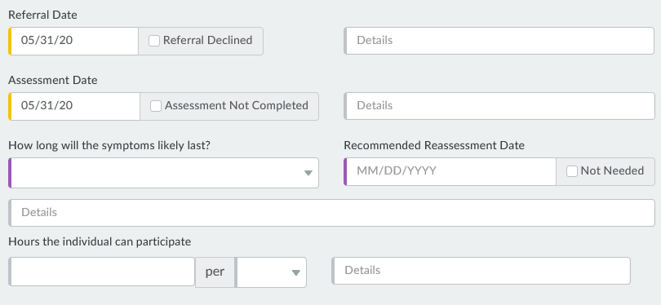
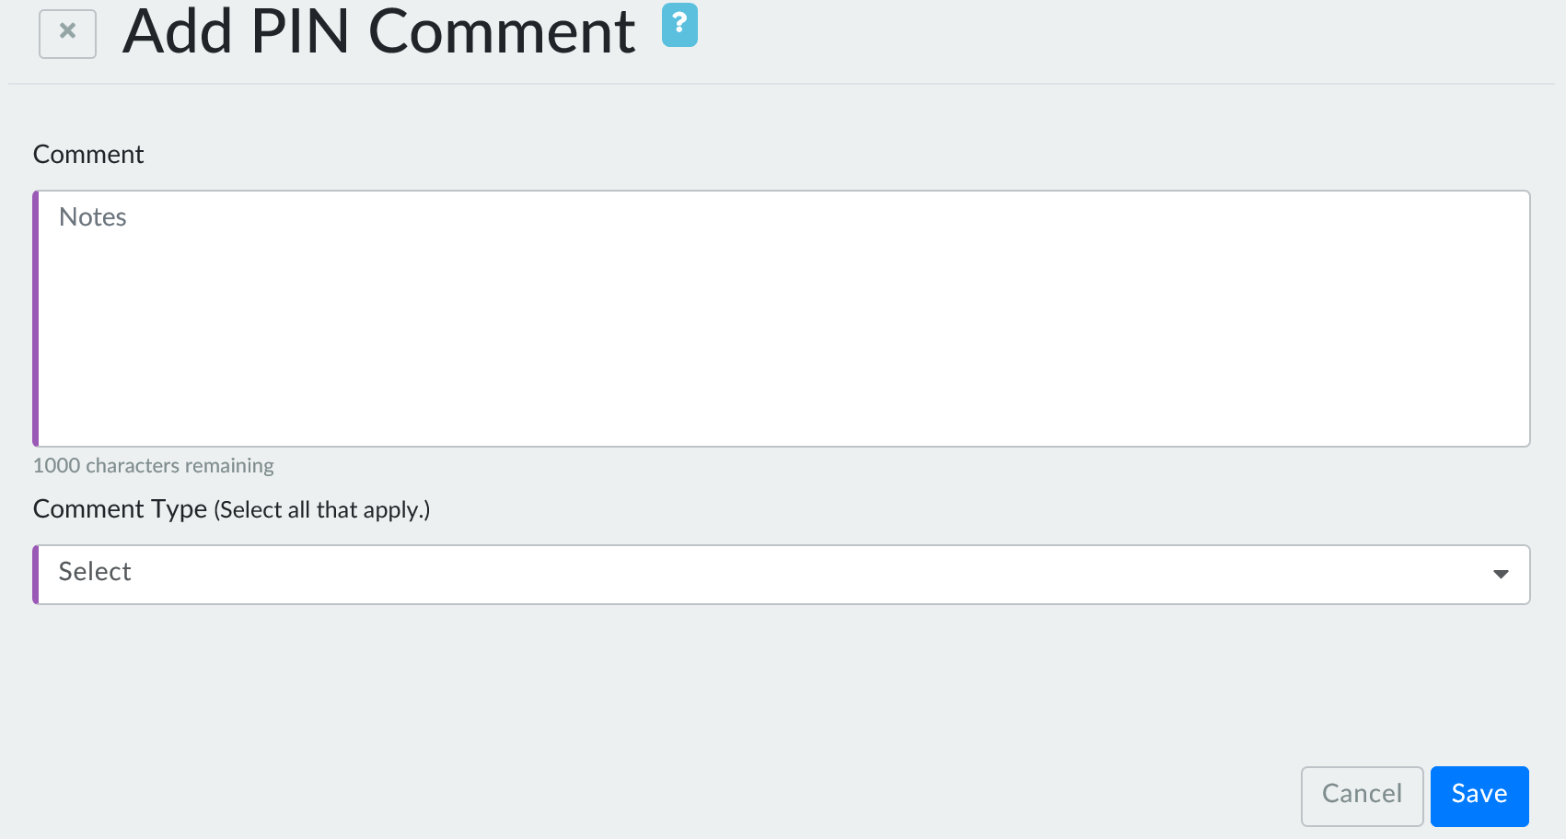
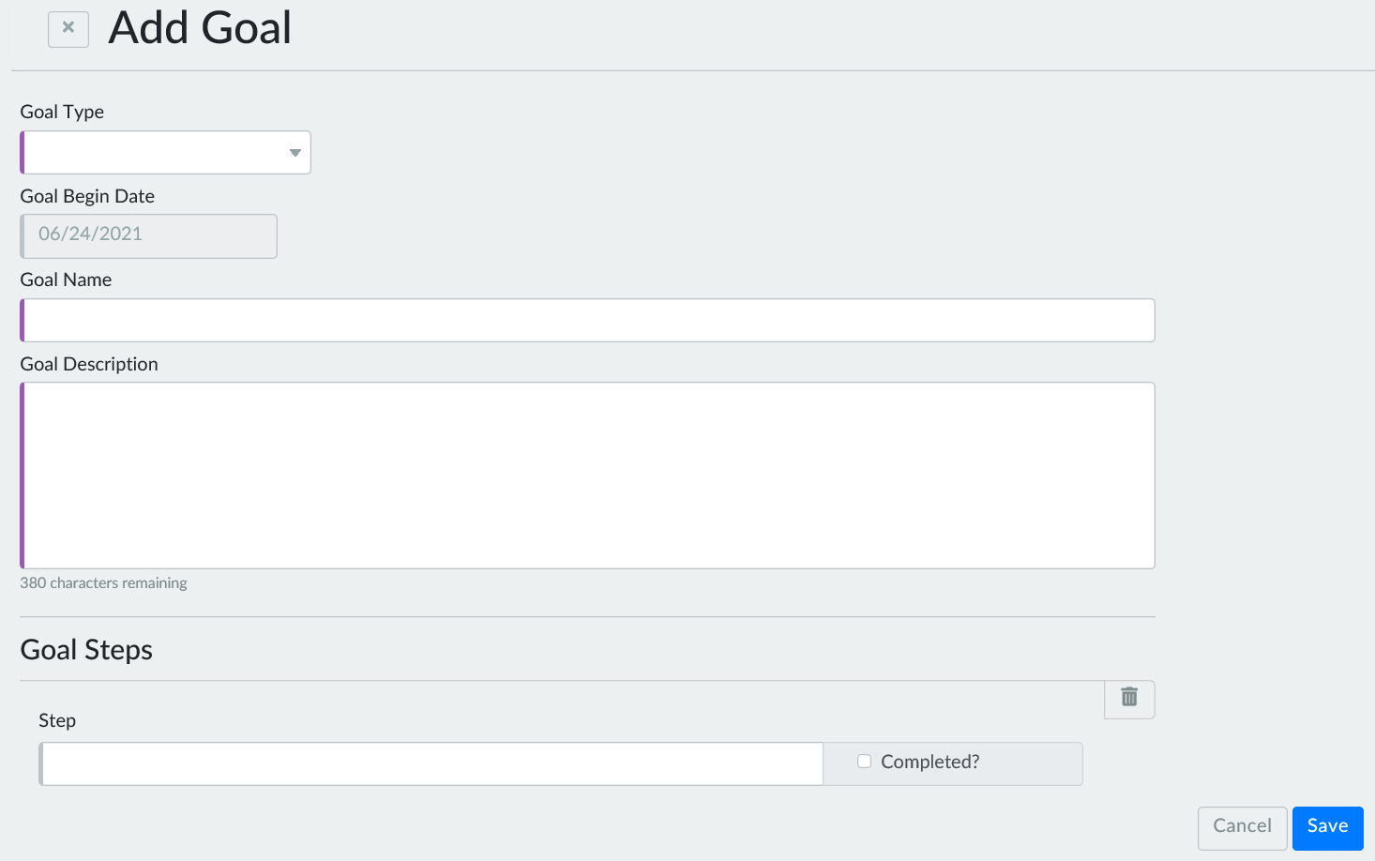
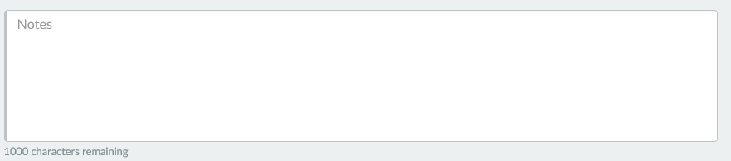
Documentation: WWP
18

Slide 27
Documentation: ECF
18

Slide 28

Wrap Up
Helpful?
Surprising?
Hope to incorporate?
19

