Slide 1
W-2 Case Management:
Assessment and Employability Plans

Slide 2
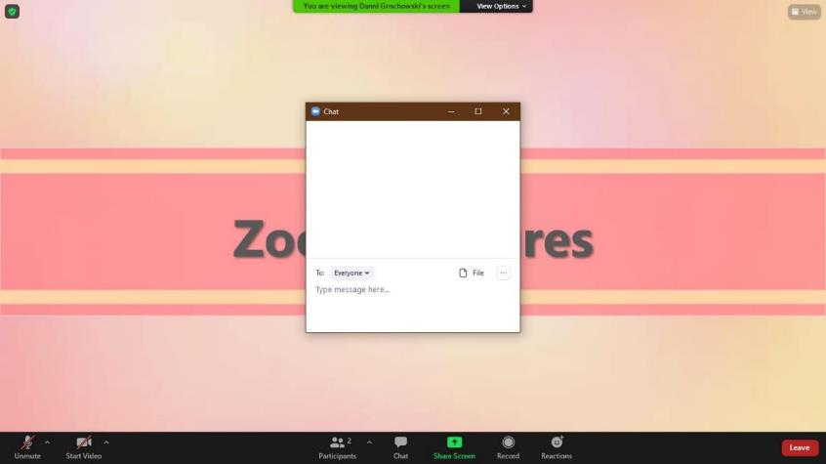
Using Zoom
Notes:
Throughout this class, we will be using several different features in Zoom.

Slide 3
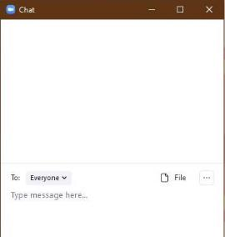
Using Zoom: Chat
Notes:
Access the chat feature by **clicking on the Chat button at the bottom of your screen. **This opens a conversation pane in your window. **Everybody say ‘hello’ in the chat so we know that you found it.

Slide 4
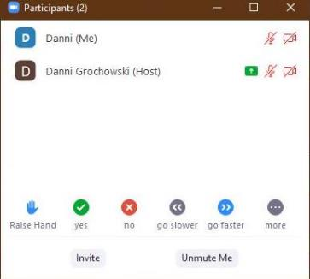
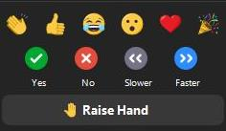
Using Zoom: Participants/Reactions
Notes:
Depending on your version of Zoom, you can access additional features by **clicking on Participants or Reactions at the bottom of your screen. **From here, you can use **various buttons to provide us feedback. If at any point you need us to slow down, please use the **gray “go slower” button. Click the Yes button so we know you found it.

Slide 5
Using Zoom: Annotations
Notes:
Sometimes, we’ll ask you to mark on the screen using annotations. To access annotations, **click the View Options at the top of your screen. **Select Annotate to open the annotation tool bar. The **stamp annotation is one we plan to use. Go ahead and pick one of the stamp options and put a stamp on the screen. Another annotation we plan to use, is **text. Use this to type text on the screen. After selecting the text annotation, use the format button to change the color or size of your text.

Slide 6
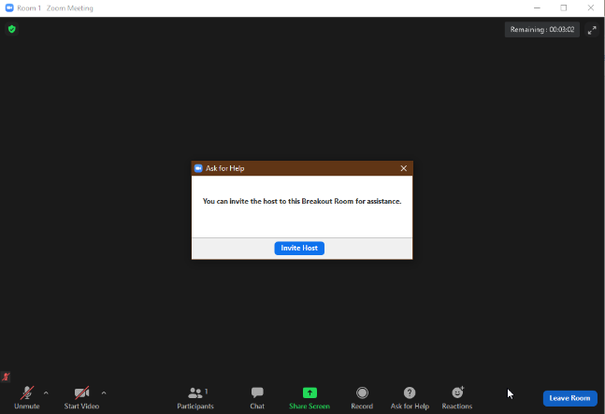
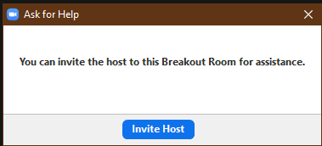
Using Zoom: Breakout Rooms
Notes:
You’ll have a chance for some discussion in small groups during this class. When we send you to a breakout room, **you’ll see this window pop up. Then, you and other learners will **join the room. Feel free to turn on your **webcams during this time if you have them. If you need help from a trainer, click the **ask for help button to invite the host. When your time is up in the breakout room, Zoom automatically brings you back to the main session.

Slide 7
Six word memoir
Succeeded in forgiving; failed to forget.
-Denise Diaz
Only I define who I am.
-Montel Williams
Wanted independence but have two dependents. -Tina Lazar
We would have named him Xavier.
-Jose A. Amayo
Having "senior moments" at age 28.
-Kimber Jones
Learned more from poverty than wealth.
-Michael Ragborn
I'm so tired I'm awake again.
-Chelsea Handler
Woman mistakes job for life.
-Betsy Rader
Last chapter hasn't been written yet.
-Angie Stahl
It all changed in an instant.
-book title
Not quite what I was planning.
-book title
I can't keep my own secrets.
-book title
Brainstorm words or phrase to describe yourself
Create a life memoir using six words

Slide 8
Learning Objectives
Identify Purpose
Discuss Benefits
Interpret Results
Facilitate Identification
Demonstrate Relationships
Formulate Goals

Slide 9
Documenting
Assessment
Planning
Follow-Up
Connecting with Resources

Slide 10
Defining Assessment
“The process of estimating or determining the significance, importance, or value of; evaluating.”
-Webster’s New World Dictionary of American English

Slide 11
How would you define assessment?

Slide 12
Defining Assessment – W-2 Manual
“…process of gathering needed information to develop an Employability Plan customized for the participant…”
-W-2 Manual, Chapter 5.1

Slide 13
Documentation
Action
Collection
Evaluation
Notes:
Heading: Assessment Process Model
Narration_#:
Earlier in W-2 New Worker Trainer, you were introduced to the Assessment Process Model (from the two-day assessment course). We can think about assessment as a process. In W-2, the Assessment Process looks like this.
Collection is gathering information to help you help participants reach their goals.
Evaluation is critically looking at each piece of information collected, both individually and collectively, and determining with the participant how to use this information.
Action is using the information you collected and evaluated. Action must be taken based on the information, even if that action is only to reinforce a current case management approach. Each of the three steps, Collection, Evaluation and Action, must be documented in the case record.
Documentation is done to tracks where you are, how you got here, what worked/what didn’t work, and what is next. It tells the story of the time you spend working with a participant.
Text:
Assessment Process Model (& its image)
Collection
Evaluation
Action
Documentation
Graphics: Assessment Process Model (from two day assessment class)
Animation:
Use animated image of the Assessment Process Model from CM within the W-2 program and the Two-day assessment class; as the narration is read the part of the model being introduced is filled in and bolded and then becomes unbolded when the next part of the model is discussed. The arrows connecting the parts of the model can be animated/moving
Interaction/Activities:
Sound Effects:

Slide 14
Public Service Announcement (PSA)

Slide 15
Informal Assessment

Slide 16
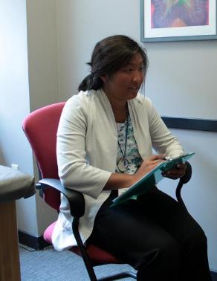
Defining Informal Assessment
-W-2 Manual, Chapter 5.2.1
“To gather information about an individual and his or her family to determine…”
Notes:
Trainer will need to click to bring up employment pictures when covering the first two bullets, then click again for the second two bullets (placement, career assessment). Two clicks total.

Slide 17
Conducting an Informal Assessment

Slide 18
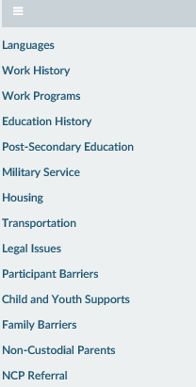
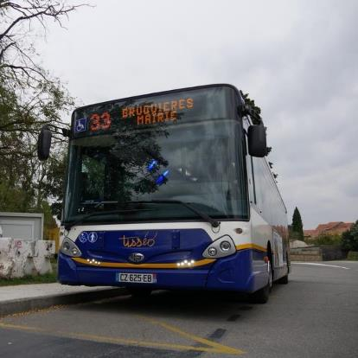
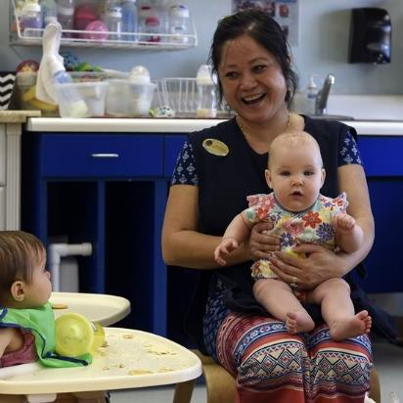
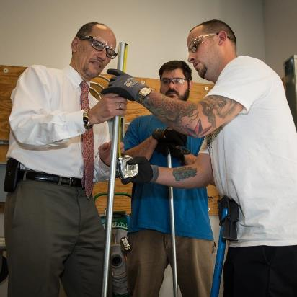
Informal Assessment Driver Flow
Work Programs
Housing
Child and youth supports
Family barriers
transportation
Education History
Ncp referral
Work history
Military service
Participant barriers
Non-custodial parents
Languages
Post-Secondary Education
Legal issues

Slide 19
Informal Assessment Driver Flow
Work Programs
Housing
Child and youth supports
Family barriers
transportation
Education History
Ncp referral
Work history
Military service
Participant barriers
Non-custodial parents
Languages
Post-Secondary Education
Legal issues

Slide 20
Informal Assessment Inventory

Slide 21
By conversations with participants and reviewing formal assessment results
Other needs or barriers identified by the participant that impedes his or her ability to participation in W-2 activities or find and retain a job
Do you know the total amount of your monthly income and expenses?
Household budgeting/money management strategies
Informal Assessment Inventory Jeopardy
Reviewing participants’ resume, and past employment responsibilities
Reviewing logs for W-2 or other work programs (FSET, Unemployment), asking about recent applications/interviews
By conversations with participants and reviewing formal assessment results
Do you know the total amount of your monthly income and expenses?
When you have a problem, who is the first person you call?
Who has been supportive when you’ve needed help in the past?
When you have a problem, who is the first person you call?
Who has been supportive when you’ve needed help in the past?
Access to social supports
Do you feel safe where you are living?
Do your kids like their school?
Do you feel safe where you are living?
Do your kids like their school?
Current neighborhood environment and schools
What steps have you taken to get to where you want to be?
Hint: Think SMART
What steps have you taken to get to where you want to be?
Hint: Think SMART
Personal strengths, interests, and goals
Which of your previous job duties did you enjoy most? Why?
Which of your previous job duties did you enjoy least? Why?
Which of your previous job duties did you enjoy most? Why?
Which of your previous job duties did you enjoy least? Why?
Job skills
Job Readiness Page
Job Readiness Page
Job readiness
Used to create Employability Plan, results scanned into ECF, Career Assessment page in WWP
Used to create Employability Plan, results scanned into ECF, Career Assessment page in WWP
Results from career assessments
Logs scanned into ECF
Logs scanned into ECF
Recent job search efforts
PIN Comments for non-confidential information, Notes/Details on confidential pages in WWP
PIN Comments for non-confidential information, Notes/Details on confidential pages in WWP
Other needs or barriers
Second page of the EP driver flow, various Informal Assessments pages
Second page of the EP driver flow, various Informal Assessments pages
Personal strengths, interests, and goals
Prompts regarding preferred shifts, travel distance, required documents, social media, and more
By using agency specific tools such as ONET, Career Locker, Xello, WisCareers, Traitify, and JIST
Results from Career Assessment that evaluate work styles, skills, and interests
Reviewing logs for W-2 or other work programs (FSET, Unemployment), asking about recent applications/interviews
Recent job search efforts
Reviewing participants’ resume, and past employment responsibilities
Job skills (including transferable skills)
Prompts regarding preferred shifts, travel distance, required documents, social media, and more
Job readiness (including work preferences, history, applications, interviews, and contacts)
By using agency specific tools such as ONET, Career Locker, Xello, WisCareers, Traitify, and JIST
How do I get that?
Q & A
Write that down
200
200
200
400
400
400
600
600
600
800
800
800
1,000
1,000
1,000

Slide 22
Career Assessment & Job Readiness Pages

Slide 23
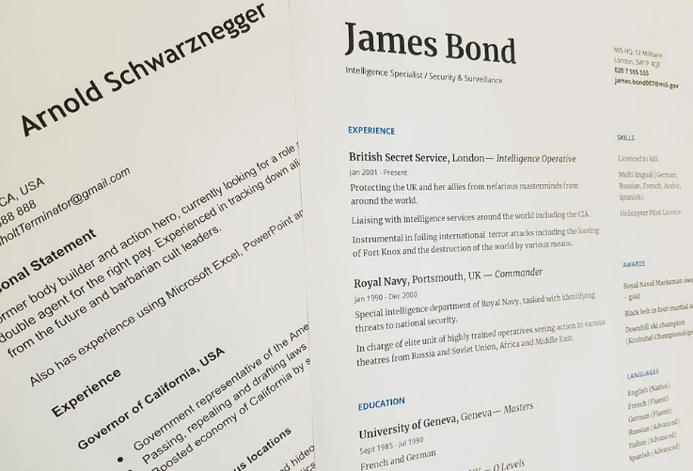
Job Readiness Page
Work Preferences Questions
History Questions
Application Questions
Interview Questions
Contact Questions

Slide 24
Top 3 Takeaways

Slide 25
Name | Agency | There are now 25 hours in a day! How do you spend your extra hour?

Slide 26
W-2 Case Management:
Assessment and Employability Plans

Slide 27
Case Management Process Model
F O L L O W U P
U
__ __ __ __ __ __ – __ __
A S S E S S M E N T
S
__ __ __ __ __ __ __ __ __ __
H
C O N N E C T I N G W I T H R E S O U R C E S
T
O
__ __ __ __ __ __ __ __ __ __
__ __ __ __
__ __ __ __ __ __ __ __ __
D O C U M E N T I N G
C
__ __ __ __ __ __ __ __ __ __ __
L
P L A N N I N G
__ __ __ __ __ __ __ __

Slide 28
Informal Assessment Driver Flow
N
R
N C P R E F E R R A L
__ __ __
__ __ __ __ __ __ __ __
N
H O U S I N G
__ __ __ __ __ __ __
T R A N S P O R T A T I O N
P
__ __ __ __ __ __ __ __ __ __ __ __ __ __
K
W O R K H I S T O R Y
__ __ __ __
Y
__ __ __ __ __ __ __
T
P A R T I C I P A N T B A R R I E R S
__ __ __ __ __ __ __ __ __ __ __
A
__ __ __ __ __ __ __ __

Slide 29
The BEST Approach
B
alance
E
xploration
S
ensitivity
T
rust

Slide 30
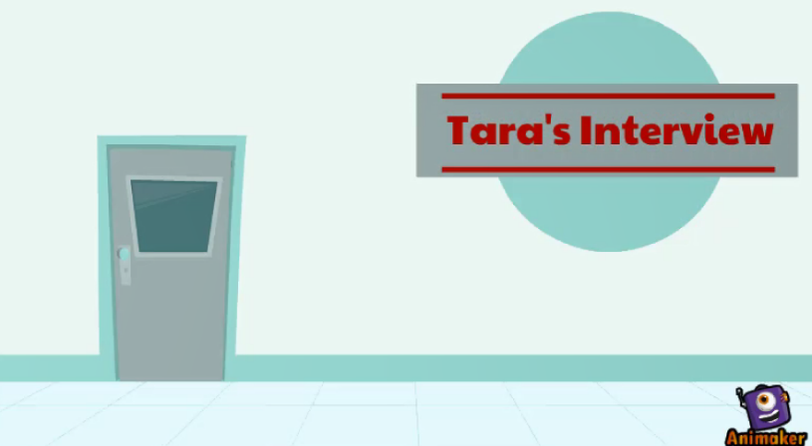
Conversational Interview

Slide 31
Activity – River of Jobs
What to Include:
Paid Employment
Volunteer employment/activities
Education - Post HS, certificate programs, trainings, etc.
Life happenings - marriage, divorce, children, births, deaths
Assessments completed

Slide 32
2000-2003: Waitressed at my parents' restaurant.
2004: Graduated High School. Started college at UWSP.
2006: Graduated college. Receptionist at Dental Office.
2008: Got married. Assistant at High School.
2010: Economic Support Specialist at county.
2009: Had baby.
2012: Left employer to care for child with chronic disease.
2015: W-2 Case Manager for WRI.

Slide 33
Formal Assessment
What is the purpose
When to offer
How to use
Where to document

Slide 34
Accommodations

Slide 35
Askjan.org

Slide 36
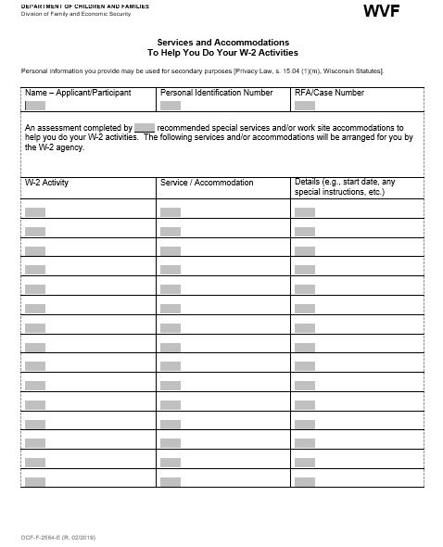
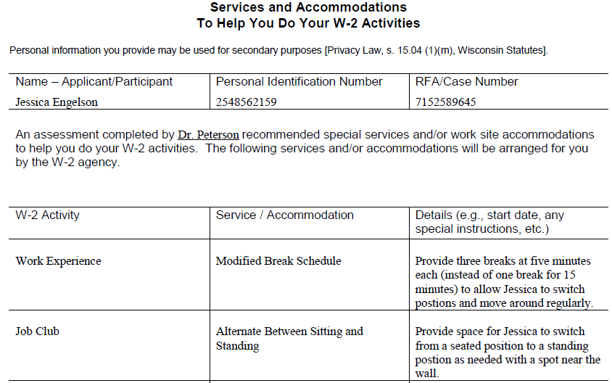
Documenting Accommodations

Slide 37
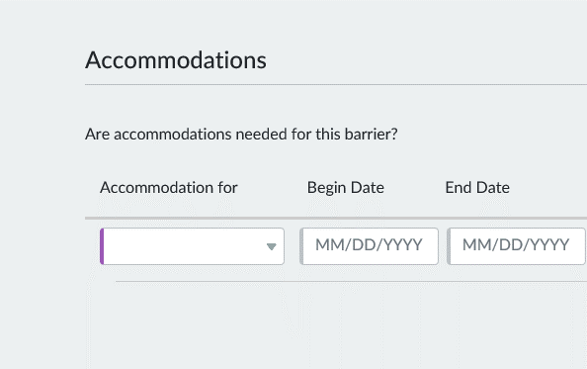
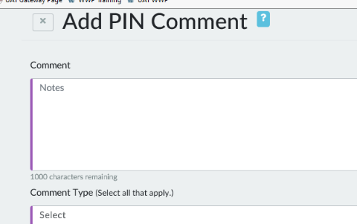
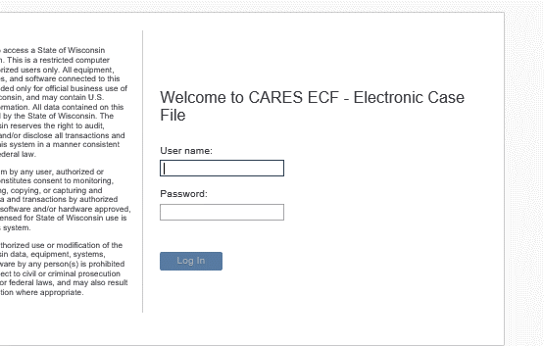
Documenting Accommodations

Slide 38
Participation Statuses
CD
CF
EC
EI
FA
SD
Marigold
Billie
Shana
Teena

Slide 40
Assessment: Putting it Together
process
solution
Assessment is a ____________ not a ___________.
case
management
Assessment should impact ___________ ________________.
formal
informal
W-2 policy requires ___________ and _______________ assessments.
interrogation
Informal assessment is not an ________________.
engages
Good informal assessment ____________ the participant.
information
The end product of assessment is ______________.
form
Assessment is more than what is on a _______.

Slide 41
Assessment: Putting it Together
need
Assessment should be done when there is a _______ for ______________.
information
document
Always ____________ the difference that assessment results make in case management.
Assessment is ___________.
ongoing
sanctioned
The participant cannot be _____________ for failing to cooperate with a formal assessment.
The success of assessment is not just getting the information, but what you ________ with the information.
do

Slide 42
Top 10 List
Remember!

Slide 43
Name | Agency | You just won the lottery! What is the first thing you would buy?

Slide 44
W-2 Case Management:
Assessment and Employability Plans

Slide 45
Reviewing Assessments

Slide 46
Goal Setting

Slide 47
SMART Goals
Specific
Measurable
Attainable
Relevant
Time Based

Slide 48
Goals in the W-2 Program
Primary & Secondary Employment
Personal
Other Program
Long Term Career
Walk 30 minutes 3 times/wk
LPN Certification
Become an RN
Bank Teller
Save $10/wk toward a car
Obtain HSED
Accountant
Apartment Manager
Read 20 minutes each night
Cook a vegan meal one night weekly
Welder
Forklift Certification
Own an auto repair business
Complete sleep study

Slide 49
Goal Steps
Goal Name: Activities Assistant
Goal Description: Participant enjoys doing activities with her current client and would like to explore other part-time opportunities in this field. She thinks working as an Activities Assistant in an Assisted Living or Nursing Home Facility would be a good fit.

Slide 50
Setting Goals with Arya

Slide 51
Employments

Slide 52
Engagement in Activities

Slide 53
Activities
Apply for 5 jobs a week.
NWSCA Food Shelf
422 3rd St West
Ashland, WI 54806
715-685-9493
Tuesday, Thursday
3.5 Hours Per Day
Begin Time 8:30am
End Time 12:00pm
Remember to sign in to get credit for attending.
Remember to bring updated resume with you and dress professionally, because employers do attend.
Complete independent job search. Focus search on positions in an office setting within a 10-mile radius.
Food Pantry
Tuesday, Thursday
3.5 Hours Per Day

Slide 54
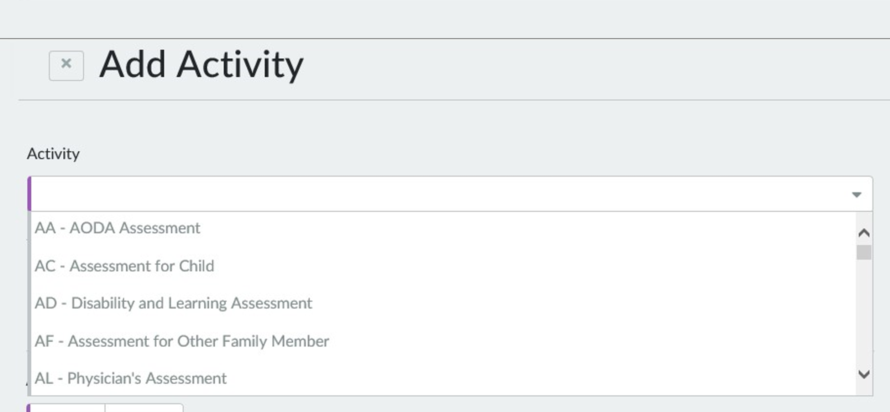
Activity Codes
AA
AD
AL
AM
AV
AC
AF

Slide 55
Analyzing Activities
Notes:
After the initial introduction for this activity, click for directions to appear on the screen for the learners to follow as they complete this activity.

Slide 56
A
BE
GE
HE
B
ES
JS
WE
D
LF
PA
PD
CA
CM
FC
C

Slide 57
BE
GE
HE
ES
JS
WE
CA
CM
FC
LF
PA
PD

Slide 58
 | BE | GE | HE
Complete classes and study time to increase math skills in preparation for tech school placement exam.
Complete classes and study time to prepare for high school equivalency exams.
Complete classes and study time to prepare for a general education certificate.
X
X
X

Slide 59
BE
GE
HE
ES
JS
WE
CA
CM
FC
LF
PA
PD

Slide 60
 | CA | CM | FC
Attend joint counseling sessions with your daughter.
Attend counseling appointments for continued addiction recovery.
Attend counseling appointments to work on coping strategies for general life challenges.
X
X
X

Slide 61
BE
GE
HE
ES
JS
WE
CA
CM
FC
LF
PA
PD

Slide 62
 | ES | JS | WE
Gain data entry skills by participating in work training at a local business.
Gain data entry skills by completing the training certification program.
Connect with local employers in the data entry field to learn about and apply for job openings.
X
X
X

Slide 63
BE
GE
HE
ES
JS
WE
CA
CM
FC
LF
PA
PD

Slide 64
 | LF | PA | PD
Use the tools on myplate.gov to complete a weekly meal plan that focuses on nutritious dinners for the whole family.
Use the tools on myplate.gov to create a personalized food plan to help you lose weight.
Attend the Establishing Healthy Eating Routines by Using MyPlate workshop.
X
X
X

Slide 65
E
CE
JR
MO
F
JS
TC TT
H
CC DR HR
MP
PD
PR
G

Slide 66
JS TC TT
CE JR MO
MP PDPR
CC DR HR

Slide 67
 | JS | TC | TT
Attend administrative professional classes at the local technical college.
Complete study time for assigned classes.
Attend CNA classes at the local technical college.
X
X
X

Slide 68
JS TC TT
CE JR MO
MP PDPR
CC DR HR

Slide 69
 | MP | PD | PR
Go to the YMCA three times a week to partake in fitness classes of your choosing
Attend monthly appointments with doctor to manage chronic pain.
Complete aquatic therapy at the YMCA two times per week with physical therapist.
X
X
X

Slide 70
JS TC TT
CE JR MO
MP PDPR
CC DR HR

Slide 71
 | CE | JR | MO
Meet with the HR Director at Kohler to complete an informational interview.
Attend weekly appointment with Job Developer to create resume and develop interview skills.
Touchbase with W-2 Case Manager on Wednesdays at 4pm to discuss employment.
X
X
X

Slide 72
JS TC TT
CE JR MO
MP PDPR
CC DR HR

Slide 73
 | CC | DR | HR
Use YoungStar to research childcare facilities near your home.
Complete online driver’s education class through justdrivewi.com.
Apply for housing assistance to help get a place of your own.
X
X
X

Slide 74
Analyzing Activities
Notes:
After the initial introduction for this activity, click for directions to appear on the screen for the learners to follow as they complete this activity.

Slide 75
Supportive Services

Slide 76
PTT
Training
Employability Plans
Goal Setting
WWP
Team
Trainers

Slide 77
Name | Agency | You just won a cruise to go anywhere in the world! Where would you go?

Slide 78
W-2 Case Management:
Assessment and Employability Plans

Slide 79
Arya’s Activities

Slide 80
Employability Plan Truths:

Slide 81
Employability Plans ARE:
Reviewed frequently
Coordinated with other plans
Printed for the participant
Required (for most W-2 cases)
For the participant
Updatable at any time
Steps toward goals
Developed WITH participant
Different for each participant
Reflection of assessment and goals

Slide 82
Keys with EPs
Consider Other Case Plans
Keep it Current/Keep it Fresh
Print & Give to Participant
Purpose
Be a partner
Personalize
Outcome Based

Slide 83
PIN Comments
Third Party Contacts
Appointment – EP Review
General
Missed Appointment
Good Cause Determination
Participation Tracking
Non-Health Barrier
Time-Limits/ Extensions
Informal Assessment
Appointment – Other
Employability Plan/Activity Assignment
Overpayments/ Auxiliary Payments
Attempted Contact
Participation Tracking
Working with Partner Agencies
Fraud
Employment
Phone Contact
Placement Decision
Performance Claims

Slide 84
Comment Type: Placement Decision, Informal Assessment, Non-Health Barriers
Marques

Slide 85
Comment Type: Working with Partner Agencies, Employability Plan/Activity Assignment – EP Review
Charity

Slide 86
Comment Type: Phone Contact, Good Cause Determination
Jema

Slide 87
Arya Updates

Slide 88
Wrap up summary
Assessment begins at application.
Use assessment information when setting goals and developing Employability Plans.
Documentation of case management actions is critical to evaluating success.
Re-evaluate goals and activities as appropriate.

Slide 89
Name | Takeaway

