Slide 1
WWP Updates: Participation Calendar Enhancements
DFES/Partner Training Team
10/11/2022

Slide 2
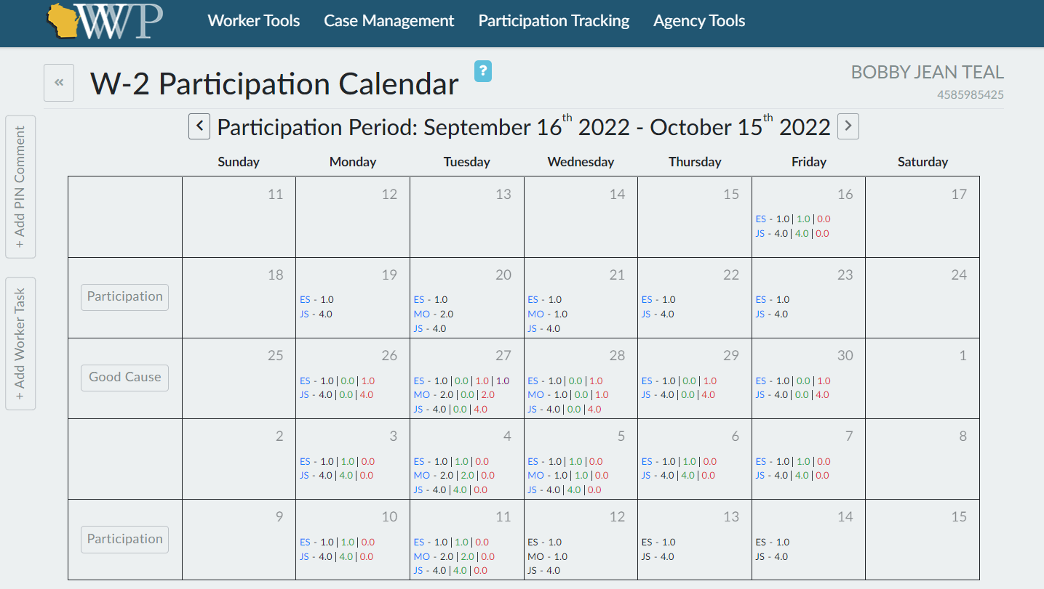

Slide 3
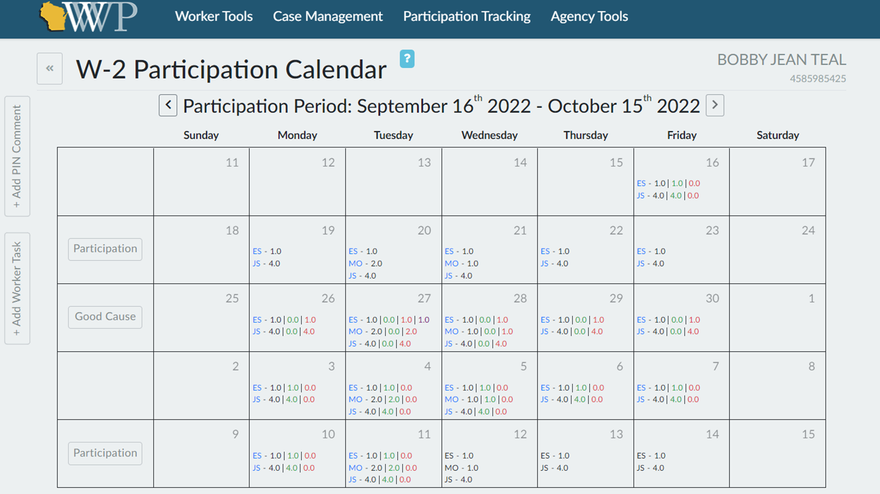

Slide 4
