Slide 1
Human Trafficking: Seeking Help
Notes:
Heading: Introduction to Human Trafficking
Narration_1: Welcome to Introduction to Human Trafficking. My name is Frankie. This course introduces you to human trafficking and the different types of human trafficking that occur.
Text: N/A
Graphics: N/A
Animation: N/A
Interaction/Activities: N/A
Sound Effects: N/A

Slide 2
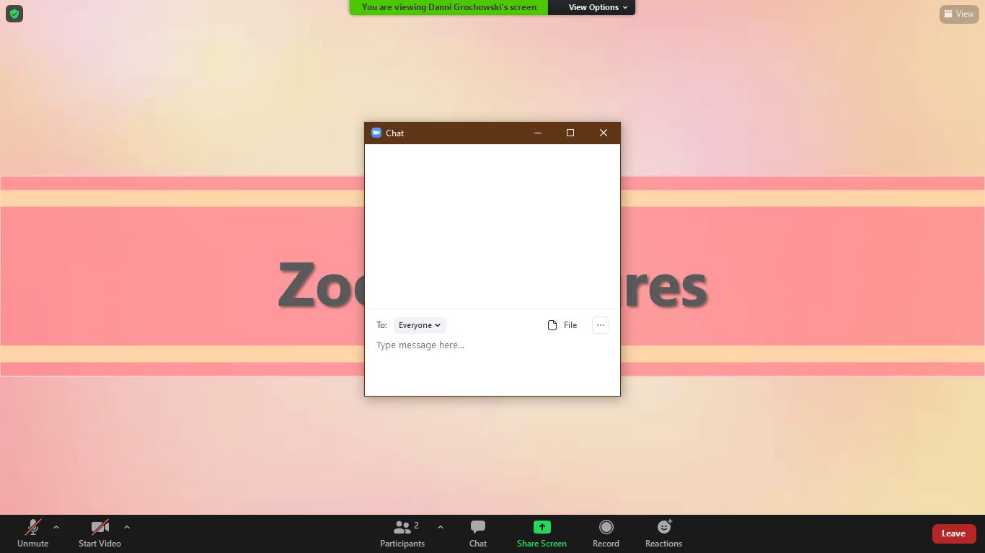
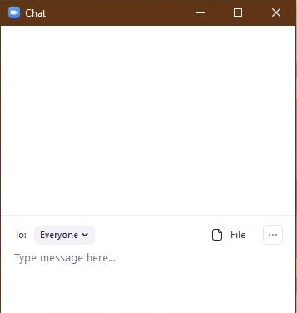
Using Zoom: Chat

Slide 3
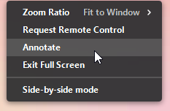
Using Zoom: Annotations

Slide 4
Only women and girls can be victims of human trafficking.
Anyone can be a victim of human trafficking.
Fact
Myth

Slide 5
There must be elements of physical restraint, force, or bondage to be considered trafficking.
A trafficker may use only psychological means to control a victim.
Fact
Myth

Slide 6
Trafficking victims will immediately ask for help, and let people know they are a victim.
Trafficking victims often do not seek immediate help.
Fact
Myth

Slide 7
Violence
Violence is used to ____ _____ over victims.
gain control
Eventually, the repeated violence _____ _____ victims into _________.
breaks down
compliance

Slide 8
Fear
Fear can be ____ or ________ .
real
perceived

Slide 9
Systems Victims Encounter

Slide 10
Fear of…
People they ____ and ____.
_________ or other legal action.
know
Deportation
love
The ________.
Losing _______.
traffickers
children

Slide 11
Psychological Manipulation
fight-flight-freeze
Your body’s _____________ response is triggered by __________ fears.
psychological
Develop an ________ _________ to the traffickers.
emotional
attachment

Slide 12
Psychological Manipulation
_________ is a practice used to manipulate someone by psychological means so they question their own sanity.
Victims ultimately become _________ on the traffickers.
Gaslighting
dependent

Slide 13
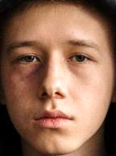
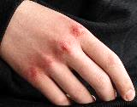
Indicators
Eye contact
Tattoos
Afraid to speak
Stereotypical clothing
Lack of concentration

Slide 14
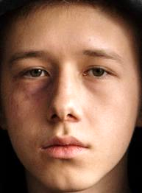
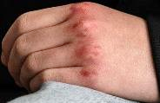

Slide 15
Indicator:
Few or No Personal Possessions
Must Meet Daily Quotas
Not Allowed to Speak for Themselves
Not Free to Come/Go at Will
Unusually Fearful/Anxious
Not Allowed Breaks
Frequent Bruises
Malnourishment
Poor Hygiene
Not Paid Directly
Working Conditions
Living Conditions
Mental/ Physical Health

Slide 16
Basics of Questioning
Safe Office Environment
Safe Participant Environment
Open-Ended Questions

Slide 17
Questions to ask
Do you have friends or family to talk with about anything you are dealing with?
Tell me about a day in your life, tell me about your (yesterday, weekday, weekend).
Tell me about the relationships with people whom you live.
Tell me about things you do outside of your home.
Tell me about your living arrangement.
Are you safe?

Slide 18
What would you do?
Asia’s Cues/Indicators

Slide 19
Human Trafficking Series
Helping Victims
Risk Factors
Seeking Help
What It Is
Trafficking vs. Smuggling
Types of Trafficking
Notes:
Heading: Human Trafficking
Narration_31: This course is an introductory overview to the complex issue of human trafficking. Knowing what human trafficking is, the difference between trafficking and smuggling, and the different types of human trafficking serves as a foundation to build from. The next part in our human trafficking series are webinars that dive deeper into the risk factors, why victims are hesitant to seek help, and finally helping victims of human trafficking. Each webinar builds on this foundation and provides you with case management strategies.
Text: What it is, Trafficking vs. Smuggling, Types of Trafficking, Risk Factors, Seeking Help, Helping Victims
Graphics: “building blocks” labeled what it is, trafficking vs. smuggling, types of trafficking, risk factors, seeking help, helping victims
Animation: Each block appears as it is said in the narration.
Interaction/Activities: N/A
Sound Effects: N/A

Slide 20
Additional Training
Damascus Road
Ending the Game (Sowers Education Group)
Exploit No More
UMOS
University of Wisconsin – Madison Continuing Studies
Wisconsin Department of Children and Families (DCF)
5 Stones
Notes:
Heading: Additional Training
Narration_32: You don’t have to wait to start building on this foundation. Throughout Wisconsin, there are a variety of additional trainings available on human trafficking and how to help victims. Click on each link for more information. These additional trainings also are in your Participant Guide. You can also start collaborating with the resources available in your community.
Text: Damascus Road, Ending the Game (Sowers Education Group), Exploit No More, UMOS, University of Wisconsin – Madison Continuing Studies, Wisconsin Department of Children and Families (DCF), 5 Stones
Graphics: N/A
Animation: N/A
Interaction/Activities: Each resource will be hyperlinked to navigate to that resource’s page.
Sound Effects: N/A

