Slide 1
Human Trafficking: Risk Factors
Notes:
Heading: Introduction to Human Trafficking
Narration_1: Welcome to Introduction to Human Trafficking. My name is Frankie. This course introduces you to human trafficking and the different types of human trafficking that occur.
Text: N/A
Graphics: N/A
Animation: N/A
Interaction/Activities: N/A
Sound Effects: N/A

Slide 2
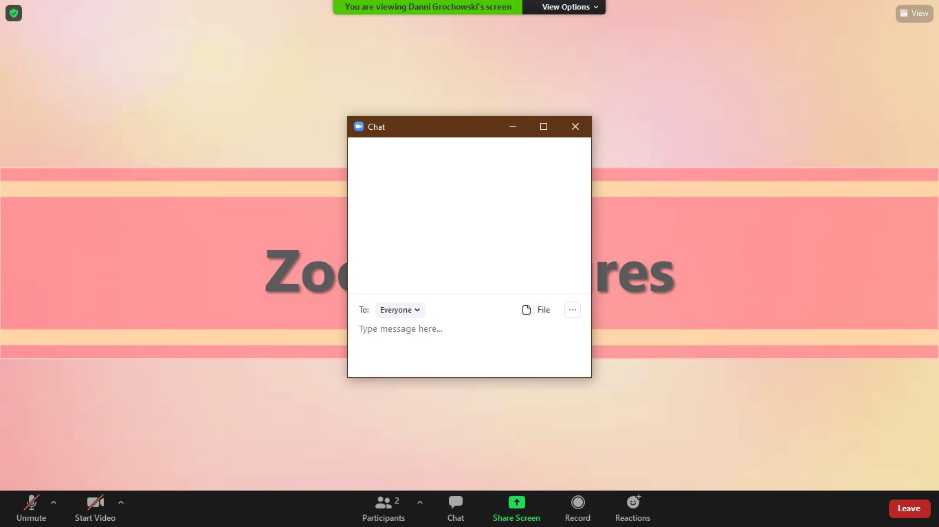
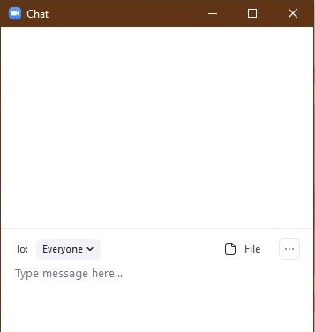
Using Zoom: Chat

Slide 3
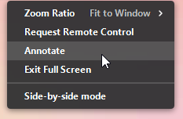
Using Zoom: Annotations

Slide 4
Two categories of Human Trafficking: sex trafficking and labor trafficking
All human trafficking involves a commercial sex act.
Fact
Myth

Slide 5
Traffickers only target victims they don’t know.
Victims’ partners and family could be traffickers.
Fact
Myth

Slide 6
Trafficking victims always come from poverty or small rural communities.
Come from all income and socioeconomic levels
Fact
Myth

Slide 7
Risk Factors
What factors do you believe puts individuals at risk?

Slide 8
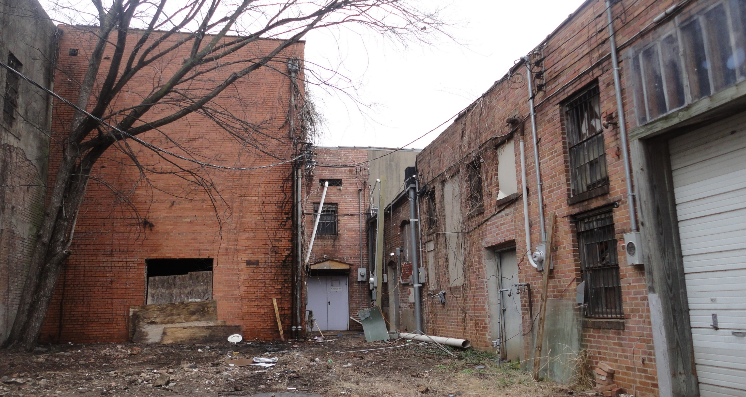
Risk Factor: Poor Neighborhoods

Slide 9
Risk Factor: Abusive Homes

Slide 10
Risk Factor:
Mental Health Disorders/Concerns
Substance Use/
Abuse
Lack of Social Safety Net
Recent Migration/ Relocation
Unemployment
Social Inequality
Sexual Abuse
Homelessness
High Crime Areas
Domestic Abuse
Economic
Social
Psychological

Slide 11
Luring Victims
Pretender
Provider
Promiser
Protector
Punisher

Slide 12
The Pretender
A trafficker who ________ to be someone ____ ___ ___.
Lures victims by being a ______ _________.
pretends
they are not
trusted
companion

Slide 13
The Provider
A trafficker who offers to ____ ____ of a victims’ _____.
Providers can ________ victims who are in dire need.
take
care
needs
recognize

Slide 14
The Promiser
A trafficker who _______ victims vast and extravagant things.
Promisers lure victims by giving __________ they never thought they would have.
promises
opportunities

Slide 15
The Protector
A trafficker who uses physical _____ and intimidation to ______ a victim.
Protectors lure victims with a _____ of ______.
power
protect
sense security

Slide 16
The Punisher
A trafficker who uses threats and ______ to ______ a victim.
This is a ___ resort for traffickers.
violence
control
last

Slide 17
Identifying the Persona

Slide 18
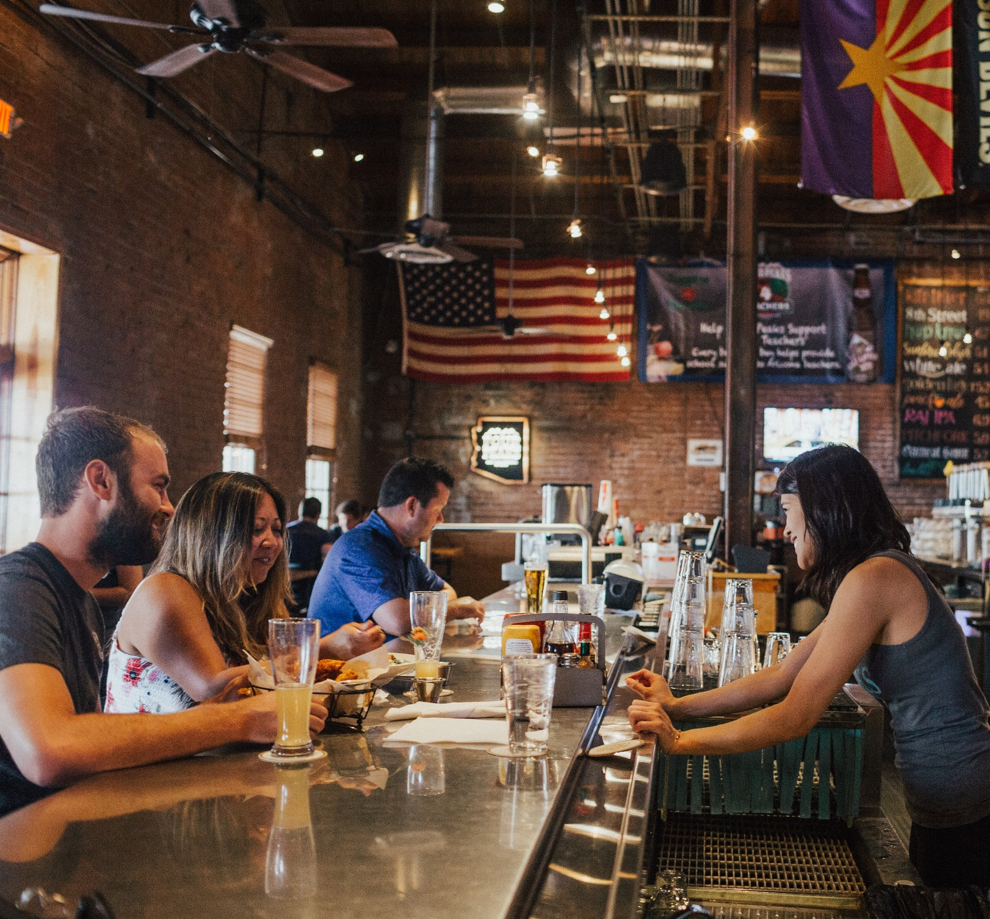
Targeting Individuals

Slide 19
What would you do?
Asia’s Risk Factors

Slide 20
Human Trafficking Series
Helping Victims
Risk Factors
Seeking Help
What It Is
Trafficking vs. Smuggling
Types of Trafficking
Notes:
Heading: Human Trafficking
Narration_31: This course is an introductory overview to the complex issue of human trafficking. Knowing what human trafficking is, the difference between trafficking and smuggling, and the different types of human trafficking serves as a foundation to build from. The next part in our human trafficking series are webinars that dive deeper into the risk factors, why victims are hesitant to seek help, and finally helping victims of human trafficking. Each webinar builds on this foundation and provides you with case management strategies.
Text: What it is, Trafficking vs. Smuggling, Types of Trafficking, Risk Factors, Seeking Help, Helping Victims
Graphics: “building blocks” labeled what it is, trafficking vs. smuggling, types of trafficking, risk factors, seeking help, helping victims
Animation: Each block appears as it is said in the narration.
Interaction/Activities: N/A
Sound Effects: N/A

Slide 21
Additional Training
Damascus Road
Ending the Game (Sowers Education Group)
Exploit No More
UMOS
University of Wisconsin – Madison Continuing Studies
Wisconsin Department of Children and Families (DCF)
5 Stones
Notes:
Heading: Additional Training
Narration_32: You don’t have to wait to start building on this foundation. Throughout Wisconsin, there are a variety of additional trainings available on human trafficking and how to help victims. Click on each link for more information. These additional trainings also are in your Participant Guide. You can also start collaborating with the resources available in your community.
Text: Damascus Road, Ending the Game (Sowers Education Group), Exploit No More, UMOS, University of Wisconsin – Madison Continuing Studies, Wisconsin Department of Children and Families (DCF), 5 Stones
Graphics: N/A
Animation: N/A
Interaction/Activities: Each resource will be hyperlinked to navigate to that resource’s page.
Sound Effects: N/A

