Slide 1
Human Trafficking: Helping Victims

Slide 2
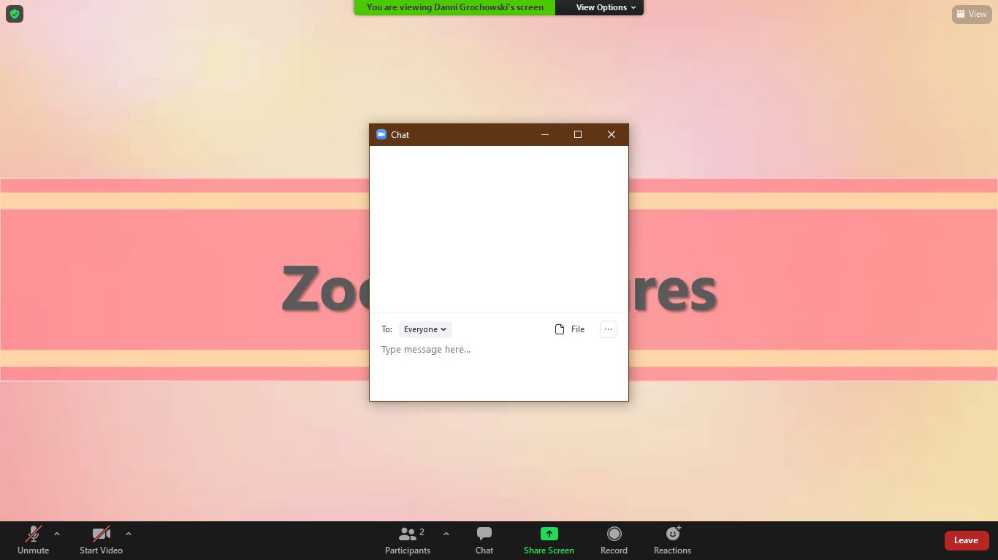
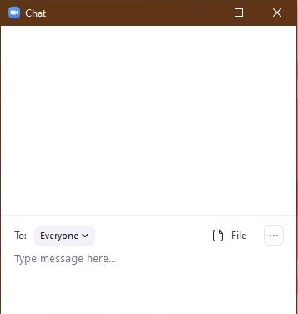
Using Zoom: Chat

Slide 3
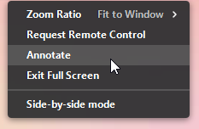
Using Zoom: Annotations

Slide 4
Human trafficking occurs only in illegal underground industries.
Human trafficking can occur in a variety of legal industries.
Fact
Myth

Slide 5
Educating yourself and alerting authorities when appropriate helps combat trafficking.
There is nothing I can do to stop human trafficking.
Fact
Myth

Slide 6
Survivors of human trafficking experience immediate relief after being rescued.
For some survivors, being rescued is extremely traumatic.
Fact
Myth

Slide 7
Develop a Plan

Slide 8
National Resources
NATIONAL HUMAN TRAFFICKING HOTLINE

Slide 9
NATIONAL HUMAN TRAFFICKING HOTLINE

Slide 10
National Resources

Slide 11
Community Resources

Slide 12
The Women’s Community, Inc.
Wausau, WI, 54401
Service Area: We serve anyone from the state but primarily in Central Wisconsin.
Click Here for Service and Referral Information

Slide 14
Agency Process

Slide 15
Disclosure Plan

Slide 16
Disclosure Plan
Imminent Danger
Call police
Non-Imminent Danger
Obtain consent

Slide 17
Disclosure Plan
Use straightforward language
Avoid labels
Prioritize confidentiality
Respect decision

Slide 18
Disclosure Plan
Document actions and communications
Services and law enforcement
Mindful of own safety
Report if necessary

Slide 19
Your Disclosure Plan

Slide 20
Trusting Environment
Trauma Informed
Give choice
Ask follow-ups

Slide 21
Ongoing Case Management

Slide 22
Ongoing Case Management

Slide 23
W-2 Activities
Safety Planning | LF - Life Skills
Housing | PD - Personal Development
Food | EL - English as a Second Language
Community Integration | HR - Housing Resources
Clothing | BE - Adult Basic Education
Legal Issues & Proceeding Support | MO - Job Readiness/Motivation
Health/Medical Care & Counseling | MP - Ongoing Medical/Personal Care
Basic Education | LA - Court-Related/Legal Appointments
ESL | CM - Mental Health Counseling
 | AL/AM - Physicians/Mental Health Assessments
 | LS – Literacy Skills

Slide 24
W-2 Activities
Safety Planning | LF - Life Skills
Housing | PD - Personal Development
Food | EL - English as a Second Language
Community Integration | HR - Housing Resources
Clothing | BE - Adult Basic Education
Legal Issues & Proceeding Support | MO - Job Readiness/Motivation
Health/Medical Care & Counseling | MP - Ongoing Medical/Personal Care
Basic Education | LA - Court-Related/Legal Appointments
ESL | CM - Mental Health Counseling
 | AL/AM - Physicians/Mental Health Assessments
 | LS – Literacy Skills

Slide 25
W-2 Activities
Safety Planning | LF - Life Skills
Housing | PD - Personal Development
Food | EL - English as a Second Language
Community Integration | HR - Housing Resources
Clothing | BE - Adult Basic Education
Legal Issues & Proceeding Support | MO - Job Readiness/Motivation
Health/Medical Care & Counseling | MP - Ongoing Medical/Personal Care
Basic Education | LA - Court-Related/Legal Appointments
ESL | CM - Mental Health Counseling
 | AL/AM - Physicians/Mental Health Assessments
 | LS – Literacy Skills

Slide 26
W-2 Activities
Safety Planning | LF - Life Skills
Housing | PD - Personal Development
Food | EL - English as a Second Language
Community Integration | HR - Housing Resources
Clothing | BE - Adult Basic Education
Legal Issues & Proceeding Support | MO - Job Readiness/Motivation
Health/Medical Care & Counseling | MP - Ongoing Medical/Personal Care
Basic Education | LA - Court-Related/Legal Appointments
ESL | CM - Mental Health Counseling
 | AL/AM - Physicians/Mental Health Assessments
 | LS – Literacy Skills

Slide 27
W-2 Activities
Safety Planning | LF - Life Skills
Housing | PD - Personal Development
Food | EL - English as a Second Language
Community Integration | HR - Housing Resources
Clothing | BE - Adult Basic Education
Legal Issues & Proceeding Support | MO - Job Readiness/Motivation
Health/Medical Care & Counseling | MP - Ongoing Medical/Personal Care
Basic Education | LA - Court-Related/Legal Appointments
ESL | CM - Mental Health Counseling
 | AL/AM - Physicians/Mental Health Assessments
 | LS – Literacy Skills

Slide 28
W-2 Activities
Safety Planning | LF - Life Skills
Housing | PD - Personal Development
Food | EL - English as a Second Language
Community Integration | HR - Housing Resources
Clothing | BE - Adult Basic Education
Legal Issues & Proceeding Support | MO - Job Readiness/Motivation
Health/Medical Care & Counseling | MP - Ongoing Medical/Personal Care
Basic Education | LA - Court-Related/Legal Appointments
ESL | CM - Mental Health Counseling
 | AL/AM - Physicians/Mental Health Assessments
 | LS – Literacy Skills

Slide 29
W-2 Activities
Safety Planning | LF - Life Skills
Housing | PD - Personal Development
Food | EL - English as a Second Language
Community Integration | HR - Housing Resources
Clothing | BE - Adult Basic Education
Legal Issues & Proceeding Support | MO - Job Readiness/Motivation
Health/Medical Care & Counseling | MP - Ongoing Medical/Personal Care
Basic Education | LA - Court-Related/Legal Appointments
ESL | CM - Mental Health Counseling
 | AL/AM - Physicians/Mental Health Assessments
 | LS – Literacy Skills

Slide 30
W-2 Activities
Safety Planning | LF - Life Skills
Housing | PD - Personal Development
Food | EL - English as a Second Language
Community Integration | HR - Housing Resources
Clothing | BE - Adult Basic Education
Legal Issues & Proceeding Support | MO - Job Readiness/Motivation
Health/Medical Care & Counseling | MP - Ongoing Medical/Personal Care
Basic Education | LA - Court-Related/Legal Appointments
ESL | CM - Mental Health Counseling
 | AL/AM - Physicians/Mental Health Assessments
 | LS – Literacy Skills

Slide 31
W-2 Activities
Safety Planning | LF - Life Skills
Housing | PD - Personal Development
Food | EL - English as a Second Language
Community Integration | HR - Housing Resources
Clothing | BE - Adult Basic Education
Legal Issues & Proceeding Support | MO - Job Readiness/Motivation
Health/Medical Care & Counseling | MP - Ongoing Medical/Personal Care
Basic Education | LA - Court-Related/Legal Appointments
ESL | CM - Mental Health Counseling
 | AL/AM - Physicians/Mental Health Assessments
 | LS – Literacy Skills

Slide 32
W-2 Activities
Safety Planning | LF - Life Skills
Housing | PD - Personal Development
Food | EL - English as a Second Language
Community Integration | HR - Housing Resources
Clothing | BE - Adult Basic Education
Legal Issues & Proceeding Support | MO - Job Readiness/Motivation
Health/Medical Care & Counseling | MP - Ongoing Medical/Personal Care
Basic Education | LA - Court-Related/Legal Appointments
ESL | CM - Mental Health Counseling
 | AL/AM - Physicians/Mental Health Assessments
 | LS – Literacy Skills

Slide 33
What would you do?
Asia’s scenario
How would you handle your appointments?
What initial steps might you take?
What ongoing case management tasks do you need to consider?

Slide 34
Human Trafficking Series
Helping Victims
Risk Factors
Seeking Help
What It Is
Trafficking vs. Smuggling
Types of Trafficking

Slide 35
Additional Training
Damascus Road
Ending the Game (Sowers Education Group)
Exploit No More
UMOS
University of Wisconsin – Madison Continuing Studies
Wisconsin Department of Children and Families (DCF)
5 Stones

