Slide 1
Case Management Strategies for Success:
Utilizing Assessment

Slide 2

Learning Objectives
1
Use assessments
Appraise progress
Support utilization through documentation

Slide 3

4
Describe your picture and put your pictures in the correct sequence. Do not show your picture to others.

Slide 4

5
Collection
Evaluation
Documentation
Action

Slide 5
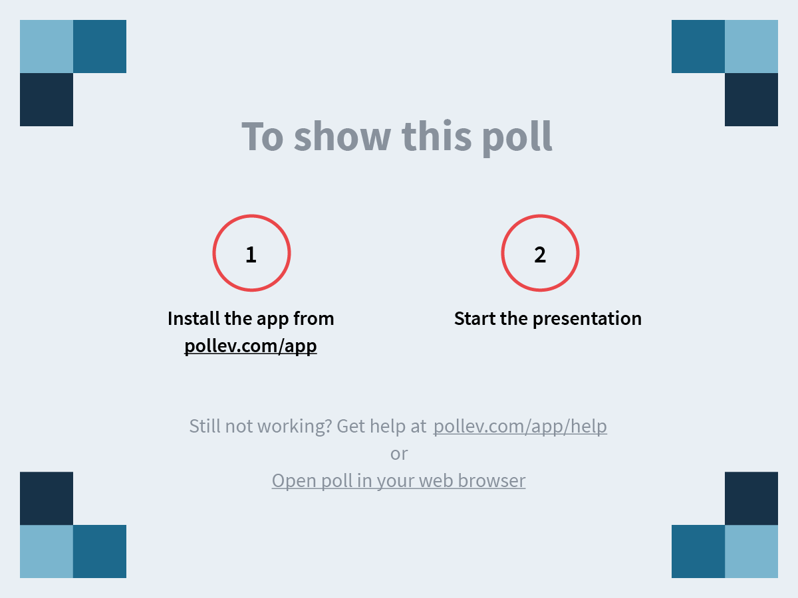
Notes:
How do you collect assessment information?
https://www.polleverywhere.com/free_text_polls/l3T9JtYJ25u5MHUq713i7

Slide 7



6
We interrupt this training for a message from WII-FM…
“Why do we need to do so many different types of assessments, isn’t the informal assessment enough? Completing all those assessments takes so much time, so what’s in it for me?” Assessments give a wealth of information, each assessment gives different types of information. By completing multiple assessments, you know what the participant is interested in, able to do, and what is needed to do it. This eliminates guessing what will work through trial and error, saving you time in the long run. Utilizing assessment also means the participant is more likely to be engaged and fully participating. Who doesn’t want to have less non-participation to enter and re-engagement calls to make?

Slide 8
7
Complete the matching activity in your Participant Guide.

Slide 9
7
Informal Assessment
Gathers information regarding a participant and their family
Formal Assessment
Establishes the extent, severity, and effect of any disability along with the need for services/accommodations
Vocational Evaluation
Assess a participant’s capacity to become employed and remain employed, establish realistic vocational goals, and develop a plan to achieve them
Work Styles
Assess a participants work personality (attitude, ethic, etc.)
Skills
Determines the skills a participant already has
Interests
Identifies careers that may fit a participant’s interests

Slide 10
8
Go to the flipchart paper with your assigned assessment. Record what you gather/gain from that assessment. When time is called, rotate and repeat.

Slide 11




Information gathered from...
8
Career
Informal
Formal
Vocational
...assessment

Slide 12

Utilizing Assessment Results
9
Why did we ask you to complete the Adult Learning Assessment?
As a W-2 worker, where/how can you utilize assessment results?

Slide 13
10
Review the scenario and assessment at your station. Answer the questions in your Participant Guide regarding that station. When time is called, rotate and repeat.

Slide 14
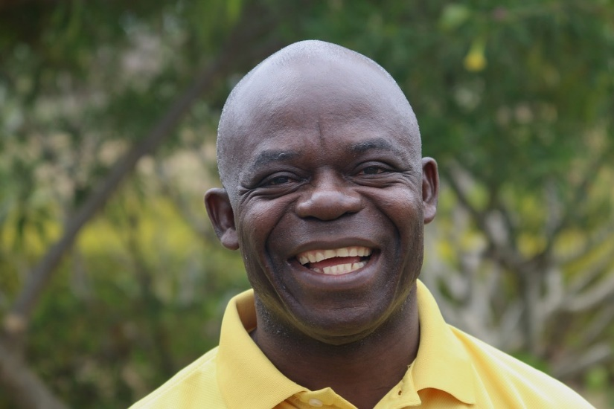




10
11
12
Cory
Fred
Darrin
Gail
Nicole

Slide 15
13
Assess your comfort level with each type of assessment. Develop an action plan to become more comfortable with the assessments you are not comfortable with.

Slide 16


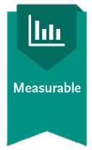
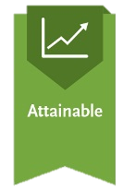
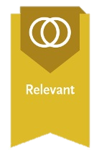

14

Slide 17

Accommodations
15
Other than assessments, how else do you identify accommodations?
Where do you document accommodations?

Slide 19
16
We interrupt this training for a message from WII-FM…
“Why do we need to evaluate assessment results? We need to incorporate them no matter what, so what’s the point?” There are many things that could’ve affected those results like having a bad day or didn’t sleep well. Taking them at face value, you could miss out. Time is precious, don’t waste it. It is crucial that you understand the results. If you don’t, having an expert help you evaluate them will allow you to gain more knowledge and knowledge is key.

Slide 20

Evaluation of Assessment
16
Evaluating results involves both the _____ and the ___________.
Understanding assessment results allows participants to _______ __________, not _______ __________.
FEP
participant
make choices
take
chances

Slide 21

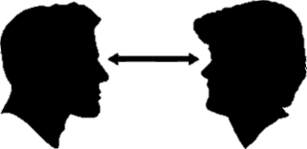

Documenting
17
Explanation
Collateral Contacts
Observations

Slide 22




Documentation
17
Helps in case transfers
Reduces errors
Supports determinations
Removes the mystery

Slide 24
19
We interrupt this training for a message from WII-FM…
“Why do we need to be documenting our rationale for incorporating the assessment results? Sure, policy requires it, but what is in it for me? I used the assessment results and plan on scanning them into ECF, why do I need to comment as well?” You both worked hard incorporating those results to make a plan to get to his/her goals. That is a lot of work, not to mention when you multiply it by your caseload! We don’t expect you to have superpowers and remember all that! By documenting, not only you can review it later, but a co-worker or supervisor can as well. This means they can cover for you when you take time off! As you mentioned, policy requires it. Following policy means happy monitors, happy monitors make for a happy agency which makes a happier life. The benefits to you really are endless!

Slide 25
19
Review your scenario again. Then record PIN comments describing how you incorporated the participant’s assessment.
Review the PIN comments and determine which scenario they belong to. Add any comments you feel are needed.

Slide 26



Appraise Progress
20
Reassess
Reevaluate
Reengage

Slide 27
20
Record your definition of Reassess, Reengage, and Revaluate.
Compare and contrast your definitions with a partner.
Find another pair and find the commonality between your definitions. Select one person to share your definitions with the group.

Slide 28
21
Judge picks card and reads scenario. Rest of group records response. Judge reads all responses, asks for clarification/elaboration as needed, picks a winner. Repeat until everyone has been the judge.

Slide 29

21
Assessing
Evaluating
Documentation
Reassessing

Slide 30
21
Document the action(s) you took for your card in the What Would You Do? activity by recording PIN comments in your Participant Guide.

Slide 32
22
We interrupt this training for a message from WII-FM…
“Of course I am trying to reassess and reengage participants, but if I can’t get ahold of them there is not much to say. I have a lot of participants on my caseload, why should I bother commenting every time someone doesn’t answer my phone calls or another appointment where no progress has been made? That time can be spent doing more important things, so what is in it for me?” We can understand where you are coming from, we know that time is precious! You are doing work to help change lives; you might as well take credit for it! Commenting leaves a trail to do this. By spending the minute or two up-front when you make the initial effort, you save yourself from having to explain your actions down the road when management or monitors want to know what is going on with the case. Commenting your attempts also provides a reminder for you when cases pop up on reports. Less time trying to remember what happened, means more time to do the great work you came to do!

Slide 33
Summary
22
ongoing
Assessment is ________ throughout the time participants are in W-2.
Results _____ to be _______ as part of ongoing case management.
As _____________ takes place, goals and activities are updated to ___________ the new information.
need
utilized
re-assessment
incorporate

Slide 34


23
Create your own
WII-FM broadcast for Participants:
< 1 minute
Benefit to them

Slide 35

Please complete your course evaluations before you leave!
DFES Partner Training Team
06/24/2021

