Slide 1
BEST in Action:
Focus on Assessment

Slide 2
Zoom
Don’t show your picture.
Describe your picture and put yourselves in order.

Slide 3
Zoom
Share your picture and reorder yourselves.

Slide 4
Zoom
Answer the questions in your Participant Guide.

Slide 5
Balance

Slide 6
Balancing Assessment Information
Consider the impact
Support or conflict prior information
Bring for further conversation

Slide 8
Applying Balance to Assessments
Review the summary.
Discuss the question.

Slide 9
Applying Balance to Assessments
Review the new information.
Discuss the questions.

Slide 10
Spotlight on…
Career Assessments

Slide 11
Closer Look…
Review the assessment.
Jot down
Potential careers,
What to look for/avoid, and
Follow-up questions.

Slide 12
Exploration

Slide 13
Compare and Contrast
Partner with Participants
Dig Deeper to Find Connection
Follow Up

Slide 15
Impact of Multiple Assessments
Review the informal and career assessment summaries.
Highlight key information.

Slide 16
Impact of Multiple Assessments
Review the new summary.
Discuss the impacts and follow up.

Slide 17
Impact of Multiple Assessments
Share your unique assessment.
Discuss the impacts and follow up.

Slide 18
Spotlight on…
Educational Needs Assessments

Slide 19
Date Tested | Content Area | Level | Test Location | Scale Score | SEM | NRS Level | MSG
Language, Mathematics, Reading

Slide 20
Date Tested | Content Area | Level | Test Location | Scale Score | SEM | NRS Level | MSG
L (Literacy), E (Easy), M (Medium)
D (Difficult), A (Advanced)

Slide 21
Date Tested | Content Area | Level | Test Location | Scale Score | SEM | NRS Level | MSG
300-800 = estimated grade level

Slide 22
Date Tested | Content Area | Level | Test Location | Scale Score | SEM | NRS Level | MSG
Estimated grade level: 1-6

Slide 23
Closer Look…
Review the scenario and assessment.
Discuss the questions.

Slide 24
Sensitivity

Slide 25
Sensitivity and Conflicting Assessments
Gently challenge
See from the participant’s perspective
Reinforce areas of agreement
Dig deeper into discrepancies

Slide 27
Navigating Results with Sensitivity
Review the case study.
Brainstorm strategies using Sensitivity.

Slide 28
Spotlight on…
Informal Assessment Inventory

Slide 29
Items
Personal strengths, interests, and goals
Job skills
Job readiness
Recent job search efforts
Results from career assessments
Current neighborhood environment and schools
Household budgeting/ money management
Access to social supports
Other needs or barriers

Slide 30
Closer Look…
Roll the die and answer the question for that item.

Slide 31
Trust

Slide 32
Follow Up
Shows you care
Using the assessment results
Follow through with commitments

Slide 34
Building on Trust
Review the scenario and Career Exploration Inventory.
Discuss the questions.

Slide 35
Building on Trust
Review the new information.
Brainstorm how it impacts your case management practices.

Slide 36
Pick your Spotlight
Mental Health Report
Medical Examination and Capacity

Slide 37
Spotlight on…
Mental Health

Slide 41
Closer Look…
Review the scenario and assessment.
Discuss the question.

Slide 42
Spotlight on…
Medical Examination and Capacity

Slide 44
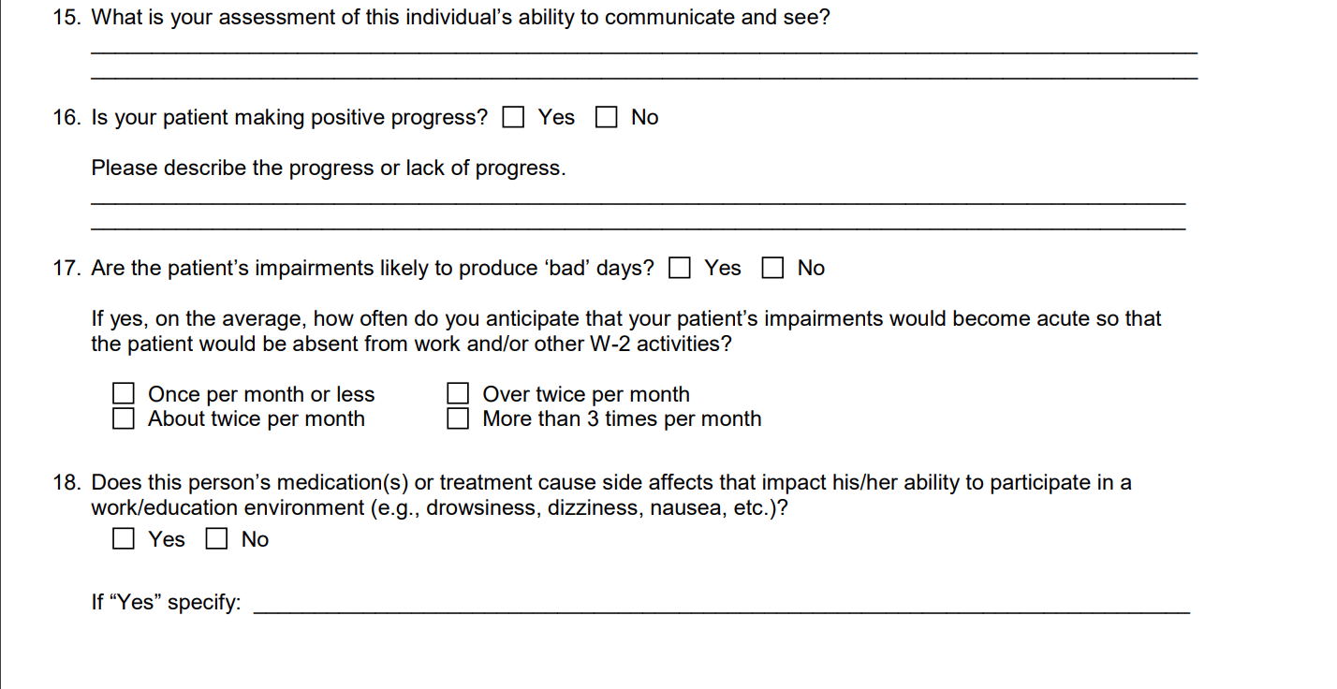

Slide 45
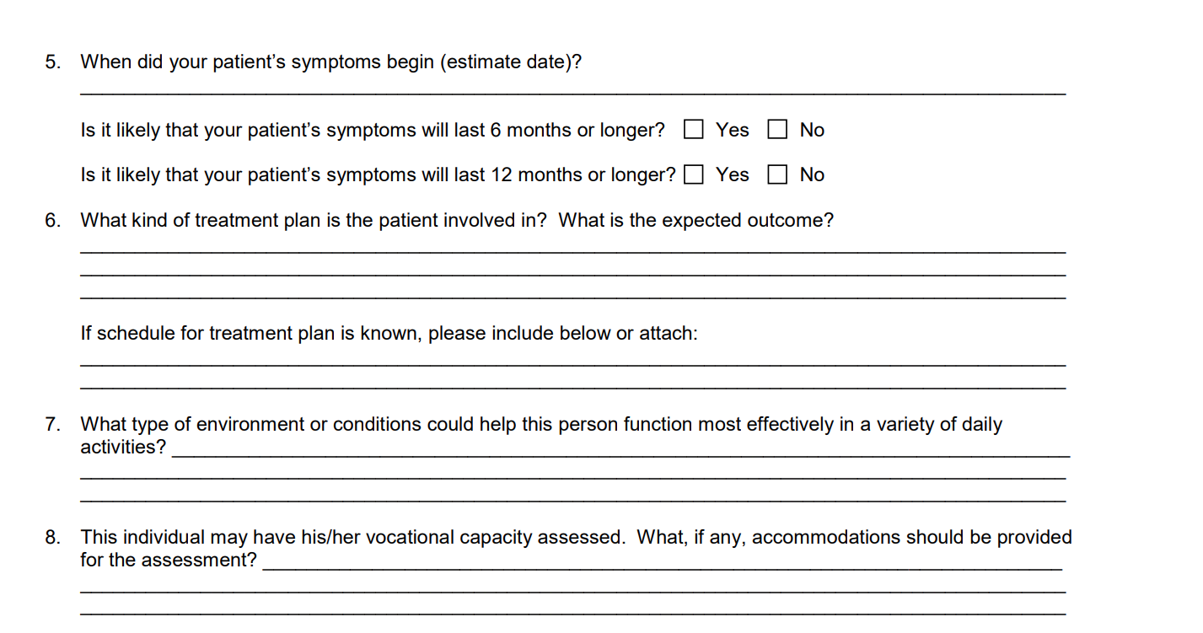

Slide 46
