Slide 1

John H. Chafee Foster Care Independence Program (CFCIP)/ Independent Living Program
Brooke Hobbs
Housing and Employment Coordinator
DCF/Bureau of Youth Services

Slide 2
John H. Chafee Foster Care Independence Program (CFCIP) Background
Federal funding source created under the passage of the Foster Care Independence Act of 1999
(Wisconsin receives approx. $2 million CFCIP funds and $700,000 Education and Training Voucher (ETV) funds annually)
Each state is required to develop a plan to meet each of the Chafee and ETV provisions

Slide 3
CFCIP Background Cont.
CFCIP Requires:
All youth likely to age out of OHC receive IL services
All youth who age out of care receive IL services up to their 21st birthday
Funding for postsecondary education
Data collection: National Youth in Transition Database outcomes and services
Young people participate directly in designing IL Programs and developing their goals, accepting personal responsibility for achieving independence
Provides option for states to:
Extend Medicaid for youth who age out of care (has since been required up to age 26 through Affordable Care Act)
Room and board assistance (for youth who age out)
Ability for youth to have trust fund up to $10,000

Slide 4
CFCIP Background Cont.
CFCIP Goals:
Help youth make the transition to self-sufficiency by providing the services needed to achieve goals;
Help youth receive the education, training and services necessary to obtain employment;
Provide personal and emotional support to those aging out of care;
Help youth prepare for and enter postsecondary training and education institutions;
Provide financial assistance for housing, counseling, health, transportation, employment and education to youth ages 18-21; and
Make available Education and Training Vouchers (ETV) for postsecondary education and training.

Slide 5
Use of CFCIP Funds
Housing
Emergency Funds
Job Training
Work Related Expenses
Education Expenses
Work Readiness
Stipends
Incentives
Transportation
Life Skills Instruction
Insurance
Security Deposits
Rent
Utilities
Groceries
Basic Necessities
Furniture and Appliances
Child Care
Mentoring
Personal Documents

Slide 6
Eligibility
Youth between ages 14 (and have attained 6 months in OHC) and 18 are eligible for County IL services
Youth who age out of care are eligible up to 21st birthday* for IL TRA services, Room & Board* and ETV/DCF Scholarship (ETV/DCF funds can be extended to age 23 if participating on their 21st birthday)
Youth who enter Guardianship or Adoption from OHC after their 16th birthday are eligible up to their 21st birthday*
Badger Care Plus for Youth who age out of care up to their 26th birthday (due to ACA*)
*Federal requirements

Slide 7
Service Responsibility
IL Life Skills development ages 14+ while in OHC (includes extended care) responsibility is with:
71 Counties
3 Tribes
Division of Milwaukee Child Protective Services
Division of Juvenile Corrections
Activities required while in OHC (learning by doing):
Life skills assessment and development opportunities related to:
Home upkeep and maintenance
Academic assistance to complete H.S.
Work readiness
Career exploration/planning
Employment assistance/maintenance
Budgeting and financial planning
Health/Medical
Healthy marriage
Postsecondary education planning
Identification and development of life long permanent connections
Securing needed documents for independence

Slide 8
Service Responsibility Cont.
Direct Service Responsibility ages 18-21 no longer in OHC is with:
Transition Resource Agencies (In 7 Wisconsin regions)
Regions 2 and 6 began January 2016 (BAWDB and FCC)
Regions 1,5 and 7 began January 2017 (Wood Co., WDB of South Central & WRI)
Regions 3 and 4 begin January 2018
Services for Youth 18-21:
Life skills instruction
Mentoring
Safe and stable housing, home upkeep and maintenance
Identified income/employment/career planning
Health and medical
Secondary education completion and postsecondary enrollment and completion
Budgeting and financial planning
Employment training and work support
Healthy marriage
Resource and referral
Life long connections to caring adults
ETV Funds and/or DCF Scholarship

Slide 9
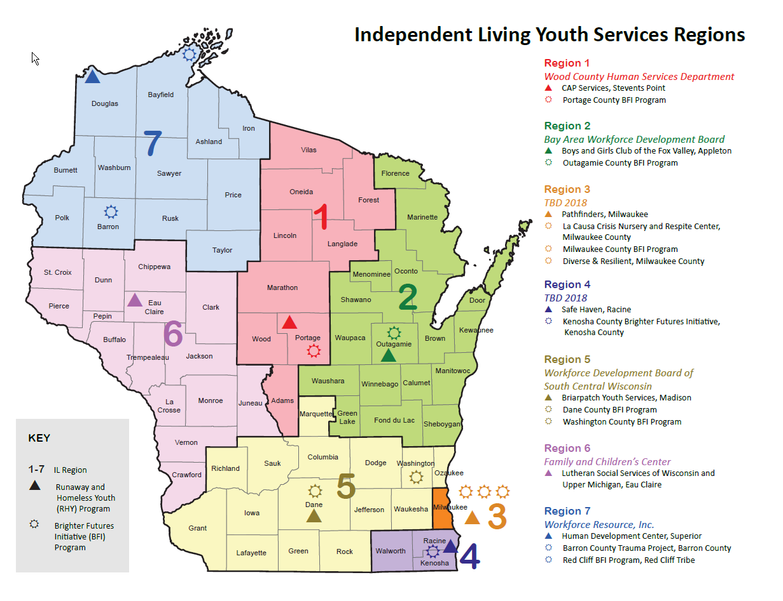

Slide 10
Thank you for your time!
Contact info:
Brooke Hobbs, Housing & Employment Coordinator
WI DCF, Bureau of Youth Services
Brooke.hobbs@wisconsin.gov
608-422-6992

