Slide 1

Using SPARC and Cost Pools

Slide 2
Agenda
SPARC Portal
SPARC Website
SPARC Reports
Time Studies
Cost Pools
SPARC Claim Reviews
Key Points
Questions

Slide 3

SPARC Portal
Using SPARC Portal Step by Step
SPARC Website
Account Setup
Creating Entries
Submitting Monthly Reports
Verifying Submissions
Revising Reports

Slide 4

SPARC Portal
New User Account Setup
Visit DWD Wisconsin Logon Management System (User Acceptance Agreement) and create username (WIEXT ID) and password that you’ll use to log into the SPARC Portal
Fill out the SPARC Authorization Form
Submit completed form to SPARC Accountants
Form requires supervisor’s signature
4. SPARC Accountants will email new user once their SPARC account is set up

Slide 5
SPARC Portal
User Account Close Out
Fill out the SPARC Authorization Form and submit to the SPARC Accountants
Can leave WIEXT ID blank if unknown
Can also just send an email without the form for deactivation requests

Slide 6
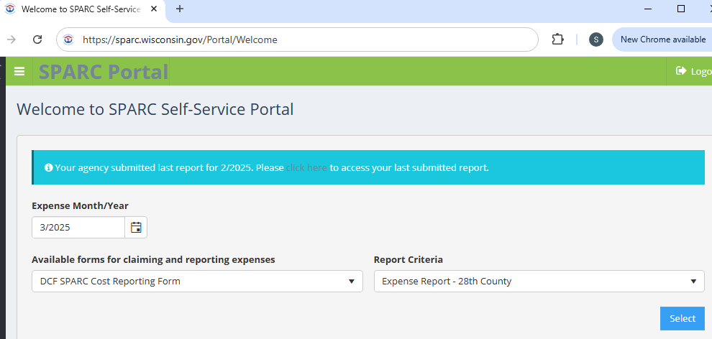
SPARC Portal https://sparc.wisconsin.gov

Slide 7
SPARC Portal – Submitting Reports
Select Expense Month/Year
60 days to submit/revise reports
Select any month within the quarter when submitting Employee Count Report
For example, if you want to file the Q2 Employee Count Report, you can select April, May, or June
Select a Form
All available forms for your agency are in the drop down list
Select a Report Criteria
If there’s only one option, it will automatically fill in when the form is selected

Slide 8

SPARC Portal – Submitting Reports
Session remains active for 8 hours
Save/submit report as often as you’d like
Each submission overwrites the last submission
Can print PDF of latest submission
Last submission will pre-populate the form when reopened
Can’t find a SPARC code on the form?
New contracts can be entered into SPARC once contract completes the internal DCF routing process
If you have a contract, but don’t see the code in SPARC, contact the SPARC Accountants

Slide 9
SPARC Portal – Revising Reports
If revising a report within 60 days
Open the report that needs to be revised
The last submitted expenses will pre-populate
Revise the necessary line(s) to the correct total
Don’t delete any expenses that are correct
The revised report will replace the previously submitted report
A report can be revised even if payment has already been received
SPARC will recalculate the difference and add/subtract it from the next payment
If revising a report older than 60 days, contact the SPARC Accountants for assistance

Slide 10
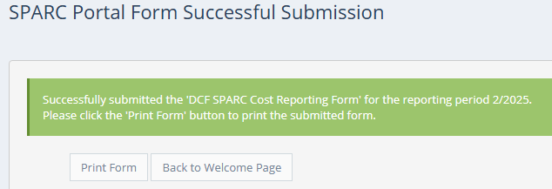

SPARC Portal – Verifying Submission
After submitting a report, SPARC will display a successful submission message where you can print the report as a PDF if desired.
The next time you log in, SPARC will display a message indicating the most recently submitted report with another chance to print it as a PDF.

Slide 11
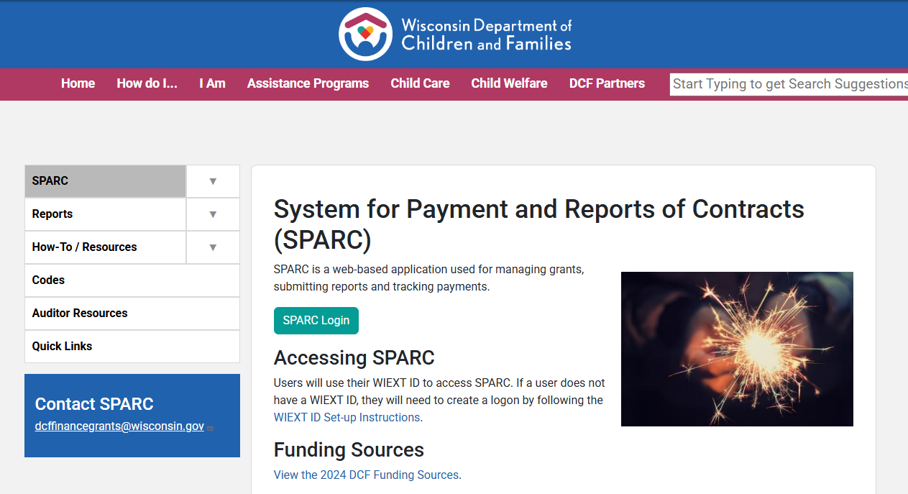
SPARC Website https://dcf.wisconsin.gov/sparc
Announcements on the front page
Access to log into SPARC – every person needs their own log in
Suppliers shouldn’t have people sharing log-ins
Handy sections:
SPARC > SPARC Reporting and Payment Schedule
Codes: contract code # and descriptions
Auditor Resources:
Payment confirmation
Funding source of different SPARC contracts
Quick Links – links to SPARC related information

Slide 12
SPARC Reports Overview
The Bank Deposit Reconciliation Report can filter down to a single day.
All other reports can filter down to a specific month or span of months
Data refreshes overnight
Any changes made in SPARC will be reflected on the reports the next business day
Contract Balance by Agency Report – shows remaining contract balance and cash position
Can only be filtered for one specific month
Expense Reports – shows what was reported each month
“Monthly Expenditure Year to Date” – shows expenses by Contract Code and Line Code
“Expense Analysis by Class Code” – shows expenses by Contract Code, Line Code AND Class Code
Payment Reports
“Bank Deposit Reconciliation Report (WIS-SR-019)” – used to reconcile individual payments by payment date
“Bank Deposit by Payment Month Year (WIS-SR-030)” – shows total amount paid for each month of the year
County RMS Cost Allocation
Did your county submit the monthly Cost Pool Report and quarterly Employee Count Report? Double check here!

Slide 13
SPARC Payments
When a SPARC payment is processed, an ACH Remittance Notice gets sent out to the designated email address for each agency
Can send ACH Remittance to up to 2 email addresses per agency
Send email to SPARC Accountants to add/change email
SPARC payments will have an invoice number that starts with ‘DCFSPARC’
Questions about unknown payments received from the State that are not SPARC payments can be sent to DOA at WIVendors@wisconsin.gov
Agencies can reconcile SPARC payments using the Bank Deposit Reconciliation Report on the SPARC Website.

Slide 14
Demo– Bank Deposit Recon
You are: Oneida Nation
Received: ACH deposit on 2/29/2024 for $150,735.62
Question: How do I find out what this reimbursement is for?
See “How to use SPARC On-Demand/WEBI Reports”
Open Bank Deposit Reconciliation Report (WIS-SR-019)
Statewide Reports > Payments
Agency Dashboard

Slide 15
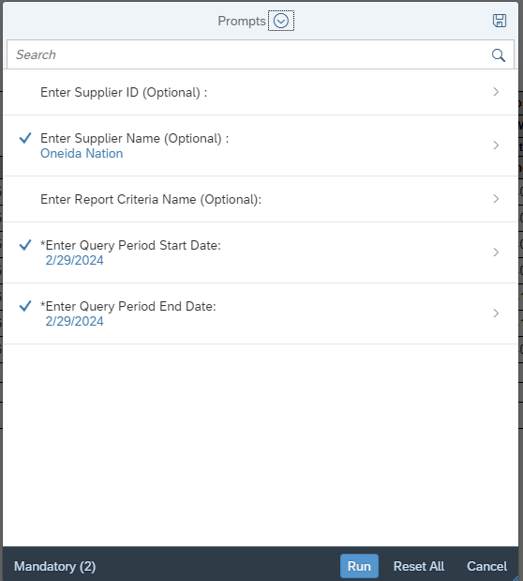

Demo – Bank Deposit Recon: exact date
One deposit might be split in multiple payments on the Report if made on the same day.
Filter for a single date (this example!)
Filter for a certain report criteria name, if applicable
Sum the ACH payments with the same Bank Deposit Date.
Bank Deposit Reconciliation Report is the only one that can be filtered by exact date.
All other reports will return information for the whole month.

Slide 16
Demo– General Report Tips
Always see what Prompts are available for the report you’ve opened!
This report might span multiple pages!
Move your mouse to bottom of screen, bar appears. Press next page.
Looking for codes from 2023, and can’t find them?
There was an IT update to the Bank Deposit reports, and some older codes are only on the legacy report tab (left tab).
The default is to open to the new Detail tab (right tab).

Slide 17

Demo – Export, Freeze Panes
Best way to view information: EXPORT the report!
Export
3 little dots “More” > Export
Determine if one or multiple reports tabs should be selected
Press Export
Freeze Panes for easy viewing once in Excel:
Make sure none are currently frozen. View > Freeze Panes > Unfreeze
Select a cell where you want all the cells above and to the left-side to be frozen
(G13) > View > Freeze Panes > Freeze Panes
Reports are best saved digitally. If choosing to print, some basic excel printing hacks:
View > Page Break Preview > Drag where desired
Select area you want to print: File > Print > Settings dropdown: Print Selection
File > Print > last Settings drop down > Fit Sheet On One Page

Slide 18



Report Issues: Fixing Errors
Did you check reports and realize some reported numbers are incorrect?
Do not enter an adjustment in a different month!
Re-open the incorrect month’s report in SPARC
View originally submitted amounts
ONLY change the totals entered incorrectly: enter the correct TOTAL
SPARC will auto-calculate any payment adjustments needed
Don’t enter the adjustment amount, do enter the correct total that should have been submitted
Leave all other correct totals alone
Press submit, save a copy of the revised report. This is now the official SPARC report for that month!
Can’t open the incorrect month’s report in SPARC?
E-mail the SPARC accountants at dcffinancegrants@wisconsin.gov
List what wishing to replace: month/year/line code/total amount that should have been submitted.
SPARC accountants will get corrections entered. (Note: If the correction is for a closed contract, there may not be funding available for additional payments)

Slide 19
Employee Count (FTE)
Who goes into which area?
The rule of thumb is to follow the funding when you are not sure
Payroll is a good place to check
Employee Count should be based on the 15th of the second month of each quarter
Q1 = 2/15, Q2 = 5/15, Q3 = 8/15, Q4 = 11/15
IM/CC count should coincide with the RMS roster number
If Child Support (CS) is within Human Services, CS count on the Employee Count Repo0rt should match with what is reported on the monthly CS Expense Form
Review the RMS website for more details

Slide 20
Time Study
What is a time study?
A method for getting a statistic of how many hours of work is spent on a specific program during a certain period
Types of time studies used by the State
Random Moment Sampling (RMS)
Used for Economic Support (IM/CC)
Programs included in RMS include
Medicaid, BadgerCare, FoodShare, etc (DHS) – makes up approx. 95% of programs
Child Care (DCF)
WHEAP (DOA)
Random Moment Time Study (RMTS)
Used for Social Services for DCF to claim Title IV-E
Child Support Random Moment Sampling (CS-RMS)

Slide 21
Cost Pool
What is a cost pool?
A pool of expenses to run programs included in the time study
The State allocates a cost pool by applying the time study statistics to claim Federal reimbursement for each program
Agencies are required to report the following cost pools to the State
RMS for IM/CC (TANF)
All Programs Shared (AMSO) – SPARC Code 4076
IM/CC Cost Pool – SPARC Code 4320
RMTS for Social Services (Title IV-E)
Social Services – SPARC Code 3301
Social Services New Worker Training (WiLearn) – SPARC Code 3301N
Child Placing Agency Admin – SPARC Code 3329
Social Services Indirect – SPARC Code 3683
Social Services Indirect New Worker Training (WiLearn) – SPARC Code 3683N

Slide 22
IM/CC Cost Pool
Cost Pool Overview for RMS
Shared Costs (AMSO) – Code 4076 – Agency costs that cannot be directly charged to a specific program
Agency’s share of indirect costs
Director’s salary/fringe/related costs
Finance and HR staff salary/fringe/related costs
Space-related costs
General admin costs such as mail & communications
Other overhead costs
IM/CC Cost Pool – Code 4320 – All costs to run IM/CC
Salary/fringe of all people on the RMS roster and their direct supervisors
Includes travel, supplies, services, and equipment costs directly associated with these people
Any costs that benefit two or more IM/CC programs within the IM/CC functional area

Slide 23
Children and Families IV-E Cost Pool
Cost Pool Overview for RMTS
3301 – Direct costs for employees on the RMTS Staff Roster who are being sampled and their supervisors
3301N – Direct employee and associated costs for child welfare related units and employees that are a part of WiLearn
3683 – The share of indirect and Agency Management, Support, and Overhead (AMSO) costs required to support the positions and functions listed on the RMTS Staff Roster for Line 3301 according to each county’s indirect cost allocation plan.
3683N – The share of indirect and Agency Management, Support and Overhead (AMSO) costs required to support the new workers and their supervisors that are listed on the RMTS Staff Roster for Line 3301N according to your county’s indirect cost allocation plan.
3329 – Child Placing Agency Administrative Costs

Slide 24

SPARC Resources/Contacts
SPARC Website https://dcf.wisconsin.gov/sparc
SPARC Access https://dcf.wisconsin.gov/sparc/access
SPARC Payment Schedule https://dcf.wisconsin.gov/sparc/schedules
SPARC Codes https://dcf.wisconsin.gov/sparc/codes
SPARC Funding Sources https://dcf.wisconsin.gov/sparc/auditor-resources
SPARC Reports https://dcf.wisconsin.gov/sparc/reports
DCFFinanceGrants@wisconsin.gov SPARC Accountants’ Inbox
Reach out for all SPARC questions
Hannah Adalance, CPA
Senior SPARC Accountant – all County SPARC questions (except Child Support)
Sara Schwoch
Advanced SPARC Accountant – all Tribes, Nonprofits, Child Support & CANPB SPARC questions

