Slide 1



Keeping Your County on Point with RMTS and RMS Rosters and Cost Pools

Slide 2

Introductions
  Andrew Kleps-Budget and Policy Analyst
  Angie Gaster-RMS Administrator/Accountant
  Becky Markgraf-IV-E Accountant
  David Berndt-Title IV-E Program Coordinator
  John Staskunas-Title IV-E Training and Claiming Coordinator
  Sara Schwoch-SPARC Accountant
  Sue Losen-SPARC Accountant
^{dcf.wisconsin.gov}

Slide 3
What are the RMTS and the RMS?
  The Random Moment Time Study (RMTS) and Random Moment Sampling (RMS) are federally approved cost allocation methods used to accurately determine proportions of worker time that are devoted to a specific program
  RMTS
  Used by DCF to claim Title IV-E on Social Services costs
  RMS
  Used for Income Maintenance and Child Care (IM/CC) or Child Support Programs that are funded by:
    DHS – Medicaid, BadgerCare, FoodShare, etc. about 95% of programs
    DCF – Child Care/Child Support
    DOA – Wisconsin Home Energy Assistance Program
^{dcf.wisconsin.gov}

Slide 4
What is the Point?
  The State of Wisconsin submits a claim on behalf of counties, receives reimbursement from the federal government, and provides funding to the counties
  The federal government requires one uniform cost allocation plan
  Federal law requires cost pools to be linked to the RMTS/RMS staff rosters
  Communication is key between workers, supervisors, liaisons, and fiscal staff
Key Points
    Establish and maintain an accurate RMTS/RMS staff roster
    Require agency staff to respond promptly and accurately to RMTS/RMS emails
    Accurately report direct and indirect costs associated with staff in the RMTS/RMS staff roster
^{dcf.wisconsin.gov}

Slide 5
RMTS/RMS Staff Roster Key Players
  Workers-Receive the survey emails indicating that they need to log into the RMTS/RMS system and respond accurately within a certain time frame
  Supervisors-Have the ability to modify general information in an employee’s RMTS or RMS record
    Monitor RMTS/RMS observations
  Liaisons-Add or delete staff members/supervisors
    Responsible for certifying the accuracy of the roster every quarter
  Accountants/Fiscal Staff-Responsible for maintaining the cost pool that is associated with the RMTS or RMS staff roster.
  Can also be added as supervisors/liaisons on the RMTS or RMS staff roster to assist with monitoring
.
^{dcf.wisconsin.gov}

Slide 6
Who Belongs on the RMTS Roster?
There are two requirements for inclusion on the RMTS staff roster:
Target Group - Employees who provide direct case management and related services for the following Target Groups, or any combination, must be included in the RMTS:
  Child Protective Services
  Child Welfare
  Youth Justice
Job Function-The scope of direct case management and related services is defined as employees whose regularly assigned job duties include one or more of the following:
  Access/Intake Worker
  Case Aides who directly assist one or more child welfare case worker
  Case Manager/Case Worker
  Initial Assessment/Investigator
  Provider Licensing (Foster Home Coordinators, Recruiters, and Licensing Specialists)
^{dcf.wisconsin.gov}

Slide 7
Who Does Not Belong on the RMTS Staff Roster?
Employees whose assigned work duties include:
  Aging & Disability Services
  Community Treatment and Support Services
  Employees with costs that are 100% directly charged to clients or other programs
  Administrative assistants, information technology, and other support staff
^{dcf.wisconsin.gov}

Slide 8
Judgement Calls
Depending on a county’s organizational structure and job duties, employees from the following units may also meet the criteria for inclusion in the RMTS staff roster:
  Children’s Mental Health (CMH)
  Children’s Long-Term Support (CLTS)
  Birth-to-Three
^{dcf.wisconsin.gov}

Slide 9
Health and Human Services Department
Director
Social Worker
Family Specialist
Social Services Aide
CLTS Worker
Children’s Mental Health Worker
^{dcf.wisconsin.gov}
Notes:
In this case, this is a Social Service Unit with mixed caseloads. The Social Worker belongs on the roster. In addition, the other four positions might work with Child Welfare, Child Protective Services, or Youth Justice, in addition to working with programs such as Children’s Long-Term Support and Children’s Mental Health. In these cases if a worker has a mixed caseload, he or she should be on the RMTS Staff Roster.

Slide 10
Children and Families Division
Director
Child Protective Services Unit
Youth Justice Unit
Child and Family Services Unit
Birth to Three Unit
CLTS Unit
Foster Care Coordinator Unit
^{dcf.wisconsin.gov}
Notes:
All workers in the Child Protective Services Unit, Youth Justice Unit, Child and Family Services Unit, and the Foster Care Coordinator Unit should be included on the RMTS Staff Roster, except for supervisors and clerical support. All workers in the CLTS Unit and Birth To Three Unit should not be included on the RMTS Staff Roster because they are separate units.

Slide 11
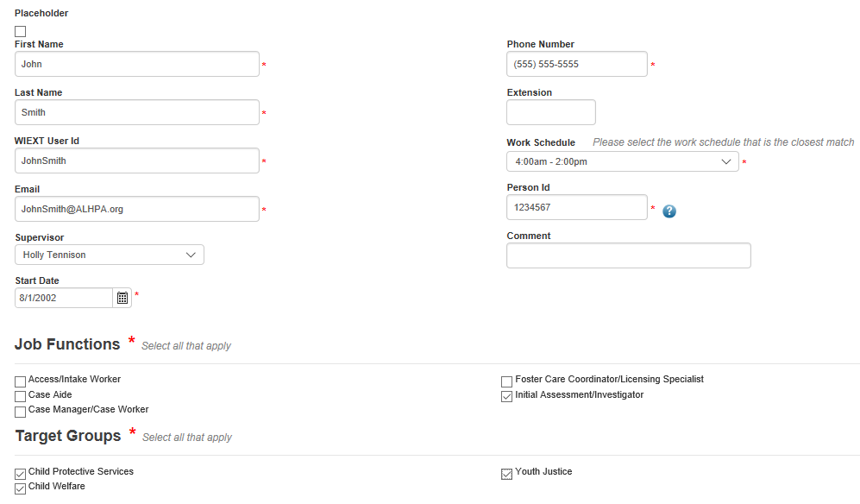
Person ID/Start Date and End Date
^{dcf.wisconsin.gov}

Slide 12
Who belongs on the RMS IM/CC Roster?
  Full time and part time staff who work with two or more programs such as FoodShare and BadgerCare and directly with clients
  Supervisors who carry a 50% caseload related to two or more programs
  The POINT: The staff roster is made up of workers who work with 2 or more programs
^{dcf.wisconsin.gov}

Slide 13
Who does NOT belong on the RMS IM/CC Roster?
  Supervisors who carry less than a 50% caseload
  Receptionists and clerical staff
  Agency management and directors who benefit the entire agency
^{dcf.wisconsin.gov}

Slide 14
Who belongs on the RMS Child Support Roster?
  Full/Part time staff who work with mixed IV-D and Non IV-D cases
  Agency management, attorneys, directors, supervisors, receptionists, or clerical staff who spend 50% of their time on cases that are mixed
  The POINT: The staff roster is made up of staff members who work more than 50% of the time on mixed cases
^{dcf.wisconsin.gov}

Slide 15
Who does NOT belong on the RMS Child Support Roster?
  Cooperating agencies
  Private sector
  Dedicated staff members(claimed on separate lines from the roster)
  Agency management and directors who benefit the entire agency (claimed as part of the AMSO)
  For more information on the Child Support Cost Pools please attend Diane Bahr’s presentation later today at 2:40PM in Expo 1 & 2
^{dcf.wisconsin.gov}

Slide 16
Administrative Cost Pools
What is a Cost Pool?
  A pool of program expenditures that is federally required to match the workers who participate in time studies
  The State of Wisconsin allocates cost pools by applying the time study statistics to claim Federal reimbursement for each program
  Agencies are required to report the following cost pools to the State of Wisconsin
    Children and Families Cost Pool (Title IV-E=RMTS)
      3301: County Child Welfare Staff
      3329: Private Child Placing Agencies
      3683: Agency Management, Support and Overhead (AMSO)
    IM/CC Cost Pool (TANF=RMS)
      4076: Agency Management, Support and Overhead (AMSO)
        The Portion Applicable to IM/CC
      4320: IM/CC Cost Pool
^{dcf.wisconsin.gov}

Slide 17
Children and Families Cost Pool
  3301: County Child Welfare Staff
  Direct staffing and related costs for child welfare related units and employees
    Salaries and fringe for all employees on the RMTS staff roster and their direct supervisors
    Travel, supplies, services and equipment costs directly associated with these employees
  3301 Exclusions: Staff expenses used as match by Child Welfare Training Partnerships to claim Title IV-E
  3329: Private Child Placing Agencies
  Net cost of payments provided to private Child Placing Agencies (CPA) for administrative functions preformed by CPA staff on behalf of children placed by the county agency in foster homes supervised by the CPA.
  3683: Agency Management, Support and Overhead (AMSO)
  Share of indirect AMSO costs required to support RMTS roster positions according to county’s indirect cost allocation plan
    Department management
    Legal staff
    Accounting and Finance Staff
^{dcf.wisconsin.gov}
Notes:
3329 Exclusions: maintenance costs for children placed with CPAs

Slide 18
Children and Families Cost Pool
Children and Families CP
County CW Staff #3301
Title IV-E Allowable Expenditures
CPAs
#3329
RMTS
Statistics
X
=
Federal Claim
AMSO
#3683
^{dcf.wisconsin.gov}

Slide 19
County Cost Pool Breakdown
County Size (Based on 2016 Child Population) | Average 3301 (Direct Costs) Calendar Year 2017 | Average 3683 (Indirect Costs) Calendar Year 2017
Extra Large (35,000+) | $7,400,000 | $1,700,000
Large (15,000-34,999) | $3,200,000 | $900,000
Medium (5,000-14,999) | $1,200,000 | $400,000
Small (0-4,999) | $400,000 | $200,000
^{dcf.wisconsin.gov}

Slide 20
IM/CC Cost Pool
  4076: Agency Management, Support and Overhead (AMSO)
  Share of indirect AMSO costs required to support RMS roster positions according to county’s indirect cost allocation plan
    Director’s salary and fringe
    Finance and HR staff and related expenses
    Space related costs
    General Admin Cost such as mail & communications
    All other overhead costs
4320: IM/CC Staff
  Direct staffing and related costs for child welfare related units and employees
    Salaries and fringe for all employees on the RMS Roster and their direct supervisors
    Travel, supplies, services and equipment costs directly associated with these employees
  Any costs that benefit two or more IM/CC programs with the IM/CC functional area
^{dcf.wisconsin.gov}

Slide 21
IM/CC Cost Pool
IM/CC
Child Support
AMSO
#4076
Employee
Count Report
X
AMSO Applicable to IM/CC Programs
Social Services
State Allocation for the Fed Claim
Aging
Cost Pool
IM/CC
#4320
IM/CC
Reports From Counties
IM/CC Cost Pool
Medicaid
DHS CARS
Reimbursements for each programs
Food Share
X
RMS
Statistics
Child Care
DCF SPARC
Reimbursements for Child Care
#8000’s
WHEAP
^{dcf.wisconsin.gov}

Slide 23
What is the Point?
  Shared costs & employee count reporting are just as important as direct expenditure reporting
  Train new staff on the roster and cost pool as well as direct expenditure reporting
  Help us help you!

Slide 24


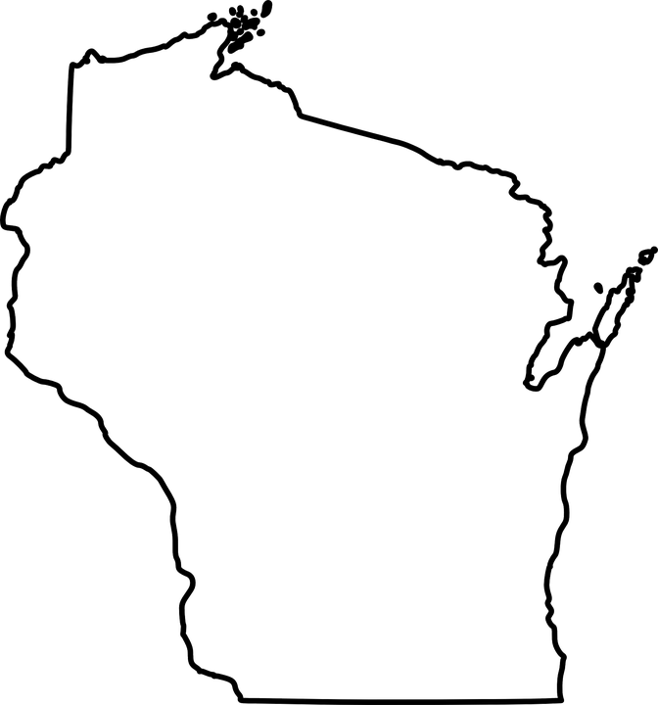



Federal Claiming
^{dcf.wisconsin.gov}

Slide 25
Takeaways
  The RMTS and RMS are used to claim funding from the federal government, and this funding is allocated back to counties
  The cost pools (3301-County Child Welfare Staff) (4320-IM/CC Staff) should derive from the RMTS/RMS Staff Rosters
  Accurate and efficient rosters create less audit risk and gives the State of Wisconsin funding to allocate to counties
^{dcf.wisconsin.gov}

Slide 26

Questions??
^{dcf.wisconsin.gov}

