Slide 1
BRP Policy Manual
Revised Publication (“V2”)
Technical Assistance: Overview
October 3, 2024

Slide 2
What’s New?
A lot! The manual has gone from 31 to 65 pages.
Contents of Chapter 18 relocated from the W-2 Manual to the BRP Policy Manual:
RCA
RMA

Slide 3
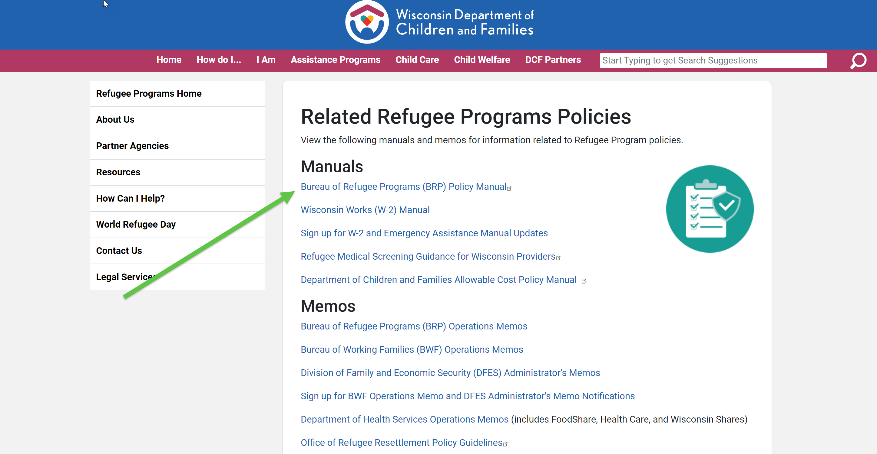
Where is everything located?
BRP Policy Page (https://dcf.wisconsin.gov/refugee/providers/policy)
Ops Memos are published here: (https://dcf.wisconsin.gov/refugee/providers/policy/memos)
The BRP Policy Manual is
published here:

Slide 4
What happens on October 29th?
October 29th is the effective date listed in the memos. What happens then?
The content from Chapter 18 in the W-2 manual will be removed.
New policies must be adhered to.

Slide 5
RCA New/Revised Policies
Backdating payments to the date the form 14880 was signed, unless that date is six or more days from the date of the initial RCA appointment
Use of RCA Rules, Rights and Responsibilities Agreement (form 5765) during initial RCA appointment; includes assigning activities
RCA-specific guidance on placement determinations
Additional guidance about starting/stopping payments for SSI- or Kinship Care-eligible recipients
Use of form 5632 for non-BRP employment and training referrals
Notes:
Here just open and walk through the OMs themselves first, to reference the summary areas.
Here mention there will be guidance for forms (5.30.24-10.29.24), particularly the participation agreement. Backdating will be required.

Slide 6
RCA New/Revised Policies, continued
Revised exemption policy
Revised sanction policy (revised form 13770)
New FSSP policy
Grace Period multiple job-related changes scenario
New Eligibility Reviews policy (new form 5764)
New case transfers policy
New case closures policy
Notes:
Note that these are not all changes, only a cursory overview of what I consider to be “significant”. There are many more! The OM is the most concise way to review it all.

Slide 7
RCA TA by Topic
Topic | Date and Time (subject to change)
Rules, Rights and Responsibilities Agreement and Eligibility Reviews | Thursday, October 10th 11am-12pm
Making Placements, Exemptions, Sanctions | Thursday, October 17th 2-3pm
Case Transfers, Closures, and other Minor Changes | Monday, October 28th 2-3pm
Additional sessions may be offered if needed.
Notes:
Invites will go out after this meeting. Please send me your email address if you had this invite forwarded to you and need to be added.

Slide 8
RMA Overview
Many minor clarifications
Effective date: October 29, 2024
More significant changes to come in a future update

Slide 9
Policy Manual Next Steps
V3 changes are in progress!
Changes may be released in future cover sheets or ops memos.

Slide 10
Questions?

