Slide 1


BRP Policy Manual
Revised Publication (“V2”)
Technical Assistance:
Rules, Rights & Responsibilities Form and Eligibility Reviews
October 10, 2024

Slide 2
Rules Rights and Responsibilities and
Eligibility Reviews, Considered Together
Rules, Rights and Responsibilities form is intended to clearly emphasize the responsibilities of the RCA recipient, especially the responsibility to report changes that may impact eligibility.
Eligibility Reviews are therefore designed with a minimalistic approach (i.e. RCA recipients are more so responsible for providing updates than RCA workers are responsible for discovering them).

Slide 3
New form
BRP Policy Manual Section 5.2.3: Completing the RCA Application
“During the initial appointment, the RCA Rules, Rights and Responsibilities Agreement (DCF-5765) must be completed, and must be scanned into ECF.”
This form replaces the Participation Agreement.

Slide 4
Forms Search
https://dcf.wisconsin.gov/forms

Slide 5
Section 5.4.7.1
All adult RCA recipients who are not exempt according to section 5.4.7.2 must be enrolled in services at an agency providing employment services and must participate in those services within 30 days of receipt of RCA. If there is an RSS Employment and Employability (RSS-E&E) service provider in the area, the individual should be referred to RSS-E&E. If the RCA recipient prefers an alternative agency providing similar employment-related services, the FEP must document this alternative referral and explain in detail the reason for the non-RSS-E&E referral. For any referrals, whether to an RSS-E&E agency or not, the form DCF 13768 Refugee Cash Assistance Work Programs- Notice of Referral (DCF Forms Search) must be completed, issued to the client, and a copy must be retained. For any referrals to non-BRP-funded agencies, the form DCF-F-5632 Confidential Information Release and Discussion Authorization (DCF forms search) must be completed, issued to the client, and a copy must be retained.

Slide 6
Section 5.4.7.1 Continued
If there is no RSS-E&E provider in the area, the FEP must determine where the individual should be referred in order to ensure they will be assisted in becoming employed. The type of services offered by that agency must be described and the steps taken to make the referral must be documented. For any referrals to non-BRP-funded agencies, the form DCF-F-5632 Confidential Information Release and Discussion Authorization (DCF forms search) must be completed, issued to the client, and a copy must be retained.

Slide 7
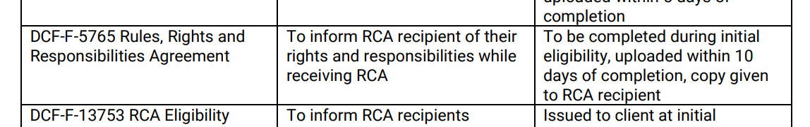
More forms references
BRP Policy Manual Section 5.6.8

Slide 8
Eligibility Reviews
5.4.7.1
  “The requirements for verifying participation in the activities assigned in the form DCF-F-5765 RCA Rules, Rights and Responsibilities Agreement are fully satisfied by completing form DCF-F-5764 Refugee Cash Assistance Eligibility Reviews and following the policy pertaining to eligibility verification, outlined in section 5.6.7 of this manual.”

Slide 9
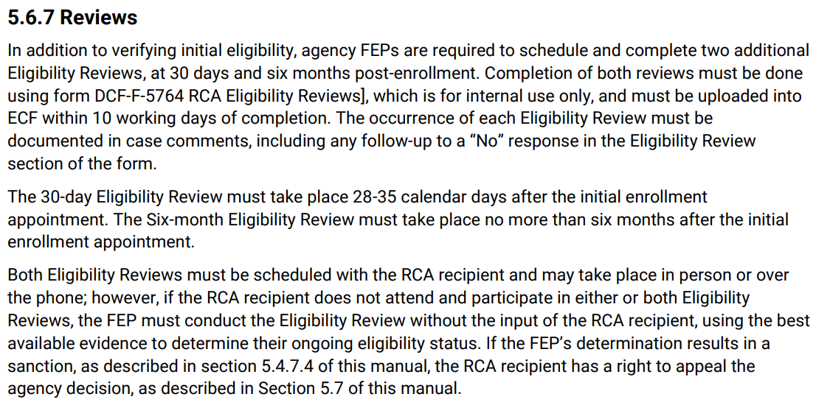

Slide 10
Forms Search
https://dcf.wisconsin.gov/forms

Slide 11
RCA TA by Topic
Topic | Date and Time (subject to change)
Rules, Rights and Responsibilities Agreement and Eligibility Reviews | Thursday, October 10th 11am-12pm
Making Placements, Exemptions, Sanctions | Thursday, October 17th 2-3pm
Case Transfers, Closures, and other Minor Changes | Monday, October 28th 2-3pm
Additional sessions may be offered if needed.
Notes:
Invites will go out after this meeting. Please send me your email address if you had this invite forwarded to you and need to be added.

Slide 12
Questions?

