Slide 1
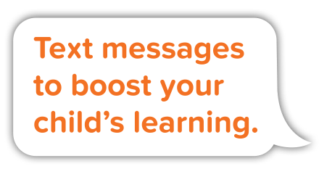
Research-based texts for parents
Tiffany C. Graham
VP of Operations & Partnerships
Rebecca Honig
Director of Content

Slide 2
Agenda
Research
Overview of Ready4K Approach
Curricula Development Process
Available Content and Enrollment
Closing/Questions

Slide 3
Significant disparities exist in home learning.
Economically disadvantaged…
Less likely to receive responsive and stimulating care and more likely to experience harsh parenting from zero to two years old (Bradley, Corwyn, McAdoo & García Coll, 2001)
Hear 30 million fewer words than wealthy children by the age of 4 (Hart & Risley, 1995)
Disparities are not unique to wealthy/disadvantaged, but appear along the income distribution.

Slide 4
Traditional approaches don’t work or are too costly to scale.
Traditional parenting programs (such as parenting workshops) place large demands on parent’s time and effort and overwhelm them with information.
Programs that are proven to help parents (such as home visitation) are too costly to scale.

Slide 5
Texting is an ideal solution.
Most Americans own a cell phone
97% of adults under the age of 50 have cell phones.
Cell phone owners use text messaging
98% of cell phone owners send and receive text messages.
Cell phone owners read text messages
99% of text messages are read within the first 3 minutes.

Slide 6
The Ready4K approach was developed by Stanford researchers.
Researchers set out to create a texting approach that achieved the following outcomes:
Enhanced parents’ default home literacy behaviors
Showed parents how to create everyday learning opportunities in fun & easy ways
Drew on multiple strands of research
Linked to state early learning standards

Slide 7
Stanford researchers conducted an RCT in San Francisco Unified School District.
San Francisco Unified School District’s pre-K program serves families in the lowest third of income in San Francisco.
1/3rd English speakers, 1/3rd Chinese (Cantonese) speakers, and 1/3rd Spanish speakers.
90% of families enrolled in SFUSD preschool received financial assistance for pre-K costs (income less than $3,900 gross per month for a family of 4).
Notes:
Median rent for a one-bedroom apartment in SF - $3,590.
Roughly equivalent to salary of 27K in Wisconsin.

Slide 8
The randomized controlled trial demonstrated positive outcomes.*
Parents found the texts to be very helpful
Effects of about 0.30-0.60 sdus
Parents reported engaging in more home literacy activities
Effects of about 0.20-0.30 sdus
Teachers reported increased parental involvement
Effects of about 0.10-0.20 sdus
Children gained 2-3 months in some areas of early literacy
The program was particularly effective for African American and Hispanic children.
*York & Loeb, 2014

Slide 9
Parents receive 3 text messages each week for 36 weeks.
Monday:
FACT
Wednesday:
TIP
Friday:
GROWTH
Activities leveraging family routines
Reinforce, encourage and extend
Inform and
motivate

Slide 10
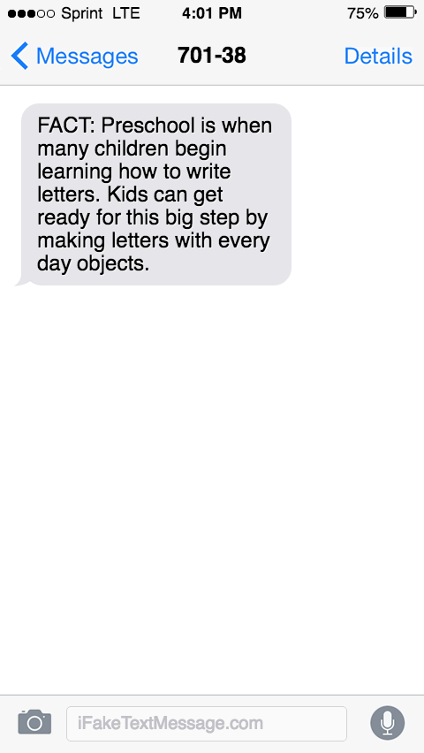
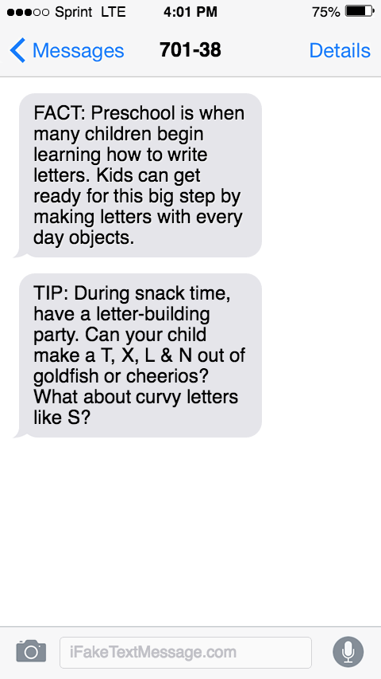
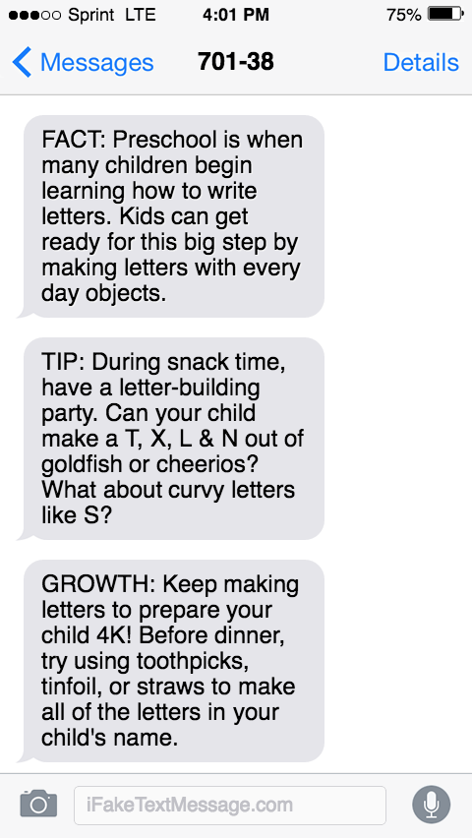
A typical week of texts focuses on a key skill and ways to extend that skill.

Slide 11
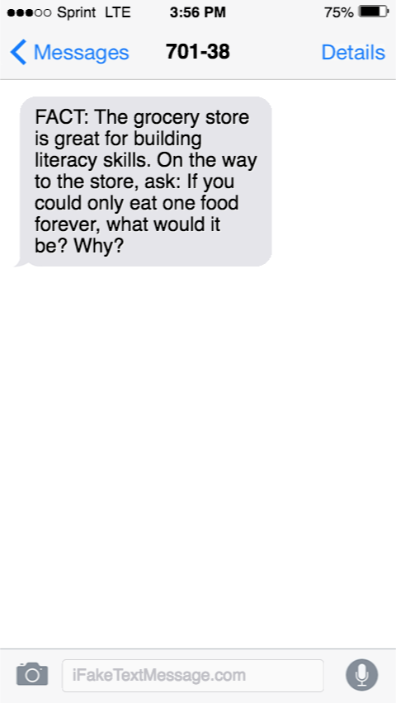
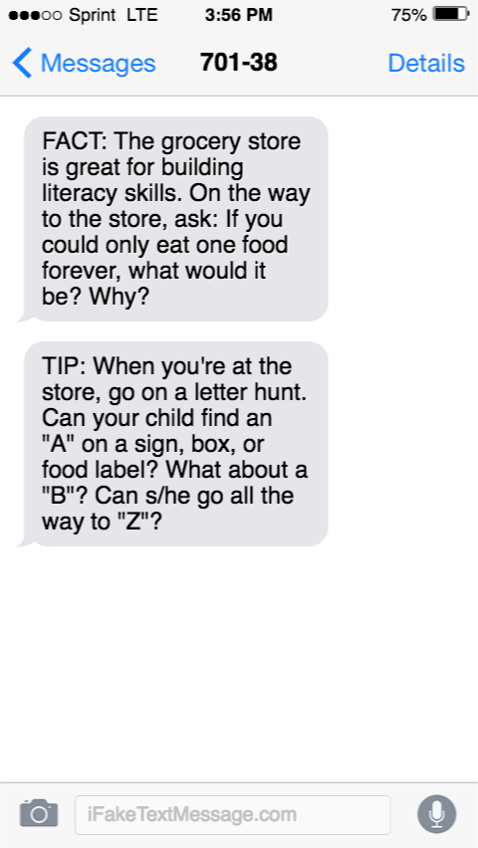
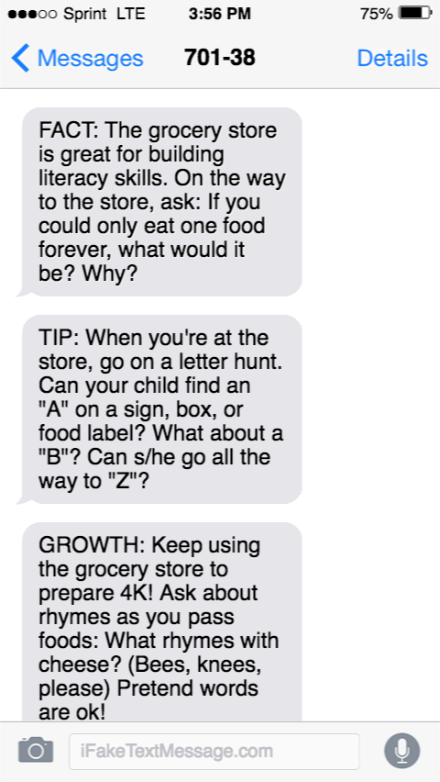
Spiral weeks bring multiple skills together around a single family routine.

Slide 12
Behind the Scenes: How do we develop our text messages?
Learn Curricular Needs of Communities
What are the unique needs of diverse communities across the country? How can our content support these needs?
Align with CCSS and Unique State Standards
What do children need to know in order to thrive in [X] grade at school?
Integrate Best Practice Instruction
What do we know about how children learn these curricular goals? What does research, experience and expert insight tell us about how we can best deliver the curriculum in deep, meaningful and developmentally appropriate ways?
Map Content onto Existing Family Routines
What works for families? Find everyday learning moments and integrate behavioral research to best deliver messages that will be compelling, actionable and meaningful within the realities of a family’s life.

Slide 13
From knowledge gained through this process, we create:
A library of research
A comprehensive curriculum
A scope and sequence
Text Messages!

Slide 14
Ready4K texts align with state early learning standards.
Notes:
Example from 4 Literacy program

Slide 15
Ready4K’s core curricula is offered at no cost to parents and schools.
Combination literacy/math/SEL/health and custom curricula are also available.
*Available April 2017

Slide 16
Enrolling in the program is simple.
Parents fill out enrollment forms, providing key information and consenting to receive text messages.
Organizations enter information into a spreadsheet and upload via our secure FTP server.
Parents start receiving text messages within one week.
Parents continue to receive messages unless they opt-out (no need to re-enroll each year).
Parents love texts
Parents more involved
Kids do better

Slide 17
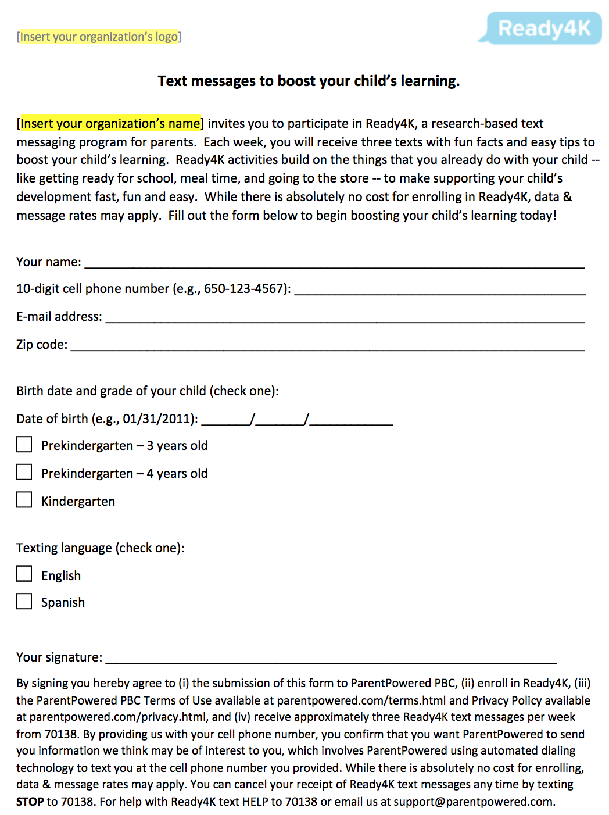
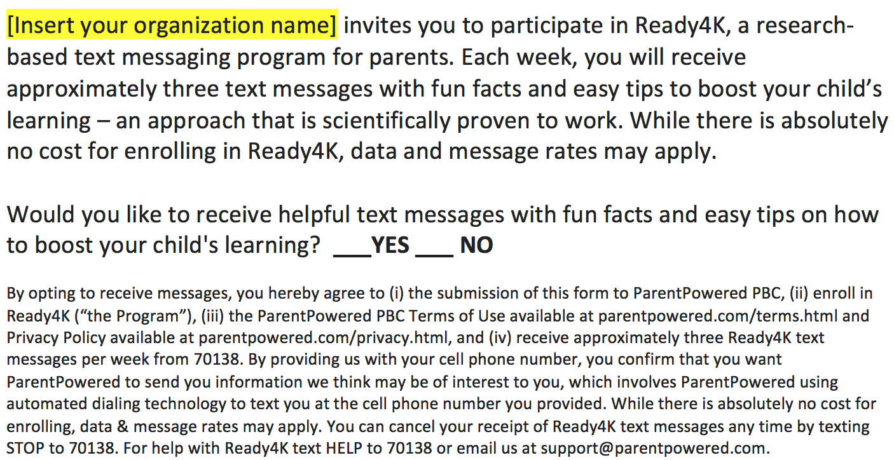
80 to 95% + of parents opt to receive Ready4K messages.*
*Average uptake numbers based on incorporating Ready4K enrollment into existing enrollment processes, such as school registration.

Slide 18
Thousands of parents across the country receive Ready4K texts.
65,000+ users in over 35 states
Partnered with over 50 local, state and national educational institutions
Nearly 4 million text messages sent
Content library expanding to 0 to 7 by the fall of 2017.
Our ultimate goal is to support parents from child birth to high school graduation.
We will serve 20 million families by 2020

Slide 19
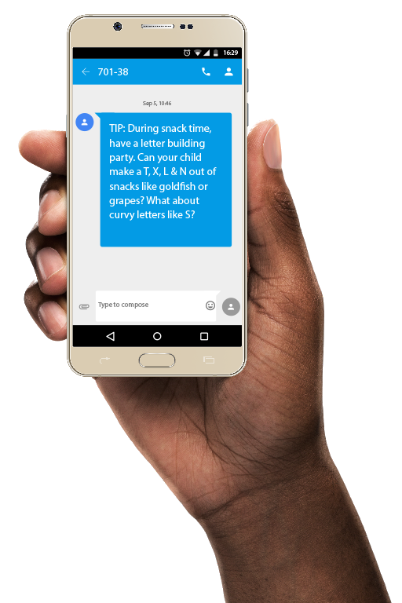
Thank you!
FACT: We deeply appreciate your time and would be happy to answer any questions you may have!
Tiffany Graham
VP of Operations & Partnerships
tiffany.graham@parentpowered.com
Rebecca Honig
Director of Content
rebecca.honig@parentpowered.com

