Slide 1

2018 DMCPS Out of Home Care Contracts
February 27, 2018
Roger Phillips
DCF Grants and Contracts

Slide 2
What are we going to cover?
About your Contract?
When will you get your Contract?
How will it come, and how do you sign it?
Who do you contact with questions?

Slide 3
What’s NEW?
Shorter contract
Scope of Services For OHC Providers is an online document:
CPA http://wwlmad0p0728.dcfint.wistate.us/files/mcps/pdf/cpa-rev.pdf
Group Home http://wwlmad0p0728.dcfint.wistate.us/files/mcps/pdf/gh-scope.pdf
RCC http://wwlmad0p0728.dcfint.wistate.us/files/mcps/pdf/rcc-scope.pdf
Assessment/Stabilization Centers http://wwlmad0p0728.dcfint.wistate.us/files/mcps/pdf/acsc-requirements-rev.pdf
Paperless! Contract signature process is electronic

Slide 4
Shorter Contract
First two pages have almost all of the most important information, including:
Contact info
Rate info
Population served info
Scope is going to be online

Slide 5
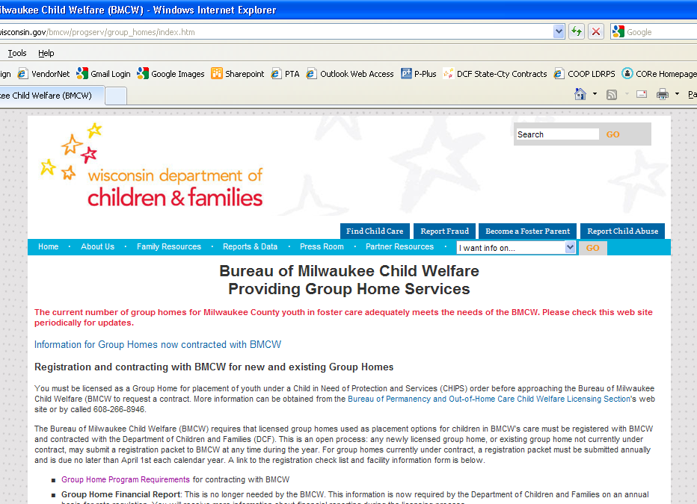
Scope of Services
Scope of Services is the official description that defines what the group homes must do to meet their obligations to DCF/DMCPS
Can be found on the
DMCPS website
http://wwlmad0p0728.dcfint.wistate.us/mcpc/ohc-provider

Slide 6
From the ‘Out of Home Care Provider Information’ page (http://wwlmad0p0728.dcfint.wistate.us/mcps/ohc-provider )
Click on “Child Placing Agencies”
Or “Group Home Agencies”
Or “ Residential Care Centers”
Or “Assessment Centers”

Slide 7
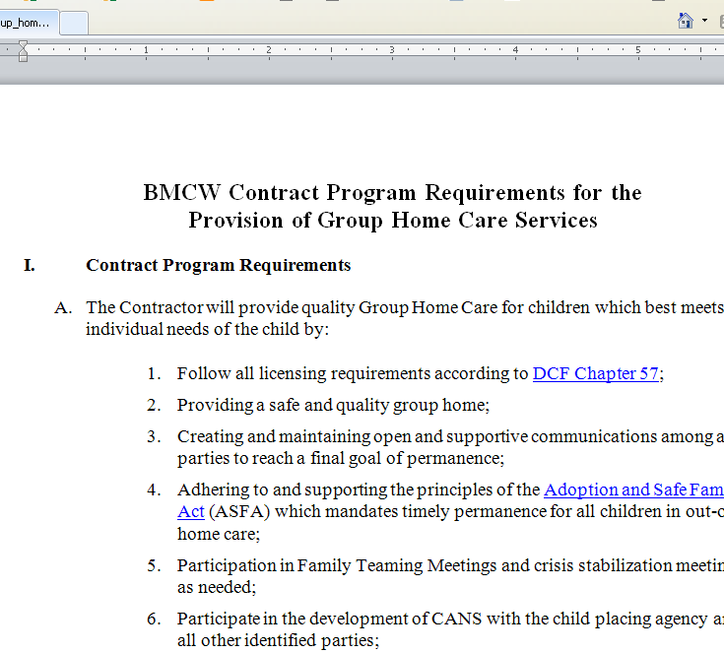
Scope of Services document opens as a Word document
Can save or print a copy
Your Agency will be
notified if the
Scope of Services
changes for ANY
reason

Slide 8
When will I get my contract?
Contracts will be granted only when:
Re-registration process is complete
Most recent (2015 or newer) Audits are complete and pass muster
Final approved Out of Home Care Provider list is due in Madison by November 30, so that contracts can be routed to you in time for…
Start Day of Contracts: January 1

Slide 9

How will I get my contract
DocuSign
The Authorized Signer will be alerted that the Contract is available through their email
Signature can only be made through the original email sent; the email cannot be forwarded
Link in email takes you to the DocuSign website
Point, click, and submit!

Slide 10
Important things to remember!
You need a list indicating the Authorized Signatory (Name and email) and CC’s (Name(s) and email(s) – Max 2)to receive and send the contract.
You will need to provide the legal name of the agency (and d/b/a if different) with physical address, phone # and the DUNS (Data Universal Numbering System) number (these numbers must be registered ANNUALLY, check https://www.sam.gov/portal/SAM/#1 .
If you don’t see the contract by about December 20, check your Spam Box.
If the notification isn’t in your spam box, and you still haven’t received the notification, email dcfcontracting@wi.gov .
You will not be able to manually change the contract when you receive it. Any changes must be requested through dcfcontracting@wi.gov .

Slide 11
Who Do I Contact?
Program, Scope, or Registration Questions:
Wendy Miller, DMCPS Program & Policy Analyst
414-343-5715
Wendy2.miller@wisconsin.gov
Contract Routing Questions:
DCF Contracting
dcfcontracting@wi.gov

Slide 12
Any Questions?
Don’t hesitate to contact DCF Contracting with any questions about the process of routing and receiving contracts!
DCF Contracting
dcfcontracting@wi.gov

