Slide 1

Care4Kids

Slide 2

Kids we serve

Slide 3
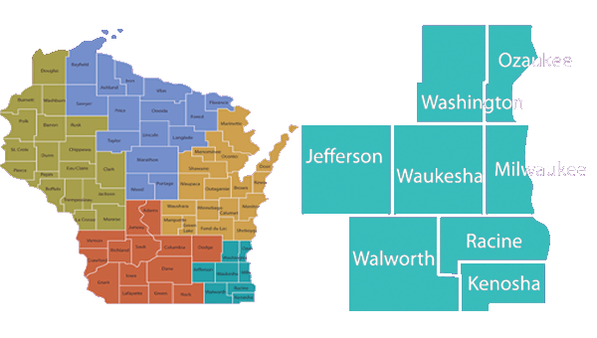
Care4Kids
Currently serve 6 Southeastern Wisconsin counties
Children need to originate in these counties
Children need to reside in these counties
Notes:
Kenosha, Milwaukee, Ozaukee, Racine Washington and Waukesha
THESE 6 SE WI counties Includes approx. 50% of all children in out of home placement in WI (2600-august 2013 out of 5500)

Slide 4
Enrollment
Out of Home
Opted Out
Not eligible
Out of Home and Care4Kids
Care4Kids
12 month extension
Adopted
Reunified

Slide 5
Not Eligible
Opt-out/Disenrollment
Ineligible placement (ex: Residential Treatment Center)
Removed from/placed outside the catchment counties
Secure Detention >30 days
WRAP Enrollment

Slide 6
Sample of What We Do

Slide 7
Developmental and/or Mental Health Screens
If a child has a positive developmental and/or mental health result on any valid screening tool, an assessment is warranted
OC’s work with Child Welfare team to obtain parental consent for the service
Developmental and/or Mental Health Screen is completed
*developmental screens are typically provided to children between 60 days to 4-5 years
*mental health screens are typically provided to children between 5-6 years and up
*discretion regarding which type of screen is allowed based upon presentation of the child and concerns shared
Notes:
Child may receive multiple developmental and/or mental health screens* during enrollment (operationally Care4Kids completes with new enrollees whenever possible). Care4Kids attempts initial completion at the 2 day visit. If not possible, responsibility moves to the assigned OC to complete. (Reasons that this may not be feasible to complete at the 2 day or after: child not in a place to participate, caregiver/caseworker not yet familiar enough with the child, difficulties connecting with caregiver/legal guardian). We also acknowledge any/all screens completed throughout enrollment completed by any source.

Slide 8
Developmental and/or Mental Health Assessments
If a child has a positive developmental and/or mental health result on any valid screening tool, an assessment is warranted
OC’s work with Child Welfare team to obtain parental consent for the service
A mental health or developmental assessment is completed
Resulting recommendations are documented, shared and followed up upon (i.e., Therapy, School involvement, etc.)
Notes:
Consent is our most frequently identified barrier; occasionally, difficulties with scheduling also occurs
Care4Kids Assessment Team

Slide 9
Ongoing Tracking of Appointments
Upcoming scheduled appointments are tracked
Necessary* follow up is identified, documented, facilitated and tracked
No show and missed appointments are also identified and outreach to the caregiver is completed by the OC to identify barriers to attending
Following each appointment, attendance is verified by calling clinic and requesting records
*”Necessary” is defined by those recommendations/referrals made by the provider of care and documented within the medical record AND/OR those visits identified within the Care4Kids contract (i.e., increased periodicity, etc.)
What could happen to upset this process? Delay or inability to receive medical records and/or difficult to engage caregivers/bio parent

Slide 10
Examples of Ongoing Communication/Collaboration
Care Coordinators outreach to Caregivers/Bio Parents, Child Welfare and Providers if/when:
Review of records identify follow up recommendations
No show, missed or late appointments
Consent is needed for treatment
Contractual visits/care is coming due
Check-in with Caregivers to identify unmet needs
Troubleshoot overcoming barriers identified
Follow up after inpatient, ED, Urgent Care visits

Slide 11
Examples of Ongoing Communication/Collaboration
Care Coordinators respond to incoming questions regarding
Provider needed
Missed appointments
Request for information regarding needs
Request for collaboration on complex cases
Request for help with barrier to care
Covered/not covered service
Medication Denials

Slide 12
Increased WCC Periodicity
Age | How often should they be seen ? | When should they be scheduled?
0-6 months | Monthly | Ten days before or after due date
6-24 months | Every three months | Fifteen days before or after due date
24 months & up | Twice annually | 30 days before or after due date

Slide 13
Care Plan Document
Completed at 60 days from enrollment
Subsequently updated every 6 months unless a qualifying event occurs*
What is a qualifying event to initiate a new care plan? Significant changes to the child’s medical, dental or behavioral health status or treatment plan

Slide 14
Care Plan Communication
Once completed, the Care Plan is sent to:
Child Welfare Worker/Supervisor
Treatment Foster Care
Caregiver
Biological Parent/Legal Guardian
Primary Care Provider
Any/All Specialists Listed on the Care Plan

Slide 15
Staffings
Polypharmacy Interdisciplinary Case Review (PICR)
Child-level staffings when issues arise:
Internal and external stakeholders
Medical, behavioral, social situations
Initiated by any stakeholder group

Slide 16
COVID Impact and Response

Slide 17
COVID Impact and Response
Initially as clinics were closed for “essential visits” only, we pivoted to:
advocating/communicating which visits would meet criteria
tracking remaining non-essential visits to ensure reschedule occurred when possible

Slide 18
COVID Impact and Response
Providers have had to limit access to allow for social distancing and cleaning between patients.
This has impacted our compliance with timeliness, however, completion of visits has remained steady and our focus

Slide 19
COVID Impact and Response
Focused check ins
DHS identified “high needs” children and direct outreach was done with all children
Telehealth visits
Child Advocacy Center
Care4Kids Assessment Team
Other providers of care
Impact of COVID on families led us to embed SDOH questions within each outreach to a family
resources were provided
communication with Child Welfare team made

Slide 20
Sample of Outcomes

Slide 21
HEDIS trends

Slide 22
Quality Metric Trends

Slide 23


Contact Us
Health Care Coordinator Team Number: 855-371-8104
Health Care Coordinator Team Email: Care4Kids@chw.org
Supervisors: Jessica Cabrera 414-266-2155
Emily DeLeo 414-266-4906
Manager of Operations, Donna McClain: 414-337-4359
Manager, Project Improvement and Analytics, Jacqueline Johnson: 414-266-2587
Director, Heather Swider: 414-266-2915
Executive Director, Mike Boeder: 414-266-3441
Medical Director:
Lisa Zetley, MD (lwzetley@mcw.edu)
Kelly Hodges, MD (khodges@chw.org)

