Slide 1
This session is being recorded.

Slide 2
eWiSACWIS Webinar
February 2026

Slide 3
Agenda
February 2026 Release (February 21st, 2026)
Development Roadmap for 2026
Recurring Webinar Series

Slide 4
February 2026 Release

Slide 5
Topics
Updates to the Home Study workflow and Forms generated from eWiSACWIS.
Updates to Family Case Plan functionality to enhance engagement and center family voice.
TSSF validations to include Family Case Plan anywhere eWiSACWIS captures Safety and/or Protective Plan.
“Made In Error” functionality to the DRAI (Detention Risk Assessment Instrument).
Exposure to Domestic Violence descriptor for Access Reports

Slide 6
Updates to the Home Study workflow and Forms generated from eWiSACWIS

Slide 7
This enhancement includes :
Modifications to the Home Study and Home Study Update/Recertification pages and associated templates generated.
Removed all copy over fields from Home Study, Home Study Update/Recertification, and associated Psychosocial Evaluation Report.
Notes:
The corresponding electronic version of these revised forms available on DCF forms page.

Slide 8
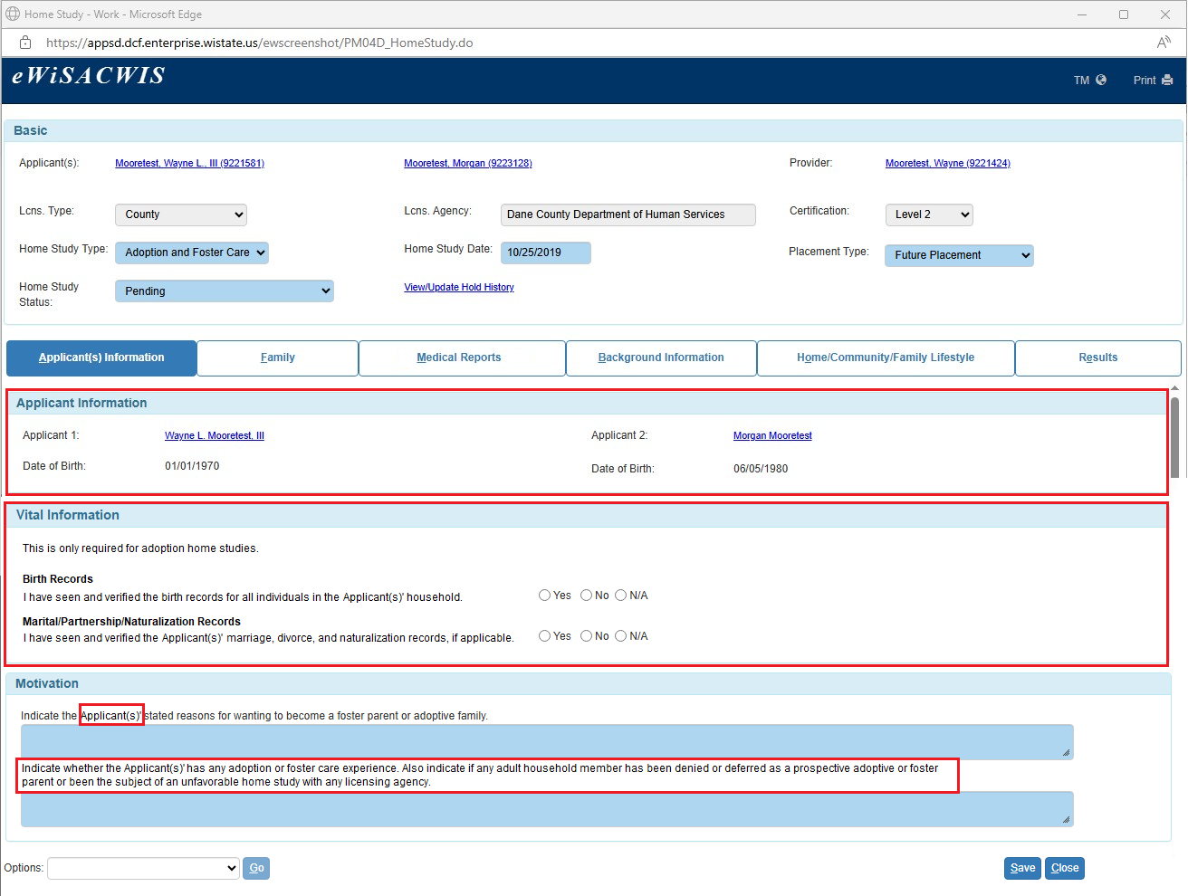
Modified Home Study Page: Future Placement
Notes:
The modifications to this page affect only Home Studies created after the release in which this change occurs. Previously created Home Studies, including pending Home Studies keep the prior format and document.
This page represents how much less is being required to be entered or prefilled into the home study for future placement type. There is creation of vital information group box that is ONLY required for adoption home studies.

Slide 9
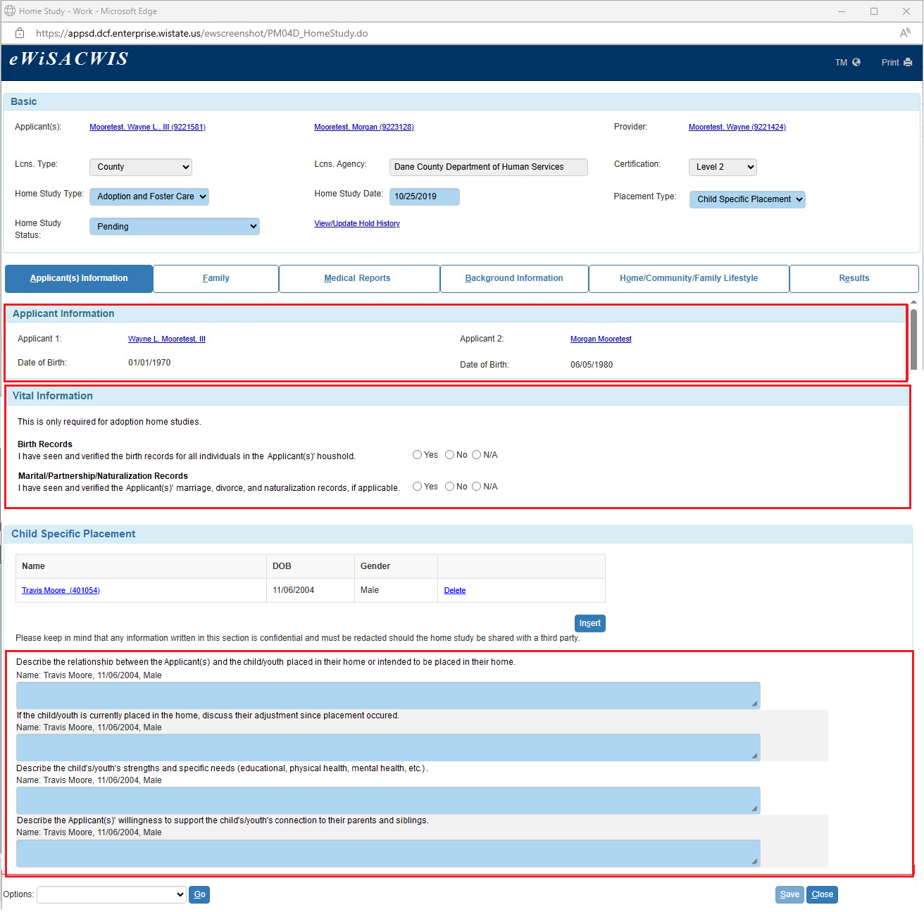
Modified Home Study Page: Child Specific Placement
Notes:
This page represents how much less is being required to be entered or prefilled into the home study for child specific type. There is creation of vital information group box that is ONLY required for adoption home studies.

Slide 10
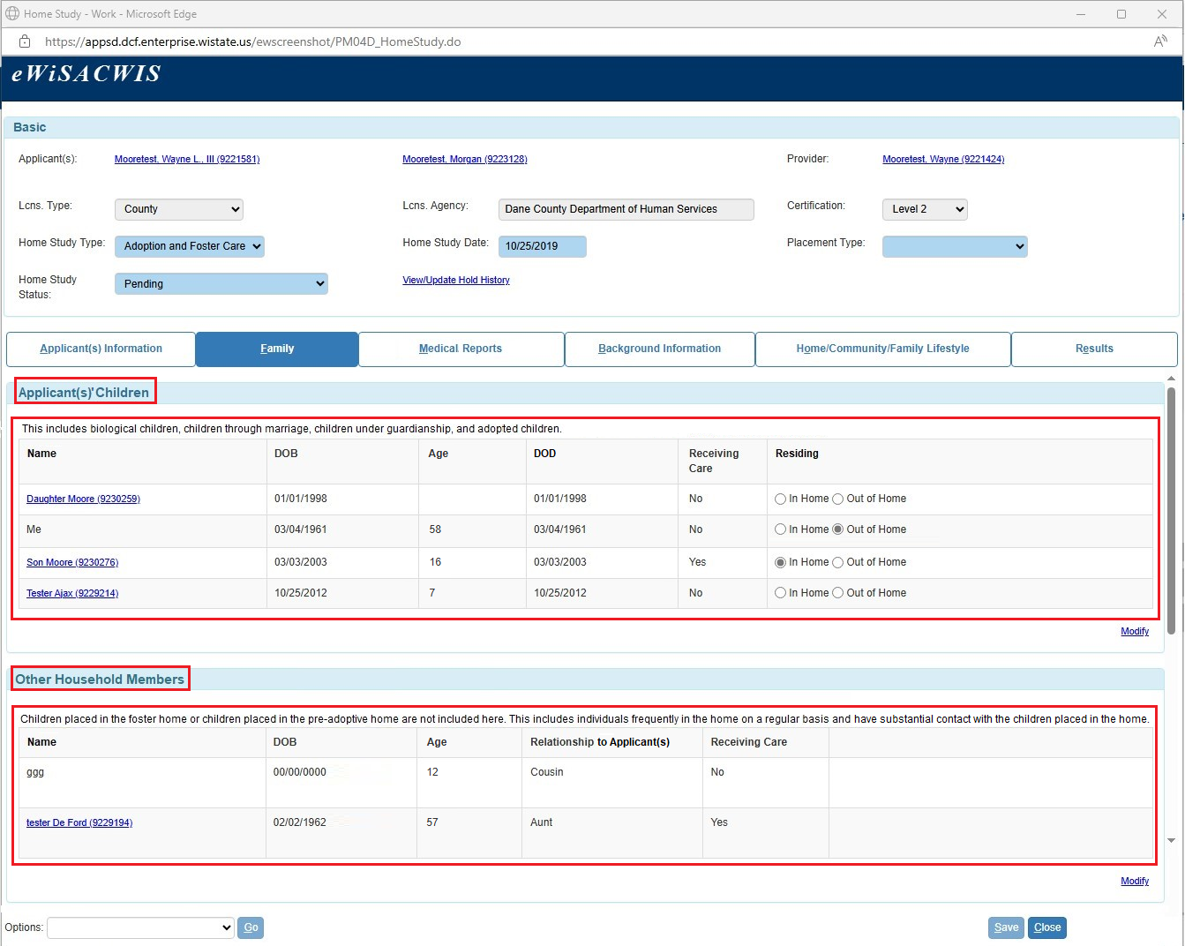
Modified Page: Home Study > Family tab
Notes:
Updated group box and column names.
Removed Extended Family Members group box(es)

Slide 11
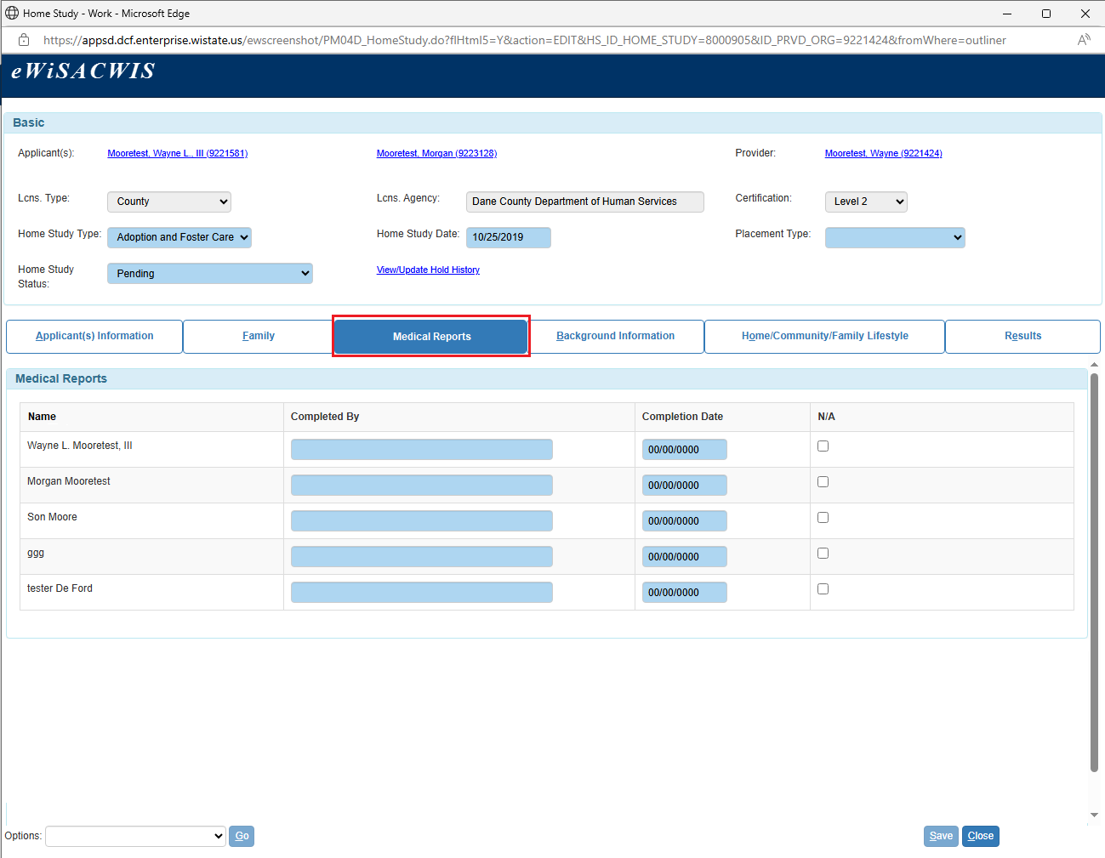
Modified Page: Home Study > Medical Reports tab
Notes:
Renamed tab name from Medical/School Reports to Medical Reports.
Removed School Reports group box.

Slide 12
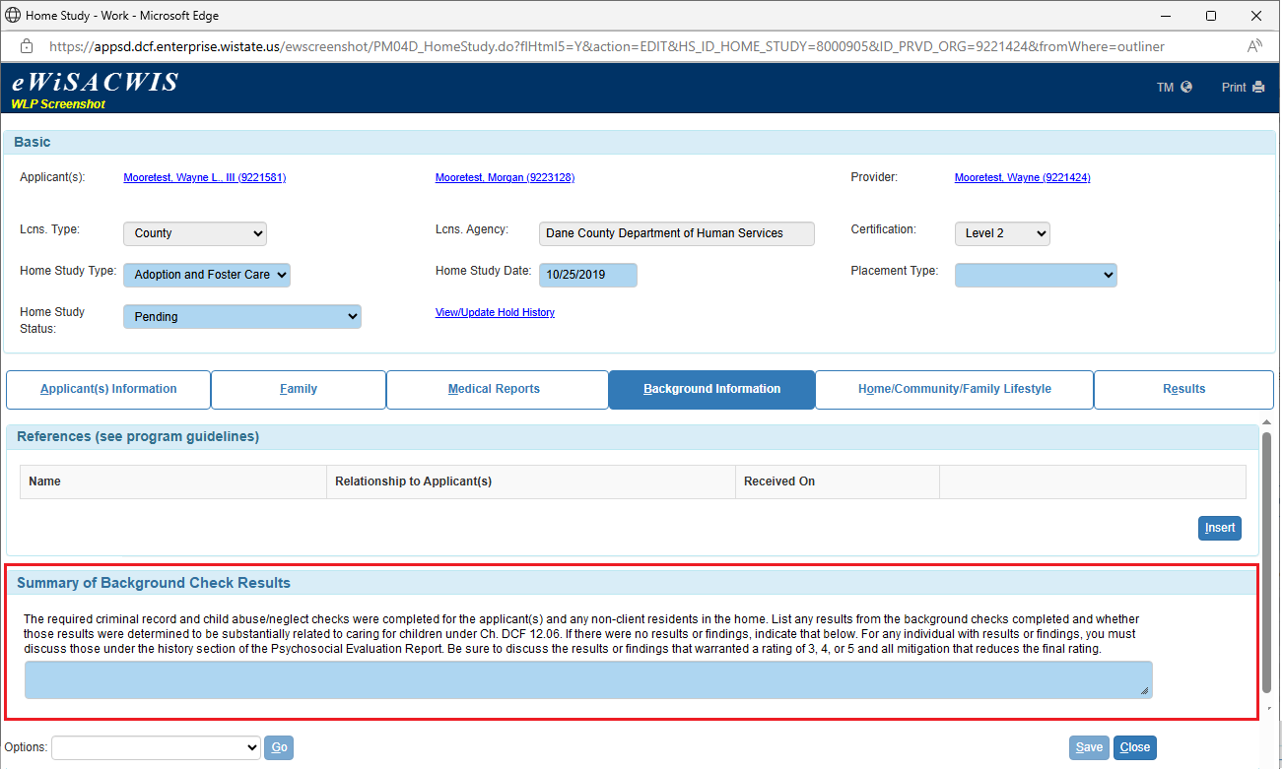
Modified Page: Home Study > Background Information tab
Notes:
Removed Face-to-Face Contacts group box.
Updated Background Check group box to one narrative field.

Slide 13
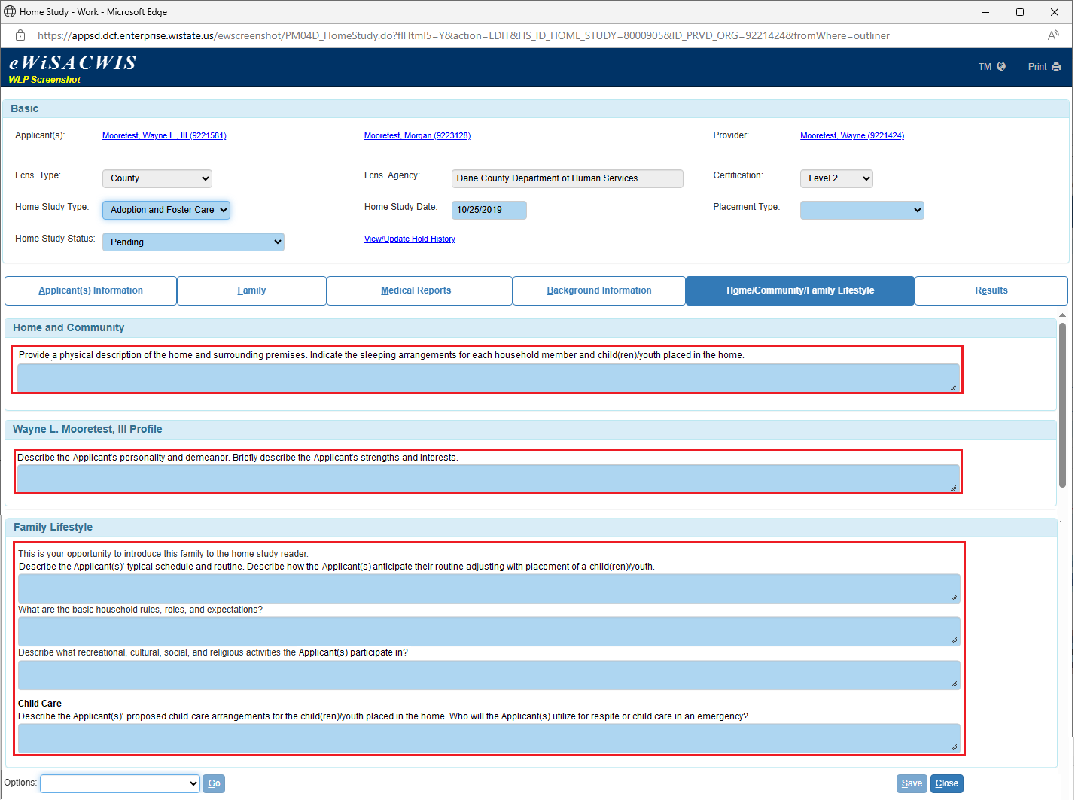
Modified Page: Home Study > Home/Community/Family tab
Notes:
Updated Home and Community group box to one narrative field.
Updated language for narrative field under Applicant’s Profile and Family Lifestyle group boxes.
Removed Privacy section under Family Lifestyle group box.
Removed Legal group box.

Slide 14
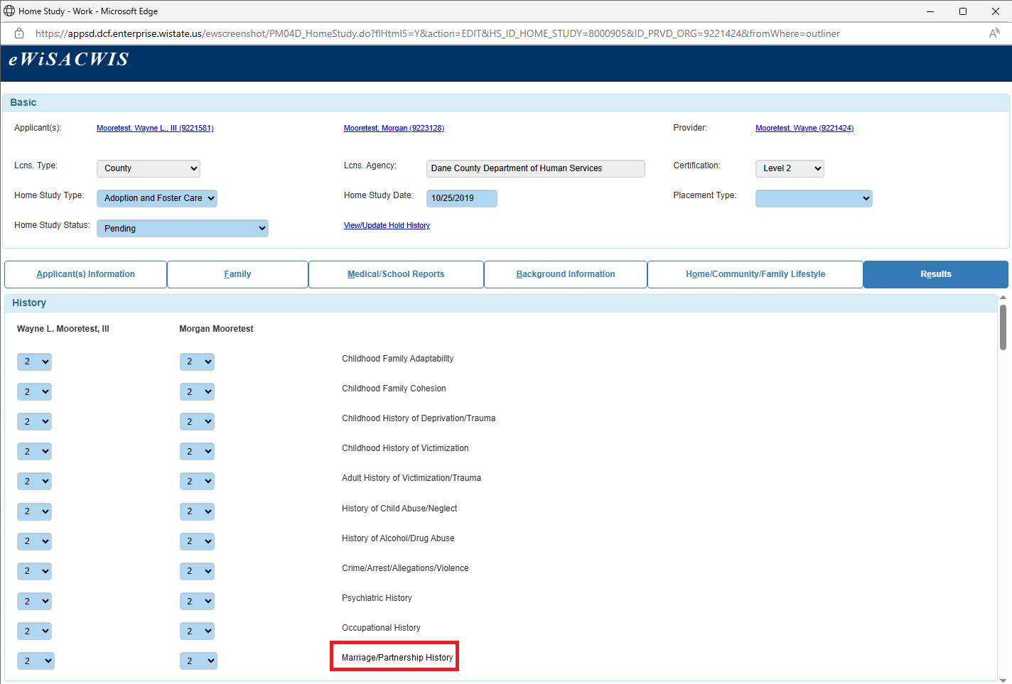
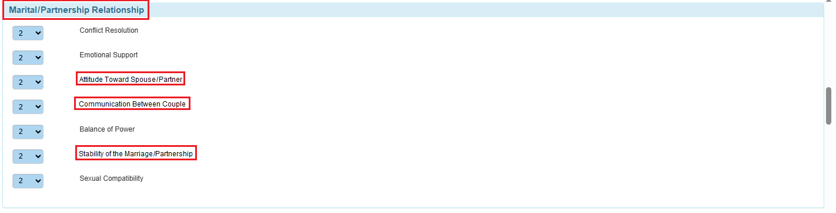
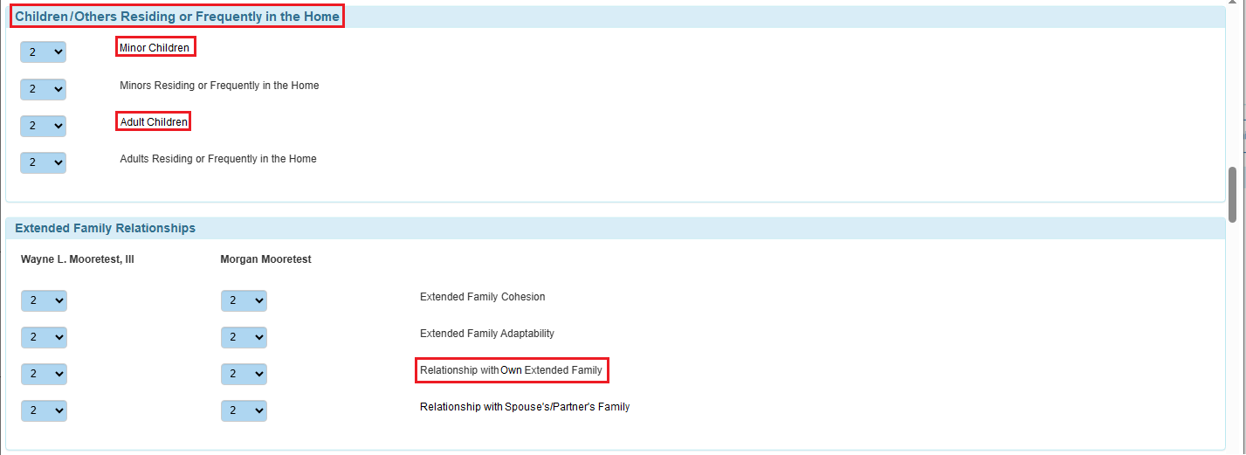
Modified Page: Home Study > Results tab
Notes:
Updated language for the some of psychosocial inventory categories to match SAFE.

Slide 15
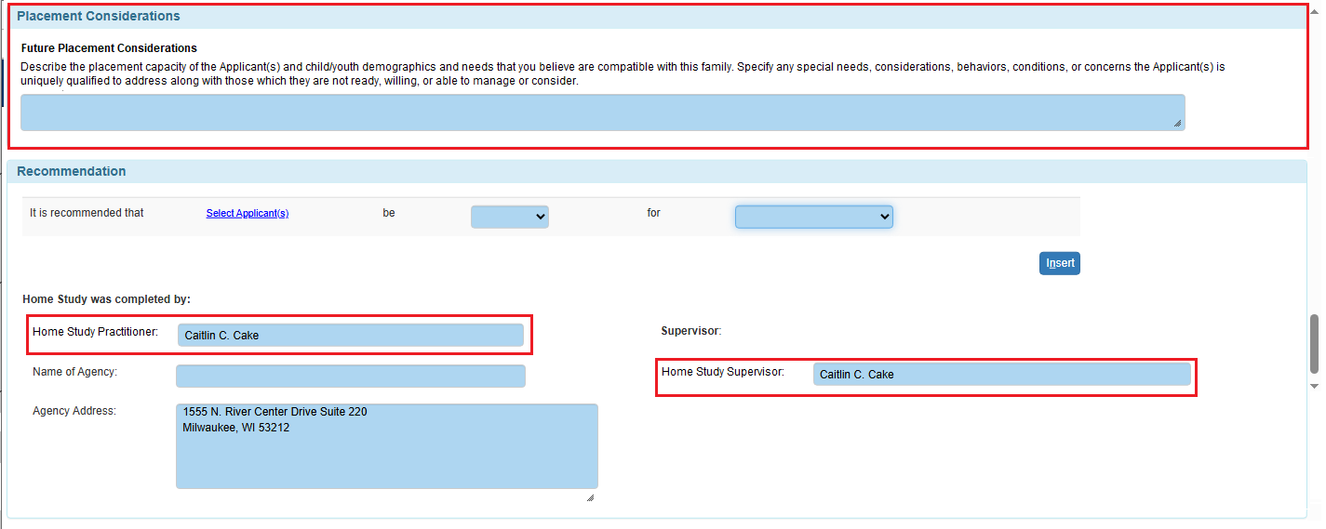
Results Tab > Placement Type(s) = Future Placement or Child Specific
Notes:
Updated Recommendation group box to remove worker/supervisor title

Slide 16
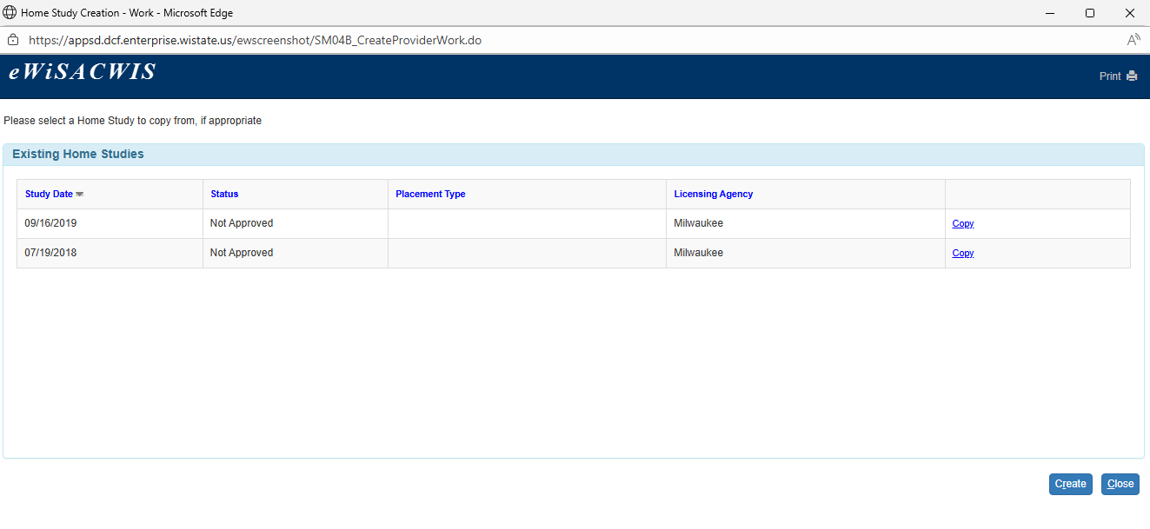
Removed Page: Home Study Creation
Notes:
The modifications to this page affect all future work.
Disabled page, launch Home Study directly from Create Provider Work.
Removed all copy over fields from Home Study and associated Psychosocial Evaluation Report.

Slide 17
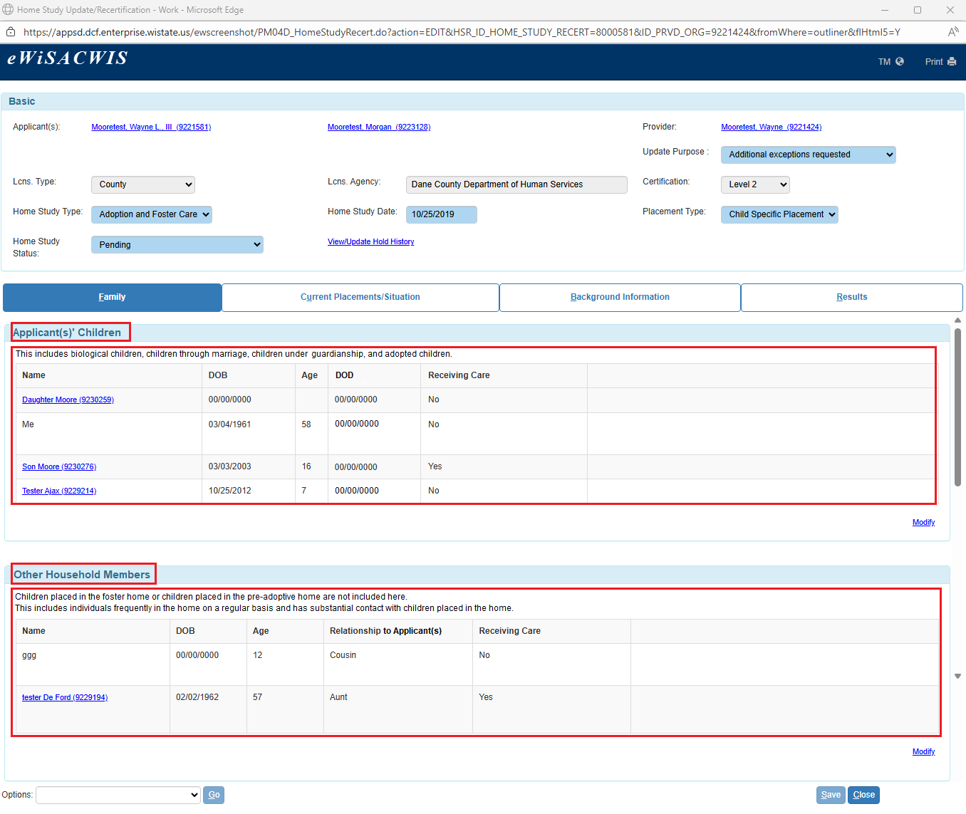
Modified Page: Home Study Update/Recertification > Family tab
Notes:
Renamed the Sons and Daughters of Applicant(s) and Others Residing or Frequently in the Home group boxes.
Removed fields from the Sons and Daughters of Applicant(s) and Others Residing or Frequently in the Home group boxes.
Removed the Extended Family Members group box(es)

Slide 18
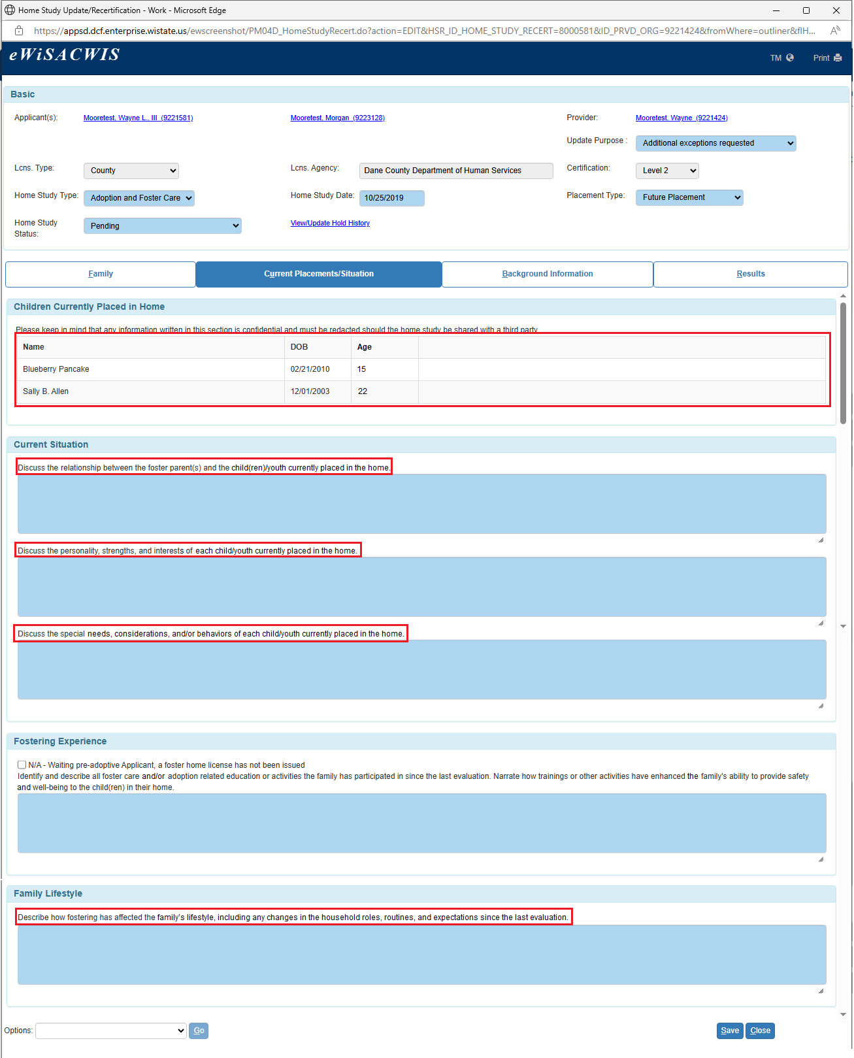
Modified Page: Home Study Update/Recertification > Current Placements/Situation tab
Notes:
Updated group box name.
Updated language for narrative fields.

Slide 19
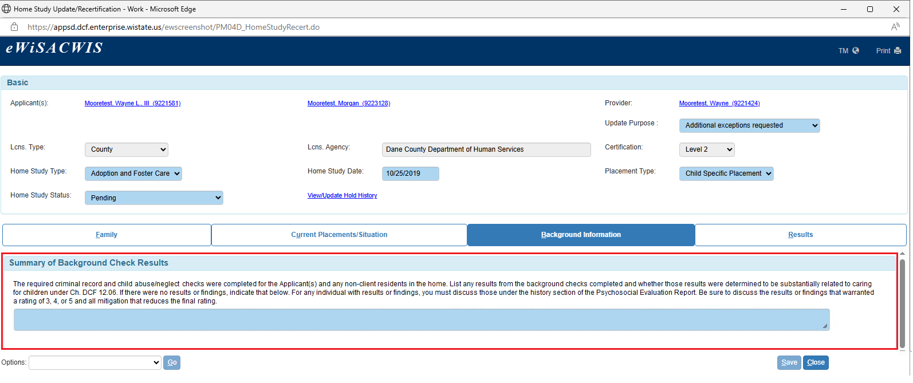
Modified Page: Home Study Update Recert> Background Information tab
Notes:
Removed Face-to-Face Contacts group box.
Updated Background Check group box to one narrative field.

Slide 20
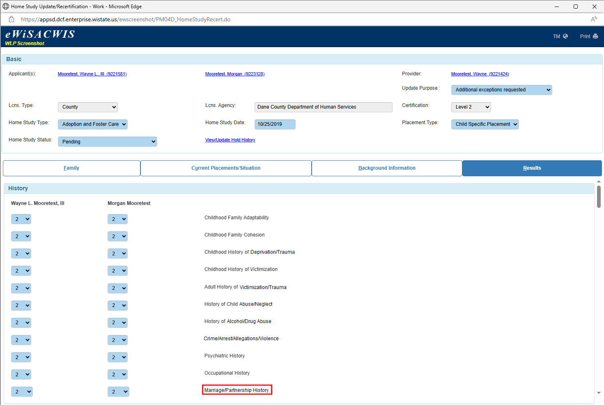
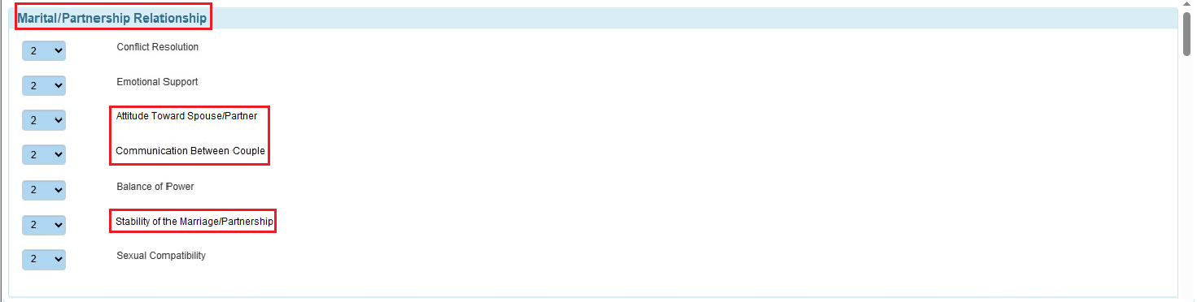
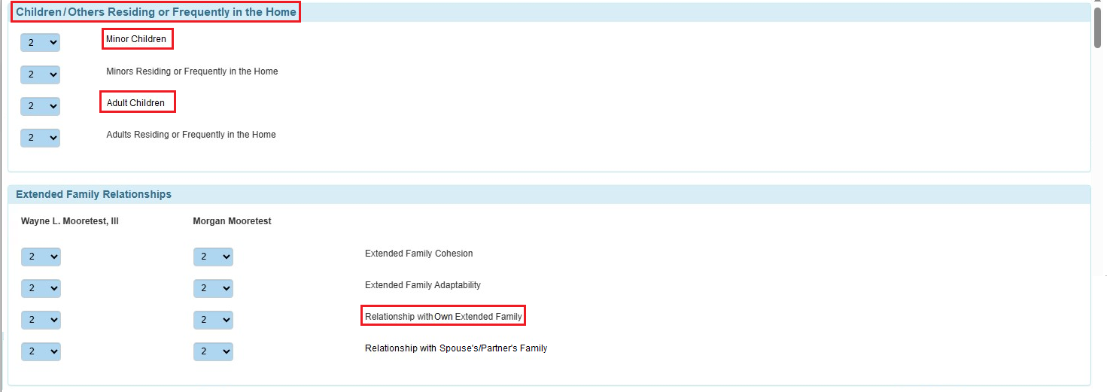
Modified Page: Home Study Update Recertification> Results tab
Notes:
Updated language for the some of psychosocial inventory categories to match SAFE.

Slide 21
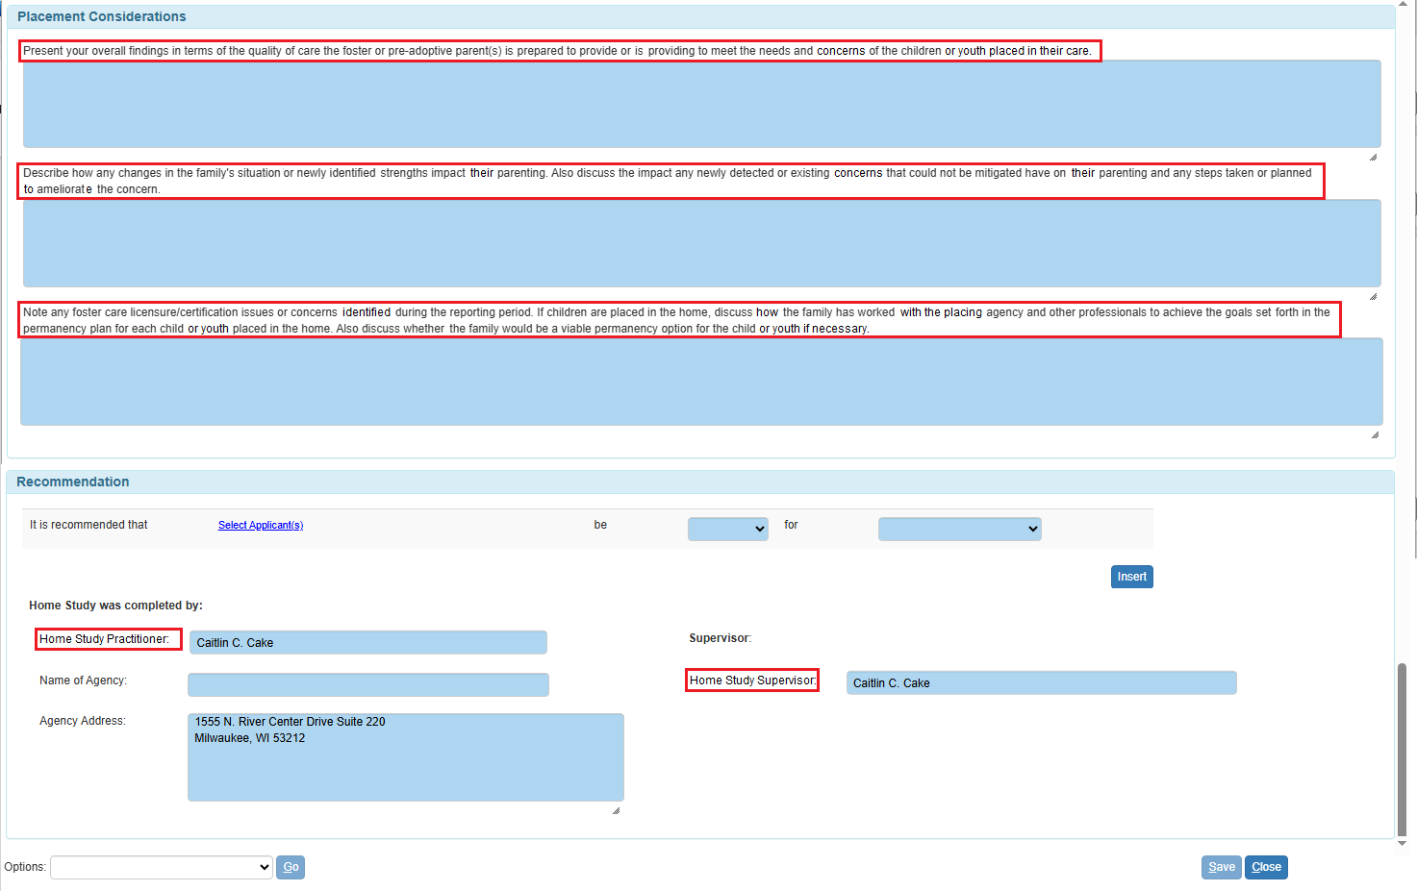
Modified Page: Home Study Update Recertification> Results tab
Notes:
Updated Placement Considerations narrative fields.
Updated Recommendation group box to remove worker/supervisor title

Slide 22
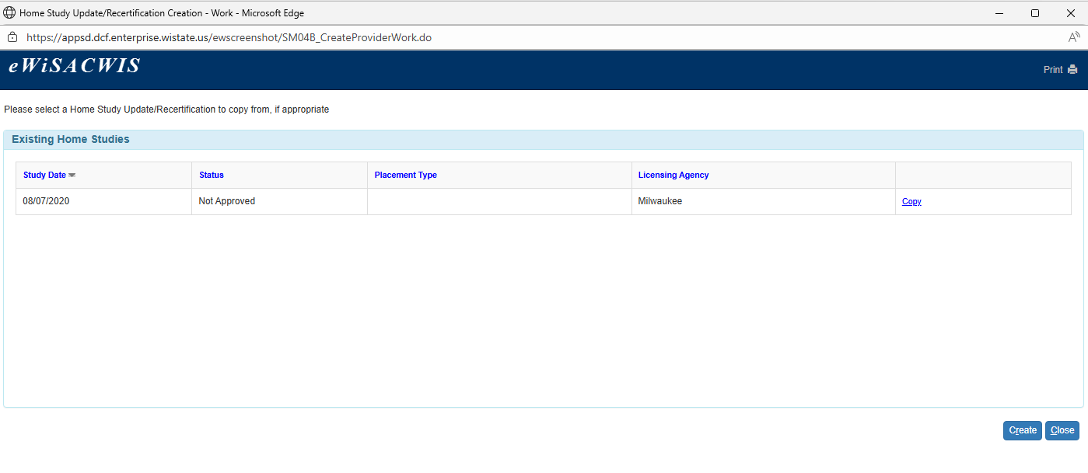
Removed Page: Home Study Update/Recertification Creation
Notes:
The modifications to this page affect all future work.
Disabled page, launch Home Study Update/Recertification directly from Create Provider Work.
Removed all copy over fields from Home Study Update/Recertification and associated Psychosocial Evaluation Report.

Slide 23
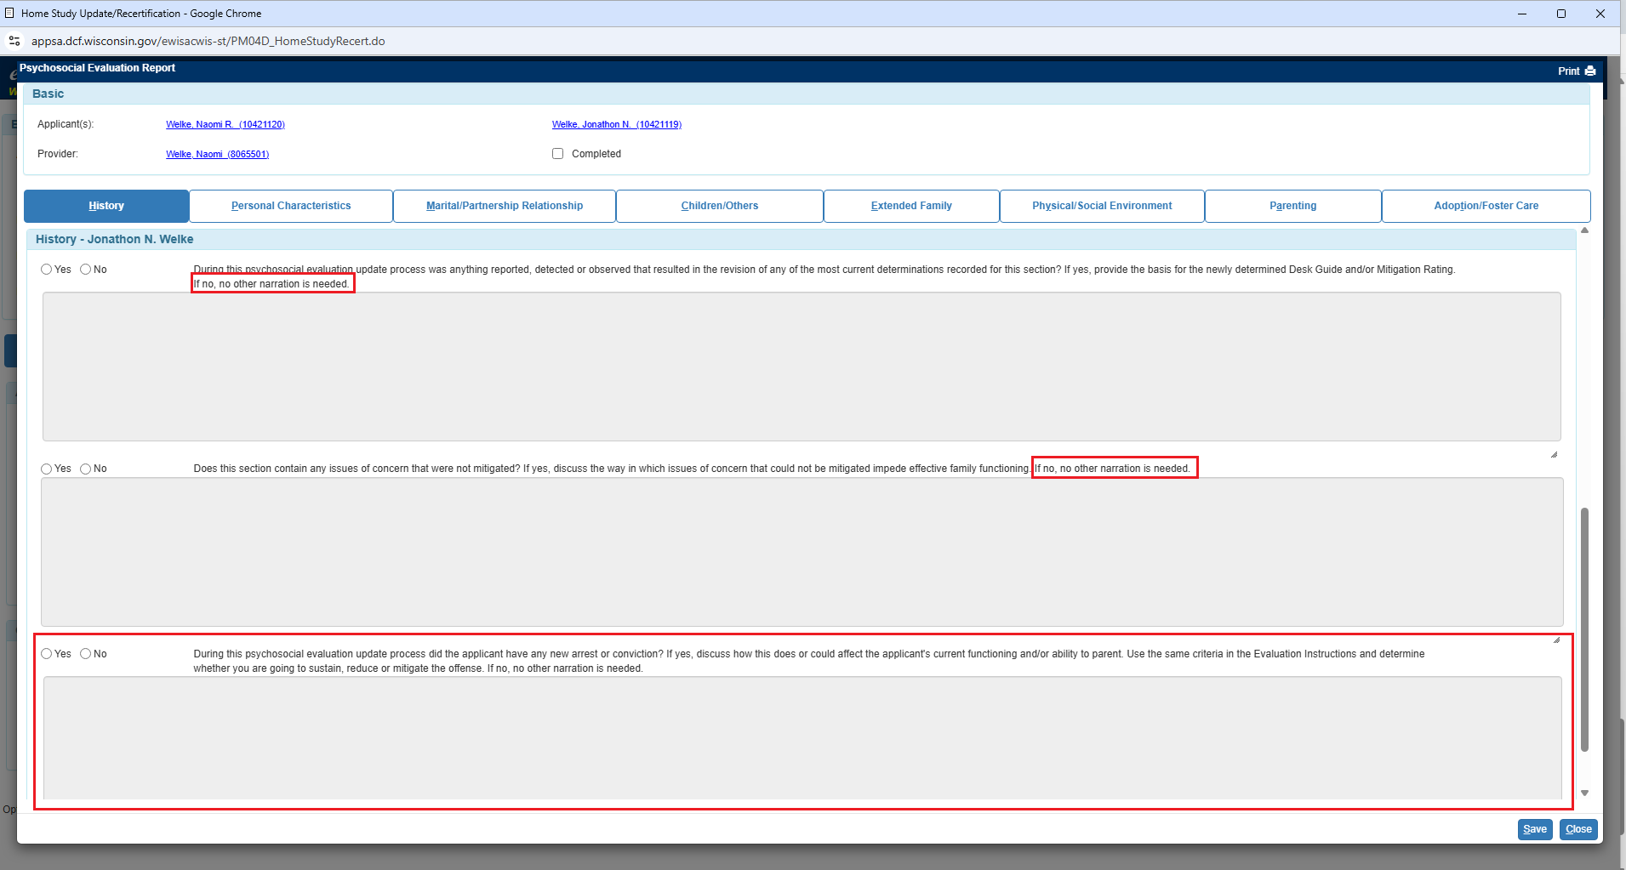
Modified Page: Psychological Evaluation Report
Notes:
There are no substantive changes to the psychological evaluation report due to SAFE's proprietary rights. There are specific narratives that may be changed in the future to be more strength-based and impactful.
Updated language for narrative fields across all tabs to align with SAFE requirements.
Added some new narrative field, dependent on the response to other questions.
The modifications to this page affect only Home Study Update/Recertifications created after the release in which this change occurs. Previously created Home Study Update/Recertifications, including pending Home Study Update/Recertifications keep the prior format and document.

Slide 24
Family Case Plan

Slide 25
Family Case Plan Updates
Enhance engagement
New tabs “ICWA” and “Collaboration/Partnership” will be added to Family Case Plan.
Center family voice
Updates on Planning and Services Tab to include individual strengths and progress towards goals.
Dynamic Printing Options
Notes:
enhance engagement center family voice

Slide 26
New Tab: ICWA/WCWA
Appears based off child(ren)/youth’s person management when membership status is pending, eligible/not a member, and member for at least 1 child on the plan.
ICWA/WICWA tab does not appear if no child meets ICWA eligibility criteria
Add tribe name under each child.
Insert ICWA links to online ICWA resources
Create connection between Case Information Page and FCP

Slide 27
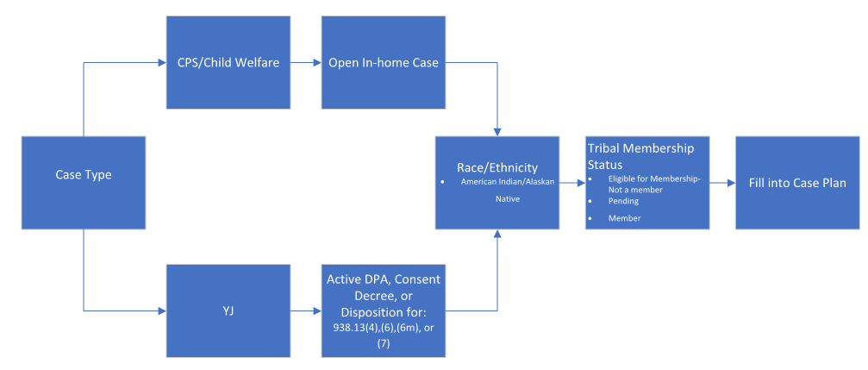

Slide 28
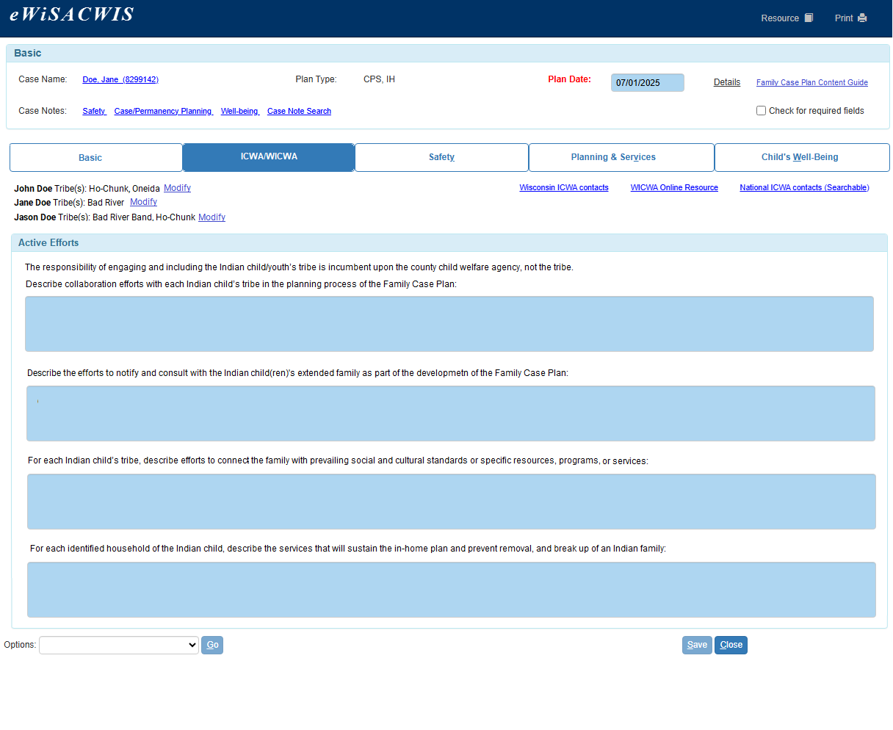
Newly added ICWA/WICWA tab to the Family Case Plan

Slide 29
Updates to Planning and Services tab
Updated Planning and Services tab for Family Case Plan with question on strengths.
Allowing family and child welfare professional to identify general strengths to make connection to services.
Applicable for all cases: CW, JIPSand CPS type.
Updated Planning and Services tab to include information on progress towards goals.

Slide 30
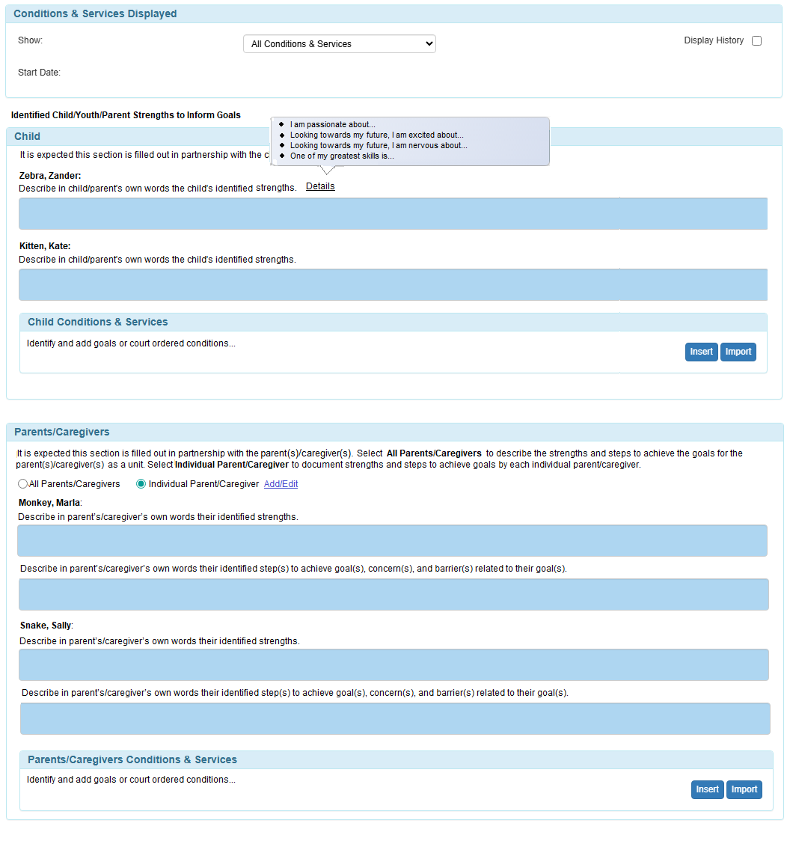
Modified Page: Planning and Services tab
Notes:
Added fields to the Planning & Services tab that capture child/parent strengths

Slide 31
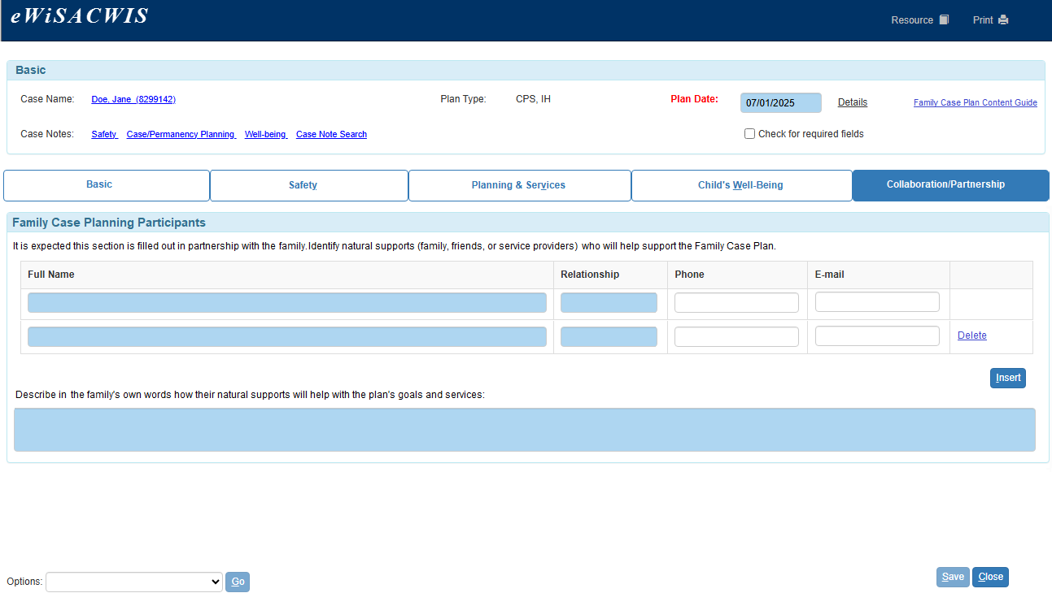
New Tab: Partnership Tab
Notes:
Add static text prompt
Add Goal Planning Participants box
Add narrative text field

Slide 32
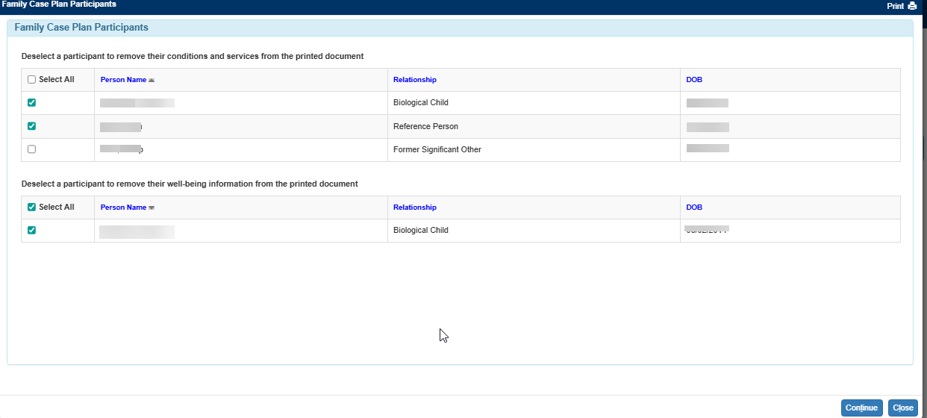
Dynamic Printing Options: Minimize Child Well-being from Family Case Plan
Notes:
This page allows child welfare professionals to customize printed Family Case Plan documents by selecting which child, youth or parent information is included.

Slide 33
Enhancements Continued:
Update 'Case Plan' to 'Family Case Plan' in all instances within the Family Case Plan
Updates to Create Case Work drop down to display both Family Case Plan and Permanency Plan
Updates on Safety Tab to display based on identified logic.
logic to display tab when the family has an active safety plan.
Ensure safety plan connected to the Family Case Plan is tied to the house where the child resides.

Slide 34
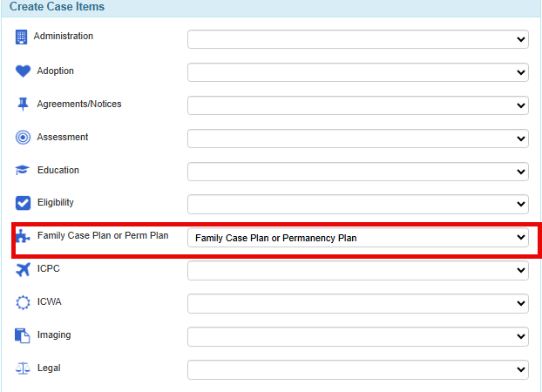
Updated Label/High Visibility: Family Case Plan

Slide 35
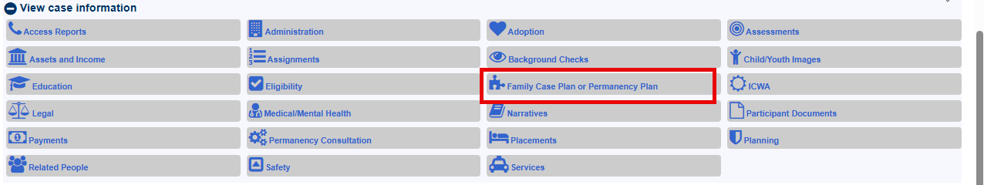
Updated Label/High Visibility: Family Case Plan

Slide 36
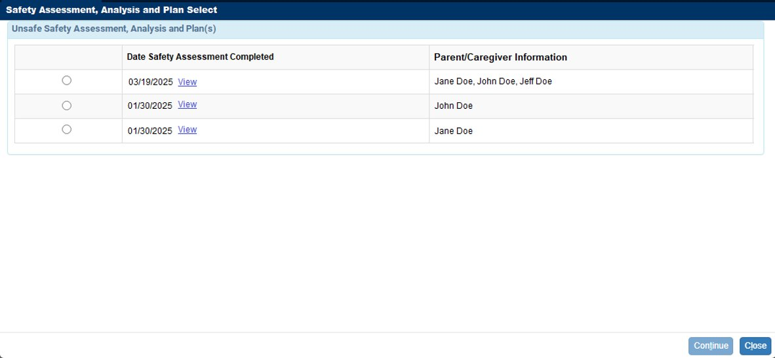
New Safety Tab Logic
Notes:
-On slide- review other dynamic print options available

Slide 37
TSSF Validations

Slide 38
Overview:
Update to the TSSF validations to include Family Case Plan anywhere eWiSACWIS captures Safety and/or Protective Plan

Slide 39
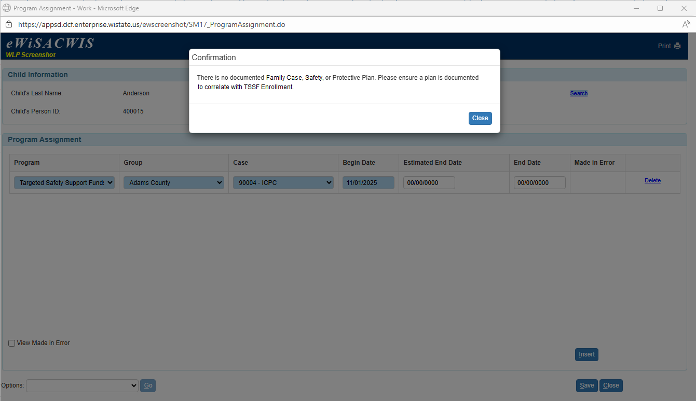
Modifications were made on Program Assistant Page
When saving a Program Assistant with Program Type = Targeted Safety Support Funds (TSSF), the system validates whether an appropriate plan is documented for the case.
No validation message appears if any of the following conditions is met:
A safety plan exists with a Final Safety Decision = Unsafe and all required Plan Analysis questions answered “Yes.”
A Protective Plan exists and “Was a Protective Plan implemented?” = Yes.
An ongoing or Approved Family Case Plan exists.

Slide 40
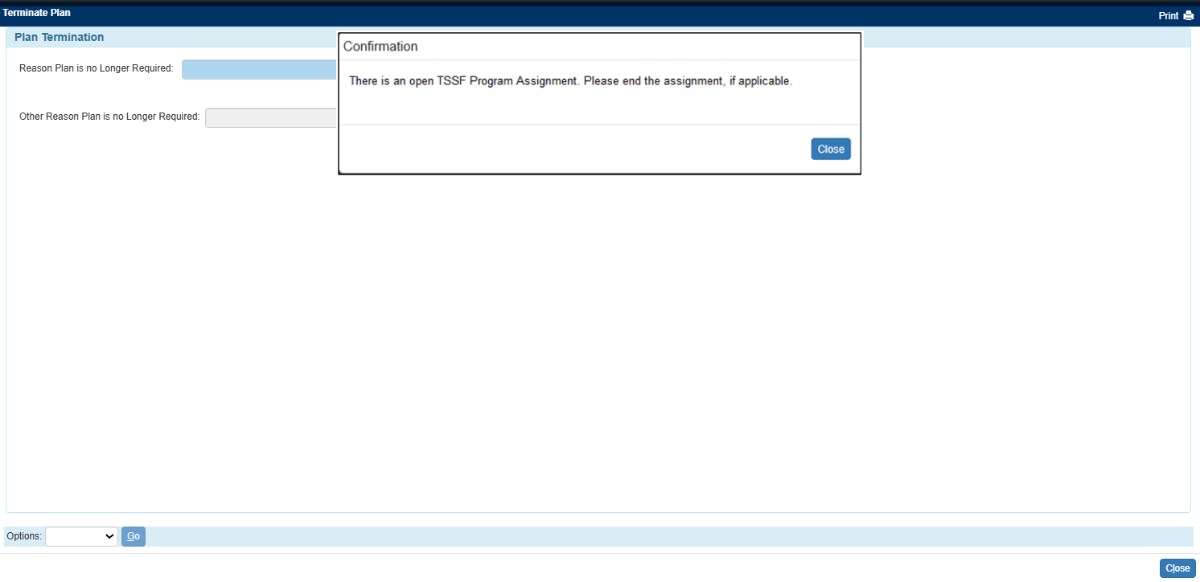
Modifications were made on Terminate Plan Page
Added informational message to the Terminate Plan page before final approval notifying user of open TSSF Program Assignment

Slide 41
DRAI Made in Error

Slide 42
Overview:
Added “Made In Error” functionality to the DRAI (Detention Risk Assessment Instrument)
The functionality applies to all counties
Ability to mark the DRAI as “Made In Error” relies on the user’s Security Profile.
Documenting the DRAI as “Made In Error” also marks the associated piece(s) of work (YJ Referral, JSDR Record (if exists) and Court Hearings row (if exists for Milwaukee CYFS only)) as “Made In Error.”

Slide 43
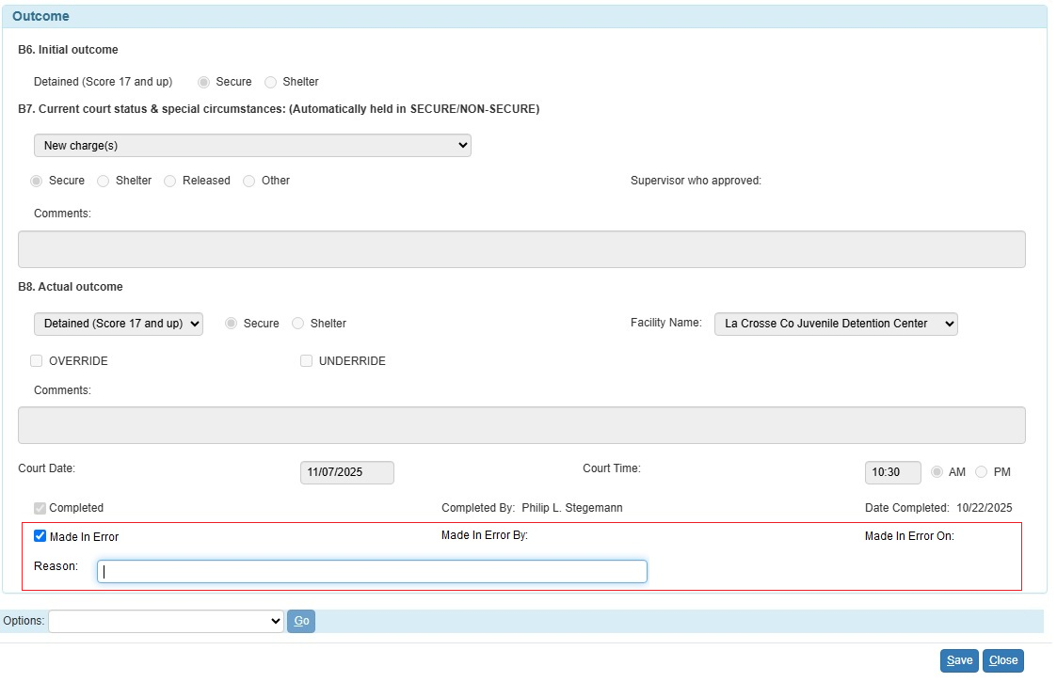
Modifications were made on Maintain DRAI (Detention Risk Assessment Instrument) page
Notes:
Added a “Made In Error” checkbox to the outcome section of the DRAI.
We know that some counties have multiple people may use DRAI information.
Record who checks the checkbox and the time user checks checkbox
Add an optional narrative to capture the “Reason” for marking the DRAI as “Made In Error.”
The DRAI is tied to several other pieces of work in eWiSACWIS – we have also added processing to remove that associated work when user marks the DRAI as made in error.

Slide 44
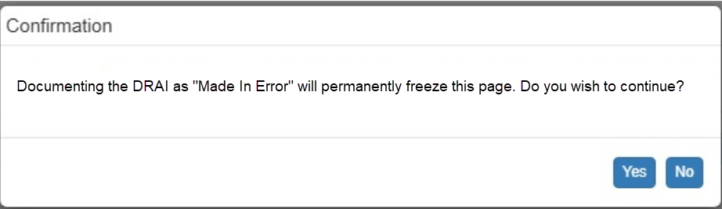
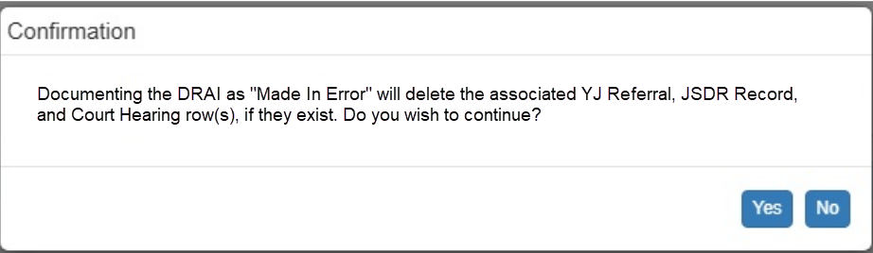
Ability to mark as "made in error" before or after marking DRAI as "completed"
New Confirmation Message – Before DRAI marked “completed”
New Confirmation Message – After DRAI marked “completed”
Notes:
This checkbox will work both before and after a DRAI has been marked as “completed”
The “completed” checkbox is what associates a DRAI with other work (like a JSDR admission, a YJ referral, and (for Milwaukee only) court hearing information).
If marked as Made in Error before DRAI is “completed,” message will display that the page will be permanently frozen. You might use this option if you saved the page before marking the assessment as completed.
If marked as Made in Error after a DRAI is “completed,” a message will display that the associated YJ referral, JSDR Record, and (for Milwaukee only) the court hearing row(s) will be deleted if you proceed.

Slide 45
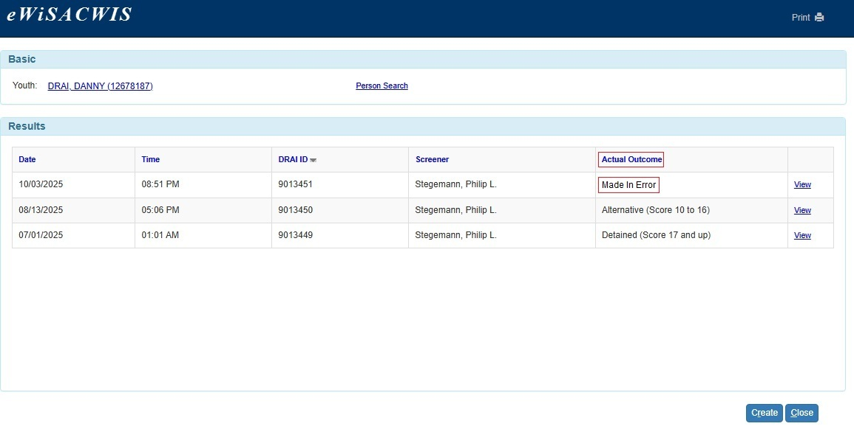
Ability to see DRAI(s) marked as “Made in Error” in "Actual Outcome" field
Notes:
Modified the logic for the “Actual Outcome” column to account for DRAIs that users document as “Made In Error.”

Slide 46
Impact of “Made in Error” on associated work
YJ Referral
Referral is deleted
If referral is only thing linked to a YJ case type when marked in error, will leave case empty.
However, if referral is de-linked from YJ case type before DRAI marked as MIE, normal case removal processing will apply.
JSDR Admission
Admission is deleted
Court Hearings (Milwaukee CYFS Only)
Court hearing is deleted
Depending on the situation, can recreate any needed information via a new DRAI or directly in the YJ Referral, JSDR, or Court Hearing pages.
Notes:
YJ Referral: Modified the background processing for the YJ Referral to account for setting the associated DRAI to “Made In Error.”
Delete the YJ Referral that eWiSACWIS automatically creates as the result of completing a DRAI if the user sets the status of that DRAI to “Made In Error”.
Remove any assignments associated with the YJ Referral that eWiSACWIS automatically creates as the result of completing a DRAI if the user sets the status of that DRAI to “Made In Error”.
JSDR: Modified the background processing for the Secure Detention Registry to account for setting the associated DRAI to “Made In Error.”
Delete the Secure Detention Registry record that eWiSACWIS automatically creates as the result of completing the DRAI if the user sets the status of that DRAI to “Made In Error”.
Remove any assignments associated with the Secure Detention Registry record that eWiSACWIS automatically creates as the result of completing the DRAI if the user sets the status of that DRAI to “Made In Error”
Court Hearings: Modified the background processing for the Court Hearings page to account for setting the associated DRAI to “Made In Error.”
Delete the row eWiSACWIS automatically inserts on the Court Hearings page with an “Intake Method” = “DRAI” if user documents that DRAI as “Made In Error”.

Slide 47
Exposure to Domestic Violence Descriptor

Slide 48
Overview:
Add Exposure to Domestic Violence descriptor to the Description page - allowing users to discretely capture this information on reports and assessments

Slide 49
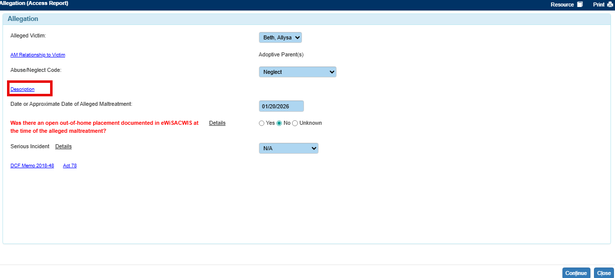
Launched from Allegation page, Description hyperlink
Notes:
This is a straightforward change so we’ll just go quickly through a few screenshots so you can see where you’ll find it. In the CPS report when you click on the ‘description’ hyperlink…

Slide 50
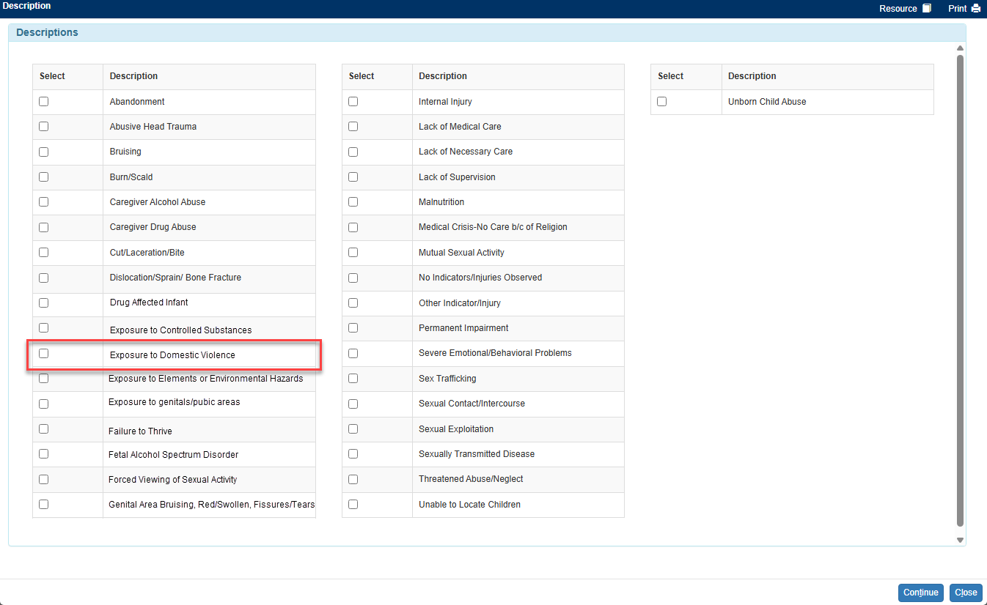
Allegation Page> Descriptions Hyperlink > Descriptions
Notes:
You’ll see that we added Exposure to Domestic Violence checkbox and label. We’ve heard from agencies that this is an allegation indicator that would be helpful for data tracking purposes. As of now there’s no way to get an accurate representation of how many reports involve DV as part of the allegation. By adding this it will be easier to track how many reports indicate the presence of domestic violence.

Slide 51
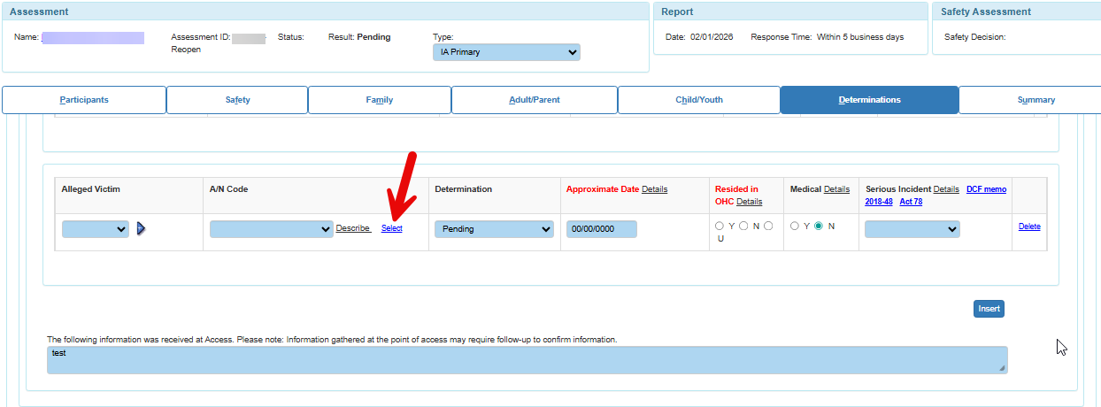
Launched from Assessment page, Determinations tab, A/N code Select hyperlink for inserted row
Notes:
If that is selected at access, you’ll see it prefill into the IA.
If during the IA the IA professional determines it’s necessary to add an allegation, they can also ‘click on select’ to add a descriptor...

Slide 52
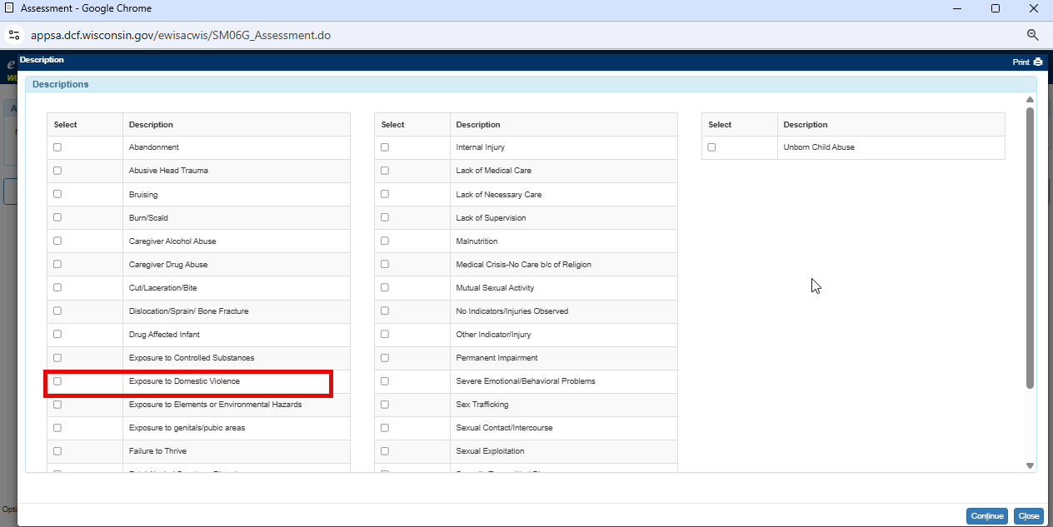
Assessment Page> Determinations tab, A/N code select Hyperlink > Descriptions
Notes:
Once selected the user sees that same list that is used at access and exposure to domestic violence is there as well.

Slide 53
Development Roadmap
2026

Slide 54
June 2026
Additional updates to Family Case Planning to better support collaboration with Youth Justice cases and integration with Case Notes
Improvements to SYNC provider portal to better support complex referral workflows
Access workflow updates to reflect the changes to response time.

Slide 55
Recurring Webinar Series

Slide 56
Webinar Topics
Upcoming Releases
Review of common workflow struggles, regular helpdesk calls
General feedback sessions
What else might you like to see these sessions used for?
Next Session: Thursday, February 26th @ Noon.
Topic: Youth Justice workflows in eWiSACWIS

Slide 57


Thank You!
Thank you, everyone, for your participation.

