Slide 1
Welcome Back!
1
Notes:
Welcome participants back and remind them of basic logistical information (location of bathrooms, timing of breaks, etc.).
Ask the participants to share any experiences or insights they may have had since the last session. Allow 5 to 10 minutes for discussion. The tools are on the next slide if participants need to refer back to get the discussion going.

Slide 2
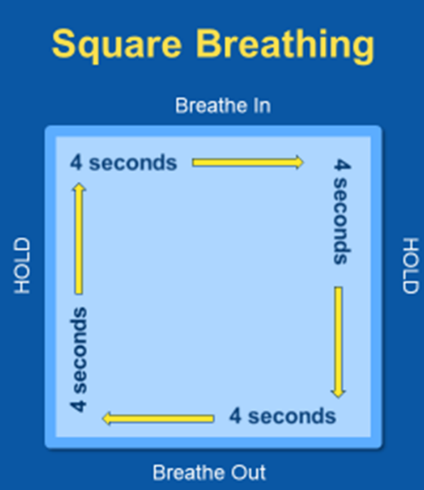
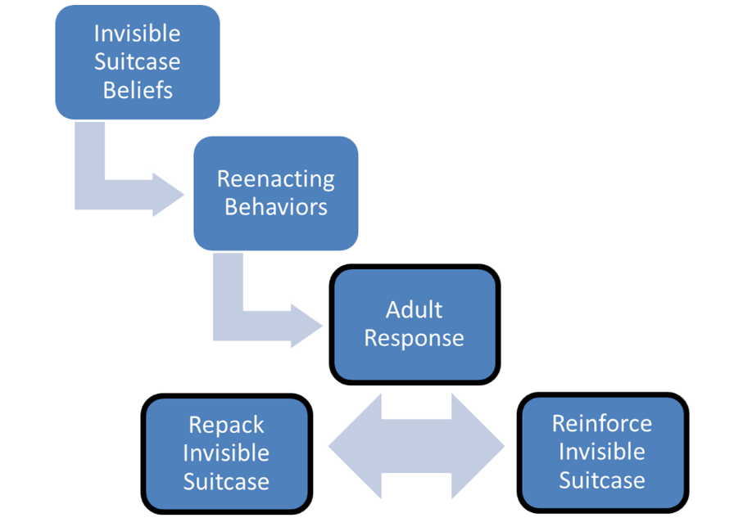
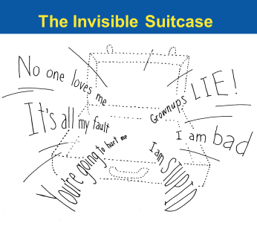
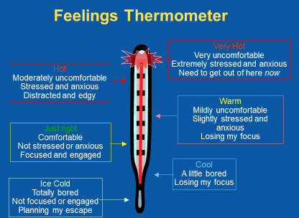
Tools from our Trauma Toolkit
Re-enactment Cycle
2
Notes:
Did anyone use the tools since the last session? If so, how did it go?

Slide 3
Chapter 8: Becoming an Advocate
Illustrations by Erich Ippen, Jr. Used with permission.
Notes:
Remember in the last chapter when we watched ReMoved 2: Zoe’s Foster Mom played a strong advocate role in her life. We saw this when the foster mom, birth mom and Zoe were in the psychiatrist’s office discussing medication, with the adoption worker to keep Zoe and her brother together and the “behind-the-scenes” advocacy the foster mom probably did with Zoe’s school. That’s the kind of advocacy we will be talking about today.

Slide 4
Essential Elements 7 and 8
Be an advocate for your child.
Promote and support trauma-focused assessment and treatment for your child.

Slide 5
Know the Child’s Team (Large Group Discussion)
Caseworker
Legal team
Foster Parents
Educators
Child
Therapist
Medical team
Birth parents
Other birth family members
Notes:
Think about who is on the child’s team. What are some other positive connections that could be included? Possibly CASA volunteers, mentors, coaches, and others?

Slide 6
Working as a Team
The team members involved in the child’s life:
Share a team commitment to the child’s well-being through a unified vision
Have distinct roles and responsibilities
Relate to the child in different ways
May need their own supports and resources
May not all be trauma-informed
Notes:
Trainer’s Note – as a result of participating in this training you now understand what trauma is and its impact; not all others have that knowledge and may not be equally trauma-informed…

Slide 7
Team Puzzle Activity
Notes:
TEAM PUZZLE ACTIVITY
Divide participants into small groups (ideally 7 participants per group).
Refer participants to the story of Josh Jr. (JJ) case story in the supplemental materials on page 19. The facilitator or volunteer participant should read aloud the case story to the large group.
Give puzzle pieces to the small groups (7 pieces – one per person, or more if there are fewer than seven small group members)
Small groups will distribute puzzle pieces within their small group. The participant holding the puzzle piece will read it aloud, and when finished, lay the puzzle piece face up on the table assembling the puzzle as the story continues. The puzzle pieces are to be read in the following order:
Teacher
Principal
Joshua Jr. (JJ)
Officer
Sadie
Social Services
Joshua Sr
When all small groups have completed assembling their puzzle, begin large group discussion around the importance of teaming. “You don’t have to do this yourself, you are not alone.”
Conversation prompts:
How did you experience this activity?
Are emotions attached to your experience?
Was there a particular statement or one person more than the others that had an impact on you?
Did your opinion of the situation change after hearing everyone’s story?
How might teaming benefit your “somebody”?

Slide 8
Trauma-Informed Advocacy
Help others to understand the impact trauma has had on the child.
Promote the importance of psychological safety.
Assisting others by identifying the cause of the behavior
Share strategies for helping the child manage overwhelming emotions and problem behaviors.
(Continued)

Slide 9
Trauma-Informed Advocacy (Continued)
Support the positive, stable, and enduring relationships in the life of the child.
Help others to identify & appreciate the child’s strengths and resilience.
Advocate for the trauma-specific services and supports the child needs.
Know when other on the team need support, including yourself.
9

Slide 10
What if all the Team Members are not on the same page?
Think about where each team member is coming from (remember everyone has an iceberg, invisible suitcase)
Acknowledge sometimes there are laws, procedures and requirements that need to be followed
Remember it is okay to disagree
10

Slide 11
What if all the Team Members are not on the same page?
Organize a meeting with all team members, without the child present
Give each team member an opportunity to share their concerns and ideas for moving forward
Develop a strength-based collaborative plan
11
Notes:
Consider setting safety rules for the meeting (everyone has the chance to speak, will be treated respectfully) and possible time limits for contributions.

Slide 12
Partnering with Team Members ("My Somebody" Worksheet)
Respect the connection that children share with their parents, other family members, current and past foster parents, service providers, and other trusted adults such as teachers.
Use your understanding of trauma when interacting with other team members.
12
Notes:
Relationships between team members can be complicated and interactions can some times be tense, depending on the circumstances. When members respect one another, keep their focus on the child and remember that trauma can affect anyone on the team, professionals included, everyone benefits, especially the child.
Turn to your “My Somebody” worksheet in Chapter 8: “My Somebody’s” Key Team Members and take some time to list some of the members of your “Somebody’s” team and steps you can take to work together in more effective-trauma-responsive ways.

Slide 13
The most helpful part of this workshop was:
“Being in community with others knowing what we’ve been through”
(Marathon County Participant)
Notes:
You may remember this quote from Week 1. It speaks directly to what we are hoping to discuss today – the shared experience and working together towards a common goal.

Slide 14
Let’s take a break!
Notes:
After break ask the participants to complete the post-surveys and hand them back to you.

Slide 15
When to Seek Help from a Therapist for the Child
When you:
Feel overwhelmed, helpless, hopeless
When the child:
Displays reactions that interfere with school, home and community
Talks about or commits acts of self-harm (like cutting) or harming others, including bullying
Has trouble falling asleep, wakes up often during the night, or frequently has nightmares
(Continued)
Notes:
Sometimes children who have experienced trauma have difficulty making and/or keeping friends.

Slide 16
When to Seek Help from a Therapist for the Child (Continued)
When the child:
Asks to talk to someone about his or her trauma
Talks over and over again about the trauma or seems “stuck” on one aspect of it
Seems plagued by guilt or self-blame
Expresses feelings of helplessness and hopelessness
Complains of frequent physical problems but checks out okay medically

Slide 17
Trauma Assessment
Trauma assessment is important for any child who has experienced trauma.
Includes gathering a thorough trauma history
Seeks input from you and others who know the child
Should be used to determine the treatment plan
Should be shared with caregivers

Slide 18
The Basics of Trauma-Informed Treatment
Common elements of effective treatments:
Research-based
Include comprehensive trauma assessment, including input from caregivers and other team members
Based on a clear plan that involves caregivers
Trauma-focused
Notes:
You have the right to ask questions about the therapy your child is receiving. If these elements are not present you have the right to ask why and change providers, if necessary. We will go through a list of specific questions you can ask in a few moments.
Examples of other tools for self-regulation and/or mind/body connection that may be helpful are: yoga and meditation

Slide 19
Ineffective or Harmful Treatments
Beware of:
Treatments that promise an instant cure
Treatments that do not appreciate the effects of trauma
Notes:
Here are some “red flags” to look for if you are unsure of the quality treatment the child is receiving:
Effects of trauma missed or underappreciated
Goals of therapy unclear
Inconsistent care
Therapy seems to be upsetting child

Slide 20
The Reality of Trauma-informed Therapy
Behaviors may initially increase after a therapy appointment, but they should decrease over time
The child may take some time in sharing their stories with the therapist; it doesn’t always happen right away
Transitions in therapists may cause setbacks in the child’s progress, however the child may avoid therapy or request a new therapist when the therapist begins to process the traumatic events with the child
Trauma-informed providers may not be available in your area
Trauma therapy is the start of a child’s healing; processing will continue (for years…)
Notes:
Therapy is not a cure-all and should actively involve supportive adults in the child’s life.

Slide 21
What questions could I ask the therapist?
What are the treatment goals?
What is the expected timeline of the therapy?
What will it look like when progress is made?
What will it look like when those goals are met?
What are the possible “side effects” of therapy?
What might be the behaviors associated with the child's diagnosis, if the child has one?
Is the team communicating about the treatment plan?

Slide 22
What questions could I ask the therapist?
How can I support the treatment plan? How can the plan be supported at home/school/day care/by the team?
What is my role in helping the child to heal/What are the expectations of me?
How can I seek a referral for myself?
What is the therapist's professional background and training and how do they treat trauma?

Slide 23
Medications and Trauma
Some medications can be safe and effective
Caregivers should ask questions about:
Medications alone (without therapy)
Medication prescribed for children under age 4
Multiple medications
Side effects that concern you or the child
When in doubt, call a pharmacist
Notes:
In treating trauma, therapy should be paired with medication. As we mentioned earlier, there are no medications for trauma, but only for some of the symptoms (such as hyperactivity, aggression, etc)

Slide 24
The Essential Elements of Trauma-Informed Actions
1. Recognize the impact trauma has had on your child.
2. Help your child to feel safe.
3. Help your child to understand and manage overwhelming emotions.
4. Help your child to understand and modify problem behaviors.
5. Respect and support positive, stable, and enduring relationships in the life of your child.
6. Help your child to develop a strength-based understanding of his or her life story.
7. Be an advocate for your child.
8. Promote and support trauma-focused assessment and treatment for your child.
9. Take care of yourself.
24

Slide 25
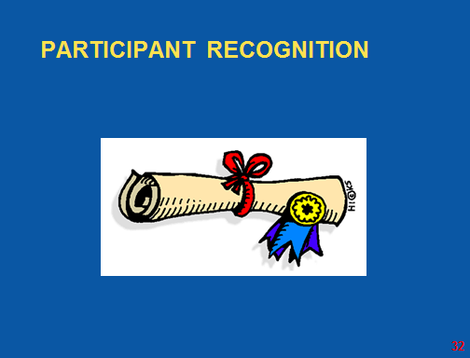
Notes:
Use this opportunity to present the Certificate of Attendance to the participants. Ask each participant to share at least 1 thing that they will continue to use after this workshop
During the recognition play: Blended Family (What you do for love) by Alicia Keys
https://www.youtube.com/watch?v=DWACsH1f2So

Slide 26
Thank you!
Strengthening Families and Systems: Building Positive Relationships with Children Who Have Experienced Trauma
Notes:
Thank the group for their participation in the workshop. Offer congratulations and recognition for their hard work!

