Slide 1
Welcome Back!
1
Notes:
Welcome participants back and remind them of basic logistical information (location of bathrooms, timing of breaks, etc.).
Ask the participants to share any experiences or insights they may have had since the last session. Allow 5 to 10 minutes for discussion. The tools are on the next slide if participants need to refer back to get the discussion going.

Slide 2
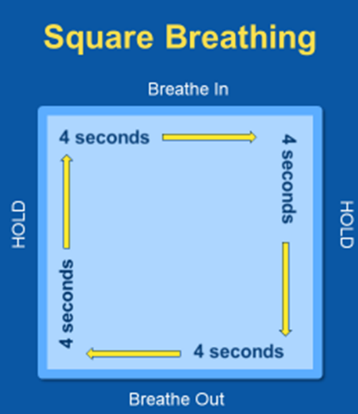
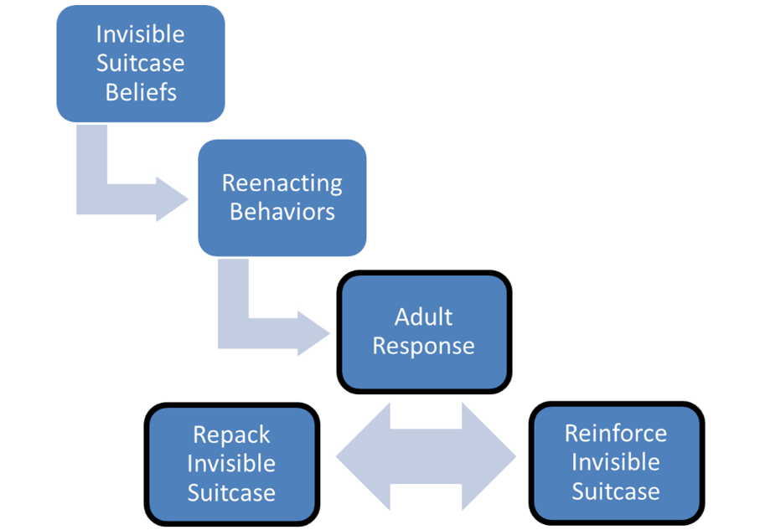
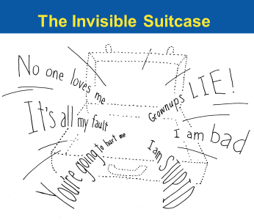
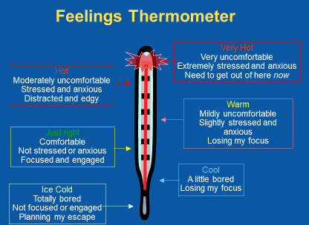
Tools from our Trauma Toolkit
Re-enactment Cycle
2
Notes:
Did anyone use the tools since the last session? If so, how did it go?

Slide 3
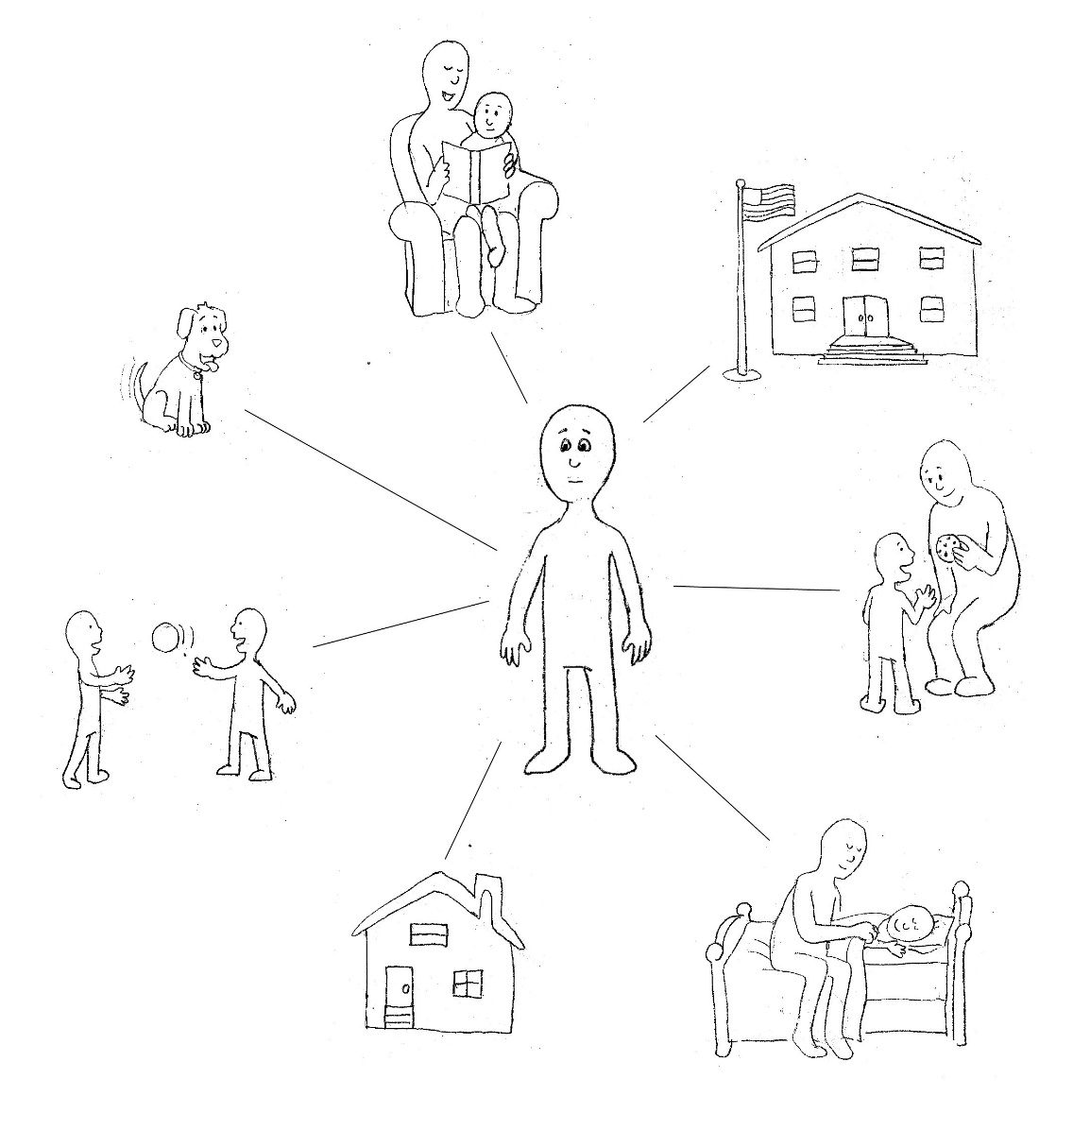
Chapter 7: Connections and Healing
Illustrations by Erich Ippen, Jr. Used with permission.
Notes:
Today we will talk about the importance of past, present and future connections for children (and for us).

Slide 4
What keeps you connected?
Relationships
Family
Friends
Co-workers
Life Stories – Past, Present, Future
Personal
Family
Cultural
Places, things, rituals, and practices
Notes:
Trainer note – Connections give us meaning, helps define who we are, where we belong. Connections are an important part of healing!
Building Resiliency – it just takes one positive, caring adult to make a difference in the life of a child
Life Stories – cultural – we usually think of culture in terms of race, ethnicity, but each household, each community has its own unique culture that can involves customs ranging from holidays celebrated to everyday interactions like mealtimes.
Children carry their life stories with them like the invisible suitcase, for example if a child’s parent is incarcerated or grew up in a violent community they may wonder what that says about them and their life story.
If TF-CBT is available in your community, make a connection to the narrative that children will create in the TF-CBT therapy model.

Slide 5






Name Your Connections . . . (Group Activity)
(Continued)
Notes:
Give each participant 5 index cards or small sheets of paper and ask that they write the 5 most important things in their lives that keep them connected.
Examples of connections are: House, Job, Spouse/Partner, Children, Pets, Holiday Traditions, Spiritual Community, Hobby, Yoga/Meditation Practice

Slide 6
Name Your Connections . . .
(Continued)
Notes:
Then ask that they voluntarily give away 1 card (for the trainer to keep forever).
After collecting the cards from each participant, read aloud to the large group the cards that were given up. A method other TIP trainers have used to enhance this activity is to then rip up the collected cards, but you must know your group to judge if it would be impactful or if it would be too emotional. As we know children in the child welfare system experience a great deal of loss in their lives. How does it feel to lose that important connection?
Then ask the participants to hold their remaining 4 cards up and randomly take 3 of the 4 cards. After taking the cards from all participants, we read them aloud to the large group. Ask the participants if they were able to keep their most important card? Remind participants that at least they were able to keep 1 thing, most children going into foster care leave everything behind.
Suggest participants use Square Breathing if they feel like they are getting warm or hot during and/or after this activity.

Slide 7
Children Define Themselves Through Their Connections to Others
Who am I?
What is lovable about me?
What am I capable of?
How can I survive and make sense out of what’s happened to me?
Who will I be in the future?
Notes:
Trainer’s Note – Children learn who they are, and what the world is like, through the connections they make.
We can support children by honoring their connections and also identifying that it is important for them to be safe. We may experience frustration with ourselves or others who have been important parts of children’s lives, however we must try to be respectful of all team members and must not put in the child in the middle of their connections.

Slide 8
Essential Elements 5 and 6
Respect and support positive, stable, and enduring relationships in the life of your child.
Help your child develop a strength-based understanding of his or her life story.
Notes:
Trainer’s Note – Important relationships can also include teachers, day care providers, social workers, residential care staff in addition to birth parents, foster parents, relatives.
Strength-based understanding of their lives - Children may blame themselves for things that have happened in the past and may need support from adults to see how the things they have experienced can make them stronger. For example, a child who has been in the child welfare system could pursue a career in social work, education, or law and have a greater understanding of his/her role that someone who has not had the same experiences. Trauma does not have to define their lives – by understanding their own story through telling it, children can begin to understand they will have many experiences in their lives and that their past does not have to represent their future. It will always be a part of their lives, but it is not the whole story.
When we help children sustain enduring relationships while building healthy new connections, they are able to put their traumatic pasts into the larger perspective of the ongoing stories of their lives.

Slide 9
ReMoved 2 (Large Group Activity)
Who are Zoe’s connections?
How does the Foster Mom advocate to maintain the connection between Zoe and her little brother?
How does the Foster Mom help Zoe develop a strength-based understanding of her life story?
Notes:
Start the movie at 2 minutes, 35 seconds and watch until the end of the movie.
https://www.youtube.com/watch?v=I1fGmEa6WnY
After the movie is over, ask participants the questions on the slide above.
Here are some examples for Question 2:
Foster Mom tells the social worker that moving the little brother would not be good for Zoe
In psychiatrist’s office – Zoe doesn’t need meds; she needs more interaction with her Mom
Foster Mom arranges visits with little brother Benaiah (Ben-eye-uh).
Example for Question 3: Wizard of Oz scene – “Is that you?...It’s not always about escaping though sometimes you have to learn how to survive inside it..right in the middle of all that spinning you can let the tornado rip apart your heart or you can choose how what has happened to you affect you. Your Mom’s story doesn’t have to be your story…your future can be different”

Slide 10
Let’s take a break!
10

Slide 11
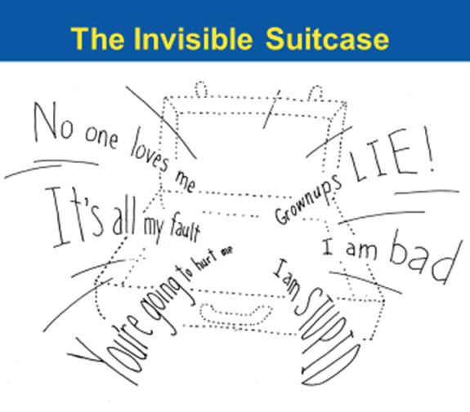
ReMoved 2 (Large Group Activity)
How did Zoe's Mom's life experiences affect her as a mother?
How might her past trauma and Invisible Suitcase influence her actions?
What might she be thinking and feeling?
Notes:
Show participants a piece of flipchart paper with an outline of an invisible suitcase. Ask participants what Zoe’s Mom could have in her invisible suitcase?
Examples:
History of abusive relationships
Lack of involvelment/support from her mother

Slide 12
What can we do? (Large Group Activity)
What are some skills children can learn to help them cope with disappointment and uncertainty?
How can caregivers and professionals help them maintain healthy connections?
What are some self-care strategies caregivers and professionals can use in challenging times?
Notes:
Have participants discuss the slide questions in a small group. After a few minutes regroup and as a large group discuss the questions.

Slide 13

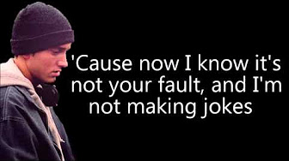
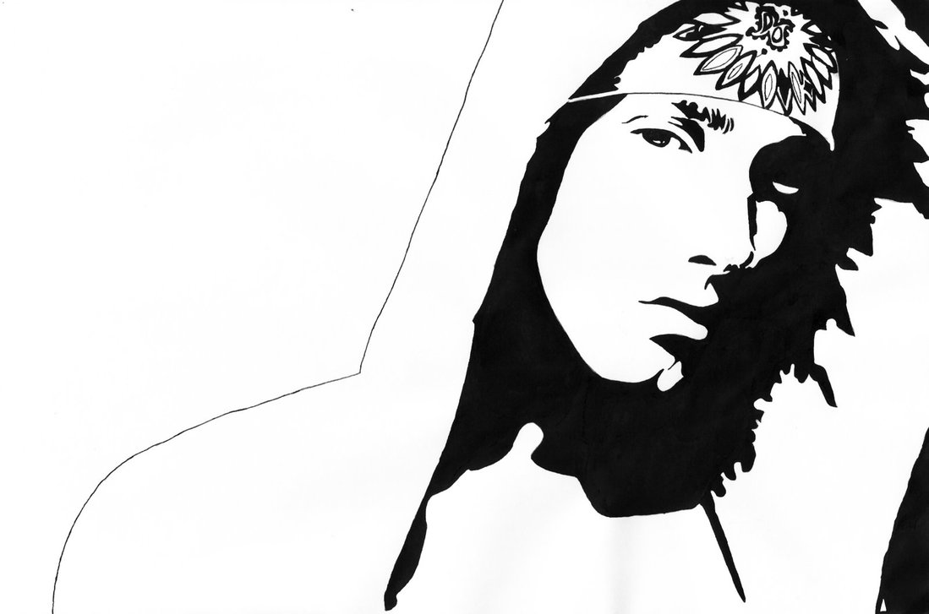
EMINEM – HEAD LIGHTS
https://www.youtube.com/watch?v=7bDLIV96LD4
Notes:
Let participants know that this video can be emotional. This is the “clean” version of the video. Have discussions after video about Eminem’s comment: You will always be my mother and I will love you from afar, What was he saying in this video?
https://www.youtube.com/watch?v=7bDLIV96LD4

Slide 14
Lessons from ReMoved 2 ("My Somebody" Worksheet – Part 1)
Every child in a family has a unique relationship with his or her parents and siblings.
Even children with the same trauma history will understand those events differently. They may have different trauma reminders and react differently to them.
Team members must respect one another and be aware of their thoughts, feelings, words and behavior at all times.
Notes:
Ask participants to turn to the Chapter 7 “My Somebody” Worksheet: Connections and Healing – ask them to complete Part 1 by listing all the people in their “Somebody’s life that they are connected to, their his/her role is and a strength or a positive experience they had with them

Slide 15
Building Connections
Building connections with children:
Let the child take the lead, especially in physical affection and sharing their story
Listen without interrupting
Provide simple, encouraging remarks in a calm tone of voice
Notes:
Trainer Note – Keep your facial expressions and body language in mind while listening i.e. avoid crossing your arms, frowning.

Slide 16
Building Connections
When you build a trusting relationship with children they may share their story, if they do:
Praise the child’s efforts to share with you; just sharing their story makes the “unmentionable” mentionable
Expect the unexpected and be mindful of your reaction
Use the opportunity to correct mistaken beliefs such as, “It’s all my fault,” if applicable
Offer comfort without being unrealistic.
Notes:
“Unmentionable” mentionable – some children believe they can never talk about the trauma they’ve experienced for a number of reasons. One of these reasons is that others will become so emotional they will not be able to handle hearing the details. Another reason is they believe they are alone; that no one will be able to understand what they’ve gone through.
Be ready to share information with the child’s therapist, and to report abuse or neglect that has not yet been reported.
It can be tempting to promise children certain things, but it is important to not promise events that cannot happen or cannot happen for some time, doing so can compromise your relationship with the child.

Slide 17
Building Connections
Help children build connections with others:
Help your child find common interests with peers
Involve them in activities with welcoming groups
Foreshadow upcoming events and practice acceptable responses
Talk with your child about how things could go differently if things do not go as planned; help them learn from past experiences
Notes:
Trainer note – Third bullet – things will not always go as planned; use these occasions to help the child prepare for next time.
Helpful hints for guiding activity selection – ensure they are well-organized. Example of well-run programs - University programs – child development department activities – students interested in or experienced with working with children

Slide 18
Building Connections
Help children maintain & repair connections across the transitions their lives:
Encourage your child to talk about positive past experiences
Document new positive events and experiences (photos, scrapbooks, journals, etc.)
Talk with your child about their future goals and dreams; share your goals and hobbies

Slide 19
Helping Your "Somebody" ("My Somebody" Worksheet – Part 2)
Think about the child or adult in your “My Somebody” Worksheet. How can you help them:
Feel safe when talking about trauma?
Build connections across transitions?
Look positively towards the future?
Notes:
Ask participants to turn to the Chapter 7 “My Somebody” Worksheet: Connections and Healing
Let participants know both children and adults who have experienced trauma may need your help in talking about their traumatic experiences, connecting with others and making positive plans for the future. Ask them, “how can you help?” “What could you do?”

Slide 20
Harry: I just feel so angry all the time. . . . What if after everything I’ve been through, something’s gone wrong inside me? What if I’m becoming bad?
Sirius: I want you to listen to me very carefully, Harry. You’re not a bad person. You’re a very good person who bad things have happened to.
From Harry Potter and the Order of the Phoenix (Warner Brothers, 2007)

Slide 21
Thank you!
See you for Chapter 8!
21

