Slide 1
Welcome Back!
Notes:
Welcome participants back and remind them of basic logistical information (location of bathrooms, timing of breaks, etc.).
Ask the participants to share any experiences or insights they may have had since the last session. Allow 5 to 10 minutes for discussion. The tools are on the next slide if participants need to refer back to get the discussion going.

Slide 2
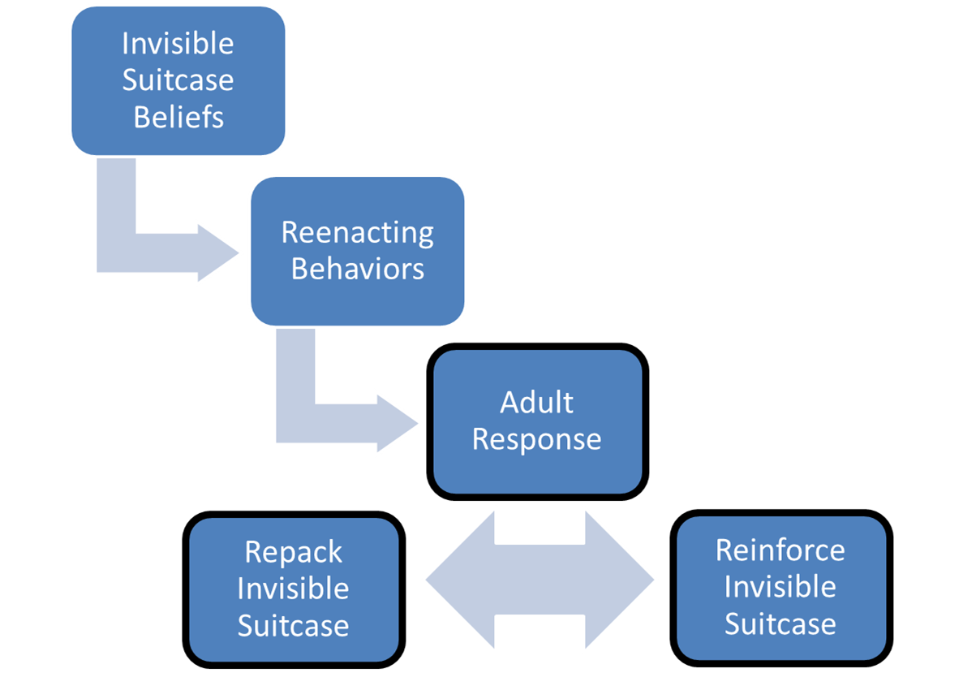
Tools from our Trauma Toolkit
Re-enactment Cycle
2
Notes:
Did anyone use the tools since the last session? If so, how did it go?

Slide 3
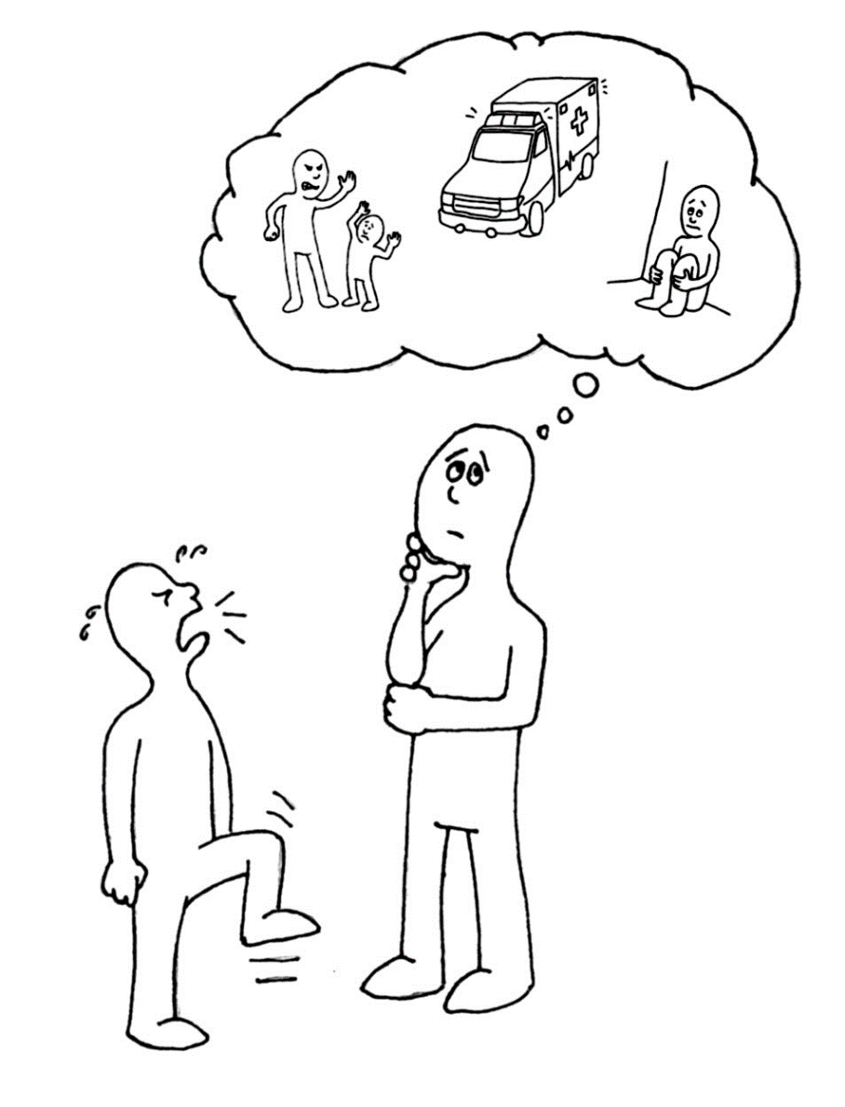
Chapter 6:
Understanding
Feelings &
Managing Behaviors
Illustrations by Erich Ippen, Jr. Used with permission.
Notes:
In this chapter, we will learn a new way to help children cope with their overwhelming emotions and understand why they are acting the way they are by putting you in the role of “Emotional Coach”

Slide 4
Essential Elements 3 and 4
3. Help your child to understand and manage overwhelming emotions.
4. Help your child to understand and modify behaviors.

Slide 5
Seeing Below the Surface
Child’s behaviors
Child’s feelings, thoughts, expectations, and beliefs
Notes:
The Iceberg is a metaphor for how trauma shows up in a child’s behavior.
The behavior you see—no matter how disruptive and frustrating—is only the tip of the iceberg for children who’ve been through trauma.
Below the surface is the invisible suitcase containing the feelings, thoughts, expectations, and beliefs that the children have accumulated as a result of their traumatic experiences.

Slide 6
ReMoved Part 1 (Large Group Activity)
What’s in Zoe’s Invisible Suitcase?
What is below the water line on Zoe’s iceberg?
https://www.youtube.com/watch?v=lOeQUwdAjE0
Notes:
While watching the movie think about what’s below the water line for Zoe as she moves to new foster homes. What’s in her invisible suitcase?
Trainer note – Stop movie at 4:43.

Slide 7
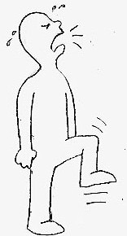
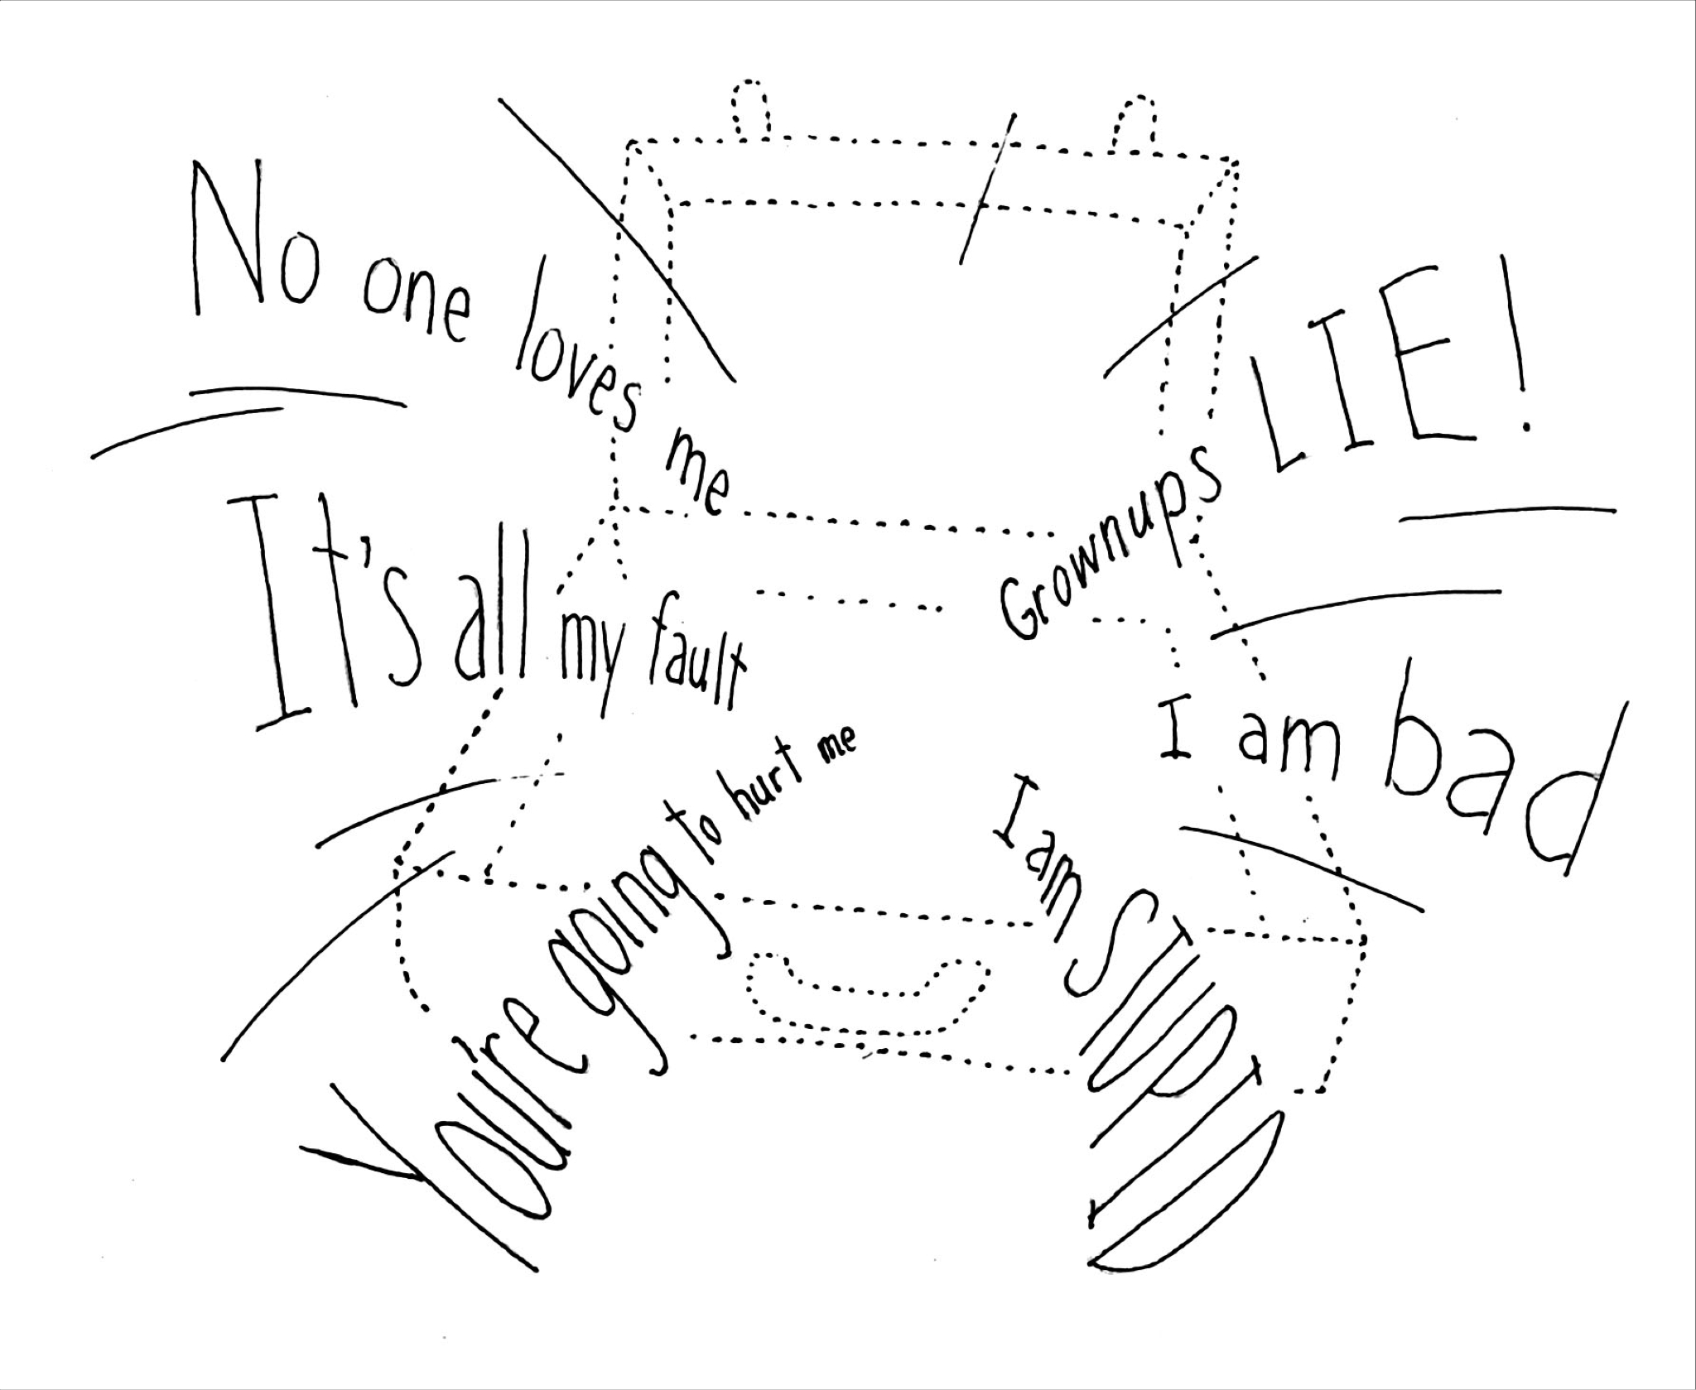
The Thinking Triangle
Behaviors
Feelings
Thoughts
Invisible Suitcase
Notes:
The Thinking Triangle is a new concept to help us understand the connection between thoughts, feelings and behaviors. Psychologists refer to the relationship between what we think, what we feel, and what we do as the Cognitive Triangle or Thinking Triangle. What we think directly affects how we feel, and how we feel affects how we behave.
You may have noticed that the arrows in the triangle are all two- way arrows. That’s because each element of the triangle influences the others. Making a change at any point on the triangle will have an effect on the other two.

Slide 8
Trauma and the Triangle
Children who have experienced trauma will need to be taught:
How to see the connection between their feelings, thoughts, and behaviors
How to understand or express what they are feeling and why (is it always anger?)
How to be aware of the impact of their reactions to threats or trauma reminders (did it really come out of nowhere?)
(Continued)
Notes:
When you recognize the connections between thoughts, feelings, and behaviors, it’s much easier to make changes.
But seeing these connections can be difficult for children and adolescents whose development has been derailed by trauma.
They may find it hard to understand or express what they are feeling and why. – Is it always anger? (Inside out characters handout)
They may be extremely reactive to any perceived threat.
Seemingly minor things can set off a flood of emotions that the child can barely describe, let alone control.

Slide 9
Trauma and the Triangle (Continued)
Children may unintentionally:
Seek attention, even if it is negative
Try to protect themselves by pushing caregivers away physically & emotionally
Try to “prove” the beliefs in their Invisible Suitcase
Notes:
Although these emotional reactions and behaviors can be frustrating and challenging, they are not calculated or conscious. Children who have been through trauma may act out for a variety of unconscious reasons, including:
To increase their interactions with you—even if the attention is negative
To keep people—including you—at a physical and emotional distance
To “prove”—on an unconscious level—that the negative beliefs in their Invisible Suitcases are true (“You can’t fool me—sooner or later, you’ll get mad and reject me!”)
To vent frustration, anger, or anxiety
To protect themselves. In fact, many of the troubling behaviors and reactions that we see in children who have been through trauma may actually have helped them to survive in troubled or abusive homes. But those survival strategies can get in the way of learning other equally important emotional skills, including the development of healthy new relationships.

Slide 10
Decoding the Triangle (Removed Part 1 & Group Activity)
Behaviors?
Feelings?
Thoughts?
https://www.youtube.com/watch?v=lOeQUwdAjE0
(Continued)
Notes:
Start Removed Part 1 again at 4:41 stop at 8:12
Use Zoe’s behavior of pushing the record player over the side of the deck or the ripping of the chapter book to work through the Triangle.

Slide 11
The Thinking Triangle
(“My Somebody” Worksheet – Parts 1 & 2)
Behaviors
Feelings
Thoughts
Invisible Suitcase
Notes:
Let’s try applying the triangle to a behavior of “Your Somebody” that you would like to better understand.
Turn to the Chapter 6 “My Somebody” Worksheet: Understanding Feelings and Managing Behaviors
Write a brief description of the behavior on the line under the “Behavior” heading of the triangle.
Allow a moment for participants to come up with a situation/behavior and write it down.
Consider everything you know about your “Somebody’s” trauma history and relationships with others. Think about the beliefs and expectations your “Somebody” may have developed about him- or herself, about adults, and about the world in general.
Based on what you know, what thoughts could have led up to this behavior? Write them down.
Allow a moment for participants to write down their “Somebody’s” thoughts.
What feelings could your they have been experiencing?
Allow a moment for participants to write down their feelings (their best guess).
If time permits, ask for a volunteer to share their “Somebody’s” Thinking Triangle with the group. One facilitator should lead the discussion, while the other draws the triangle and information on the board or easel.
After the volunteer presents the triangle, allow a few minutes or so for a larger group discussion of how the behaviors, thoughts, and feelings relate to the past trauma.
Now let’s consider how changing the thoughts or feelings might affect their behavior.
Ask participants to think of ways they could help their “Somebody” change their triangle? How could they change some of the thoughts? And shift the feelings and behaviors?

Slide 12
“Anything that’s human is mentionable, and anything that is mentionable can be more manageable. When we can talk about our feelings, they become less overwhelming, less upsetting, and less scary. The people we trust with that important talk can help us know that we are not alone.”
― Fred Rogers
(Mr. Rodgers)
Notes:
Ask for a volunteer to read the quote on the slide. If no one volunteers, one facilitator should read the slide aloud.

Slide 13
Be an “Emotional Coach”
(Continued)
13
Notes:
As with any coach, emotional coaches need to practice emotional co-regulation skills before expecting the individuals they coach to master them.
We all know that children learn by example. Children who have been through trauma may have had very little experience with adults who were able to control their emotions. We can show by our example that it is possible to experience emotion without being overwhelmed, and to express emotion without losing control.
We need to be clear, calm, and consistent in expressing our feelings to the child. That can be hard when faced with some of the challenging behaviors these children can show. But every time we correct a child without flying off the handle, express sadness without retreating into depression, or express disappointment without shaming, we are showing that child not only how to express emotions, but that it is safe to do so.
Being calm and consistent does not mean being dishonest.
You can—and should—let children know if you are feeling hurt, disappointed, or unhappy with something they’ve done or said, provided you can do it in a calm, non-shaming way.
Children who have experienced trauma can have particular difficulty understanding mixed emotions, or understanding that they can feel different emotions at the same time (e.g., anger and love towards a parent or family member). We can reassure children that it is normal to have mixed emotions about some things, and set an example of how to express and cope with this ambivalence.
Take care not to:
“Buy into” the beliefs in their invisible suitcases
React in anger or the heat of the moment
Take behavior at face value
Take it personally

Slide 14
Emotional Coaching – Step #1
Where are you on the thermometer?
(Continued)
Notes:
Take a moment to figure out where YOU are on the thermometer before you do anything else.

Slide 15
Emotional Coaching – Step #2
What tools could you use to self-regulate?
(Continued)
Notes:
Examples of Tools are – Square Breathing, repeating a phrase over and over in your mind.

Slide 16
Emotional Coaching – Step #3
How will you connect with your child?
(Continued)
Notes:
It’s important to realize your child will need time to come back down from the “Hot/Red zone” before you can help them process why they are upset.
Some phrases you could use in this time include: I’m here, you are safe, you are not in trouble, it’s okay, I want to help. Sometimes the best thing you can do is just wait and let them know you are there for them.
In the moment:
Be willing—and prepared—to tolerate strong emotional, not physical, reactions.
Remember the suitcase (beliefs about themselves, caregivers and the world)!
For most children, a distraction can help reduce strong emotional reactions

Slide 17
Emotional Coaching – Step #4
How will you help your child deescalate?
(Continued)
Notes:
Skills/Tools – sensory - offering a cold glass of water, bare feet on the tile, favorite toy or animal, a hug, throwing a foam ball, get outside and run, pushup contest.
Other coping mechanisms are holding an ice cube, the feel of a feather, as the child what they would like – making them a part of the solution
Other coping techniques/stress busters could be:
Activities (running, playing a particular song),
Things (a toy, a stuffed animal, a picture, a favorite blanket, a particular food)
Places (a spot in the yard or a park, a room)
People
A specific thought, phrase, or prayer
After the moment has passed:
Reassure your child that it is okay to feel any and all emotions.
Help your child identify and label the feelings beneath the outburst.
Brainstorm with the child about other ways they could have handled the situation.
Practice coping mechanisms such as breathing techniques with the child

Slide 18
Emotional Coaching – Step #5
How will you help your child identify and label the feelings beneath the outburst?
(Continued)
Notes:
Skills/Tools – Inside Out Feelings chart, Thinking triangle, Iceberg, Suitcase
Be sensitive to cultural differences. As we learn to tune in to and read a child’s emotions, we have to consider how their background affects the way they express and interpret feelings. If you’ve ever been to an emotional event such as a wedding or funeral, you probably noticed that some people express their feelings by rushing right at your personal space and smothering you with hugs and kisses. Others appear standoffish and are uncomfortable with physical contact of any kind, perhaps barely even making eye contact. In such situations, the collision of cultural—and personal—differences can lead to unintended hurt feelings, misunderstandings, perceived insults, or awkward moments. The same holds true for children.
Tool for skill building - Some children respond well to regular “check-ins” that give them a chance to assess their feelings in the moment (at breakfast, for example, or when they come home from school).
Provide opportunities to practice emotional skills in playful, nonthreatening ways:
Feelings thermometer/feelings charts
Feelings charades
Other practice activities
Games and storybooks

Slide 19
Let’s take a break!

Slide 20
Limits and Expectations
When setting limits and expectations:
Consider the child’s history – every child is different
Set one or two limits or expectations before adding to the list
Let the child know the purpose of the limits and expectations is their safety
Notes:
Behavior change takes time. Setting limits and expectations should come over time and not all at the same time.

Slide 21
But what about consequences?
Responding to behavior in a trauma-responsive way:
DOES NOT mean excusing behaviors
DOES mean choosing consequences that take the child’s trauma history into consideration & are the most effective for the child
(Time-in consequences versus Time-out consequences)
Notes:
By responding in a trauma-responsive way, caregivers and supporters can the child manage his/her emotions more quickly (recover more quickly) and help them better manage their emotions in the future.
Ask yourself, are you adding gasoline or water to the fire?
Caregivers should also keep in mind there are natural consequences that are out of our control as well such as being asked to leave a store if the child is breaking things or being excluded from sports for low grades. The child has already been excluded so the caregiver could also ground the child or help them study so they can participate next season.
Time-in consequences versus Time-out consequences
Some children may need time away from others to calm down and process their emotions, however others may be triggered if in their trauma history they often were left alone or felt isolated. A time-in consequence could be do a chore with a caregiver such as raking the lawn. Some children may need to feel connected to others to manage their emotions day to day or in a challenging moment.

Slide 22
Correct and Build
When correcting negative behavior and choosing consequences:
Be clear, calm, and consistent
Target one behavior at a time
Avoid shaming or threatening
Keep the child’s age (and “emotional age”) in mind
Be prepared to “pick your battles”
(Continued)
Notes:
Despite our best efforts, there still will be times when we need to impose consequences for inappropriate or problematic behavior.
When correcting behaviors and establishing consequences, keep in mind everything we’ve learned about how trauma affects children’s sense of self and their ability to control their emotions and behavior. When correcting children who have experienced trauma, remember to:
Be clear, calm, and consistent. This means using a calm voice, showing a calm face and body, and using few words.
Target one behavior at a time. This makes it easier to stay consistent and see results, and will avoid setting children up for failure.
Avoid shaming or threatening. This will only serve to confirm the beliefs in their Invisible Suitcases, which will likely escalate bad behavior and become a self-fulfilling prophecy.
As we have discussed, children who have experienced trauma— particularly early and chronic trauma—may act younger than their chronological age. Keep this “developmental” or “emotional age” in mind when you give consequences.
Pick your battles. Sometimes the most effective option is to leave the behavior to the magic of “natural consequences.” For example, when a preteen refused to clean up his room, his foster parents decided to close the door and not look at it anymore.
Sure enough, the day came when the boy discovered that an important homework assignment had been ruined because he’d left it on the floor and spilled soda on it. He had to miss a game he was looking forward to in order to redo the assignment. After the heat of the moment had passed, his parents had a chat with him and helped him come to his own conclusion that keeping his room neat was to his own advantage.

Slide 23
Correct and Build (Continued)
AFTER the child is calm, the connections can be made. Now you can help the child:
Understand the links between thoughts, feelings, and behavior
Understand the negative impact of their behavior
Identify alternatives to problem/negative behaviors
Notes:
Of course, it’s not enough just to tell children that something is wrong and impose some type of consequence. To really help our children heal, we need to help them:
Understand the connections between their thoughts, feelings, and behaviors.
Understand the impact of their behaviors. In particular, children need to understand that the behavior is not helpful to THEM, and that they can benefit from changing the behavior.
Figure out workable alternatives to problem behaviors.
Learn and practice techniques that can help them change negative thoughts and take control of runaway emotions. Much of this work can—and should—be done in concert with other members of your child’s team, and particularly with a trauma- informed therapist. (We’ll be going into that in greater detail in Chapter 7.)

Slide 24
ReMoved Part 1 (Large Group Activity)
What was Zoe’s trauma reminder? How did she react to the reminder?
What can we learn from the Foster Mom?
https://www.youtube.com/watch?v=lOeQUwdAjE0
Notes:
Show the rest of ReMoved – Part 1 – start movie at 8:12 through the end
While watching the movie think about the actions of the Foster Mom –how did she react to Zoe’s behavior when she gave her the dress?
Let’s learn from the actions of the Foster mom – scaffolding with cooking eggs at the stove, instead of reacting to Zoe’s behavior she realized Zoe needed connection with her brother rather than asking for Zoe to be removed from her home.
Remember the reenactment cycle – how did the Foster Mom repack Zoe’s suitcase?

Slide 25
Correct and Build ("My Somebody” Worksheet – Part 3)
What are the negative effects of this behavior on your “Somebody’s" life?
How can you help your “Somebody” to understand these effects?
What alternatives can you suggest for this behavior?
What consequences can you set if the behavior continues?
Notes:
Take one of the behaviors from the flipchart and discuss these questions in the large group – ask participant to share age, emotional age and a BRIEF trauma history before running through these questions:
What are the negative effects of this behavior on your “Somebody’s" life?
How can you help your “Somebody” to understand these effects?
What alternatives can you suggest for this behavior?
What consequences can you set if the behavior continues?

Slide 26
Achieving a Balance with your “Somebody”
What talents/skills/interests can you encourage?
Where can you give your “Somebody” some control?
What fun activities/interests can you share?
What kinds of praise would your “Somebody” appreciate?
What kind of rewards would be most meaningful?
Notes:
Again, learning from the Foster Mom in ReMoved Part 1 – scaffolding cooking at kitchen.
To achieve a balance between encouragement and correction, keep the individual's history, interests, and talents in mind. Try to plan specific actions that take into account:
The individuals' talents, skills, and interests
The areas where you can reasonably give your “Somebody” some additional control
Fun activities that you can share with the your “Somebody”
The types of praise your “Somebody” is most likely to appreciate - Strive for at least six praises for every one correction.
The kinds of rewards that would be most meaningful to your “Somebody”
The more we can build on the strengths of individuals and provide them with a sense of mastery and control, the greater our chances of success when trying to encourage positive behaviors.
To enhance an individual’s sense of having control over their own lives, offer choices whenever possible.
Pay attention to the individual’s interests and special skills, and give support and encouragement as appropriate.
Help individuals develop responsibility and build self-confidence by mastering a new skill that they are interested in. Physical activities might include horseback riding, swimming (especially in the “deep end”), or martial arts. Nonphysical options might include activities such as painting a large wall or mural or playing a large instrument (e.g., cello, piano, drums).

Slide 27
How can we use motivation to help us?
If the child likes to feel powerful; ask for their help “Can you help me set an example for your sisters?”
If the child is very social; likes connection and fun – ask them to organize a game with others
If the child likes helping people, avoids conflict –offer reassurance; avoid pressure
If the child is very serious, likes order and internalizes anxiety; offer step by step specific instructions
Notes:
Think about the child as an individual – what kind of a person are they? How can we use what naturally motivates them as individuals in managing behaviors?

Slide 28
Review of How You Can Help
Set an example by using the emotional regulation tools in times of stress.
Help your child define and express their emotions.
Encourage positive emotional expression and behaviors by supporting the child’s strengths and interests.
Correct negative behaviors and inappropriate or destructive emotional expression, and help your child build new behaviors and emotional skills.
Notes:
Some caregiving experienced in your child’s past who may have been unpredictable, rejecting, angry or frightening, or simply absent.
You can help this process in several ways:
Set an example by using the emotional regulation tools in times of stress.
Help your child to define and express his or her feelings.
Encourage positive emotional expression and behavior by supporting your child’s strengths and interests.
Correct negative behaviors and inappropriate/destructive emotional expression and help your child build new behaviors and emotional skills.
We will spend the rest of our time in this session talking about each of these important strategies.

Slide 29
Let’s Play . . .
What’s my emotion?
Notes:
Let’s practice identifying some of the emotions we’ve been talking about today.
Feelings game group activity
Materials needed:
sheet of paper per participant
pen/pencil
one pair of dice (two different colors) for each group
Divide the group up so there are 4-6 participants per table. Try to mix up participants so they are not paired up with people they already know. Once groups are formed, provide one sheet of paper to each participant.
Instruct participants to draw a line down the center of their paper to form two columns. In the first column, write the numbers 1 to 6 vertically. Then fill in these spaces with the names of 6 people they know. In the second column, write the numbers 1 to 6 vertically. Then fill these spaces with six different emotions.
Have groups identify which die will represent the people column and which die will represent the feelings column.
Each member in a group takes a turn rolling both dice. They identify the number on the die that correlates with the person on their list and the number on the die that correlates with the feeling on their list. Then they tell their group about a time when they had an experience with that person and that feeling. For example, if they roll a 1 & 6 – The #1 person is their husband, and the #6 emotion is “Happy”, they will tell a story of when they felt happy with their husband. After telling the story the dice are passed to the next participant for their turn. Allow about 10 minutes of play.
Ask the large group if they could see themselves trying this game with their own family?
There are many commercially available games that are designed to help children identify, express, and control their feelings, as well as excellent storybooks for children of various ages. A partial list of these resources can be found starting on page 5-23 of the Participant Handbook.

Slide 30
Thank you!
See you for Chapter 7!

