Slide 1
Welcome Back!
Notes:
Welcome participants back and remind them of basic logistical information (location of bathrooms, timing of breaks, etc.).
Ask the participants to share any experiences or insights they may have had since the last session. Allow 5 to 10 minutes for discussion. The tools are on the next slide if participants need to refer back to get the discussion going.

Slide 2
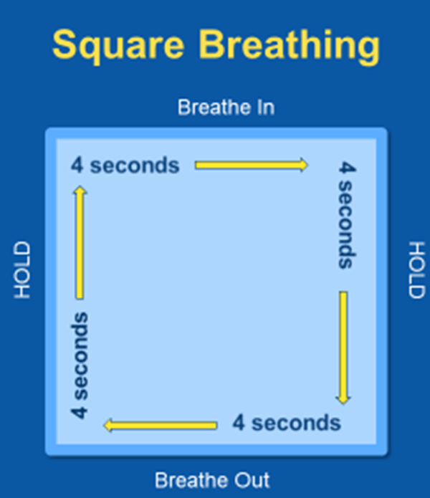
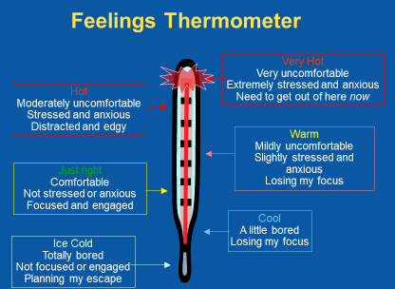
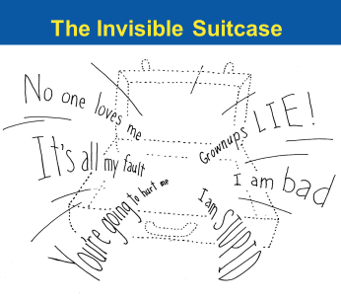
Tools from our Trauma Toolkit
Notes:
Did anyone use the tools since the last session? If so, how did it go?

Slide 3
Chapter 5:
Creating a safe-feeling environment
Illustrations by Erich Ippen, Jr. Used with permission.
Notes:
Welcome participants and ask if anyone has story that that would like to share about using the thermometer, square breathing, personal care, invisible suitcase or behaviors that are struggling to them.

Slide 4
Essential Element 2
2. Help your child to feel safe.

Slide 5
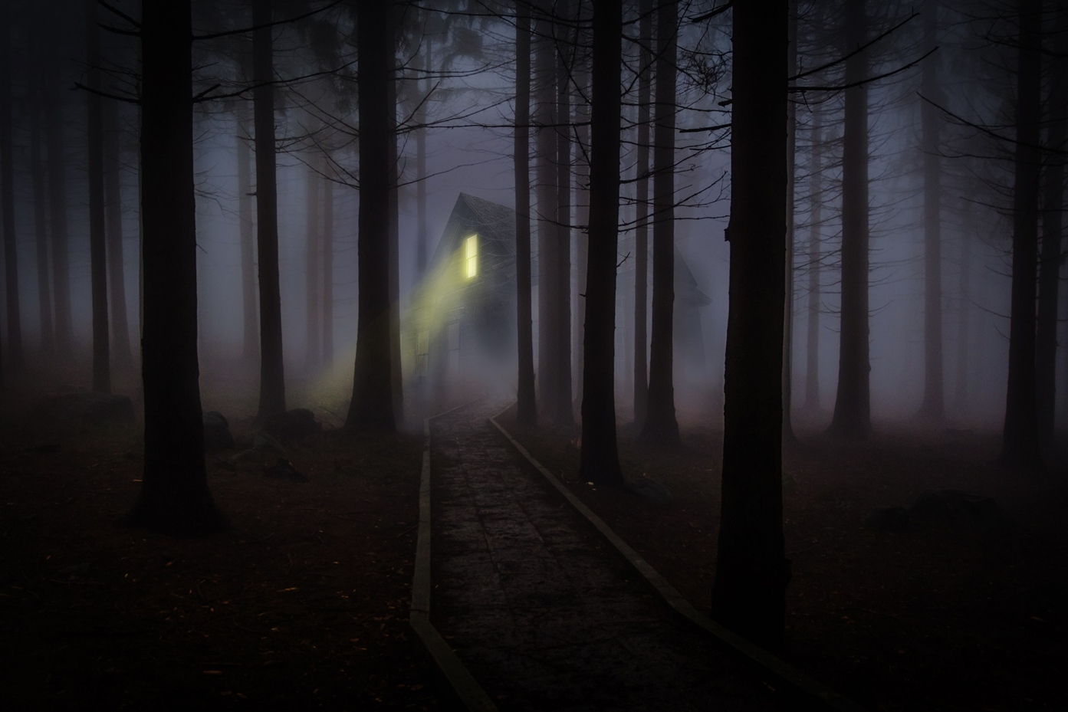
5
Notes:
Lead participants through a psychological versus physical safety demonstration – Imagine you are home alone and turn on a scary movie. It is dark outside and very quiet. Midway through the movie you start to hear a noise outside, a strange noise you’ve never heard before. The noise gets louder and louder and sounds like it is getting closer and closer to your back door.
What are you feeling? Is your heart racing, is your breath quickening? Do you feel frozen in your seat?
What are you thinking? Are you planning your attack strategy? Or your get-away plan?

Slide 6
Psychological Safety and Trauma
Physical safety is not the same as psychological safety.
Your child’s definition of “safety” will not be the same as yours.
To help your child feel safe, you will need to look at the world through his or her experiences.
(Continued)
6
Notes:
Physical and psychological safety are not always the same! You can BE physically safe and not FEEL safe. Children—and adults—who have experienced trauma are likely to feel unsafe long after they are out of actual physical danger.
Your child’s definition of safety may not be the same as yours. Children who have experienced trauma may get comfort and a sense of safety from things we take entirely for granted—like having heat in every room of the house, or a specific cereal in the kitchen cabinet. On the other hand, actions and activities that we consider comforting or benign—like a pat on the shoulder or a hot bath—may have dangerous overtones to a child who has been physically or sexually abused.
To help these children feel safe, we need to look at the world how your child sees it.

Slide 7
Psychological Safety and Trauma (Continued)
Children who have been through trauma may:
Have fears about their own safety or the safety of loved ones based on their experiences
Have difficulty trusting adults to protect them
Be hyperaware of potential threats
Have problems controlling their reactions to perceived threats
7
Notes:
Based on their experiences, children who have experienced trauma may feel fear in situations that others would feel safe i.e. a walking down a dark hallway at night, being left in a room alone.

Slide 8
Trauma Reminders/Triggers
People, situations, places, things, or feelings that remind children of traumatic events:
May cause intense and disturbing feelings tied to the original trauma
Can lead to behaviors that seem out of place, but may have been appropriate at the time of the original traumatic event
Notes:
As we talked about in Chapter 2 and Chapter 4, during the course of a traumatic event, everything associated with it—sights, smells, tastes, sounds, sensations, people, places, colors, textures, words, emotions— may become linked in the child’s brain with the trauma.
Psychological safety comes from having a sense of control over your outside world, but also from having a sense of control over what goes on inside yourself.
Trauma reminders can cause physical and emotional reactions that threaten a child’s sense of safety.
Afterward, exposure to any of the things that have become associated with the trauma in the child’s mind can bring up intense and terrifying feelings, similar to those felt during the trauma itself. Sometimes the child may understand what’s happening, but more often than not the reaction is completely unconscious—which can make it even more terrifying.

Slide 9

Identifying Trauma Reminders
When you notice a child or adolescent’s behavior change, make note of:
When
Where
What
Who
When possible, reduce exposure in the future
Share your observations with your child’s team
Notes:
A child who is having frequent reactions to trauma reminders may need trauma-focused psychotherapy to help identify reminders and reduce the intensity of reactions. No one expects you to be your child’s therapist. (We will be talking more about this in Chapter 8: Becoming an Advocate.) That said, there are things you can do:
Be observant. Since your child may be unaware of what is causing the reactions, you may have to play detective to make the connection between a reminder and the trauma. When the child has a reaction, look for patterns and pay attention to:
When the reaction occurred. Has the child had similar reactions at the same time of day? What happened before the reaction?
Where did the reaction occur (i.e. school, home, a particular room or a particular place in the room?
What was around at the time? Try to identify the people, sights, sounds, and other cues that might have been trauma reminders for the child. Remember that the reminder may be something obviously related—such as loud noises for a child who was witness to a shooting, or something that just happened to be present when a traumatic event occurred— such as the song that was playing on the radio.
Once you’ve identified potential trauma reminders, it may be possible to reduce the child’s exposure. In the long run, we want to help children to manage their reactions to trauma reminders. But in the beginning—especially with children too young to comprehend the relationship—the best way to help may be to manage the environment to reduce exposure.

Slide 10
What’s the Reminder? (Large Group Activity & "My Somebody" Part 1)
What situation or event did James react to?
Based on James’ trauma history, what was it a reminder of?
What else could serve as trauma reminders? (Try to think of at least three reminders.)
10
Notes:
Use James’ story in a large group for this activity – Read his full story (can be found in the Supplemental Materials) out loud to the large group. Ask the participants the questions on the slide.
Then ask them to turn to Chapter 5 - “My Somebody” worksheet – Part 1 – Now think of your “Somebody.” What could some of your “Somebody’s” trauma reminders and reactions be? Look back to the “My Somebody” worksheet from Chapter 2 - What behaviors from the list could be the result of trauma reminders?

Slide 11
Coping with Trauma Reminders (Large Group Activity)
How did James’ Uncle. . .
Help James calm down?
Help James understand what happened?
Acknowledge his feelings and build relationship with James?
Help James understand it was not his fault?
What else could James’ Uncle have done?
Would you have done anything differently?

Slide 12
Trauma Reminders’ Impact
Frequent reactions to trauma reminders can:
Keep a child in a state of emotional upset
Be seen by others as overreacting to ordinary events
Result in avoidance behaviors
Isolate the child from peers and family
Make a child feel ashamed or afraid of going “crazy”
Notes:
Children who have been exposed to chronic trauma may face many trauma reminders in the course of a day. They may feel as if danger is everywhere and they can never be safe.
Facing many trauma reminders can keep a child in a chronic state of emotional upset.
Since other people may not recognize the child’s trauma reminders, they might think that the child is overreacting or reacting strangely to ordinary events.
In order to avoid trauma reminders, a child may become isolated.
A child who is having frequent reactions may avoid other people or activities because that is the only way to feel safe.
Children—particularly adolescents—can be embarrassed when others notice their reactions to trauma reminders and may confirm their belief they are “abnormal,” different, weird. (Remember Javier’s reaction to the kid pulling the Ipod out from his pocket and how embarrassed his was about his reaction.)

Slide 13
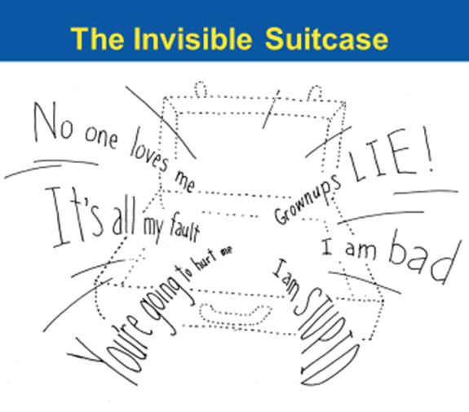
Notes:
Frequent reactions to trauma reminders can reinforce what is in many children’s suitcases who have experienced trauma – who feel that they are different, weird, etc.

Slide 14
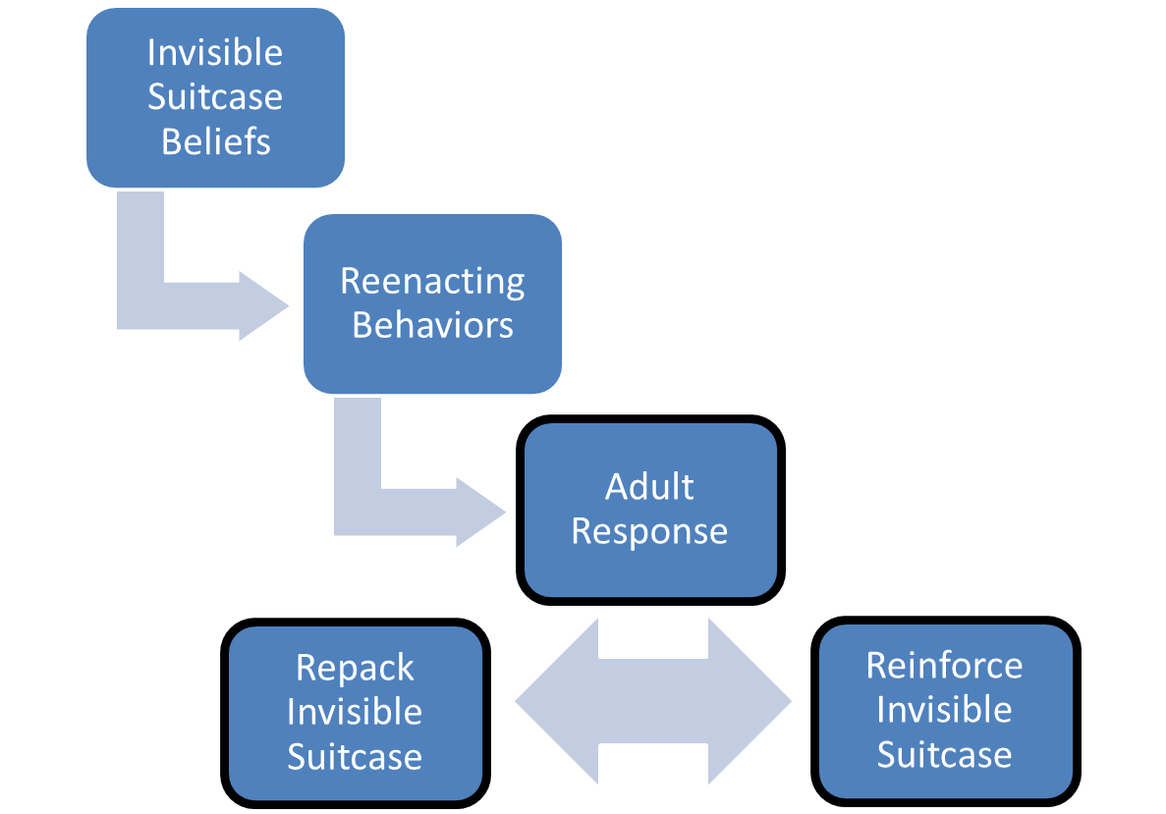
THE RE-ENACTMENT CYCLE adapted from NCTSN, Delaney 1991
14
Notes:
Introduce the Re-Enactment Cycle – Reenactment is the habit of recreating old relationships with new people. Reenactments are behaviors that evoke in others some of the same reactions that individuals who have experienced trauma experienced with other adults, and so lead to familiar—albeit sometimes negative—interactions. Just as traumatized children’s’ sense of themselves and others is often negative and hopeless, their reenactment behaviors can cause the new adults in their lives to feel negative and hopeless about the child.
Children, like adults, are more comfortable with predictable surroundings and may try to create situations that reinforce the beliefs in their invisible suitcase. For example, if they grew up in a household where adults shouted at them they may unintentionally provoke adults in their lives until they shout at them (i.e. get the adults to react in a predictable way).
What are some ways you’ve experienced behaviors like this? Are there any behaviors on the flipcharts that seem to happen over and over?
Children who engage in reenactments are not consciously choosing to repeat painful or negative relationships. The behavior patterns children exhibit during reenactments have become ingrained over time because they:
Are familiar and helped the child survive in other relationships
“Prove” the negative beliefs in the invisible suitcase, by provoking the same reactions the
child experienced in the past. (A predictable world, even if negative, may feel safer than an
unpredictable one.)
Help the child vent frustration, anger, and anxiety
Give the child a sense of mastery over the old traumas
Many of the behaviors that are most challenging for adults are strategies that in the past may have helped the child survive in the presence of abusive or neglectful caregivers. Unfortunately, these once-useful strategies can undermine the development of healthy relationships with new people and only reinforce the negative messages contained in the invisible suitcase.
Notice the third box – adult response. This is the part of the cycle that we can control. By shifting the adult response you can affect the rest of the cycle, however the first step is simply recognizing it. If the adult response challenges the beliefs in the suitcase the child can begin to form new pathways, but this may be disorienting for the child since it is contrary to the response they expect. So they may try over and over to get the response they expect.
Preventing the vicious cycle of negative interactions requires patience and self-awareness. Most of all, it requires a concerted effort to respond to the child in ways that challenge the invisible suitcase and provide the child with new, positive messages.
Messages that tell the child/individual:
You are worthwhile and wanted.
You are safe.
You are capable.
And messages that say you, as a caregiver or child-serving professional:
Are available and won’t reject him/her.
Are responsive and won’t abuse him/her.
Will protect him/her from danger.
Will listen and understand him/her.
This does not mean giving children a free pass on their negative behaviors. Children still need to be held accountable, given consequences, and have expectations set for them. But with the invisible suitcase in mind, you balance correction with praise, and deliver consequences without the negative emotions that may be triggered by the child’s reenactments.

Slide 15
I started cursing at the foster mom. I wanted her to lose control. I figured that sooner or later she would say something that would hurt me. I wanted to hurt her first . . . Later, I felt depressed. I knew I'd acted out of control. When I get angry I don't even realize what I do and I hurt the people around me. . . . I feel sad that I'm not good about expressing myself. I feel like a walking time bomb. I hope I can find a foster mom who can handle my anger, and help me take control of myself.
—A. M.
Am I too angry to love? Represent. Nov./Dec. 2004. Available at http://www.youthcomm.org/FCYU-Features/NovDec2004/FCYU-2004-11-10.htm
15
Notes:
After reading the quote (or asking for a participant volunteer, let the participants know they will be working in three groups in an activity. Before break, ask the participants to count off by 3 to create three groups for the activity. After break, ask participants to find their groups to transition right into the activity.

Slide 16
Let’s take a break!

Slide 17
Identifying Emotional “Hot Spots”
Food and mealtime
Sleep and bedtime
Physical boundaries, privacy, personal grooming, medical care
Notes:
In our groups we will be doing an activity to help us identify ideas to help manage emotional “hot spots”.
In addition to identifying patterns of behavior, another tool for your toolkit is being aware of certain activities or times of day that confusing, and sometimes challenging, behaviors can happen.
Food and mealtime can be challenging for some children when they have not had enough to eat at a time in their lives or if food was somehow incorporated into their abuse and/or neglect.
Sleep and bedtime can be a scary time for children who experience nightmares or who have experienced or witnessed abuse in their beds/bedrooms at night
Physical boundaries, privacy, personal grooming and medical care can be challenging for children whose bodies have not been respected by adults or those who have experienced medical trauma.

Slide 18

HOT SPOTS - GROUP ACTIVITY
Notes:
Ask participants to move into the 3 groups they created before break. Give each group a different color marker. Write each of the 3 Hot Spot categories on the top of flip chart paper and stick to the wall: Food & Meals, Bedtime, and Physical Boundaries. Assign one group to each of the 3 hot spots. The goal of this activity is to see how many ideas the group can write down on the flip charts for overcoming the hot spots, i.e. Sleep hot spot: warm milk, or reading a story at bedtime.
This will be done in 3 rounds.
Round 1 is for 2 minutes and each idea is worth 2 points each. At the end of the round count the number of ideas, multiply it by 2 and write down/remember your score.
Round 2 - 1 minutes to review ideas from round 1 and (2) minutes to add new ideas. Each “new” idea is worth 5 points each. At the end of Round 2 count the number of ideas, multiply it by 5, and write down/remember your score and add it to the Round 1 score.
Round 3 - 1 minute to review ideas from round 1 & 2 and (2) minutes to add new ideas. Each “new” idea is worth 10 points each. At the end of Round 3 count the number of ideas, multiply it by 10, and write down/remember your score and add it to the Round 1 & 2 scores.
Total all three rounds for each team. The highest score is the winner of this activity. You are also encouraged to have someone take these brilliant ideas home and type them up as a handout to give to all participants at the next workshop. More tools to use in the hot spots!!

Slide 19
When dinner was over I saw that there were many rolls piled high on the table an unbelievable sight to me. . . . I was afraid that somehow the rolls might disappear during the night… I did not want to wake up in the morning, . . . feeling hungry … So,… I took some of the rolls from the table and slipped them into my pocket.
—Richard Wright
Adapted from Wright, R. (1945). Black boy. NY: HarperCollins Publishers, Inc.
19
Notes:
Use this slide to help participants get settled into their seats after the activity. Let the participants know the ideas generated in the activity will be typed up and brought back to the group.
Read the quote to the group or ask for a participant volunteer.
The author did not break the habit of stealing and hoarding bread until he was sure, in time, food would be provided at every meal.

Slide 20

Tips for Food and Meals
Set/Suggest consistent meal times.
Involve child in planning and making meals.
Keep mealtimes calm and supportive.
Ask the child what they like to eat, keeping in mind preferences change over time
Notes:
Use the next few slides to recap and reinforce ideas from the group activity. If you are a child-serving professional, you can use the following strategies to make suggestions to families and caregivers.

Slide 21
I woke up in a panic. I couldn't stay asleep. [My foster mother] came into my room. “Honey, what's wrong?“
I couldn't even tell her how I felt. I couldn't get the words out to say what was the matter.
“You're safe here, OK? If anyone tries to get through the door to hurt you I will get them."
I was glad that she was so aggressive—it made me feel like I could loosen up and let someone else protect me. I didn't have to worry anymore. —A. M.
Learning to love again. Represent. July/Aug 2006.
Available at http://www/youthcomm.org/FCYU-Features/JulyAug2006-07-04b.htm
Notes:
Read quote or ask for a participant volunteer.

Slide 22
Sleep and Bedtime
(Continued)

Slide 23
Tips for Sleep and Bedtime (Continued)
Help the child to “own” their bedroom.
Respect and protect children’s privacy.
Acknowledge and respect fears.
Set/Suggest consistent sleep and wake times with predictable, calming routines.
23
Notes:
Examples of “owning” the bedroom could be choosing how they want the furniture arranged.

Slide 24
I don't think there was a time when I wasn't abused as a child. In order to survive the abuse, I made believe that the real me was separate from my body. That way, the abuse was happening not really to me, but just this skin I'm in. Still, my body sometimes betrayed me. Crying when I wanted to remain strong, becoming tired and refusing to obey my commands to stay awake, and, most horribly, physically responding to sexual advances. It seemed to me like my body had a mind of its own. I hated the thought of sexual contact, yet my body would respond to it, even when it was unwanted.
—C. M.
My body betrayed me. Represent. Sept./Oct. 2003. Available at http://www.youthcomm.org/FCYU-Features/SeptOct2003/FCYU-2003-09-24.htm
Notes:
Read the quote or ask for a participant volunteer.

Slide 25
Physical Boundaries
Children who have been neglected and abused may:
Never have learned that their bodies should be cared for and protected
Feel disconnected and at odds with their bodies
See their bodies as “vessels of the negative memories and experiences they carry, a constant reminder not only of what has happened to them but of how little they are worth”
Pughe, B., & Philpot, T. (2007). Living alongside a child’s recovery.
London, UK: Kingsley Publishers.

Slide 26
Tips for Physical Boundaries (Continued)
Respect your child’s physical boundaries.
Set an example of appropriate physical boundaries
When helping younger children bathe or toliet, ask permission before touching and be clear about what you are doing and why.
26
Notes:
Set an example of appropriate physical boundaries – not hugging, touching strangers

Slide 27
Create a Safe-feeling Environment
Follow-through and consistency creates safety
Be reassuring and realistic about what you can do & be honest about what you do and don’t know
Let them know what will happen next, to the best of your knowledge

Slide 28
What can I do to help "My Somebody" feel safe?
What to do first –
Be an active member of the child’s team (birth parents, foster parents, caseworker, therapist, educator and others working together)
Acknowledge that the child’s feelings make sense in light of his/her experiences
Have a conversation with the child directly about what he/she needs to feel safe
(Continued)
Notes:
We will focus on the team concept in Chapter 7.
Trainer’s note – asking the child what they need to feel safe – examples for caregivers: leave a light on, move the bed away from the window, take a snack to bed at night. An example for a child-serving professional could be sitting next to them before/during court; letting them know who will be there any if any decisions will be made that day to the best of your knowledge.

Slide 29
My Trauma-informed Safety Plan (Continued) ("My Somebody" Worksheet – Part 2)
What to do next –
Help your “Somebody” to express their concerns to other members of the team
Offer choices and give them responsibilities
Set limits and expectations based on the individual’s immediate needs emotionally, psychologically
Notes:
Ask participants to turn back to their Chapter 5 “My Somebody” worksheet and ask them to list the things they will do to help their “Somebody” feel safe
An example may be: help the child/person make a list of concerns for the other members of their team to prepare for team meetings or court. Just writing down a concern can help a child/person feel more in control.

Slide 30
Thank you!
See you for Chapter 6!
30

