Slide 1
Welcome Back!
Notes:
Welcome participants back and remind them of basic logistical information (location of bathrooms, timing of breaks, etc.).

Slide 2
Getting to Know Each Other
(Group Activity)
Are there any new folks?
If so, who are we?
  Are you a Parent, Kin Caregiver, Foster, Social Worker, Child Care Provider, Teacher, Attorney etc.?
  Kids & Ages
  (in your family, those you have a close
  relationship with or those you work with)
Notes:
Welcome any new participants ask them to share their names, ages of children in their family or those they work with and ask returning participants to share their names and who they are (i.e. parent, relative caregiver, child-serving professional).

Slide 3
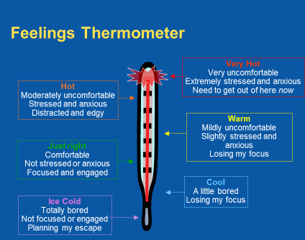
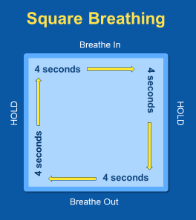
Tools from our Trauma Toolkit
Notes:
Did anyone use the tools since the last session? If so, how did it go?

Slide 4
Chapter 3:
Understanding Trauma’s Effects
Illustrations by Erich Ippen, Jr. Used with permission.
Notes:
In the last session, we discussed what trauma is and how it affects children. Now let’s take a closer look at what happens inside the bodies and minds of children who have been through traumatic experiences.

Slide 5
Essential Element 1
1. Recognize the impact trauma has had on your child.
Notes:
As we learned in the last chapter, the effects of trauma may reveal themselves through a child’s behaviors, withdrawal, difficulties in school, or even as physical complaints like headaches or stomachaches. In adolescence, substance abuse, eating disorders, and self-harming behaviors like cutting can result from trauma exposure.
To understand why trauma has these effects, we need to understand how experience shapes the brain.

Slide 6
Reactions to Trauma Reminders/Triggers
Fight – Acting aggressively with those around you
Flight – Running away, Removing yourself from the situation
Freeze – “Scared stiff”, Feeling stuck, not knowing what to do
6
Notes:
During a “fight” episode, a child may be in a hyper-aroused state like we learned in the last chapter.
An example of flight may be going to your room and slamming the door, putting up the hood on your sweatshirt. A child could be “in flight” while they are in avoidance and/or in withdrawal like learned in Chapter 2.
An example of freeze may look like someone “checking out,” being unable to respond and sometimes “collapsing” which may look like someone “folding” because of helpless/hopelessness. A child could be “freezing” while re-experiencing the trauma.
A child may have one or more of these reactions in a short period of time.

Slide 7
We Learn by Experience
(Continued)
Notes:
Everything that we expect and believe—about ourselves, about other people, and about the world that we live in—is learned through experience. For example, imagine that you’re taking a walk in a park near your home. You glance down, and in front of you is a huge snake.
How do you think you’d react?

Slide 8
We Learn by Experience
(Continued)
Notes:
Now imagine that you have to walk through that same park a couple of days later. How do you think you’d feel about it?
Allow time for responses.
More than likely you’re going to be watching the ground a lot more closely!

Slide 9
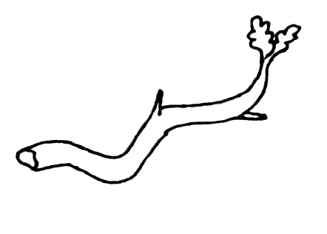
We Learn by Experience
(Continued)
Notes:
And if you happen to see a stick on the path, you’re likely to startle, even before the thought “Augh! Snake!” reaches your conscious awareness.
Even if you’d been through the park many times before without seeing a snake, seeing a snake once changes your perception of the park, and makes you expect danger there.
That’s because it’s a lot more dangerous to mistake a snake for a stick than to see a snake in every stick. Our brains are wired this way—to generalize in the direction of looking out for danger so that we can protect ourselves.
Remembered the angry and scared faces of the man and the woman from Chapter 2? The ones in which children see anger when the emotion is scared? This is the same concept. Seeing danger when it is not there can help keep us safe, however missing danger when it is present can cause us harm.

Slide 10


Your Internal Alarm System
If the threat is removed, everything returns
to normal
The brain releases chemicals that help the body to respond to the threat (fight, flight, freeze)
(Continued)
Notes:
To fully understand just how the brain responds to danger, it helps to take a closer look at the body’s internal alarm system.
When faced with a threat, the brain triggers the release of adrenaline, cortisol, and other stress hormones. These chemicals activate the systems you need to immediately respond to the threat—either by fighting back, getting away, or freezing
The area of the brain that prompts the response is sometimes called “primitive brain.” It is the first part of the brain to develop, and it controls the most basic functions and reactions that we need to survive—including fear, anger, sexual responses, and memory. It’s the primitive brain that enables us to make the split- second decisions that protect us in a dangerous situation.
Other, more advanced parts of the brain are responsible for thinking, reasoning, and consciously processing information. These areas of the brain help to analyze the threat and signal the primitive brain to stop pumping out stress hormones so the body’s systems can return to normal.
When you realize that you’re looking at a stick, not a snake, and you feel yourself relax, those higher centers have done their job.

Slide 11


Your Internal Alarm System
(Continued)
If the threat continues or is repeated, the system stays on "red alert"
The brain releases chemicals that help the
body to respond to the threat (fight, flight, freeze)
Notes:
For most people, the body’s emergency response shuts down shortly after danger has passed.
But in children exposed to severe or chronic trauma, the emergency response system can get stuck in the “on” position.
The stress hormones keep flowing and make it harder for the parts of the brain that think and plan to work efficiently. The stress hormones and related brain chemicals that are generated actually get in the way of rational thinking.
Take a moment and remember a time that you were really frightened. Were you able to think clearly, take in new information, and plan for the future during that moment? Or was all of your mental energy focused on keeping yourself safe?

Slide 12
Experience Grows the Brain
Brain development happens from the bottom up:
  From basic survival (fight, flight or freeze)
  To planning, decision making
12
Notes:
Trauma during childhood affects many aspects of a child’s functioning because childhood is when the brain develops and becomes organized.
A child’s brain grows from the bottom up, starting with the most basic functions needed for survival (including those controlled by the primitive brain) and then getting more and more complex as the child accumulates experiences.

Slide 13

Experience Grows the Brain
(Continued)
The brain develops by forming connections.
Interactions with
caregivers are critical to
brain development.
The more an experience is
repeated, the stronger the connections become.
Notes:
The brain develops by forming connections.
Even though a baby is born with 100 billion brain cells, the connections between these cells form over time. These connections, called neural pathways, are like the wiring in a house or highways that connect one part of the brain to the other.
Experience determines the growth and pattern of brain development, including the connections that form the basis for thoughts, feelings, and behaviors. It is through relationships with caring adults that children develop the brain connections that make it possible for them to trust, regulate their own emotions, and love other people.
The more an experience is repeated, the stronger the resulting brain connections become. For example, when you repeat words and phrases to a baby, you are strengthening the language connections in the brain that enable the child to understand speech.
Repeated traumatic experiences, on the other hand, have a more negative effect.

Slide 14
Brain Builders Video: https://www.youtube.com/watch?v=LmVWOe1ky8s
14
Notes:
We are going to watch a video from the Alberta Family Wellness Intiative that puts what we’ve just talked about into action: https://www.youtube.com/watch?v=LmVWOe1ky8s

Slide 15
Trauma Derails Development
Exposure to trauma causes the brain to be wired to expect danger:
On constant alert
Quick to react to threats (fight, flight, freeze)
The stress hormones, cortisol and adrenaline, produced during trauma also interfere with brain development.
    Source: Teicher., M. H. (2002). Scars that won't heal:
    The neurobiology of child abuse. Scientific American, 286 (3),68-75.
Notes:
When the people who should be protecting, loving, and guiding young children expose them to trauma instead of care, children’s development can get derailed.
A brain that is constantly reacting to threats can become “wired” for survival in a risky and unpredictable world—developing in a way that:
-Keeps the child on constant alert for danger
-Allows the child to respond quickly to even the slightest threat
When this happens, other developmental pathways get disrupted, and children may fail to accomplish other important “developmental tasks.”

Slide 16
Young Children (0–5)
Key Developmental Tasks | Trauma’s Impact
Understand what you see and hear Understand and respond to emotional cues Form attachment to primary caregiver | More sensitive to noise Avoidance of physical or eye contact Startle more easily Confusion about what’s dangerous and who to go to for protection Fear of being separated from people/places they know
(Continued)
Notes:
Refer back to the “My Somebody’s” behaviors in Part 2 of the Chapter 2 supplemental handouts. Compare the list of behaviors to those in the next couple of slides on development and trauma’s impact. Circle the behaviors that coincide with those listed on the trauma’s impact side of the chart above and those on the next few slides. There may be some behaviors that are not represented on the lists and maybe related to specific triggers and not necessarily a developmental delay.
Notice also some of the behaviors are commonly seen in children diagnosed with certain mental health challenges, for example – Autism (i.e. sensitivity to noise). Also many fears of separation are developmentally appropriate important tasks of growing and there is a wide range of at what age they appear and resolve. It is critical to have a realistic and open understanding of child development.

Slide 17
School-Aged Children (6–12)
Key Developmental Tasks | Trauma’s Impact
Manage fears, anxieties, aggression and anger Maintain attention for learning and problem solving Control impulses and manage physical responses to danger | Emotional swings Learning problems Specific anxieties and fears Wanting a lot of attention – good or bad Acting younger than their age
(Continued)
17
Notes:
Ask participants what diagnosis is sometimes given to children who are happy one minute, angry the next, or sad (Bi-Polar, mood disorder, etc)
Also, when children can not sleep due to trauma or extra sleep is needed for developmental growth, or a child is on the verge of being ill (cold, ear ache, etc.) they can display behaviors.
The subtitle running under the silent movie of their behavior is something is taxing my current capabilities. I am being overwhelmed. I have unmet needs and need some type of support; my resources are being used to cope with trauma symptoms rather than developmental tasks.

Slide 18
Adolescents (13–25)
Key Developmental Tasks | Trauma’s Impact
Understand the consequences of behavior Accurately judge danger and safety Create and plan for long-term goals | Difficulty imagining or planning for the future Over or underestimating danger Inappropriate aggression (physical & verbal or bullying) Reckless and/or self-destructive behaviors (cutting, drug/alcohol abuse, unprotected sex)
18
Notes:
Note many adolescent and adult behaviors can be traced back to the trauma and make sense at the time of the trauma. We can also see how these behaviors relate to the basic survival responses of fight, flight, and freeze. Don’t overlook healthy sexual development milestones as well. This is important for all children and especially those who have been sexually abused or may not have had support from their caregiver in understanding their development in this area.

Slide 19
Getting Back on Track
People who have experienced trauma can learn new ways of thinking and responding.
Positive interactions can help form new connections in the brain.
Using those new connections takes time!
19
Notes:
Rational thought and self-awareness practice, such as checking in with yourself and your emotions, over time can help override primitive brain responses if you are regularly engaging in self-regulation practices that help calm the nervous system and body.
Mastery takes doing something 10,000 times!

Slide 20
What Trauma-Responsive Parents,
Caregivers & Providers Can Do
Understand the child’s definition of love and safety.
Be emotionally and physically available.
Understand and respond to the child’s needs.
Provide guidance and lead by example.
Provide opportunities to safely explore the world.
Source: Better Brains for Babies. (2007). Attachments and the role of the caregiver. Available at http://www.fcs.uga.edu/ext/bbb/attachCareGiver.php
Notes:
Being curious about the behaviors keeps us in our thinking brain where we can have reasoning, empathy, and humor to draw from. We can be a lighthouse in the storm rather than adding or sinking into it as well.
Children learn through example, especially up through age 7, not through words or logical explanations or lectures. They need to see it to believe it.
If a child is on fire literally, we FIRST put out that fire. We then teach fire safety when the crisis is over. Children who have experienced trauma and even those who haven’t who have ‘flipped their lid’ as Dr. Siegal says, have brains that are on fire. First we must create a safe space, “I will not let you hurt yourself, me or others. You are safe here,” for them to put out the fire. Learning will be done later. They need to get back to calm before anything else. If they are very angry but being safe, this is a time you can set a timer or visual timer and say, “Let’s come back to this after 15 minutes and the bell rings or all the glitter in this bottle settles.”
Provide opportunities to safely explore the world – give concrete examples such as, practicing how to order food at a restaurant

Slide 21
Let’s take a break!

Slide 22
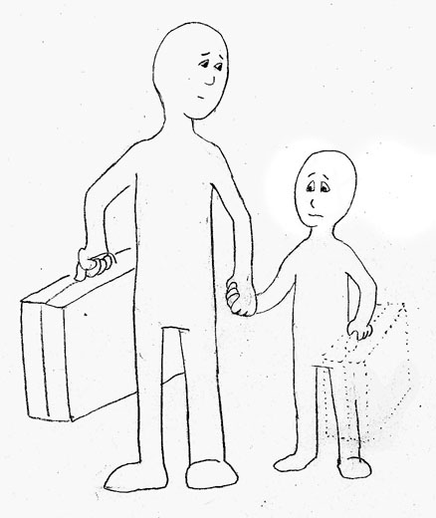
The Invisible Suitcase
Traumatic experiences form children’s beliefs and expectations:
About themselves
About the adults in their lives
About the world in general
Notes:
We’ve seen that trauma can actually affect the development of children’s brains. In the process, trauma also shapes children’s beliefs and expectations about:
Themselves
The adults who care for them
The world in general
Many who survived trauma have learned to expect and believe the worst about themselves and about the people who care for them.
These beliefs and expectations are like an “Invisible Suitcase” that children carry with them from living environment to living environment, from school to school, and from childhood into adulthood.

Slide 23
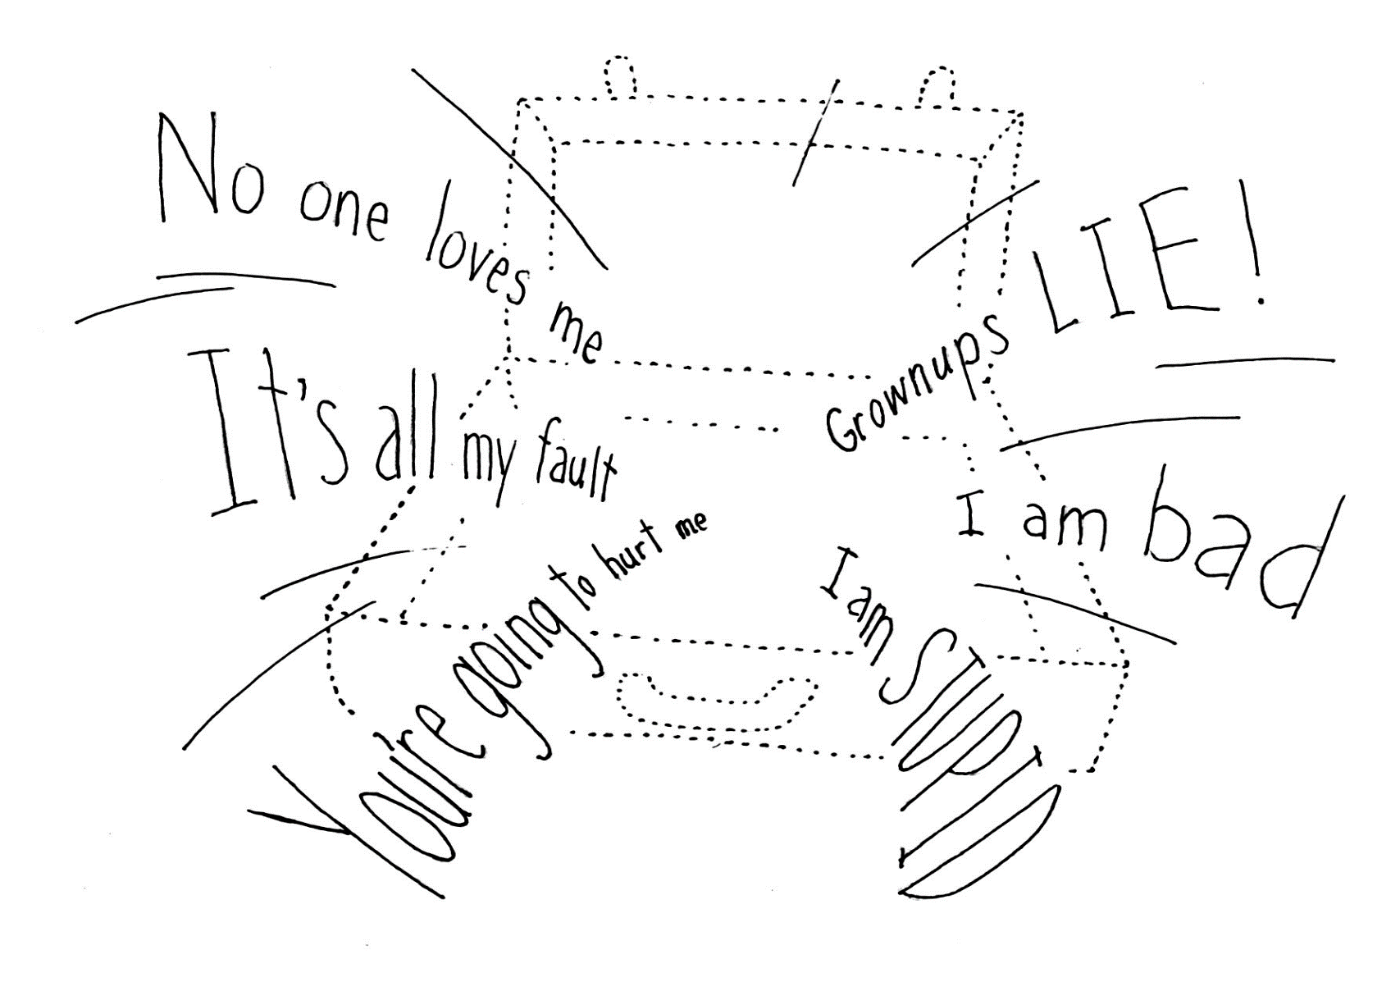
The Invisible Suitcase
Notes:
Understanding the contents of your child’s Invisible Suitcase is critical to understanding your child and how you can help him or her to overcome the effects of trauma.
To see the effects of how experiences can that impact an individual’s invisible suitcase, we are going to watch a Kelly Clarkson video “Because of You” Let participants know that this is a difficult and emotional video for some to view. Remember that it is important to take care of you and if you find this video difficult to view, please feel free to take care of yourself by leaving the room if necessary.
Instruct participants watch and listen to the song lyrics – Think about how her experiences affected her beliefs about herself, adults and the world.

Slide 24
Kelly Clarkson “Because of You” Video: https://www.youtube.com/watch?v=Ra-Om7UMSJc
Notes:
Because of you video link: https://www.youtube.com/watch?v=Ra-Om7UMSJc

Slide 25

Feelings Thermometer
Very Hot
Very uncomfortable
Extremely stressed and anxious
Need to get out of here now
Hot
Moderately uncomfortable
Stressed and anxious
Distracted and edgy
Warm
Mildly uncomfortable
Slightly stressed and anxious
Losing my focus
Just right
Comfortable
Not stressed or anxious
Focused and engaged
Cool
A little bored
Losing my focus
Ice Cold
Totally bored
Not focused or engaged
Planning my escape
Notes:
Check in on the thermometer, are participants elevated? If so, have the participants practice square breathing.

Slide 26

What’s in Kelly’s Suitcase? (Group Activity)
Beliefs about herself?
Beliefs about adults?
Beliefs about the world?
Notes:
Have participants work at their table and discuss Kelly’s suitcase beliefs. Then bring participants back to the large group and discuss using a flip chart.
Discussion Points for small group work – Given what we saw on the video, what do you think Kelly has learned?
What are Kelly’s beliefs about herself?
What are Kelly’s beliefs about adults?
What are Kelly’s beliefs about the world?
Give participants time to share their thoughts with their small groups. Then in the large group, one facilitator should lead the discussion, asking small groups to share their thoughts, while the other makes notes on the board. Allow five minutes for this discussion (fewer if the participants finish sooner). Make sure the following points are made:
I’m not important enough to be seen or heard
I cannot cry because it’s a sign of weakness
Relationships aren’t’ forever – Parents/adults walk out of relationships when things get tough
When parents/adults get angry it’s okay to throw and break things
You’re in this world alone – You can’t depend upon or trust anyone
The world and relationships are not safe
Remind of the song lyrics “Because of you I find it hard to trust no only me but everyone around me because of you I am afraid.”
This video also provides another opportunity to discuss the impact of intergenerational trauma. Asking the participants “I wonder what her mother experienced or witnessed in her parents’/adults’ relationships when she was young?
How many would love in the heat of the moment to just stop and put down the picture and hug their partner, but this may feel impossible without help addressing our flight and fight response from past trauma. By putting the picture down, and hugging her partner with her child watching, think about how that action can stop the transfer of intergenerational trauma to the next generation.
Sometimes stopping this cycle of abuse and trauma may feel like standing in front of a run away freight train with nothing but yourself and a flashlight and an upheld hand saying stop. Families and survivors need support in making change.
This is an accordion slide, which allows you to extend time or reduce time if necessary.

Slide 27
What's in your "Somebody's" Suitcase?
("My Somebody" Worksheet - Part 1)
What are your “Somebody’s:”
  Beliefs and expectations about themselves?
  Beliefs and expectations about adults?
  Beliefs and expectations about the world?
Notes:
Based on what you know of his or her behaviors and trauma history, what sort of beliefs and expectations is your child carrying around in that Invisible Suitcase?
Be sure to include at least one belief about:
Themselves
Adults
The world in general

Slide 28

GROUP ROCK ACTIVITY -
Notes:
Have participants choose a rock. Have them think about one negative belief that their child (or themselves) have about themselves, caregivers or the world that you would like to unpack from their suitcase. Have each participant drop the rock into the bag and saying aloud what the belief is. Example: “I am not loveable”. This activity segways nicely into the next slide, where we are repacking the suitcase.

Slide 29
“Repacking” the Suitcase
("My Somebody" Worksheet – Part 2)
How can you add positive experiences and beliefs to their suitcase?
Notes:
Share with the participants that now that we have removed a “negative” belief from the suitcase and now created space in the suitcase, we are going to “repack” the suitcase with positive beliefs. If there is time, ask participants to think of how they would wish to help their child repack those beliefs that they just shared and transform them into more helpful beliefs. For example, for the belief, “I am alone,” we could help the child repack this with experiences of being known, seen, appreciated, loved and that “people care and will be there when I need them.”

Slide 30
What Trauma-Responsive Parents,
Caregivers & Providers Can Do
When we protect them from harm. . .
  . . . children learn that the world is safe.
When we support and respond to them. . .
  . . . children learn that they are capable.
When we care for and nurture . . .
  . . . children learn that they are worthy of care.
30

Slide 31
Thank you!
See you for Chapter 4!
Notes:
Any Big ideas anyone wants to share from today’s content?

