Slide 1
PDG Research Sandbox Toolkit PowerPoint
The purpose of these slides is to support you in sharing and discussing the PDG Sandbox research with colleagues and stakeholders. We encourage you to customize this PowerPoint for your audience and to meet your needs:
You may remove or hide slides as needed.
You may add slides that help tell the story of your area.
Do not edit the data/information on the slides.
Many slides contain details and talking points in the notes section.
Looking for support or more information about how to use this slide deck?
Contact us—we’re happy to help!
wipdg@wisconsin.gov

Slide 2

Preschool Development Grant: Welcome to the Research Sandbox
July 2020
v.1

Slide 3

All data is pre COVID-19

Slide 4

Come play in the PDG sandbox!
Just as children learn best through play, adults need to dig, explore and try out different tools, too!
The Wisconsin Preschool Development Grant is building a “research sandbox” big enough for all of us. Join us to find answers to our questions, notice trends, encounter new information and dream up opportunities to grow.
Notes:
This ppt includes Statewide data. The sandbox pages on the website is county specific for ECE data & county & region for background indicators.

Slide 5

This PowerPoint shows statewide data.
The PDG website shows county-specific Early Care and Education information. It also shows county- and region-specific Background Indicator information.
Notes:
Wisconsin’s 72 counties are divided into regions. County-level data is categorized by region. Counties & regions can then be compared to each other & statewide data. Wisconsin’s 11 Indigenous Tribes are typically included in county-level data. See the PDG website for more details

Slide 6
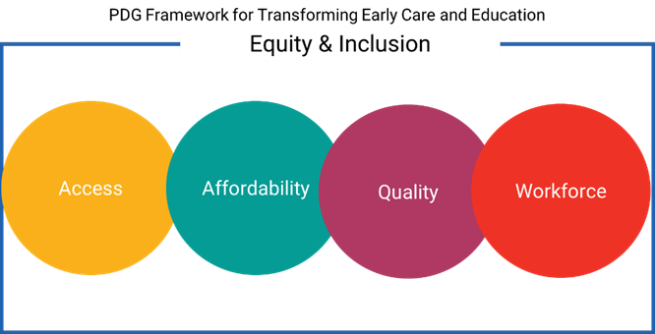
The Preschool Development Grant uses Access, Affordability, Quality and Workforce within the Lens of Equity & Inclusion as a framework for evaluating and transforming Early Care & Education in Wisconsin.

Slide 7
Equity & Inclusion Lens: An Equity and Inclusion Lens is a transformative tool used to:
Identify systemic and institutionalized racism, bias, disparity and inequality in practices, policies, procedures and programming
Analyze data and information for racism, bias, disparity and inequity
In order to:
Move towards more equitable and inclusive planning, programming, decision-making and resource allocating
Ensure that everyone, particularly members of underrepresented groups (communities of color, low socioeconomic populations, vulnerable populations, people with disabilities and other disenfranchised peoples) are included as equal participants at every level of policy, procedure and program processes
Work to equalize power in decision-making and opportunities for self-governance
So that: all Wisconsin children and youth are safe and loved members of thriving families and communities.

Slide 8
Background Indicators: Many factors impact communities & families. Background indicators help tell a more complete story of what is going on for children & families in Wisconsin.
Health
Uninsured
Vaccination
Infant Mortality
Adverse Childhood Experiences (ACEs)
Child Abuse
Employment
Unemployment
Median Household Income
Education
4th Grade Reading Proficiency
High School Completion
Poverty
Overall Poverty
Child Poverty
Households Struggling to Make Ends Meet (ALICE)
Racial/Ethnic, Geographic & Socioeconomic Disparities
Exist Across All Measures.
Notes:
Disparities:

Slide 9
Background Indicators: Health
 | Statewide | NER | NR | SER | SR | WR
% Uninsured | 6% | 7% | 8.5% | 7% | 8% | 8%
range | 4% in Waupaca Co to 16% in Clark Co | 4% in Ozaukee Co to 13% in Menominee Co | 5% in Wood Co to 12% in Forest & Sawyer Co | 4% in Waukesha Co to 10% in Milwaukee Co | 5% in Sauk Co to 11% in Walworth Co | 5% in St Croix & Pierce Co to 16% in Clark Co
% Vaccinated | 72% | 73% | 67% | 72% | 67% | 66%
range | 45% in Clark Co to 83% in Green Co | 58% in Marquette Co to 82% in Calumet Co | 56% in Taylor Co to 79% in Marathon Co | 67% in Kenosha & Milwaukee Co to 81% in Waukesha Co | 53% in Lafayette Co to 82% in Green Co | 45% in Clark Co to 78% in La Crosse Co
Racial/Ethnic, Geographic, Socioeconomic Disparities Exist Across All Measures
Notes:
Uninsured: % of Wisconsin adults 65 & under without health insurance
% Vaccinated: % of Wisconsin children aged 19 to 35 months received the recommended doses of DTaP, polio, MMR, Hib, Hepatitis B, Varicella and Pneumococcal conjugate vaccine
Source: 2020 County Health Rankings

Slide 10
Background Indicators: Health
Child Abuse Rate: Statewide child abuse rate is 4 per 1,000 children.
Florence County had the highest rate with 23 per 1,000
Burnett County had the second highest rate with 22 per 1,000
Infant Mortality Rate: Wisconsin had the highest infant mortality rate in the nation for babies born to Black mothers
ACEs (Adverse Childhood Experiences): 58% of Wisconsin adults experience at least one ACE growing up. ACEs disproportionately impact children of color.
Wisconsin’s Black mothers are 3 times more likely than White mothers to plan their baby’s funeral instead of a first birthday party.
Notes:
Child Abuse Rate Source: 2019 County Health Rankings
Child Abuse Rate: This is NOT the number of children but rather a rate so comparisons can be made regardless of population per county
Infant Mortality Rate: The number of deaths within the first year of life per 1,000 babies
Infant Mortality Rate Sources: 2019 County Health Rankings, Annual Wisconsin Birth & Infant Mortality Report, CDC Infant Mortality Data Brief
ACEs: DHS
Infant mortality rate for babies born to non-Hispanic Black mothers—14.3 deaths per 1,000 babies—the national average was 11.1 for 2013-2015

Slide 11
Background Indicators: Employment
 | Statewide | NER | NR | SER | SR | WR
% Unemployment | 3% | 3% | 3% | 3.4% | 3% | 3.3%
range | 2% in Dane Co to 6% in Iron and Menominee Co | 2.5% in Sheboygan Co to 5.7% in Menominee Co | 2.6% in Marathon Co to 6% in Iron Co | 2.6% in Waukesha Co to 3.6% in Milwaukee and Racine Co | 2% in Dane Co to 5% in Adams Co | 2.6% in Eau Claire Co to 5% in Burnett Co
Median Household Income | $60,779 | $60,041 | $51,905 | $65,617 | $59,546 | $57,980
range | $40,682 in Menominee Co to $87,333 in Waukesha Co | $40,682 in Menominee Co to $83,014 in Ozaukee Co | $44,130 in Iron Co to $63,442 in Marathon Co | $49,771 in Milwaukee Co to $87,333 in Waukesha Co | $44,740 in Walworth Co to $82,253 in Sauk Co | $48,448 in Rusk Co to $82,575 in St Croix Co
Racial/Ethnic, Geographic, Socioeconomic Disparities Exist Across All Measures
Notes:
% Unemployment: % of Population over 18 without employment
Median Household Income: income point at which half of population makes more & half makes less
Source: 2020 County Health Rankings

Slide 12
Background Indicators: Education
 | Statewide | NER | NR | SER | SR | WR
4th Grade Reading Proficiency, % Proficient | 45% | 46% | 45% | 43% | 44% | 46%
range | 12% in Menominee Co to 67% in Ozaukee Co | 12% in Menominee Co to 67% in Ozaukee Co | 27% in Forest Co to 57% in Iron Co | 33% in Milwaukee Co to 60% in Waukesha Co | 31% in Adams Co to 56% in Crawford Co | 34% in Burnett Co to 59% in St Croix Co
% High School Completion | 92% | 92% | 92% | 86% | 93% | 92%
range | 77% in Milwaukee & Menominee Co to 98% in Pepin Co | 78% in Menominee Co to 96% in Ozaukee Co | 88% in Sawyer Co to 97% in Vilas Co | 77% in Milwaukee Co to 95% in Waukesha Co | 90% in Dodge Co to 97% in Iowa Co | 83% in Burnett Co to 98% in Pepin Co
Racial/Ethnic, Geographic, Socioeconomic Disparities Exist Across All Measures
Notes:
Reading Proficiency: the number of children who were proficient or advanced in reading in 4th grade in 2016-2017
High School Completion is defined as the percentage of ninth-grade cohort that graduates in four years.
Source: 2020 County Health Rankings

Slide 13
Background Indicators: Poverty
 | Statewide | NER | NR | SER | SR | WR
% Poverty | 11% | 10% | 12% | 12% | 11% | 11%
Range | 4% in Ozaukee Co to 27% in Menominee Co | 4% in Ozaukee Co to 27% in Menominee Co | 8% in Marathon Co to 16% in Ashland Co | 5% in Waukesha Co to 19% in Milwaukee Co | 7.6% in Columbia Co to 15% in Adams & Juneau Co | 5% in St Croix Co to 14% in Vernon Co
% Child Poverty | 14% | 13% | 17% | 16% | 14% | 15%
range | 4% in Ozaukee Co to 43 % in Menominee Co | 4% in Ozaukee Co to 43% in Menominee Co | 9% in Marathon Co to 24% in Sawyer Co | 5% in Waukesha Co to 27% in Milwaukee Co | 9% in Dane Co to 25% in Adams Co | 5% in St Croix Co to 23% in Rusk Co
ALICE | 38% | 36% | 39% | 39% | 39% | 39%
range | 27% in Ozaukee Co to 62% in Menominee Co | 27% in Ozaukee Co to 62% in Menominee Co | 34% in Portage Co to 46% in Ashland Co | 31% in Waukesha Co to 48% in Milwaukee Co | 30% in Columbia Co to 45% in Adams & Juneau Co | 31% in St Croix Co to 45% in Rusk Co
Racial/Ethnic, Geographic, Socioeconomic Disparities Exist Across All Measures
Notes:
% Poverty: Percentage of Wisconsin’s population living below the Federal Poverty Line
% Child Poverty: Percentage of Wisconsin children living below the Federal Poverty Line
ALICE: ALICE is an acronym which stands for “Asset Limited, Income Constrained, Employed” used to describe people who earn above the federal poverty level but not enough to afford a basic household budget. The ALICE threshold, or Households Struggling to Make Ends Meet, is based on the cost of basic needs for each county in Wisconsin.
Source: 2020 County Health Rankings, 2018 United Way ALICE Report

Slide 14


Early Care & Education
Birth to 5 is the most critical time in a child’s development. During their first five years, Wisconsin’s children can potentially be involved with multiple programs across multiple agencies. Consistent, responsive care is foundational to brain development and lays the groundwork for a child’s whole life.

Slide 15

ECE Programs & Services
Home visiting/Family Foundations Home Visiting (FFHV)
Parenting Support & Service Navigation
Health Programs
Early Intervention/Special Education
Head Start/Early Head Start
4-Year-Old Kindergarten
Child Care

Slide 16
4Cs
Connections Count
Wisconsin Family Ties
Parent Cafes
Family Voices of WI
Early Head Start Center-Based
WIC
Regional Centers for Children & Youth with Special Health Care Needs
WI FACETS
Trauma & Recovery Project
Parents As Teachers (FFHV)
Wisconsin Statewide Parent-Educator Initiative
Parent to Parent
Family Resource Centers
Parents Reaching Out/Parent Mentor Program
Condition-Specific Programs
Wisconsin Family Ties
211
Nurse-Family Partnership (FFHV)
Prenatal Care Coordination
Birth to 3 Program
Healthy Families America
YoungStar
Early Childhood Special Education
Head Start
Tribal Clinics
4K & 4KCA
Early Head Start Home-Based
Harambee Village Pregnancy, Birth & Breastfeeding Care
Early Childhood Zones
Child Care Resource & Referral Agencies
Wisconsin Well Badger
Leading Men Fellowship
FAST
Reach Out & Read
Notes:
Wisconsin has many programs & services that reach families of young children 0-5!

Slide 17
Child Care
Access * Affordability * Quality * Workforce

Slide 18
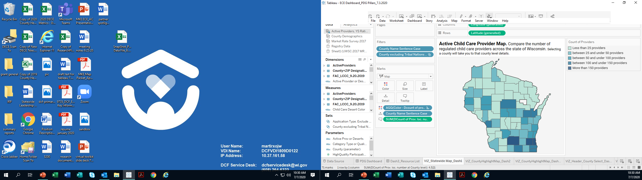
Access
Regulated family child care programs declined by 68%
Equity & Inclusion:
Geography impacts accessibility of child care
Even in areas such as Milwaukee County, where there are a high number of providers, gaps exist
In rural areas family child care, the primary regulated option, has been declining
Licensed group child care centers declined by 9%
Notes:
Wisconsin has a shortage of infant and toddler care and non-standard hour care (evening, overnight, weekend). Over the past decade, the number of regulated family child care programs has declined by 68%. The number of licensed group child care centers declined by 9%.

Slide 19

Access
Fewer providers are participating in YoungStar.
This disproportionately impacts families participating in Wisconsin Shares who must enroll their children with a YoungStar-participating provider.
Families with income constraints in need of WI Shares assistance may be at an even greater disadvantage in finding child care near their home or work.

Slide 20
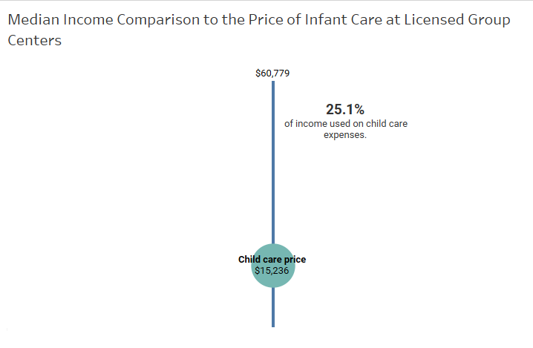
Affordability
The average annual cost of infant care in Wisconsin significantly exceeds the average in-state tuition for a 4-year public college & average annual rent.
Notes:
Source: Market Rate Survey & Median Household Income County Health Rankings
Median Household Income=exact mid point with 50% of Wisconsin earning more & 50% of Wisconsin earning less
Other factors that impact this: making less than household income, more than 1 child in care, cost of care varies

Slide 21
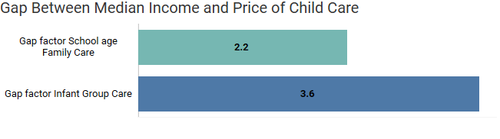
Affordability
Equity & Inclusion:
For families making less than the median income, this gap is even greater.
Single-parent families are at a greater disadvantage than two-parent families.
In many counties, Blacks & Hispanics make less than Whites, making affording child care an even greater driver of economic hardship.
The Federal Government defines “affordable” child care as costing less than 7% of a family’s income.
No state meets this definition.
A family with a school-age child 6+ will pay 2.2x the affordable amount.
A family with a child 0-1 in a group child care setting will pay 3.6x the affordable amount.

Slide 22
Affordability
Wisconsin Shares Child Care Subsidy participation has been steadily declining.
Families who qualify often do not participate.
The gap between the subsidy rate & the cost of care may still leave families unable to afford child care.
Equity & Inclusion:
Children receiving WI Shares must enroll in a YoungStar-participating program.
Families unable to access a YoungStar participating provider may be unable to access WI Shares.

Slide 23
Affordability
WI Shares maximum amount for this child: $761
WI Shares maximum amount for this child: $1,141
Avg. price for child 0-1 Group Center: $1,031/mo.
Avg. price for child 0-1 Group Center: $1,513/mo.
$270 gap
$370 gap
Example: Chippewa County
63% of zip codes considered child care deserts
Example: Dane County
9% of zip codes
considered child care deserts
Families may be unable to afford the difference.
Families may be unable to find YoungStar-participating providers and with openings.
Families may be unable to find any providers with openings.

Slide 24
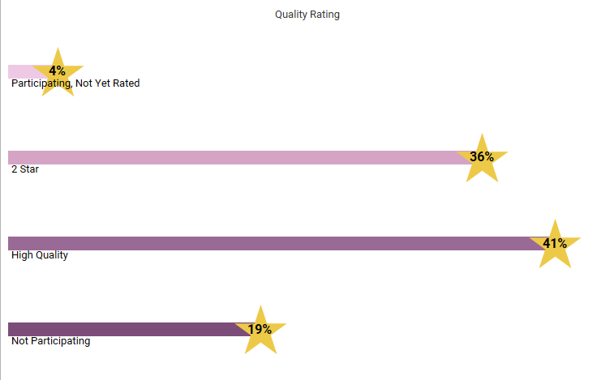
Quality
High Quality is defined as a YoungStar rating of 3-5 Stars.

Slide 25
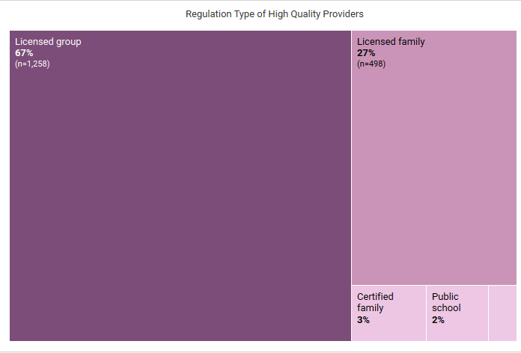
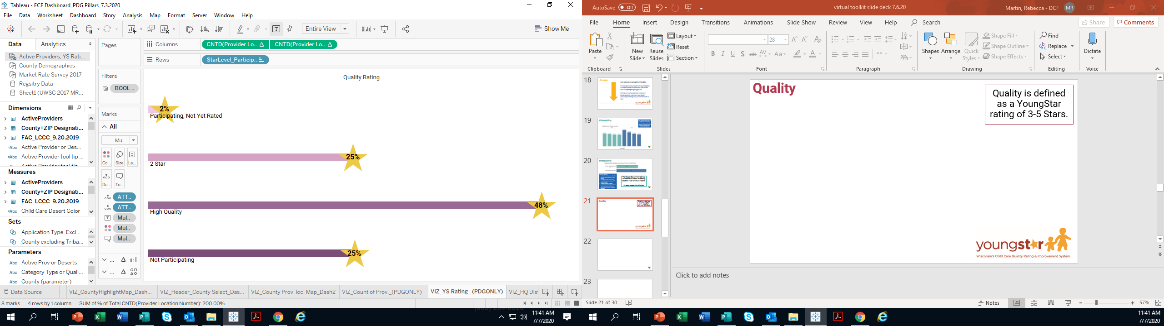
Quality
Of the 41% with a YoungStar rating of 3-5 Stars, 67% are from a Licensed Group, 27% are Licensed Family, 3% are Certified Family.

Slide 26
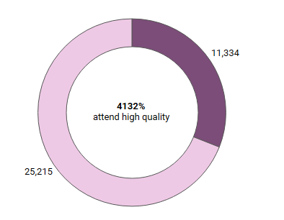
Quality
Percent of Children Participating in Wisconsin Shares Child Care Subsidy Served by High Quality Providers
Equity & Inclusion:
The location of 3-5 Star programs varies. Families may not have access to a high quality provider near where they live or work.
Not all programs participate in YoungStar and so are not rated.
For families, the definition of quality may involve different factors than YoungStar system measurements.
Children not in 3-5 Star Rated Setting
69% attend high quality care
Children in 3-5 Star Rated Setting

Slide 27
Workforce
Equity & Inclusion:
Staff at child care programs with 50% or more children with child care subsidies had lower wages, were less likely to have a degree and had a higher turn over rate.
The Southeastern Region has more racially/ethnically diverse child care professionals compared to the rest of the state.
In Milwaukee, 41% of child care professionals identify as Black or African American and 11% identify as Hispanic.
The average hourly wage for a Wisconsin child care worker is $10-13. The average annual income of Wisconsin child care workers was $2,000 less than the US average.
A provider with an Associate Degree in Early Childhood Education earns less than others with a similar degree.
Notes:
· WECA Policy Brief summer 2010, Volume 2
· Early Childhood Workforce Index 2018, Wisconsin, Center for the Study of Child Care Employment, University of California, Berkeley

Slide 28
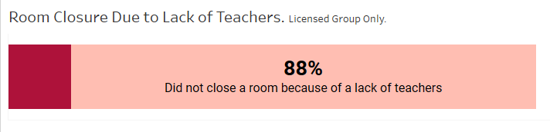
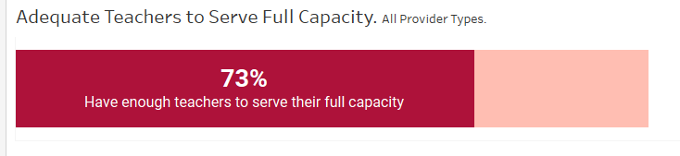
Workforce
Future PDG efforts will include evaluating workforce indicators post-COVID-19.
In the 2017 Workforce survey:
Notes:
In 2017, DCF and the UW Survey Center conducted an intensive survey of Wisconsin’s regulated child care providers. This survey was used to collect information on a variety of areas that impact early care education workforce.
In 2017 survey, of providers who closed a room, 88% did not close a room because of a lack of teachers.
In 2017 survey, 73% of respondents reported having enough teachers to serve their full capacity

Slide 29
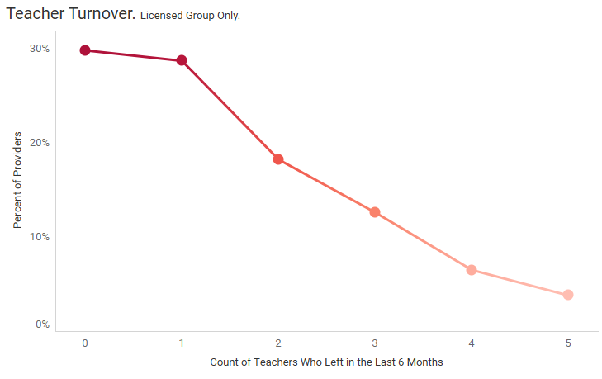
Workforce
In the 2017 Workforce survey:
Future PDG efforts will include evaluating workforce indicators post-COVID-19.
Notes:
In 2017, DCF and the UW Survey Center conducted an intensive survey of Wisconsin’s regulated child care providers. This survey was used to collect information on a variety of areas that impact early care education workforce.
In 2017, the graph shows the percentage of providers who had x number of teachers leave in the last 6 months

Slide 30
Coming Up Next in PDG Research:
Listening Sessions
Child Care Desert Mapping
Key Informant Interviews
Case Studies
Surveys
Additional data will be added to Wisconsin’s needs assessment and will be used to help develop Wisconsin’s strategic plan.
Visit the PDG website for up-to-date information!

Slide 31

Questions & Reflections
Did the PDG Sandbox data confirm or challenge your prior beliefs?
What information was new or surprising to you?
How might the data inform decisions you make?
Which data could help you communicate about needs or advocate for changes in your community?
What questions do you still have that you would like to have answered?

Slide 32


Contact Us:
wipdg@wisconsin.gov

