Slide 1

State of Wisconsin
Abusive Head Trauma Prevention Training
For Child Care Providers
Name of Presenter
Organization
Job Title
Notes:
Purpose: Welcome and introduction to training
Background Information for Facilitators:
_________________________________________
How to use this scripted curriculum:
The notes sections accompanying each slide of this power point are designed to contain a variety of types of information and resources that can be helpful to you as a facilitator.
The notes section of each slide begin with a purpose statement to summarize the topic of that slide.
Italicized sections are instructional or provide background information.
Notes that are bolded indicate concepts that must be communicated to the audience. However, the presenter is encouraged to use their own words and examples and not to feel obligated to read bolded statements word for word.
Discussion questions are designated as conversation starters. Feel free to select from and adapt questions. You do not need to use every discussion question.
Several slides contain activities designed to enliven and engage the audience. The notes section contains instructions.
__________________________________________
Welcome the audience to Abusive Head Trauma Prevention Training. Presenter introduces self.
This training is directed toward anyone who works or volunteers within a licensed child care facility. The content of this presentation serves as a source of information for child care providers to utilize within their work and interactions with children as well as to share with parents.
Optional, if within time constraints:
Invite audience members to introduce themselves.
To warm up the room and get buy-in to the training ask participants, “Share one thing you hope to get out of this training”.
Share any housekeeping issues.
Whether presenter is open to audience members getting up as necessary or prefers that everyone keep their seat and wait for the conclusion of the presenter.
Share time frame with audience.
Share predetermined cell phone rules.
May want to share location of rest rooms.

Slide 2

Purpose of this Training
Notes:
Purpose: To explain the purpose of this training to participants
During the next two hours, we are going to talk about a very serious threat to babies and small children, the circumstances that can lead to tragedy and ways to prevent it from happening. As a child care provider, you play an extremely important role in this effort. If you work with babies and young children, this information will be very applicable to your daily work. Equally important is your unique ability to share this information with parents in order protect children and ensure their safety and well being. Everyone in the community needs to be aware of the need to support parents and safeguard the health and well being of children. As a child care provider, you can be one of the frontrunners.

Slide 3
ACEs in Wisconsin
Learning Objectives
  Abusive head trauma
  The Period of PURPLE Crying
  Soothing strategies
  Coping with frustration
  A crying plan
  Educating others
Notes:
Purpose: To share learning objectives
The learning objectives for this presentation include the following:
To build awareness of abusive head trauma, its adverse consequences and how it is preventable,
To gain an understanding of the Period of PURPLE Crying
To develop the knowledge and skills to handle the challenges and frustration of increased infant crying, including soothing strategies
To create a crying plan in order to avoid becoming over stressed or overwhelmed by infant crying.
To be able to support and educate parents, caregivers and other staff about abusive head trauma and coping with normative crying
As you go through this training remember to listen with dual perspectives: as a caregiver of young children and as a source of critical support and knowledge for parents and community members.

Slide 4
ACEs in Wisconsin
All Babies Cry
  Crying is infant communication
  Crying varies in length and intensity
  Sometimes infants cannot be soothed
  Inconsolable crying can lead to caregiver distress and frustration
Notes:
Purpose: Facts about infant crying
All Babies Cry! Crying in an essential form of infant communication with caregivers in order to get their basic needs met. From the moment that they are born, babies cry to communicate hunger, discomfort, over/under stimulation, fatigue or dysregulation.
However, some infants cry more than often, longer and more intensely than others. They can cry for no apparent reason and caregivers may be unable to sooth them. Inconsolable crying can be very upsetting and frustrating for caregivers.

Slide 5

ACEs in Wisconsin
All Babies Cry
  The number one trigger for Shaken Baby Syndrome
  is frustration with infant crying.
Notes:
Purpose: Introduce relationship between infant crying and Shaken Baby Syndrome, a form of abusive head trauma
Read Statement:
The number one trigger for Shaken Baby Syndrome is frustration with infant crying.

Slide 6
What is Shaken Baby Syndrome?
  A form of Abusive Head Trauma (AHT)
  Occurring in infants and young children
  Specific group of signs and symptoms
  Resulting from violently shaking child or shaking and causing child’s head to hit an object
  Inflicted by an adult on purpose
Notes:
Purpose: Describe Shaken Baby Syndrome and its relationship to Abusive Head Trauma
When a caregiver becomes overly frustrated with an infant crying, adverse consequences can stem from that frustration, particularly – Shaken Baby Syndrome.
Shaken Baby Syndrome is:
One form of Abusive Head Trauma (AHT). AHT also includes injury, not only to the brain, but also the skull and spinal cord which can result from shaking but also from inflicting trauma on the head by other means such as throwing, intentionally dropping, striking or other forms of impact.
“Shaken baby syndrome” occurs in babies and young children. - Who are vulnerable because they are wholly dependent upon caregivers, are so small in size and are not capable of defending themselves.
The term “shaken baby syndrome” is defined by the collection of signs and symptoms specifically resulting from violently shaking a child OR shaking a child and causing the child’s head to hit an object such as a wall, furniture, or the floor.
“Shaken Baby Syndrome” is inflicted by an adult on purpose.
Below are some typical movements and activities that do not cause abusive head trauma:
Tossing a baby in the air
Bouncing a baby
Jogging/running with baby
Short accidental falls (like falling off a couch).
Sudden stops or bumps
Emphasize to audience that AHT is an act of abuse, and easily recognizable as abuse. A typical observer would never confuse it with play.
Throughout the remainder of this training we will use the medical term Abusive Head Trauma or AHT rather than the term Shaken Baby Syndrome.

Slide 7
Quiz Yourself
How much of an infant’s body weight is its brain?
a. 10% b. 15% c. 25% d. 33%
An infant’s skull has more space or less space inside
that an older child or adult? True or False
3. An infant’s neck is very __________________ ?
a. soft b. weak c. sweet smelling (when clean)
4. Bleeding is the most dangerous injury that results
from shaking a baby? True or False
Notes:
Purpose: A quiz help participants understand the unique characteristics of young children that make them so vulnerable to AHT
The brain comprises 25% or one fourth of an infant’s total body weight. It is very heavy in comparison to the rest of the body. In contrast, an adult brain is approximately 10 % or one tenth of the total body weight. Much lighter to carry around in comparison.
An infant’s skull is roomier than an adult.
Question: Why do you think that might be the case?
An infant’s skull is designed to have more room for the brain to grow.
Question: What might be the effect of that additional space between the brain and skull when a baby or small child is violently shaken?
Demonstration: Ask for two volunteers to stand in front of the group to “high five” one another. Have one person be the “receiver” of the high five and the other be the “giver” of the high five. Ask the receive to hold their arm stiff and try not to let it move during the high five. Ask the giver to try to make the receiver’s hand move. Then have both the giver AND the receiver hold their hands about 2 inches apart and have the giver give the high five (remind him or her to try to move the other person’s hand). Next have the giver and the receiver stand about two feet apart and have the giver give the high five, trying to make the receiver’s hand move. The distance between the two hands should cause the giver’s high five to have more impact on the receiver’s hand. This is the same with the brain and skull. The greater distance between a baby’s brain and skull causes shaking to have a greater impact on a baby’s brain that it would on an adult whose skull and brain have much less space between one another.
When an infant is shaken the brain moves further back and forth and gains speed as it hits the surface of the skull. Additionally, blood vessels in infant brains are delicate and not very securely anchored, so the back and forth movement stretches, tears and breaks the blood vessels, causing bleeding on the brain.
3. All three are true – an infant’s neck is soft, sweet smelling when clean and weak. However, it is the fact the neck muscles are so weak that puts infants at such high risk of injury from shaking or trauma to the head. Their neck muscles are not strong enough to stop the infant from moving when the head is shaken. Think of a floppy rag doll. It is a similar effect.
4. It is true that bleeding of the brain is injurious. Equally damaging is the swelling of the brain that occurs from the impact of the brain against the skull. The pressure from this swelling stops blood circulation to parts of the brain. This lack of circulation can cause those parts of the brain to die, resulting in permanent damage.

Slide 8
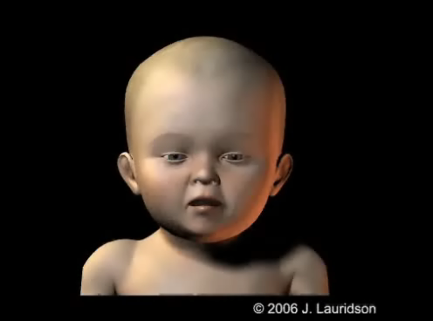
Effects of Shaking
Notes:
Purpose: To describe the physical process of how shaking damages the brain
What actually happens when an adult violently shakes a baby or small child?
As mentioned previously, because of their large heads and weak neck muscles, they do not have the strength to control the movement.
The strength of an adult shaking a baby causes an infant’s head to move in a figure eight pattern.
This causes different parts of the brain to move at different speeds and in different directions.
As mentioned previously, this type of motion can cause swelling in the brain as well as tearing and bleeding of the blood vessels in the brain and eyes.
As the back of the brain hits the back of the skull, damage can occur to the occipital lobe which controls vision.
As the front of the head hits the front of the skull damage can occur to the frontal lobe which controls memory and emotion.
As the left and right sides of the brain hit the corresponding side of the skull, speech, hearing and the movement of arms and legs can be affected.

Slide 9
Characteristics of Abusive Head Trauma Victims
Age
Demographics
Relationship to perpetrator
Notes:
Purpose: To describe the characteristics of abusive head trauma victims and emphasize that AHT can happen to any child in any family. And that perpetrators are almost always a trusted caregiver, so parents, child care providers, friends, family members and neighbors need to be aware of the signs when caring for vulnerable children.
Abuse head trauma occurs among babies and children from birth up until 5 years of age.
The majority of cases are among infants less than 6 months of age.
However, severe shaking can seriously injure children as old as 4 or 5.
AHT can happen to any child, regardless of race, socioeconomic status or family structure. However, young parents, parents with little support, those experiencing stress, those who are not able to meet their basic needs for food, shelter etc., those experiencing other forms of violence or at reduced capacity due to substance use or mental illness, and homes where unrelated adults are residing have increased risk.
There are more male AHT victims than female.
A perpetrator of AHT is almost always a person who has been entrusted with an infant’s care (parent, a parent’s significant other, child care provider).
60-70 of perpetrators are male. Usually the child’s father or mother’s boyfriend. Others include mothers, grandparents, step-parents, other relatives or child care providers.
Anyone who may become frustrated is capable of shaking a baby. It can happen to any child in any family. It is, therefore, very important to help caregivers become aware of the risk for themselves and from others, to be aware of the signs that shaking has or may occur and to scrutinize those in whose care vulnerable children are left.

Slide 10
Abusive Head Trauma in the US
Approximately 1300 cases annually
25% of cases are fatal
Majority of non-fatal cases show either short- or long-term disability
Notes:
Purpose: To describe the prevalence and impact of AHT in the US
The United States averages approximately 1300 cases of abusive head trauma each year.
It is difficult to determine an exact number of AHT cases due to 1) differences in the reporting requirements of each state and 2) the fact that many signs and symptoms of AHT mirror symptoms of other common childhood illnesses, resulting in misdiagnosis.
Of the cases of abusive head trauma diagnosed each year, approximately 1 out of 4, or 25%, result in death. And for the victims who do survive, most will continue to have lifelong challenges resulting from trauma and damage to the brain.
60-80% of non-fatal cases show either short- or long-term disability
Clearly abusive head trauma is a huge threat to infants and children who experience shaking.

Slide 11
Less Severe Signs
Irritability
Lethargy or sleepiness
Feeding difficulty
Vomiting
Low levels of consciousness
Notes:
Purpose: To describe early signs of the AHT, which are often somewhat less severe.
The consequences of abusive head trauma vary and are different for each case. Early or less severe signs of AHT can be only slightly more pronounced forms of typical infant behavior or similar to symptoms of other types of illness.
Such signs and symptoms can include:
Irritability (sometimes extreme irritability or accompanied by high pitched crying)
Lethargy or sleepiness
Feeding difficulties, including trouble sucking, swallowing or decreased appetite
Vomiting
Low levels of consciousness
When only the less severe signs of abusive head trauma are present, AHT can be difficult to detect and there is a significant chance for misdiagnosis.
Question:
Why do you think this might be the case?
Several of these signs are also symptoms of other childhood illnesses.
Caregivers either do not want their physician to know the true origin of symptoms or may not know themselves, so doctors do not necessarily have a true picture or complete facts of what provoked the symptoms.
Why is misdiagnosis so problematic?
Any treatment is not addressing the true origin of the problem.
The child is at high risk for future episodes of shaking.

Slide 12
Sentinel Injuries
A fairly minor abusive injury that occurs prior to a more serious physical injury
  Occurring before a baby is mobile
  Not accidental
  Warning sign for future abuse
Babies who are not cruising,
should not be bruising!
Notes:
Purpose: Describe sentinel injuries and explain how they can be an indicator of HIGH risk for future abuse.
What are Sentinel Injuries?
Optional Discussion Question: Ask if participants are aware of the concept of sentinel injuries
Sentinel Injuries are minor abusive injuries that often present themselves before a more serious physical injury.
They can come in many different forms:
Bruising
burns,
broken bones
Injuries to the inside of a baby’s mouth (caused by ramming a bottle into mouth)
These type of injuries are not likely to happen without a cause, because they primarily occur in early infancy to babies that are not mobile enough to be injured by obstacles around them or in places that an infant cannot reach or that are not exposed for injury.
Example include: A bruise on an arm or leg of an infant who is not mobile, a bruise on an infant’s ear or cuts or bleeding in the mouth.
Research shows that 27.5%, more that one quarter, of abused infants had an earlier sentinel injury. Reportedly, doctors were aware of the sentinel injury in less than half of cases.
Just remember: BABIES WHO ARE NOT CRUISING SHOULD NOT BE BRUISING! If you are a caregiver or parent who notices bruising, red marks, or mouth injury in a very young child, consider consulting a physician.
To find out more about Sentinel injuries …
_______________________________________________________________________
Additional information/optional training materials:
Free sentinel injury training: https://uwm.edu/mcwp/sentinel-injuries/
Citation: Sheets LK, et al. Sentinel injuries in infants evaluated for child physical abuse. Pediatrics. April 2013.
Office of Child Abuse and Neglect, Children’s Bureau
American Academy of Pediatrics, 2013

Slide 13
Severe Symptoms
Inability to make sounds or movement
Difficulty breathing
Seizures
Unable to suck or swallow
Unconsciousness
Death
Notes:
Purpose: To describe severe symptoms of AHT
For severe cases of AHT, symptoms can include:
Inability to make sound (cooing, babbling or words) or movement or lack of social engagement (lack of smiling, tracking or focusing on objects)
Difficulty breathing. This may be evidenced by skin coloring. Pale/bluish skin indicates lack of oxygen. Or unusual breathing patterns such as continuous deep breathing or a pattern of short and shallow breathing
Seizures
Damage to the blood vessels of the eye, which can cause bleeding
Bleeding or drainage of clear fluid (spinal fluid) from the ear
Inability to coordinating sucking and swallowing
Loss of consciousness
Death
Physical signs that can (but do not always) accompany abusive head trauma:
- Wounds or bruising on the skin
- fractured ribs, arms, legs or other bones
If you see any potentials signs or symptoms of AHT among the children that you work with, you need to report them or have them checked out by a physician. It is also important to share information with parents the signs and symptoms to watch for, so that they are aware and can identify them if their child has been with another caregiver.

Slide 14
Long-term Effects
Speech disabilities
On-going seizures
Cerebral Palsy
Behavior disorders
Learning disabilities
Cognitive impairment
Physical disabilities
Visual disabilities/blindness
Hearing impairment
Notes:
Purpose: To describe long-term effects of AHT
As mentioned earlier …among victims of AHT that survive, 60-80% of hospitalized cases have shown long-term or life-long effects.
These effects may include:
Learning disabilities
Visual disabilities/blindness
Speech disabilities
On-going seizures
Cognitive impairment
Physical disabilities
Hearing impairments
Cerebral Palsy
Behavior disorders
Not only does AHT effect the victim, but it also carries a large impact on caregivers and society. Many of the long-term effects of AHT require special services, additional medical treatment and round-the-clock caregiver support; not to mention the extreme financial burden and time commitment associated with these services. Estimated average lifetime cost for a surviving AHT victim =$2.6 million.
Equally tragic is the loss of life and potential for a child experiencing AHT related death. Estimation of lost of lifetime income, contribution and potential results equals $5.7 million.

Slide 15
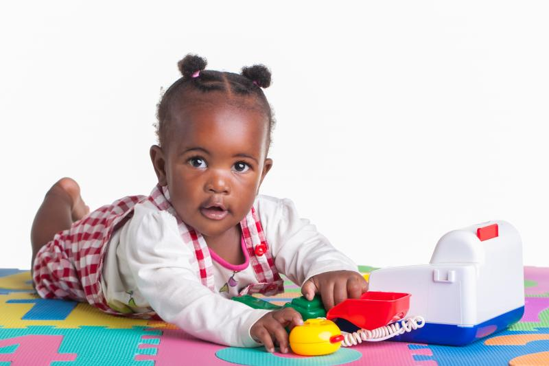
ACEs in Wisconsin
Prevention of Abusive Head Trauma
Notes:
Purpose: Transition slide to section on abusive head trauma prevention
Abusive head trauma creates a high risk for potentially devastating consequences. Therefore, efforts to prevent AHT are extremely important. Prevention efforts focus on providing education, promoting awareness and offering support.
The next section of this training will center on normative crying, the developmental period when infant crying increases, why it is important for caregivers to understand crying and be prepared for it.
In your dual role as caregiver and support to parents, information on normative crying is useful and should be shared with parents.

Slide 16
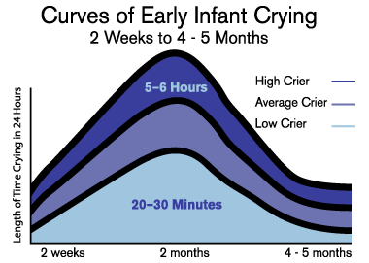
Crying Curve
Notes:
Purpose: Describe the “Crying Curve”
How many of you have heard of the crying curve?
An early study on infant crying, performed by pediatrician Dr. T. Berry Brazelton in 1962, first demonstrated increased crying in the early months of infancy is a normal stage of infant developmental. The trajectory of increased crying is demonstrated in the Crying Curve found on this slide.
As you can see,
The amount of time infants spend crying during the course of each day begins to increase slowly but steadily at approximately 2 weeks of age
The amount of time an infant spend crying during a 24-hour period generally peaks around the 2nd month
Around the beginning of the 3rd month the amount of daily crying begins slowly but steadily to decrease over time and, generally, tapers off around 4 to 5 months.
Amount of Crying:
The total amount of crying time per day varies from infant to infant
Low criers may only increase to 20-30 minutes per day. While high criers can wail for upwards of 5-6 hours each day.
Regardless of how much a baby cries, all babies increase their crying during this period of their development.
Premature babies experience this same crying curve at approximately 2 weeks corrective age (in accordance with the timing of their due date, rather than their birthday).
Questions:
For those who were NOT aware of the crying curve prior to today, how many of you are grateful to have that information now?
How many of you wish that you had had it sooner?
How many of you plan to share this information with other parents you know?
How many of your plan to share this information with parents at your center?
Parents really need this developmental information, especially new parents. However, any parent, caregiver or child care provider can find themselves in new territory, where a child’s crying pattern feels very different from previous children or a child is especially difficult to soothe.
Here are some sample questions to start a conversation with a parent about crying.
How often and how long does your baby cry?
Have you noticed specific times when your baby cries more?
How are you coping with the crying?
Reference:
Courtesy of the National Center on Shaken Baby Syndrome, dontshake.org

Slide 17

!Kung San Tribe Study
Despite caregiving practices much different from Western culture, the crying curve remains the same.
 | !Kung San | Western Culture
Contact | Constant | Occasional
Carrying | Constant | Response to crying
Feeding | Constant | Paced
Posture | Upright | Laid on Back
Response | Universal | Occasional/ Non-responsive
Notes:
Purpose: To illustrate that the crying curve is not culture specific
!Kung San Study
An observational study of the !Kung San tribe supports that this increased period of crying is seen in all infants, not just those of Western culture.
!Kung San is a hunter-gatherer tribe in Botswana.
!Kung San tribe does everything known to sooth infants during the course of their normal day-to-day caregiving
Constant contact with mother
Baby wearing or constant carrying using a sling and not only in response to crying
Continual feeding every 15 minutes for the first 2-3yrs of life
Upright posture through use of sling
Quick/Universal response time – on average respond within 10 seconds, 92% of time
Yet their infants’ crying follows the same crying curve/pattern of other infant studies. This provides strong indication that this pattern of early crying is not due to differences in caregiving but is a normal period of development.
It is also important to note one difference found, !Kung San infants’ lengths of crying periods were shorter. This may show that increased efforts to comfort an infant, may reduce the length of crying.
Reference:
Barr RG, Konner M, Bakeman R, Adamson L (1991) Crying in! Kung San infants: A test of the cultural specificity hypothesis. Dev Med Child Neurol 33:601–610

Slide 18
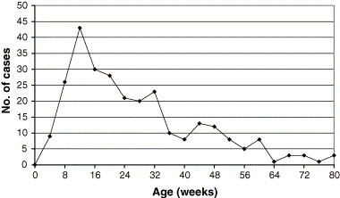
Relationship Between Abusive Head Trauma and the Crying Curve
Barr, Trent et al., Child Abuse & Neglect 2006
Notes:
Purpose: Demonstrate relationship between increased crying and increased incidence of abusive head trauma
We know that there is a normal period of development in an infant’s life where crying increases. We also know caregivers’ frustration increases during this period of development. So what is the importance of this in terms of Abusive Head Trauma occurrences?
The above graph shows data from a study that analyzed 273 hospitalized cases of AHT from 1996-2000 in the State of California. What the data shows is that number of cases of AHT increases with the amount of crying as demonstrated on the crying curve. The highest incidence of abusive head trauma corresponds with the peak of the crying curve where the highest amount of the baby’s day is spent inconsolably crying. Since the period of heavy crying occurs within the first six months of life, most AHT victims are less than 6 months of age.
Reference:
Barr RG, Cross J, Trent R. “Age-related incidence curve of hospitalized Shaken Baby Syndrome cases: Convergent evidence for crying as a trigger to shaking.” Child Abuse & Neglect, vol. 30, no. 1, 2006, pp.7-16

Slide 19

ACEs in Wisconsin
The Period of Purple Crying
  A phrase used to describe the time in a baby's life when it is normal for them to cry a portion of every day.
Notes:
Purpose: To introduce the Period of Purple Crying
The research and evidence is there. Infants have a normal period of increased crying and occurrences of AHT align with this period of development. So how do we help educate and make caregivers aware of what to expect during this time? What knowledge and resources can we instill to help ease frustration and prevent AHT?
The Period of PURPLE crying was developed by Dr. Ronald G. Bar and is a phrase used to describe the time in a baby’s life when they cry more than any other time.
Reference:
Courtesy of the National Center on Shaken Baby Syndrome, dontshake.org

Slide 20
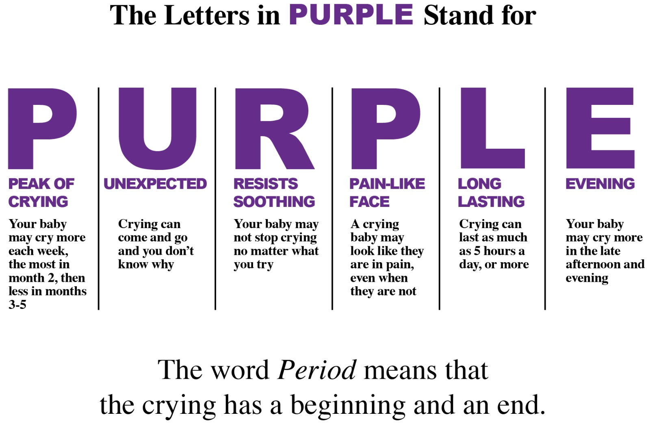
What does PURPLE mean?
Notes:
Purpose: Explain the meaning of the PURPLE acronym
The PURPLE acronym is an easy way for parents and caregivers to learn and remember the characteristics of the type of crying that occurs during the Period of Purple Crying.
P stand for Peak of Crying – crying starts to increase around 2 weeks, peaks in the second month and gradually decreases in the 3rd-5th month.
U stands for Unexpected – The crying can be unexpected and difficult to plan for, because it can come and go at any point without any rhyme or reason.
R stand for Resists Soothing – No matter how many different things a parent or caregiver tries in order to sooth the baby, it may not work some or, even, all of the time.
P stands for Pain-Like Face – A crying baby may look like it is in pain, even if it is not. Although it is ok for parents to get their baby checked by a physician if they are concerned.
L stands for Long Lasting – Babies can cry up to 5 hours or more each day.
E stand for Evening - Babies are often likely to cry more in the late afternoon and evening during this period.
Having a crying baby does not mean someone is a bad parent or caregiver as long as the baby has been fed, cleaned, provided with an appropriate environment and opportunity for sleep, and snuggled.
The word “period” in Period of Purple crying means that the timeframe, where prolonged crying occurs, has a beginning and an end.
Fun Fact:
PURPLE does not mean that that babies turn purple when they cry during the Period of PURPLE Crying.
Note: It is important to understand crying can occur outside of these parameters as well. Parents should always be supported in seeking medical help to learn whether their baby’s crying pattern is normal or a sign of an illness.
Reference:
Courtesy of the National Center on Shaken Baby Syndrome, dontshake.org

Slide 21
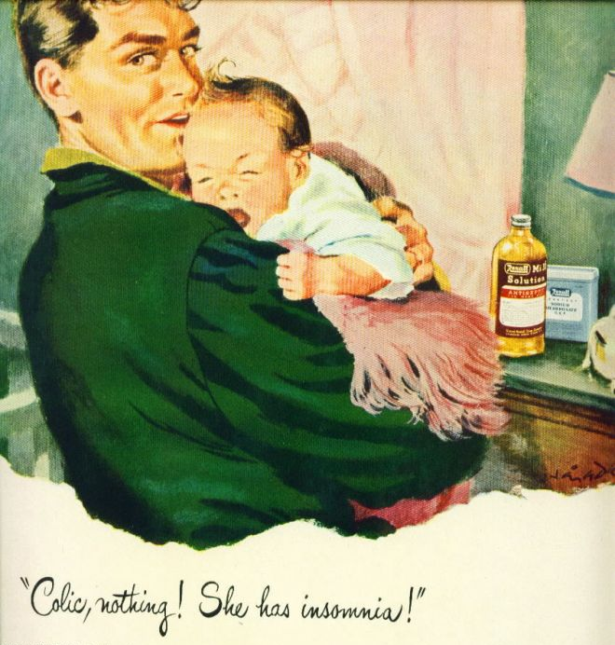
PURPLE Crying vs. Colic
Notes:
PURPLE Crying vs. Colic
Discussion Questions:
How many of you have heard of colic?
How would you describe colic?
Researchers use Wessel’s Criteria to define colic.
A healthy infant that cries at least: 3hrs per day, 3 days per week for at least 3 weeks
Crying periods start between 3 and 21 days, subside by 3-4 months
Crying occurs in the evenings
The crying baby has flexed legs with “pained” look on face
Do those characteristics sound familiar?
What was referred to as colic is now thought to be a normal developmental stage with variances in intensity in individual babies. The term colic in the medical field has no accepted diagnostic criteria, it is often used to describe an overly fussy baby that has no medical reason for the increased crying.
However, colic is understood by most people to be an illness that some babies have and others do not, which can imply that there is something wrong with a baby. When, in fact, all babies go through a normal crying curve, some babies just happen to cry more than others within that curve.
It is important to remember, even though it is normal for some babies to cry a lot during the period of PURPLE crying, some babies do cry even more that the highest range of normal or are actually in pain. So it is important to support parents and caregivers, who feel that their baby needs help or that they need help with their baby, so that they can get the assistance they need – whether that might be medical diagnosis or support with parenting.

Slide 22

Becoming Prepared for
the Period of PURPLE Crying
Notes:
Purpose: Transition slide to section on helping caregivers become prepared for the Period of PURPLE Crying
Discussion Question:
Now that you know the characteristics and general timeframe of the Period of PURPLE Crying, can you think of strategies that you’ve seen, heard about or used yourself that could help a new parent or caregivers can prepare so that they had strategies and are better able to cope during the Period of Purple Crying?
Ex.
Pace up and down, back and forth in the room jiggling baby and remind yourself how many calories you are using up with all the activity
Schedule a break by asking a friend, partner or family member if they would be responsible for the baby twice a week for 30 minutes or an hour during peak crying time
Get favorite coffee or special music to help sooth parent while baby is crying
Activity Option: (You will need a flip chart and, possibly, paper for notes at tables)
Presenters can have participants share in a large group or have them discuss at their tables for 5 minutes and share out to the large group afterward. Presenters might want to take down a list of suggestions to share with the group following the training. Participants may come up with some excellent ideas that they may want to remember and share with other caregivers and parents.
Thank you for sharing your ideas. We’ll continue to talk about them, during the next portion of this training, as we discuss
ways to soothe a crying infant
ways a parent can care for themselves in the midst of this stressful time and
ways to help with frustration resulting from crying and to plan for times when that frustration becomes overwhelming. This is particularly important for protecting infant safety.

Slide 23
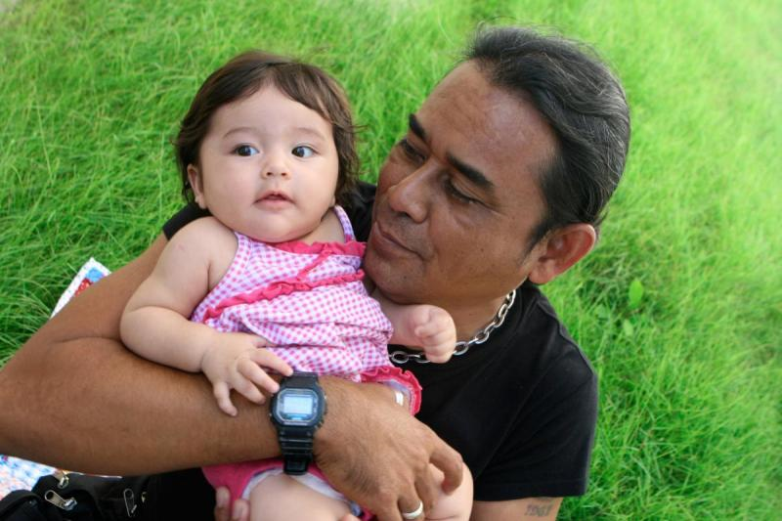
Principles for Soothing a Baby
Change Position
Movement
Repetition and Rhythm
White Noise
Smells, Sights and Sounds
Closeness to Caregiver
Sucking
You CANNOT “spoil a baby!”
Notes:
Purpose: To share Principles for soothing a baby
True or False? Soothing a baby is something that just comes naturally and easily to all parents and caregivers?
If you feel like this statement is accurate, you are a lucky person, but it is not necessarily the case with many parents and caregivers.
Plus, some babies are just much more challenging to soothe than others, which is perfectly normal, but requires a few more strategies and ideas.
No one holds the magic key to soothe all babies 100% of the time. No matter what you do or what you try, it is important to know that some crying bouts are inconsolable (5-10%). Techniques that may have worked yesterday, may not work today. That does not mean a parent or caregiver is doing something wrong.
As a caregiver you will feel responsible for the baby and may become frustrated with your inability to “fix” the crying. It is NORMAL to feel frustrated during this time, what is most important is how you handle that frustration!
If you learn principles, of soothing, rather than individual techniques, you will be more likely to think of a variety of strategies to try when the pressure of crying is on:
7 Principles of Soothing (Have participants brainstorm examples for each strategy before providing suggestions and summing up.)
Change Baby’s Position - Changing a baby’s position can provide different points of contact between you and the baby, change the baby’s view, provide eye to eye contact between you and the baby and allow the baby to stretch different limbs and body parts. Examples include: Picking the baby up, laying the baby down, holding the baby over the shoulder, carefully balancing your babies over and arm or leg, holding the baby facing out.
Movement – Movement is very soothing for babies. Caregivers can use their own movement to sooth babies or use mechanical means to provide movement. Examples include: Walking with baby, using a swaying motion, up and down jiggling motion. Pushing baby in a stroller, riding in the car, putting the baby on top of a cycling washer or dryer (with careful supervision), using a baby swing.
Repetition and Rhythm – Repetition and Rhythm often go hand in hand with movement and with one another. Repeating soothing things is calming, particularly when repeated in a pattern. Examples include: Walking in a pattern or making the same movements over and over like rocking a baby or pushing a baby back and forth in a stroller, singing song, telling a nursery rhyme or story, patting a baby’s back or placing the baby to your chest so they can hear your heartbeat.
White Noise – White noise is sound that often is without rhythm, such as random background noise that does not have a melody. Examples include: The sound of a vacuum, shower, hum of an engine or fan – or, even, a white noise machine. Whatever you choose to make white noise, make sure the infant is safe and secure.
Smells, Sights and Sounds – We often forget that baby’s senses are very sensitive. They can identify and be soothed by familiar smells, sounds and sights. Examples include: wrapping the baby or covering the caregiver’s shoulder with a familiar blanket that hasn’t recently been washed, keeping a cloth item from a parent or familiar caregiver near baby (in a safe manner), human faces are recognized and soothing to babies, as is the human voice, particularly that of a parent or familiar caregiver.
Closeness to Caregiver - Being held and snuggled is extremely important and soothing to babies. Examples include: skin to skin contact, cheek to cheek, carrying, sitting on a lap.
Sucking - Sucking motions begin in the womb and can be very relaxing for babies. Sucking that is unrelated to food intake can be just as soothing when a baby is not hungry. Examples include: Sucking on a pacifier, sucking a thumb or fingers (though is takes many babies some time to coordinate their fingers) or even a caregiver’s clean finger.
While each principle can be helpful on its own, using multiple principles can be more successful.
Optional Discussion Question:
Can you give examples of how these principles can be used together?
Examples: Listening to soothing music or talking in soothing voices while driving your baby in the car.
Singing, rocking and cuddling your baby.
It is a myth that you can spoil a baby. Spoiling a baby is not possible. In fact, a caregiver responding to an infant’s signs of fussiness quickly and consistently actually lessen inconsolable crying bouts as well as strengthening attachment between caregiver and infant.
Reference:
Courtesy of the National Center on Shaken Baby Syndrome, dontshake.org

Slide 24
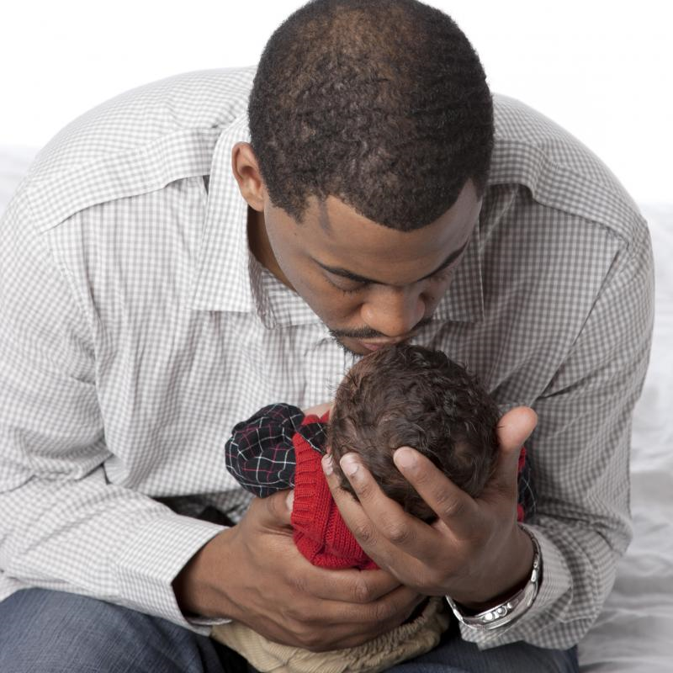
Managing Stress and Frustration
Take time to calm yourself
Try to be mindful
Take a break!
Notes:
Purpose: Describe 3 Coping Strategies to help manage frustration
It is not an easy feat to take care of yourself while dealing with an inconsolable infant. But when you take the time to manage your frustration, you not only benefit from the reduction of stress, but also limit the possibility of harming or shaking an infant.
Here are three strategies for dealing with frustration and that can be shared with parents:
1.) Take time to calm yourself
This is the first and most important step. It is more important for parent or caregiver to stay calm, than to stop the crying.
Parents and caregivers should think of some calming activities before they are dealing with a crying baby.
Examples might include:
Walking
Taking deep breaths
Listening to music
Watching a mindless TV program or movie
Remember – if the parent or caregiver is able to relax, it helps the baby also. Infants feel caregivers emotions and respond accordingly, which does not mean that a crying baby is the fault of the caregiver.
2.) Mindfulness
Try to stay focused on the task at hand, even though the baby is crying
Examples: If driving, trying to fix dinner or caring for an older child, parents or caregivers should try not to allow the baby’s crying to stress them to the point that they are so stressed and distracted and cannot concentrate or complete your tasks.
3.) Take a Break
It is okay for parents or caregivers to take a responsible break.
Lay the baby in a safe place, using recommended safe sleep guidelines
Parents or caregivers should take time to calm themselves - once calm, they should try soothing techniques again
Check on baby often
Remember, feelings of frustration are NORMAL! It is okay for parents and caregivers to ask for help!
These are strategies that you can share with parents when they express frustration due to their baby’s crying.

Slide 25
Having a Plan
  Have a plan in place for parents and caregivers:
  Identify those who will provide help
  Alert support persons so they are aware and prepared if help is needed
  Ensure that contact information of support persons is readily available
  Practice asking for help
Notes:
Purpose: Having a plan
Human beings are biologically programmed to be very sensitive to infant crying, so it is natural to become frustrated when a baby is crying inconsolably, and a caregiver is unable to do anything about it. However, it is essential that parents and caregivers have a plan so that the frustration does not escalate out of control. It is hard to imagine someone would ever being frustrated enough to harm an infant, but it happens 1300 times each year. Perpetrators often say they could not have imagined harming an infant, but that the frustration just “took over.” Every caregiver of an infant, whether a parent, child care provider or relative, is responsible for having a plan of action in place in case they ever reach their boiling point.
1. The first step is for parents and caregivers to identify a couple of individuals who they can to turn to for help.
Discussion Question:
Who are the type of individuals that parents’ and caregivers should try to identify? (add examples: a neighbor, a friend …)
What characteristics should those individual possess?
What type of characteristics should parents avoid?
2. Alert support persons so they are aware and prepared if help is needed.
Supports persons will need to understand how important their help is in the moment, so that, even if it is not convenient for them, they need to be prepared to provide help if at all possible.
Have contact information of support persons easily available. When a parent or caregiver is at their wits end, they are not in a good place to need to go looking for contact information.
3. Practice asking for help
Parents do not have to wait until they are at the end of their rope to ask for help. They can practice by seeking help at times where it is less crucial so that they have been through it before things get really stressful and tense.
Discussion Questions:
As child care providers, do any of you have a plan in place?
If not, you deserve to have one. Infant crying can be extremely stressful and you need to take breaks and receive support also.
It is also very important that you discuss the need for a plan with parents of the young children you care for and who and what might fit into that plan. You can also support parents by asking how they are holding up and if they are utilizing their plan.

Slide 26

Educating Others
Abusive Head Trauma is Preventable
Know that You Can Make a Difference
Notes:
Purpose: To encourage participants to share information about Abusive Head Trauma with others
While information about abusive head trauma may be important to you personally, it is also important to educate and share with others if abusive head trauma is going to be eliminated. Each of you can be an important spokesperson and educator for yourself, other child care providers, for parents and for the community.
Resources are also helpful.
Highlights of this presentation are available in the brochure Babies Cry, Be Prepared, which contains general information on normal infant crying, strategies to stay calm and how to prepare for stress associated with infant crying. The brochure can be downloaded for free from: https://dcf.wisconsin.gov/ccic/aht-training-materials (available in English, Spanish and Hmong)

Slide 27
Key Takeaways
The Period of PURPLE Crying is developmentally normal
When babies can’t be soothed, frustration is normal
Develop a variety of soothing techniques
Support your own wellbeing by learning how to self-calm or taking a short break and walking away
Create a plan for when times when crying becomes overwhelming
For additional resources go to to purplecrying.info
Notes:
Recap of primary learning objectives

Slide 28

Questions?
Notes:
Purpose: Ask for any final questions.

Slide 29
Questions?
What is …
One thing you learned today that you plan to remember
One thing that you plan to share with others in the future
Notes:
Purpose: Reflect on learning
This is an optional slide/activity to help participants reflect upon and remember what they learned. You can have participants write down their answers or discuss their answers with one another.

Slide 30
Additional Resources
Contact Information:
Additional Resources
    Period of PURPLE Crying - purplecrying.info
    National Center on Shaken Baby Syndrome – dontshake.org
    Babies Cry, Be Prepared Brochure: - dcf.wisconsin.gov/ccic/aht-training-materials
    Sentinel Injury Training - uwm.edu/mcwp/sentinel-injuries/
    Department of Children and Families - dcf.wisconsin.gov
    Child Abuse and Neglect Prevention Board - preventionboard.wi.gov
    Child Care Information Center - dcf.wisconsin.gov/ccic/aht-training-materials
Notes:
Purpose: To share contact information of facilitator and additional resources.

Slide 31



Credits
This training was developed by the Wisconsin Child Abuse and Neglect Prevention Board and the Wisconsin Department of Children and Families. Special thank you to the National Center on Shaken Baby Syndrome for providing professional knowledge, expertise and collaboration throughout the development of this training.
  Disclaimer: The Period of PURPLE Crying® is a registered trademark and all content is copyright protected. All Rights Reserved, Ronald G. Barr, MDCM, FRCPC and the National Center on Shaken Baby Syndrome (2004–2018). Revised 2/5/2018.
Notes:
Purpose: To highlight credits and PURPLE disclaimer

