Slide 1


Child Care Vehicle Safety Alarm
Updated April 2026
Notes:
Welcome to an overview of Child Care Vehicle Safety Alarms in Child Care Vehicles. This training is for regulated child care providers who transport children. Initially, Wis. Stat. 48.658 was passed and took effect on August 1, 2009.

Slide 2
Learning Points
Background of the Child Safety Alarm Bill and what the law requires
Identify examples of child safety alarms
Provide situational examples of violations
Notes:
Objectives:
To provide a brief background of the Child Safety Alarm Bill and what the law requires.
To identify examples of child safety alarms, that when installed and used properly, meet the intent of the Child Safety Alarm law.
To provide examples of violations regarding the Child Safety Alarm law that a licensing specialist or certification worker may cite.

Slide 3
§48.658
Child Care Vehicle Safety Alarm
A child care provider or contractor of a child care provider that is the owner or lessee of the child care vehicle shall have an alarm system that prompts the driver of the vehicle to inspect the vehicle for children before exiting
Drivers and child care providers who knowingly transport children in vehicles without alarms or with alarms that are not properly maintained or in good working order may face criminal penalties of up to a year in jail and $1,000 in fines.
Individuals and child care providers who remove, disconnect, tamper with, or turn off the alarm without checking the vehicle may be charged with a felony punishable by up 3.5 years in prison and $10,000 in fines.
Notes:
Brief History:
Senator Spencer Coggs proposed the initial Child Safety Alarm Bill in 2005 when 2-year-old Asia Jones died after being left unattended in child care van that had picked her up from her home earlier in the day. The driver was arrested but not charged. In 2009, Jalen Knox Perkins died in a similar situation, and it served as a catalyst in passing Wisconsin statute 48.658, which requires a child care program to install a child safety alarm in certain vehicles used to transport children to and from a child care program.
The Child Safety Alarm law states a child care provider or contractor of a child care provider that owns or leases the child care vehicle shall have an alarm system that prompts the driver of the vehicle to inspect the vehicle for children before exiting.
Drivers and child care providers who knowingly transport children in vehicles without alarms or with alarms that are not properly maintained or in good working order may face criminal penalties of up to a year in jail and $1,000 in fines.
Individuals and child care providers who remove, disconnect, tamper with, or turn off the alarm without checking the vehicle may be charged with a felony punishable by up 3.5 years in prison and $10,000 in fines.

Slide 4

Definitions
Child care provider: A child care program that is licensed under Wis. Stat. 48.65, a child care provider that is certified under Wis. Stat. 48.651, or a child care program that is established or contracted for under Wis. Stat. 120.13 (14).
Child care vehicle: A vehicle that has a seating capacity of 6 or more passengers in addition to the driver, that is owned or leased by a child care provider or a contractor of a child care provider, and that is used to transport children in care.
Child safety alarm: An alarm system that prompts the driver of a child care vehicle to inspect the child care vehicle for children before exiting the child care vehicle.
Notes:
Child care provider: A child care program that is licensed under Wis. Stat. 48.65 (1), a child care provider that is certified under Wis. Stat. 48.651, or a child care program that is established or contracted for under Wis. Stat. 120.13 (14).
Child care vehicle: A vehicle that has a seating capacity of 6 or more passengers in addition to the driver, that is owned or leased by a child care provider or a contractor of a child care provider, and that is used to transport children in care.
A provider may not alter the vehicle (i.e. take seats out) to reduce capacity.
Parent volunteers using their own vehicles are not required to have an alarm.
Employees/staff/licensees using their own vehicles during the hours of operation are required to have alarms if their vehicle seats more than 6 passengers in addition to the driver.
Child safety alarm: An alarm system that prompts the driver of a child care vehicle to inspect the child care vehicle for children before exiting the child care vehicle

Slide 5




Types of Safety Alarms & Devices
Devices hardwired into a vehicle’s electrical system and activated when the ignition is turned on
Wireless devices
Reminder systems*
Child sensing or tracking systems*
Notes:
There are many types of child safety systems on the market but many do not meet the intent of the child care vehicle safety alarm law. It is important to be familiar with the types of systems available and which ones are used to meet the intent of the law. These child safety systems devices can be identified by the following groups:
Alarm systems that are hard wired into the vehicle’s electrical system and activated when ignition is turn on (when installed and used properly meet the intent)
Wireless devices (may meet the intent of the law if the device is not compromised by interference that would disable its use)
*Reminder systems (not considered a child care vehicle safety alarm system and will not meet intent)
*Child sensing or tracking systems (not considered a child care vehicle safety alarm system and will not meet intent)

Slide 6
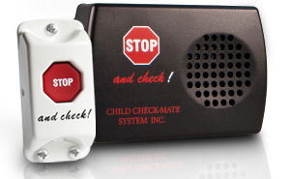
Hardwired Alarm Systems
Child Check-Mate SystemTM
Notes:
Examples of hardwired alarm systems can be found on the BECR Internet at https://dcf.wisconsin.gov/ccregulation/providers. Select “Vehicles” from the drop-down menu of resources.
Each of the hardwired systems listed here act on the same premise: Once the ignition is turned on, the alarm is activated. When these devices are installed and used according to manufacturer instructions, the intent of the Child Care Vehicle Safety Alarm law is met.
A few examples of the hardwired alarm systems listed on the DCF website and how they work are shown in the next couple of screens. Please note that new vehicle alarm systems are being developed, and the ones shown here are just examples of what to look for. DCF can not endorse a specific product, and it is the child care provider’s responsibility to determine which child care vehicle safety alarm best meets their needs.
The Child Check-Mate SystemTM is usually installed in buses. When the ignition is turned on, the alarm will emit an audible noise indicating the system is operational and flip the master switch to the on position. It is activated when the flashers are on, and the front door is opened. When the front door is opened, the red overhead lights will flash and an audible sound from the alarm will be heard. When the front door is closed, the overhead lights will stop flashing. Before the ignition is turned off, the driver completes a child check on the way to the back of the bus to depress the “STOP and check!” button.
If the ignition is turned off, the alarm will emit a high-pitched beep, and after eight seconds the bus horn will begin to sound. Turn the ignition back to the on position and the alarm will sound three times at 30-second intervals to remind driver to perform their child check by walking to the back of the bus and depressing the reset button for at least three seconds; a deactivation signal will sound. The alarm has been deactivated, and the key can be removed from the ignition.

Slide 7
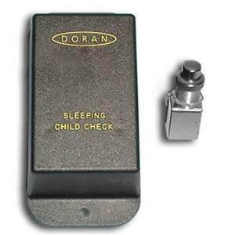


Hardwired Alarm Systems-2
Notes:
A picture of the Systems Sleeping Child Check MonitorTM is located on the upper left of the slide. Warning lights are activated when children enter the bus. The alarm is turned on and becomes engaged when the ignition of the bus is turned off. To deactivate the monitor, the bus driver must move to the back of the bus and depress a button on the monitor. If a driver fails to deactivate the monitor and exits a door, the horn will sound reminding them to check for any children on the bus.
A picture of the Bus-Scan® is located on the upper right in the slide. At the end of each trip, turning off the ignition (or other activation source) activates a reminder tone for the driver to begin a seat check. If a disarming switch at the back of the vehicle is not pressed within the prescribed time, the vehicle horn will sound, alerting all who are nearby that the required check was not performed.
The Kiddie VoiceTM system is automatically armed each time the ignition switch is turned on and automatically activated whenever the ignition key is turned off. An electronic oral warning message begins prompting the driver to commence checking the vehicle for passengers. Once the message system has been activated, it can only be deactivated by the driver’s walking to the rear interior of the vehicle and manually depressing the cancellation button. During this walk to the rear of the vehicle, the driver is prompted to check each seat for occupants. A secondary visual inspection is automatically accomplished as the driver returns to the front of the vehicle to exit.

Slide 8
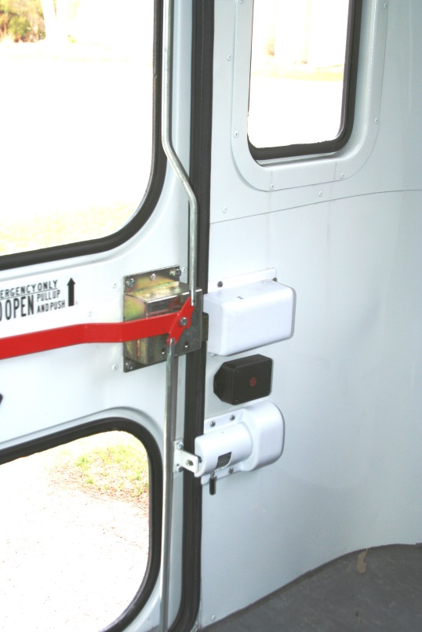
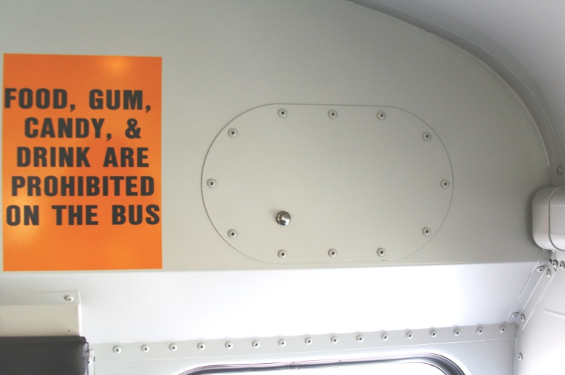
Hardwired Alarm Reset Methods
School Bus & Mini Bus - Reset button located in
the back of the bus or reset by lifting the emergency
door handle.
Notes:
Hardwired Alarm Reset Methods
The most common vehicles used for child care transport are passenger vans, school buses, minibuses, and vehicles with capacity to seat six plus the driver (minivan, larger SUVs). Each child care vehicle safety alarm reset is different depending on the model that is installed.
School Bus & Minibus - Most alarm systems in a school bus or a minibus will have a single “reset button” that is installed. The reset button is usually located above the back row of seats, so the driver walks to the back of the bus and checks for children to reset the alarm.
In some child safety alarm models, there is not a reset button. Rather, the emergency door handle needs to be lifted to reset the alarm. The door does not have to be physically opened, just lifting on the red emergency handle suffices.
In other models, there may be a “dual button” reset in which both buttons need to be pressed at the same time (to avoid kids being able to reset the alarm in lieu of the driver).
There is no rule to the placement of reset buttons in the child care vehicle alarm system, so the provider must demonstrate that the location prompts the driver to look for children.

Slide 9
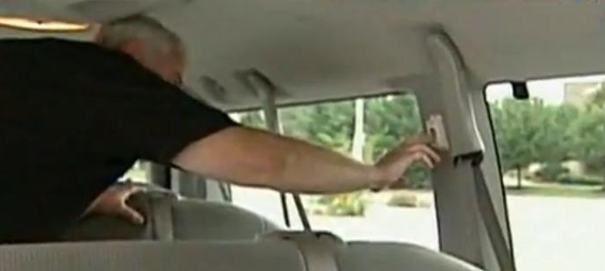
Hardwired Alarm Reset Methods-2
Passenger Van - Reset button located in the center of the van (opposite of side passenger doors) or in the back of the van
Notes:
In a passenger van, the child care vehicle safety alarm reset button may be located in the back of the van above the rear seat where the driver must walk/crawl over the seats to the back to reset the alarm (while checking for kids) or above the van’s middle seat on the driver’s side which allows the driver to open the service doors and check seats in front and back before pressing the alarm button.
Note: If a driver unloads children from the passenger side service doors but then opens the rear door of the passenger van to deactivate the alarm, they may not have actively checked for children. Even if the driver goes through the motions, if they do not actively check for children, the intent of the law has not been met,

Slide 10
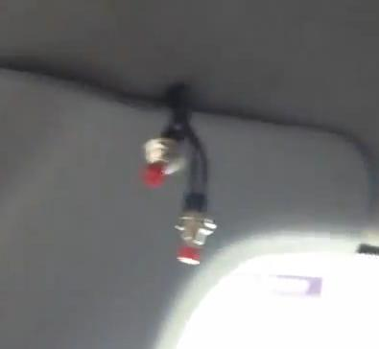
Hardwired Alarm Reset Methods-3
Minivan/SUVs - Reset button located in the center or in the back of the vehicle.
What’s wrong with
this picture?
Notes:
In vehicles with a capacity of six or more such as minivans or sport utility vehicles (SUVs), the reset button may be in the back of the vehicle, so the driver looks in all the seats as they walk/crawl to the back of the van to reset the alarm or open the back door/hatch to turn it off. Again, if the driver does not actively check for children, the intent is not met.
The reset button may also be in the middle of the vehicle within arm’s reach of the service door, so the driver needs to get out, open the service door and reach to press the reset button as they scan for children.
What is wrong with this picture? These reset buttons are meant to be arms length apart so a child cannot reset the alarm for the driver.

Slide 11
Systems That Do Not Meet
Intent of the Law
Reminder systems
Child sensing or tracking systems
Notes:
Now that you are familiar with the systems that will meet the intent of the Child Care Vehicle Safety Alarm rules, we’ll look at some systems that do not meet the intent of the rule such as reminder systems or child sensing or tracking systems.
You may encounter these systems, but they will not meet intent of the rule for various reasons.
*Please note that some wireless devices do not prompt the driver to check the rear of the vehicle to make sure all children have exited, so the provider would need to demonstrate the device meets this requirement and the integrity of the wireless device is not compromised by interference that would disable its use. So long as these requirements are met, a wireless device may be used.

Slide 12
How the Child Care Vehicle Safety Alarm Rule is Monitored
Licensed Family Child Care
DCF 250.08(5)(e) & 250.08(8)
Group Child Care
DCF 251.08(5)(c) & 251.08(8)
Day Camps
DCF 252.09(5)(c) & 252.09(8)
Certified Family Child Care
DCF 202.08(9)(p) – (s)
Notes:
Licensed Family Child Care:
DCF 250.08(5)(e) At least once per year, the licensee shall make available to the department each vehicle that is required to have a child safety alarm under sub. (8) (a) to determine whether the child safety alarm is in good working order.
250.08(8) CHILD CARE VEHICLE SAFETY ALARM
Licensed Group Child Care:
DCF 251.08(5)(c) At least once per year, the licensee shall make available to the department each vehicle that is required to have a child safety alarm under sub. (8) (a) to determine whether the child safety alarm is in good working order.
251.08(8) CHILD CARE VEHICLE SAFETY ALARM
Licensed Day Camps
DCF 252.09(5)(c) At least once per year, the licensee shall make available to the department each vehicle that is required to have a child safety alarm under sub. (8) (a) to determine whether the child safety alarm is in good working order.
252.09(8) CHILD CARE VEHICLE SAFETY ALARM
Certified Family Child Care:
DCF 202.08 (9) (p) A vehicle shall be equipped with a child safety alarm that prompts the driver to inspect the vehicle for children before exiting if all of the following conditions apply:
The vehicle is owned or leased by the operator or a contractor of the operator.
The vehicle has a seating capacity of 6 or more passengers plus the driver. The seating capacity of the vehicle shall be as determined by the manufacturer.
The vehicle is used to transport children in care.
(q) No person may shut off a child safety alarm unless the driver first inspects the vehicle to ensure that no child is left unattended in the vehicle.
(r) The child safety alarm shall be in good working order each time the vehicle is used for transporting children.
(s) At least annually, the operator shall make each vehicle that is required to have a child safety alarm under par. (p) available to the child care certification worker to determine whether the child safety alarm is in good working order.

Slide 13
Types of Child Safety Alarm Violations
Alarm present but not turned on and no transportation being provided
Alarm present but is broken, not working properly or has been disabled and/or tampered and no transportation is being provided
Notes:
Alarm is present but is broken, not working properly, or has been disabled and/or tampered with and transportation is being provided
When a vehicle alarm is installed but is broken, no longer works properly, or has been disabled and/or tampered with (when a certification worker or licensing specialist asks for the alarm to be tested) and there is evidence, observation, or admission that children were transported in the vehicle without an operational alarm.
Violation cited for broken, tampered or disabled (non-working) alarm under rule 250.08(8)(c), 251.08(8)(c) or 252.09(8)(c) or DCF 202.08(9)(f). For licensed programs, an order or a direct forfeiture may be issued. An order may be issued in conjunction with the direct forfeiture if appropriate.

Slide 14
Types of Child Safety Alarm Violations (cont.)
No alarm present and transportation is being provided
Notes:
No alarm present and transportation is being provided
When a vehicle requiring a safety alarm is not equipped with the required alarm and there is observation, evidence, or admission of transporting children in the vehicle without an alarm installed.
Violation cited for no alarm under rule 250.08(8)(a), 251.08(8)(a) or 252.09(8)(a) or DCF 202.08(9)(p). For licensed programs, an order or direct forfeiture may be issued. An order may be issued in conjunction with the direct forfeiture if appropriate.

Slide 15
Types of Child Safety Alarm Violations (cont.)2
Deliberately not using or disabling the alarm and transportation is being provided – no harm to child
Deliberately not using or disabling the alarm and transportation is being provided – a child was harmed
Notes:
Deliberately not using or disabling the alarm and transportation is being provided – no harm to child
When there is observation, evidence or admission that an individual has circumvented using a required safety alarm (i.e., no person may shut off a child care vehicle safety alarm that is installed in a child care vehicle unless the person first inspects the vehicle to ensure that no child is left unattended in the vehicle) but no child was harmed or left unattended in the vehicle
Violation cited under rule 250.08(8)(b), 251.08(8)(b) or 252.09(8)(b) of DCF 202.08(9)(q). For licensed programs, an order or direct forfeiture may be issued. An order may be issued in conjunction with the direct forfeiture if appropriate.
Deliberately not using or disabling the alarm and transportation is being provided – a child was harmed
When there is observation, evidence or admission that an individual has circumvented using a required safety alarm (i.e., no person may shut off a child care vehicle safety alarm that is installed in a child care vehicle unless the person first inspects the vehicle to ensure that no child is left unattended in the vehicle), and a child was harmed or left unattended.
Violation cited under rule 250.08(8)(b), 251.08(8)(b) or 252.09(8)(b) or DCF 202.08(9)(q). An order and direct forfeiture may be issued.

Slide 16

Questions | Considerations
Consult with your Licensing Specialist or Certification Worker for questions or considerations related to the Child Care Vehicle Safety Alarm rules
Licensing: https://dcf.wisconsin.gov/cclicensing/contacts
Certification: https://dcf.wisconsin.gov/files/ccregulation/cccertification/certifiers.pdf
Notes:
If you have a questions or considerations related to the Child Care Vehicle Safety Alarm rule, please contact your Licensing Specialist or Certification Worker.

