Slide 1


Community Services Block Grant
DFES Program Spotlight
July 2021

Slide 2

What is the Community Services Block Grant (CSBG)?
Flexible funding specifically designed for Community Action Agencies (CAAs)
Federal CSBG Act and Wis. Stat. s. 49.265
CAAs are governed by a tripartite board:
  1/3 Low-income people
  1/3 Elected officials
  1/3 Community members
Uses of CSBG dictated by a Community Needs Assessment
CAAs monitored for compliance with 58 Organizational Standards
125% FPL eligibility for services
Notes:
The federal CSBG Act and Wisconsin Statutes designate the types of agencies eligible to receive CSBG funds. Community Action Agencies, (commonly referred to as CAAs, CSBG agencies, Eligible Entities, and CAP agencies), are traditionally funded by CSBG, but the CSBG Act also allows for Limited (or Single) Purpose Agencies and organizations Serving Migrant Farmworkers to receive CSBG funds. CAAs are local, private and public nonprofit organizations that provide direct services to low-income individuals. There are over 1,000 CAAs in the United States and its territories.
A major defining characteristic of CAAs is that persons affected by poverty have meaningful roles in guiding the agencies’ programs and approach to improving the lives of low-income individuals and families. This is realized through a tripartite board of directors, comprised of one third low-income individuals or representatives of low-income individuals; one third elected or appointed officials (such as a county supervisor); and one third members of the local community.
Community Action Agencies are locally controlled organizations that seek to alleviate the causes and conditions of poverty with programs tailored to specific local needs. These needs are assessed every three years through a thorough Community Needs Assessment process, required by the CSBG Act.
CSBG funds are not open for applications, and CSBG grants are not provided directly to individuals. This funding is available only to already established eligible entities across Wisconsin. States may only add or remove organizations from the list of eligible entities according to procedures outlined by the CSBG Act.
CSBG funding is flexible, however, persons receiving services funded by CSBG must be at or below 125% of the Federal Poverty Level.

Slide 3
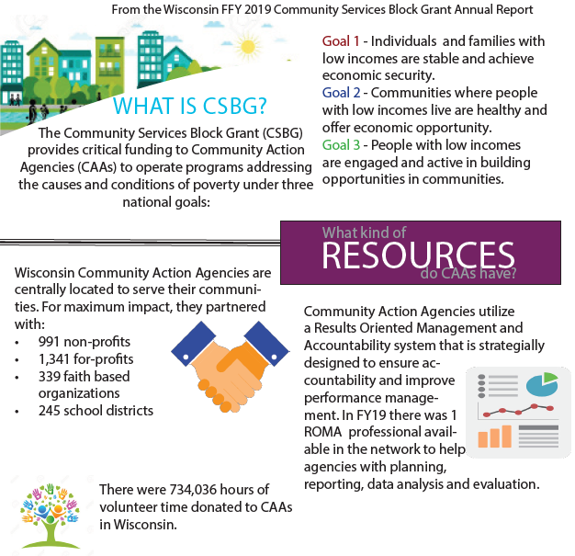
CSBG National Goals

Slide 4
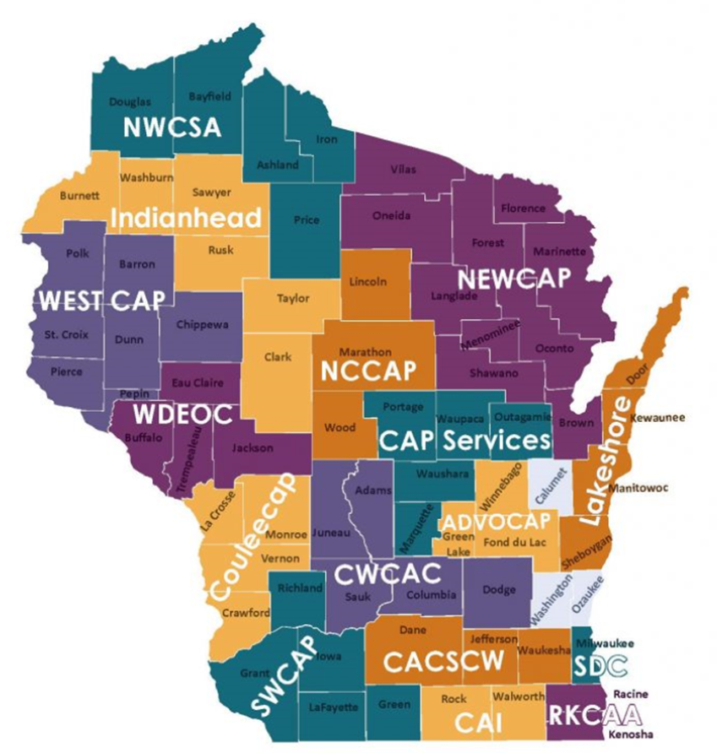
Community Action in Wisconsin is:
WISCAP
16 CAAs
UMOS & Foundation for Rural Housing
Notes:
Wisconsin has 16 CAAs, each of which serves a specific geographic area, plus two Single Purpose Agencies, which have been “grandfathered” in as eligible for CSBG funding. United Migrant Opportunity Services (UMOS) and the Foundation for Rural Housing have been designated as eligible entities for CSBG funding and are subject to the same requirements as the CAAs.
All 18 of these agencies comprise the board of directors for the Wisconsin Community Action Program Association, or WISCAP. WISCAP is the association of these Community Action Agencies and two Special Purpose Agencies and acts as the statewide voice for Community Action Agencies and people struggling with poverty.
WISCAP advances the work of these agencies to help people and communities become economically secure through a variety of services, including:
Public policy and advocacy
Training and Technical Assistance
Resource Development
Poverty Awareness
Program management and administrative support

Slide 5
CSBG Funding Delivery
US Department of Health & Human Services
Administration of Children & Families
Office of Community Services (OCS)
Wisconsin Department of Children & Families
Division of Family & Economic Services
Bureau of Working Families
Contract Administration Section (CAS)
CAAs
WISCAP
Tribes
Federal Oversight
State Administration
Local Services
Notes:
DCF is designated as the state CSBG office in Wisconsin. Our role as the pass through entity is to contract with and monitor the CSBG recipients, complete a biennial State Plan, draft an Annual Report, and provide Training and Technical Assistance for agency compliance with the 58 CSBG Organizational Standards, which include governing board oversight, strategic planning, and financial operations.

Slide 6
CSBG National Partners
OCS
National Association for State Community Service Programs (NASCSP)
Federal Level
CSBG State Office (DCF)
NASCSP
State Level
National Community Action Partnership (CAP)
WISCAP
Agency Level
National Community Action Foundation (NCAF)
CAPLAW
Notes:
These efforts are truly a community effort at all levels – there are many, many national resources.
Wisconsin is also participating in the State Management Work Group, which is working on developing tools and best practices that can assist other state offices and OCS in their oversight of state offices.

Slide 7
Wisconsin CSBG Allocations
Funding Breakout per CSBG State Plan | 2021 Funding
Total Funding | $8,970,499
Less 1% holdback for OCS | $8,880,794
Community Action Agencies (CAAs) - 87.47% | $7,768,031
Tribes (FSP Contract) - 4% | $355,232
UMOS - 4% | $355,232
Foundation for Rural Housing - 1.4% | $124,331
State Administration and WISCAP - 3.13% | $277,969
Total | $8,880,794
Notes:
Wisconsin’s federal CSBG allocation is about $9 million.
Each year our allocation is subject to a discretionary 1% for national T/TA efforts. Historically, OCS holds this percentage back from our allocation. This amount provides grants to CSBG national partners to develop resources for the CSBG network and provide training and technical assistance on all levels.
The allocations for the Community Action Agencies (CAAs) are based on the following formula: The total CSBG allocation divided by the percent of Wisconsin residents in poverty residing in each agency's service area. For example, according to the 2010 U.S. Census, 4.425% of the 668,834 people living in poverty in Wisconsin reside in ADVOCAP's service area. Therefore, ADVOCAP will receive 4.425% of the CSBG allocation for the CAAs.
Wisconsin uses some of its discretionary CSBG dollars to fund part of the tribes Family Services Program (administered through BRO). This is usually about 4% of the state’s allocation.
As a statewide, migrant farmworker agency, UMOS's award is not calculated using percentage of population in poverty. Instead, UMOS receives 4% of the total CSBG allocation based on a methodology established over 20 years ago.
As a statewide, single-purpose agency, Foundation for Rural Housing's award is not calculated using percentage of population in poverty. Instead, FRH receives 1.4% of the total CSBG allocation based on a methodology established over 20 years ago.
The state may retain up to 5% of its total CSBG allocation for administration costs, but as a very small state office, we do not usually retain that much. Other states retain more administrative dollars so they can administer all training and technical assistance requirements in-house. Typically, we only retain about 3% which is split with WISCAP for a training and technical assistance contract and to assist in network coordination activities, like supporting the Poverty Matters! Conference. The amount we pass through to WISCAP can be adjusted from year-to-year, in accordance with our CSBG State Plan and current needs. We use the remainder to fund 1.25 FTEs + travel, training, etc. for CSBG contract management and monitoring activities.

Slide 8
CSBG Resources

Slide 9
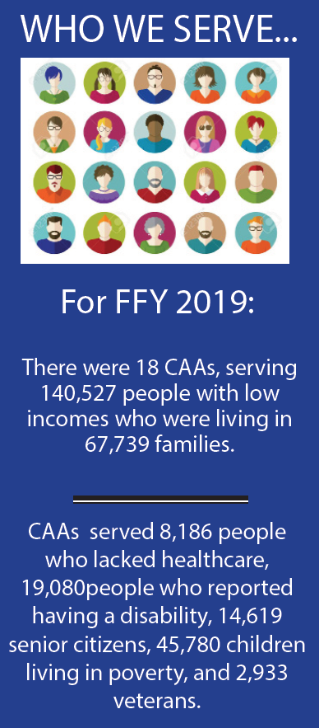
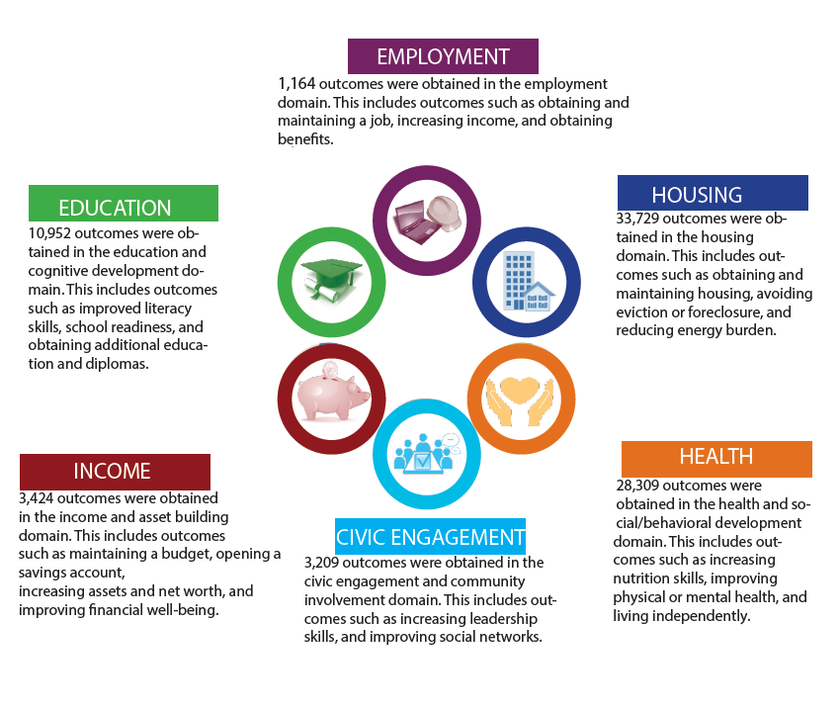
CSBG Outcomes
Notes:
In Wisconsin, our CSBG agencies exist to help people get out of and stay out of poverty. These agencies provide direct services to low-income individuals and coordinate community resources for:
Education & Skills Development
Job & Business Development
Energy & Utility assistance
Food security
Housing solutions
Family support
Health care
All services provided by CSBG agencies are dictated according to each agency’s Community Needs Assessment, therefore all agencies operate a different set of programs tailored to their specific communities.
There is a saying in the CSBG world: “If you’ve seen one Community Action Agency, you’ve seen one Community Action Agency.”

Slide 10

While CSBG funding is only a fraction of a Community Action Agency’s total funding, CSBG is its entire IDENTITY.
Notes:
While CSBG funding is only a fraction of an agency’s total funding, CSBG is the IDENTITY of Community Action Agencies.
In order to understand this a little better, let’s take a look at the history of Community Action and requirements of CSBG.

Slide 11
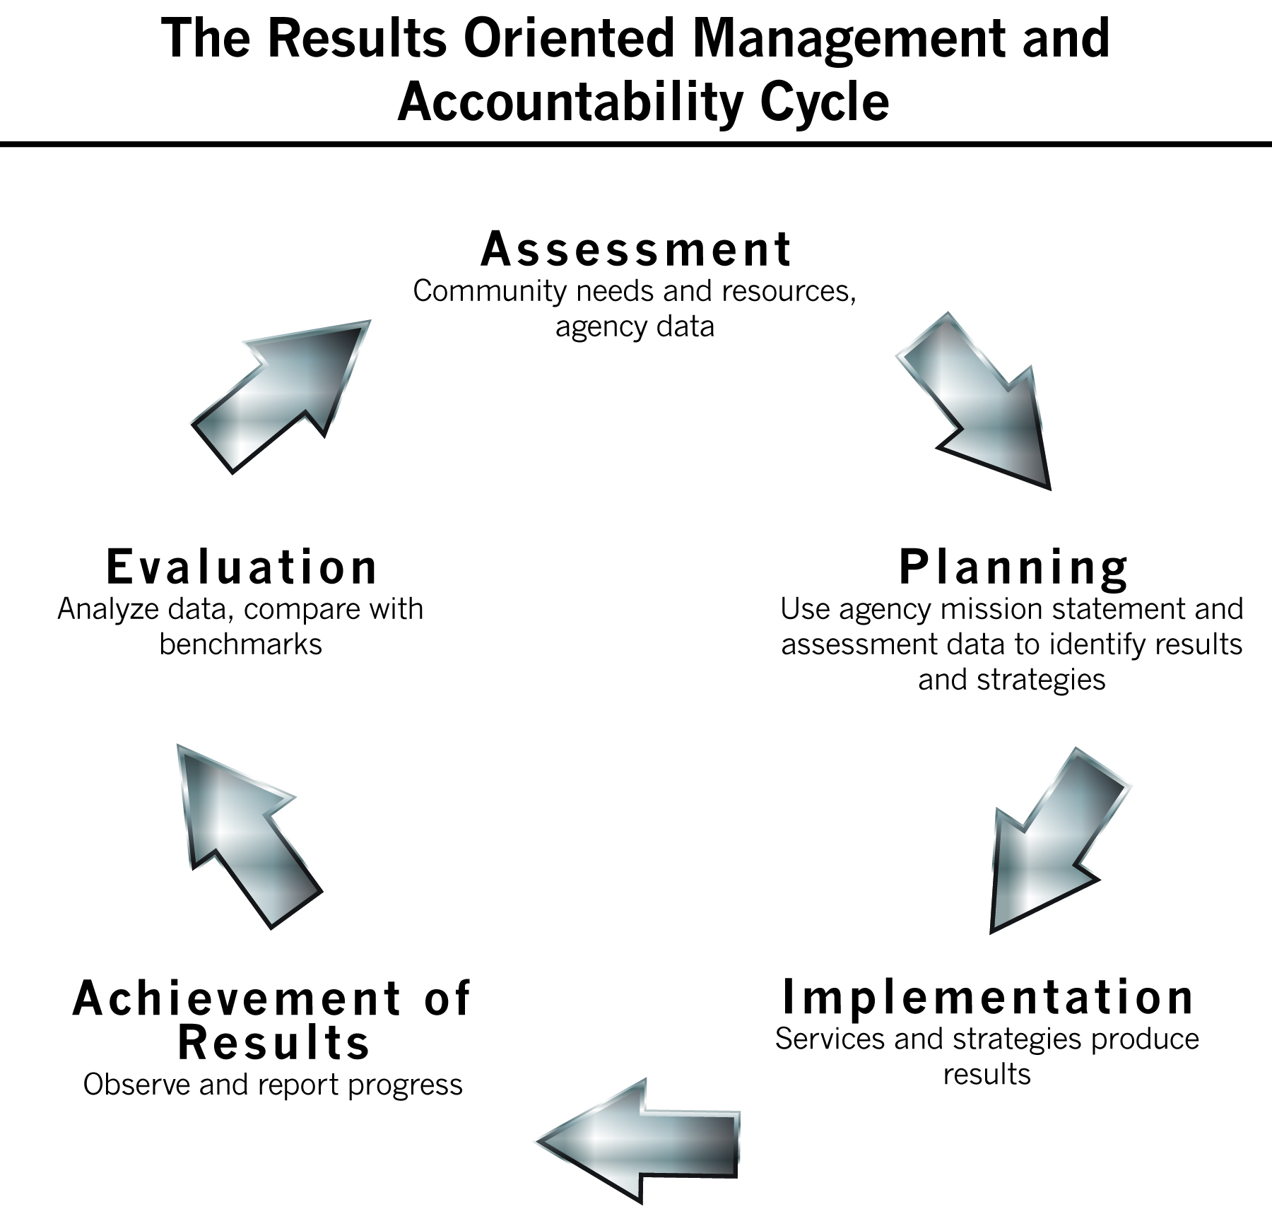
ROMA
https://www.youtube.com/watch?v=ph2pCwfu5z8
Notes:
ROMA is a complete performance measurement and management system designed to help CAAs improve their abilities to achieve and demonstrate results. ROMA gives structure to CAAs and is a requirement of CSBG funding.
Part of the role of the CSBG state office is to provide assistance to agencies in implementing the ROMA cycle and reporting on their outcomes. Last summer I went through the National Certified ROMA Implementer training in order to do this. We also partner with WISCAP in delivering ROMA training and technical assistance to our CSBG agencies.
In order to understand ROMA, let’s take a look at the history of Community Action. This YouTube video was the product of a partnership with WISCAP to deliver an on-demand training for CAA board members to help understand their agency’s operations and their role as a board member.

Slide 12
Community Needs Assessment
Identify and quantify levels of needs
Identify service gaps
Learn about change in local communities and design programs to respond
Have a foundation for strategic planning and guidance for decision-making
Build new/stronger community relationships
Get buy-in from community members
Document the need for resources
First step in the ROMA cycle
Notes:
The first step in the ROMA cycle is ASSESSMENT. The agencies complete a comprehensive Community Needs Assessment every 3 years in order to develop targeted services and direct the use of their CSBG funding. These needs assessments are used for the agency’s Community Action Plan, which includes a budget and shows how the agency will use the ROMA cycle to achieve family, community, and agency-level outcomes that meet the needs the found as a result of their assessments. These plans are reviewed and approved by DCF in the form of a CSBG Application. Even though the agencies receive a standard allocation of CSBG funding and the list of eligible agencies does not change from year-to-year, the agencies must still apply for funding and show DCF how this funding will be used and what they expect to achieve with it.
Progress is reported annually through several modules which together comprise the CSBG Annual Report. Expenses are reported in SPARC and reimbursed on a monthly basis, and each agency completes a yearend expenditure report to true-up their budget with their actual expenditures and explain any deviation. As needs change, so can their use of the funding, so this is how DCF provides CAAs flexibility while also allowing us to maintain our oversight and ensure funding is being used in accordance with the CSBG Act.

Slide 13

The CSBG Annual Report
Module 1
  “State Administration”
  This is the module that the state completes.
  States report their administration processes, allocation of CSBG funds, training/technical assistance activities, monitoring efforts, management achievements, and agency innovations.
Module 2
  “Eligible Entity Expenditures, Capacity, and Resources”
  This is where agencies report funding sources & financial information.
  Agencies report all sources of funding, all community partners, and all volunteer hours to show the “whole picture” and how CSBG is leveraged.
Notes:
In order to demonstrate the results of each agencies ROMA efforts, and to report on the various requirements of State CSBG administration, we are required to draft and file a comprehensive CSBG Annual Report, which consists of 4 different Modules:

Slide 14
The CSBG Annual Report
Module 3
  “Community Level Transformation”
  This is where agencies report the impact specific programs have had on their community over time. It is different from other modules in that narrative is used to tell the story of Community Action – changes that aren’t as easily grasped through quantitative data reporting.
Module 4
  “Individual and Family Level”
  This is where agencies report National Performance Indicators (NPIs) in accordance with ROMA practices. These include the numbers and characteristics of the individuals and families the agency served, and the outcomes they achieved.

Slide 15
CSBG Monitoring Principles
Mutual Respect
Joint Problem Solving
Open Communication
Notes:
The CSBG Act of 1998 requires that CSBG eligible entities be monitored onsite at least once every three years by the State CSBG office. Monitoring is one of many block grant management responsibilities held by the State CSBG office. Monitoring can assist the over 1,000 CSBG eligible entities, predominately Community Action Agencies (CAAs), continually improve outcomes as they strive to adopt high impact strategies to end poverty. It is an important part of a strong partnership that should be forged between State CSBG offices and the CAAs to build capacity at the local level and to provide training and technical assistance to CAAs in working to eliminate poverty. State Associations are also an important part of the training and technical assistance needs that may arise from monitoring. Community Action leaders at the national, state, and local levels work together to ensure the Network is strong. Monitoring of CAAs is a state responsibility, but strengthening the capacity of CAAs to develop a high performing network is a shared responsibility among all members of the CAA Network.
We monitor in accordance with 3 principles:
Mutual Respect
In working with grantee boards, staff, and consultants, State CSBG offices value and recognize the unique knowledge, ability, and independence of each person. State CSBG offices are committed to treating all persons fairly and maintaining credibility by matching actions with words.
Open Communication
Effective communication is key in facilitating good working relationships with partners, and State CSBG offices are committed to keeping lines of communication open. The purpose of communication is to assist in developing solutions to problems, to share program improvement ideas, and provide information on new developments in the anti-poverty field. State CSBG offices communicate frequently through a variety of tools and media. State CSBG offices should be open to contact and are committed to listening to suggestions/concerns. This aids the State CSBG office in gaining an understanding of local operations and assisting CAAs in pursuing priorities.
Joint Problem Solving
State CSBG offices operate under the basic belief that a team approach to problem solving is in the best interest of all parties involved. State CSBG offices sincerely believe that collectively the State CSBG office and the CAA can arrive at the best solution to any situation. Through a team approach to problem solving, State CSBG offices think outside traditional methods and come up with the best strategies for program development, conflict resolution, or compliance issues. State CSBG offices want to promote an environment in which the State CSBG office and all Community Action partners will be open to change and can work together in exploring options and developing mutually agreeable solutions. The goal is to have agencies function independently—with State CSBG office support—to meet the needs of local communities within the parameters set by legislation.

Slide 16

Overview of CSBG Monitoring
DCF is required to assess the health of the entire agency, not just program-by-program compliance
Monitoring includes a combination of general oversight, desk reviews, and on-site reviews of:
Community Action Plans
Contracts
Community Needs Assessments
Service delivery systems
Administration, management, and financial systems
Strategic plans
Board and governance systems
ROMA implementation
CSBG Organizational Standards
(58)
Notes:
State CSBG Monitoring Requirements:
1. We look at more than compliance with program rules and regulations.
2. We assess the effectiveness of the board of directors.
3. We assess administrative and leadership capacity of agency management as it relates to meeting the Board of Director’s goals.
4. Monitoring CAAs is part of a process to strengthen CAAs and the entire Community Action Network.
5. We have a system in place to document and inform the agency of findings and/or deficiencies.
6. We have a system in place to provide training and technical assistance when necessary.
7. We monitor the entire Performance Management Framework of the agency using ROMA and the 58 CSBG Organizational Standards.

Slide 17
Overview of CSBG Monitoring
On-site Visits
Deliverables
Board rosters & meeting minutes
DCF Yearend Expenditure Reports
Desk Audits
CSBG Organizational Standards
Community Action Plans (CSBG Application)
SPARC reports
Random expense sampling
Every 3 years
After new Executive Director or CFO placement
Funding terminated for cause

Slide 18
CSBG Organizational Standards
The CSBG Organization Standards are organized in three (3) thematic groups comprising nine categories and for a total of 58 standards:
Maximum Feasible Participation
  Consumer Input and Involvement (Category 1)
  Community Engagement (Category 2)
  Community Assessment (Category 3)
Vision and Direction
  Organizational Leadership (Category 4)
  Board Governance (Category 5)
  Strategic Planning (Category 6)
Operations and Accountability
  Human Resource Management (Category 7)
  Financial Operations and Oversight (Category 8)
  Data and Analysis (Category 9)
Notes:
Examples of CSBG Organizational Standards include:
The community assessment includes key findings on the causes and conditions of poverty and the needs of the communities assessed.
The organization documents the number of volunteers and hours mobilized in support of its activities.
The governing board has reviewed the organization’s mission statement within the past 5 years and assured that:
The mission addresses poverty; and
The organization’s programs and services are in alignment with the mission.
4. The organization’s governing board has written procedures that document a democratic selection process for low-income board members adequate to assure that they are representative of the low-income community
5. The organization has a system or systems in place to track family, agency, and/or community outcomes.

Slide 19
Virtual Monitoring Process for 2021
Agency receives a monitoring engagement memo
Pre-monitoring documents uploaded to secure SharePoint site
Monitoring introduction meeting via Zoom
DCF requests select HR, program, and financial documents for upload to SharePoint
Exit Interview with Executive Director via Zoom
DCF conducts Zoom interviews with Executive Director, key staff, and board chair over the course of one (1) week
Monitoring report & required responses
Pre-monitoring
Monitoring “visit”
Post-monitoring
Notes:
During the COVID-19 pandemic, our federal oversight, OCS, gave state CSBG offices permission to substitute virtual monitoring for the on-site monitoring requirement.

Slide 20
Project Recovery:
Leveraging the
Community Action Network
Community Action has been used for statewide responses in:
  Flooding/natural disasters
  COVID-19 pandemic
  Farmworkers in crisis
https://projectrecoverywi.org/
https://www.nbc15.com/content/news/SWCAPs-Pop-Up-Food-Pantry-hits-the-road-568959011.html
https://wkow.com/2021/03/23/project-recovery-counselors-help-community-cope-with-crisis/
https://www.youtube.com/watch?v=XCMH2pC-BAc

Slide 21

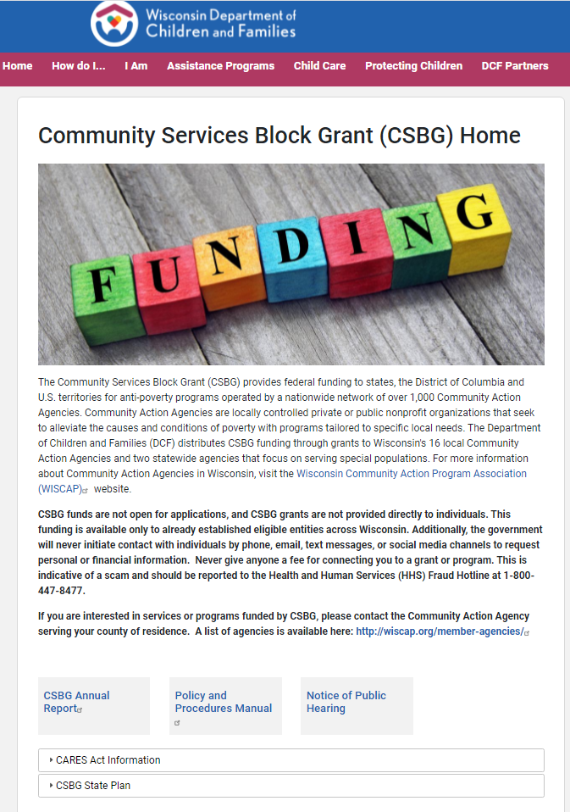
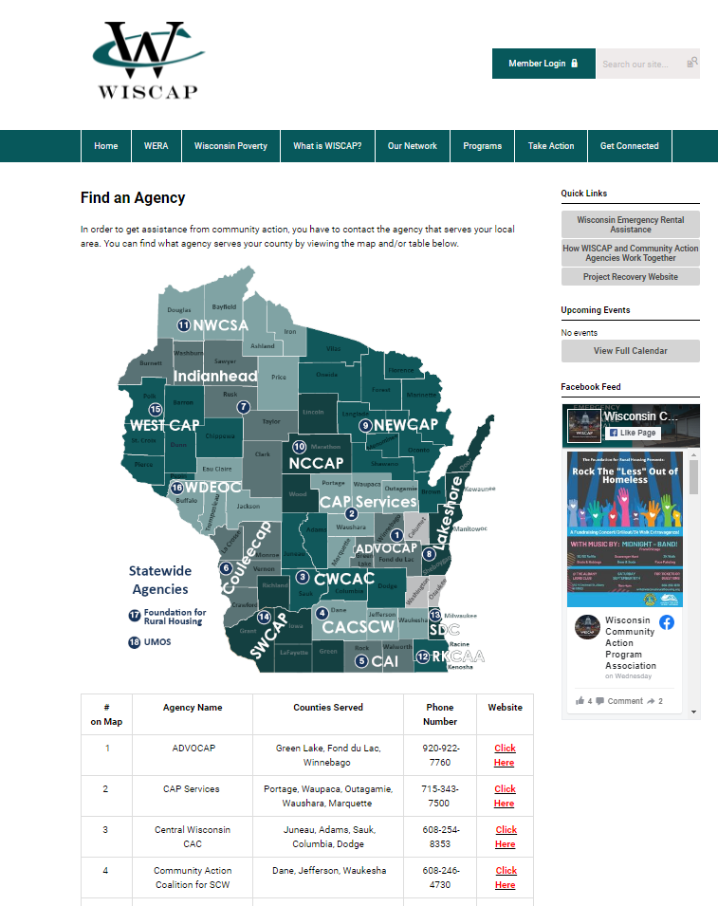
CSBG Resources
https://dcf.wisconsin.gov/csbg
https://www.wiscap.org/find-an-agency

Slide 22


Questions & Discussion
If I don’t know, I will find out!

Slide 23

Thank you!
Anna Sainsbury
CSBG Contract Manager
Department of Children and Families
anna.sainsbury@wisconsin.gov 608.422.6270

