Slide 1
CSBG Training Roundtable
SPARC Reporting & Contract Compliance
December 2020

Slide 2

Agenda
SPARC expenditure reporting for CSBG
*NEW* SPARC Performance Report & year end requirements
CSBG contract compliance
Questions & discussion

Slide 3


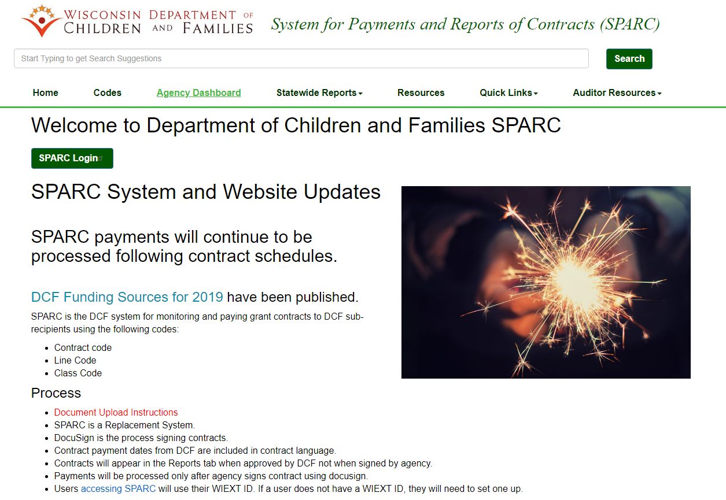
SPARC Expenditure Reporting
Access expense & payment info by agency
Click to login for submitting expenses or documents
SPARC Portal: dcfsparc.wisconsin.gov
Instruction manual for accessing SPARC and uploading the various documents required by your CSBG contract

Slide 4
SPARC Expenditure Reporting
New User Account Set Up
    Visit DWD Wisconsin Logon Management System (User Acceptance Agreement) and create Username (WIEXT ID) and password that you’ll use for SPARC portal: https://accounts.dwd.wisconsin.gov/
    Fill out the SPARC Authorization Request form at: http://dcf.wisconsin.gov/files/forms/doc/5157.docx
    Submit the form to DCFFinanceGrants@wisconsin.gov
      Form requires supervisor’s signature
    DCF Finance will email a new user after the SPARC account is set up
    Current turn around time is 3-5 business days

Slide 5
SPARC Expenditure Reporting
SPARC Statewide Reports Available on SPARC Website
  All reports are updated daily at 5 am
    If refreshed date is not today’s date, you need to clear browsing history
  Available Reports
    Contract Balance Information
      Contract Balance By Agency - How much of contract left for my program?
    Expense Information
      Monthly Detail for each calendar year – Did I report expenses last month?
      Supplier Reconciliation Report (YTD Report) - What’s my YTD reported expense for the program?
      Agency Contract Detail – YTD reported expense and payment side by side
      Expenses by Class Code – How did I break down the expenses when I reported?
    Payments
      Bank Deposits Reconciliation – Which program received a payment?
      Calendar Year Payments at a Glance – I want to see payments by reporting period instead of payment date

Slide 6
SPARC Expenditure Reporting
Payments from State via ACH Remittance (direct deposit)
  When DCF runs payments from SPARC, ACH Remittance Notice gets sent out to designated email address for each agency
    Can designate up to 2 email addresses per agency
  All DCF SPARC payments will have invoice numbers that start with ‘DCFSPARC’
    Example: Invoice# DCFSPARC0000071926190613

Slide 7
SPARC Expenditure Reporting
SPARC Claim Reviews
  Quarterly review of prior quarter’s claims
    Federal requirement
    Samples done at random
    Not an audit
    Checking for general compliance
    Documentation to support your expenses will be requested
      Don’t send personally identifiable information (PII)
    Email request for documentation will be sent to SPARC user that submitted claim

Slide 8
SPARC Performance Reporting
DCF is now requiring your DCF yearend expenditure reports to be uploaded as a “performance report” in the SPARC portal
  The person at your agency that normally submits expenses in SPARC can do this, or you can designate a new person.
  This person will need the new SPARC user role of “Performance Report” delegated to them.
  You will need to complete a SPARC Authorization Request form and submit to DCFFinanceGrants@wisconsin.gov.
    This is the same form you use to set up a new user/account

Slide 9
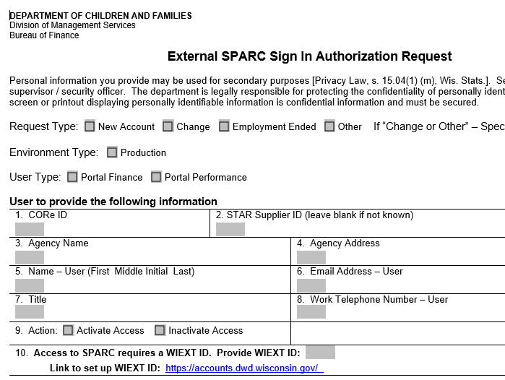
SPARC Authorization Request Form
Form located here: http://dcf.wisconsin.gov/files/forms/doc/5157.docx
User Types
“Portal Finance” gives access for:
Expense reporting
Contract document uploads
  Cost allocation plans
  Indirect cost rate agreements
“Portal Performance” gives access for:
Performance reporting (for CSBG, it is the DCF Yearend Report)
Your agency can give one person both types of access or delegate different types of access to different people.

Slide 10
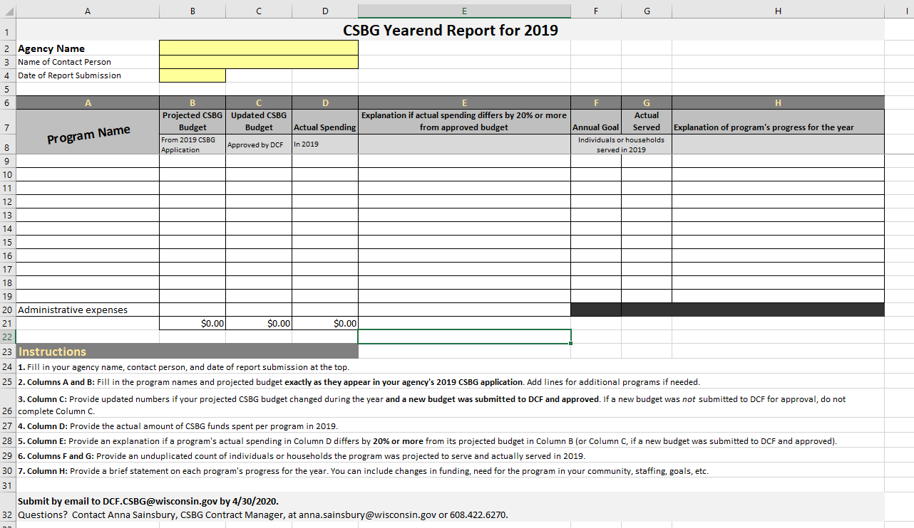
SPARC Performance Reporting
What is the DCF yearend expenditure report?
AKA “DCF Yearend Report”
Excel form provided by DCF
Report out of your actual CSBG expenses vs. what was projected in your CSBG Application (Community Action Plan)
Explanation required for deviations from budget ≥20%
Due in SPARC on April 15
Forms are updated each year
The DCF yearend expenditure report is NOT the same as the
CSBG Annual Report
What is the CSBG Annual Report?
AKA “Modules 2, 3, & 4”
Excel SmartForms provided by OCS
Submitted to CSBG Contract Manager via email
Will not be uploaded in SPARC
Our discussions today all refer to the DCF yearend report, not the CSBG Annual Report!

Slide 11
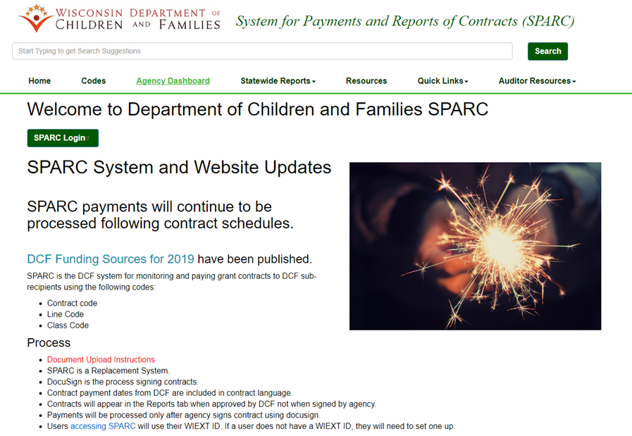
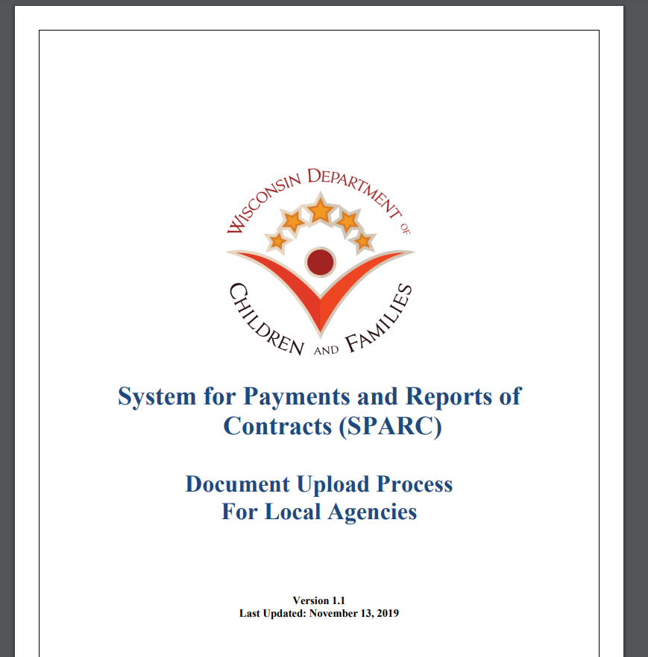
SPARC Document Uploads
SPARC Portal:
dcfsparc.wisconsin.gov
Instructions for uploading Performance Reports and all other documents in SPARC can be found here on the SPARC home page:

Slide 12
CSBG Contract Compliance
Requirement & Authority | Due | Submission Method
Annual Single Audit Reporting Package (Org. Standard 8.1, 8.2 and DCF CSBG Contract) | Within 180 days of the end of the Contractor’s fiscal year | Email to DCFAuditors@wisconsin.gov
Affirmative Action Plan (DCF CSBG Contract) | Within 15 business days of signing the contract | Submitted to DOA Instructions, exceptions, and form located at: http://vendornet.state.wi.us/vendornet/doaforms/DOA-3021P.pdf
Civil Rights Compliance Letter of Assurance (CRC LOA) (DCF CSBG Contract) | Within 15 business days of signing the contract and updated in the event of changes to key personnel identified in the LOA | Email to DCF Civil Rights Unit at DCFCivilRights@wisconsin.gov Instructions and templates located at: https://dcf.wisconsin.gov/civilrights/plans
Board minutes (DCF CSBG Contract) | Within 45 days of meeting | Email to DCF.CSBG@Wisconsin.gov or CSBG Contract Manager
DCF Yearend Report (DCF CSBG Contract) | April 15 | Uploaded to SPARC via the “Performance Report Upload” screen of the SPARC Portal
CSBG Annual Report (Modules 2,3, and 4) (Org. Standard 9.4 and DCF CSBG Contract) | Feb/March (TBA) | Email to CSBG Contract Manager
Cost Allocation Plan (DCF CSBG Contract) | Within 30 days of signing the contract and resubmitted when material updates are made to the plan | Uploaded to SPARC via the “Document Upload” screen of the SPARC portal
Federal Indirect Cost Rate Agreement (DCF CSBG Contract) | Within 30 days of signing the contract and resubmitted when new agreements are made | Uploaded to SPARC via the “Document Upload” screen of the SPARC portal
Your CSBG contract with DCF require you to submit several other documents to DCF throughout the term of your contract

Slide 13


Questions & Discussion
If I don’t know, I will find out!

Slide 14
SPARC Contacts
DCF will communicate with agencies by…
  Email – We will use email address tied to the SPARC account
  SPARC Website Home Page – Updates related to SPARC will be posted
  SPARC Portal Log In Page – SPARC maintenance notices and information will be posted
  Telephone – Will use phone number tied to the SPARC account
Agencies can contact DCF by…
  Email – DCFFinanceGrants@wisconsin.gov is the primary contact address to reach DCF Finance
  Specific questions related to CSBG SPARC expense reporting or payments should go to Sue Losen at Sue.Losen@wisconsin.gov or 608-422-6379
  Specific questions related to CSBG SPARC performance reports or access should go to PerformAdmin@wisconsin.gov

Slide 15
Thank you!
A copy of this presentation will be made available to you.
Please send questions and comments to:
Anna Sainsbury
CSBG Contract Manager
Department of Children and Families
anna.sainsbury@wisconsin.gov | 608.422.6270

