Slide 1
BusinessObjects WEBI
User Interface & functionality changes with version 4.3

Slide 2
WHAT is happening and WHEN?
BO version 4.3 will be implemented
the new user interface is the most significant difference
Saturday July 9th
starting Monday July 11th, everyone will have to adopt and adapt to the new ui

Slide 3
Accessing WEBI does NOT change
The URL to access BusinessObjects WEBI will remain the same, even after July 9^{th.}
Your existing bookmarks will not need to be updated.
https://dwdbiportal.wisconsin.gov/BOE/BI
DCF users will continue to use the Accounts Domain credentials (same as STAR) and the password will synchronize when changed

Slide 4
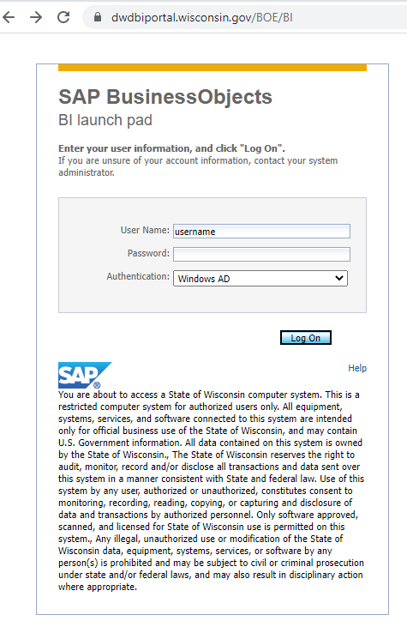
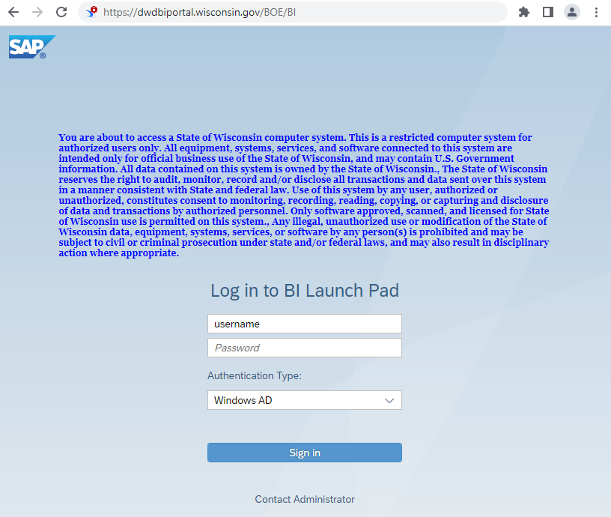
The BI Launch Pad login is the first change When we talk about ‘log in to WEBI’, we mean BI Launch Pad
OLD: NEW:

Slide 5
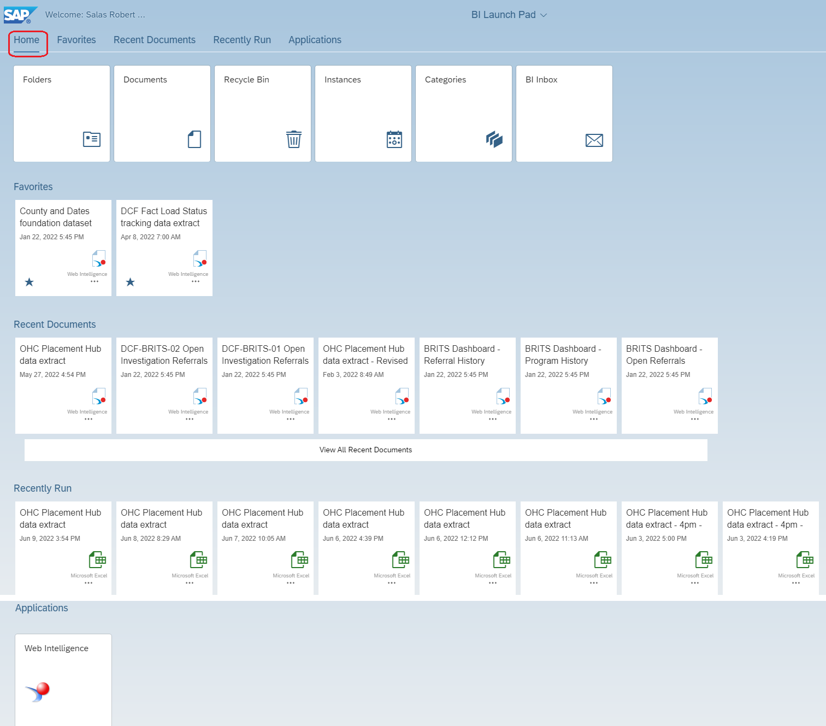
Default Home / Landing Page Much more useful than the old BI LaunchPad

Slide 6
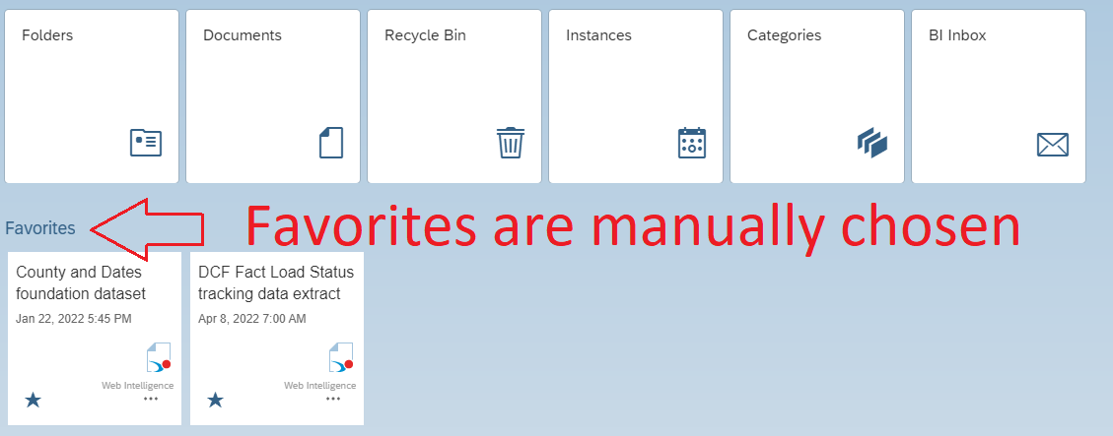
Default Home / Landing Page. You can designate Favorite WEBI reports

Slide 7
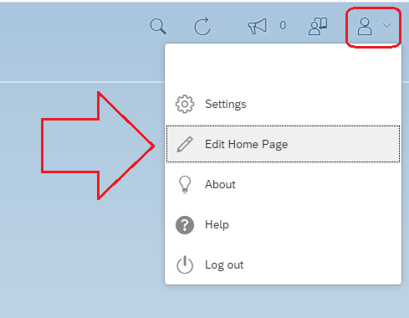
Edit your Home Page (rearrange tiles)
In the top right corner of the window, select the user profile icon / drop-down and select “Edit Home Page”. Rearrange as desired, and click “Done” in the bottom right corner.

Slide 8
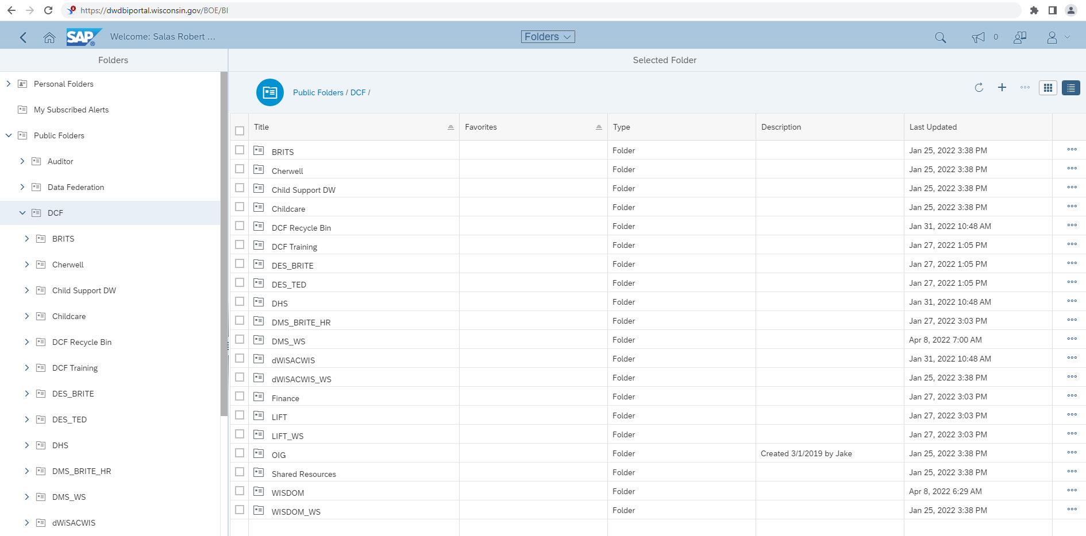
Change Your Landing Page … to a specific folder that is your typical starting location

Slide 9
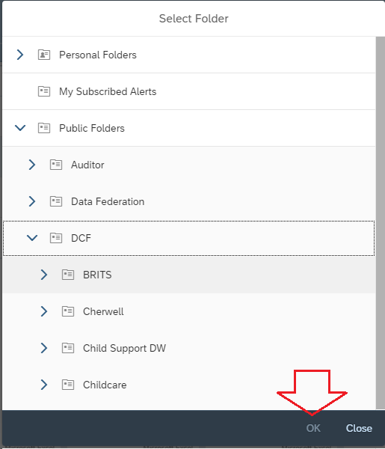
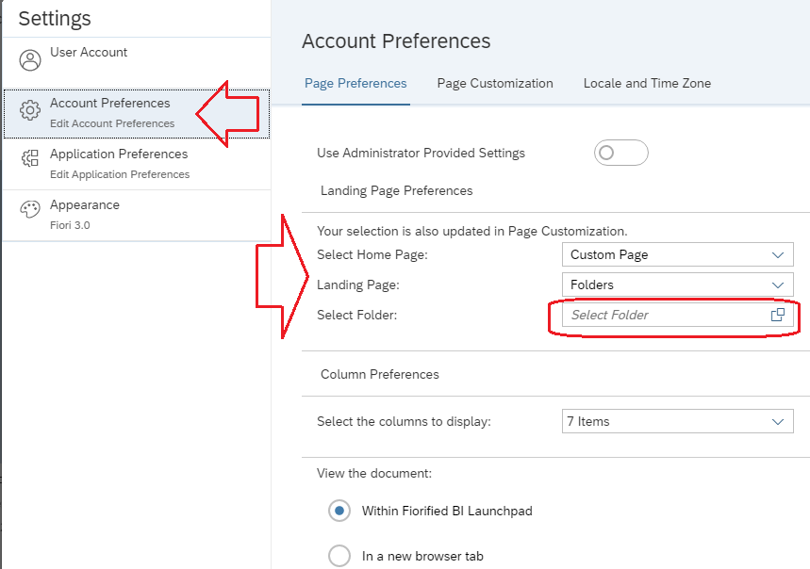
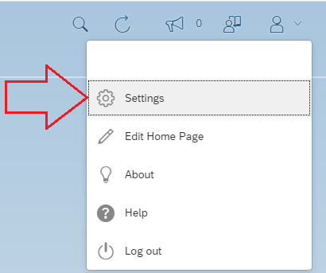
Edit your Landing Page
In the top right corner of the window, select the user profile icon and select “Settings”.
Select Folder, navigate to select starting folder and click “OK” Then click “Save”

Slide 10
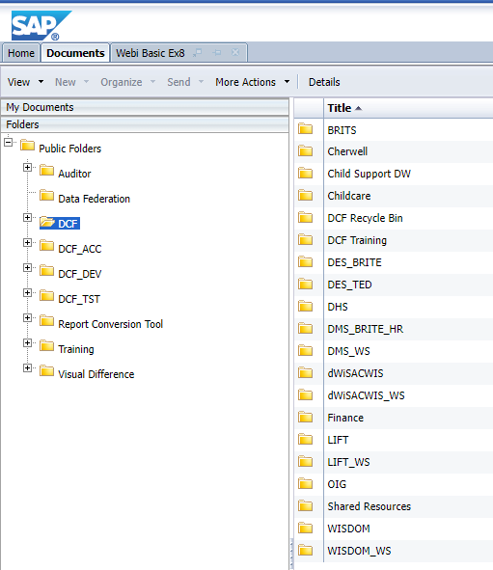
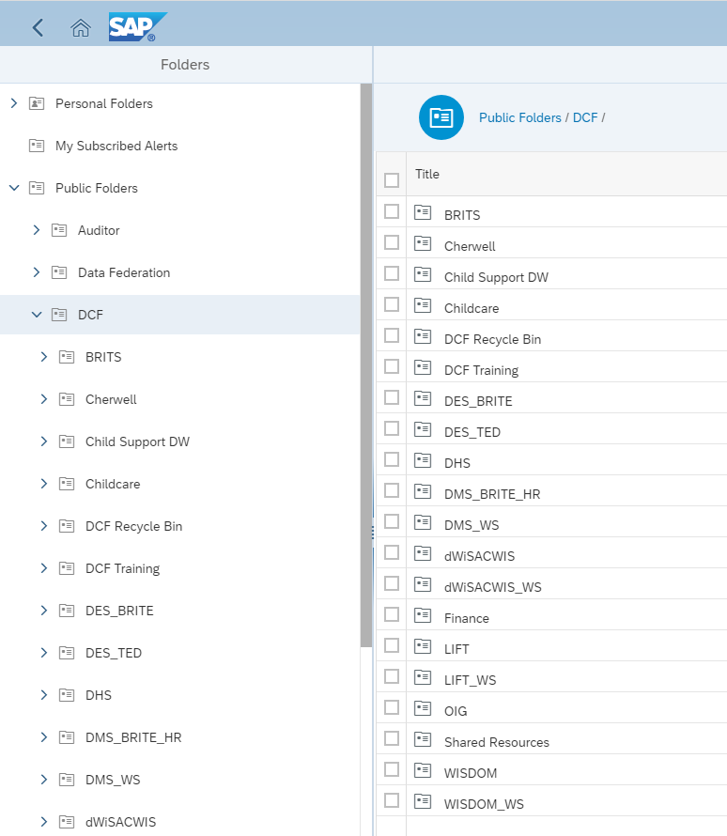
Functional Differences --High Level -- Old WEBI vs New WEBI

Slide 11
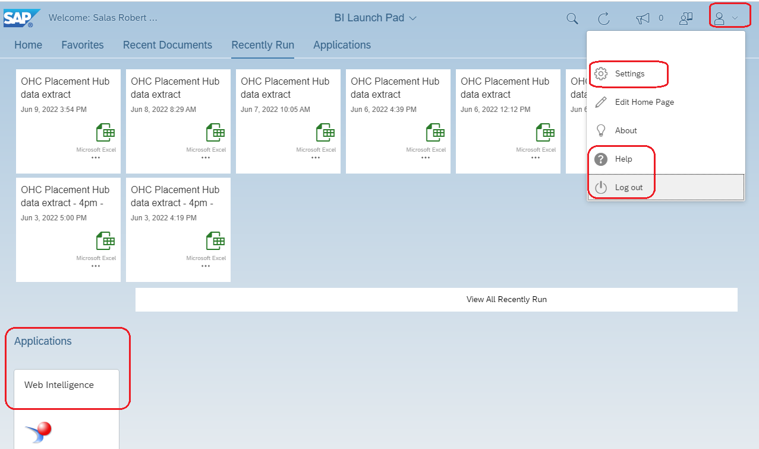
Preferences and account controls
Old WEBI had Applications, Preferences, help and Log off in the top right tile area.
New WEBI has Preferences (now “Settings”), Help and Log out in the user menu drop-down at the top right. “Applications” are their own tile area on the home screen.

Slide 12
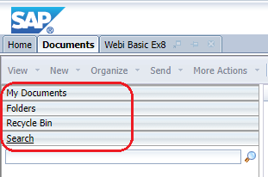
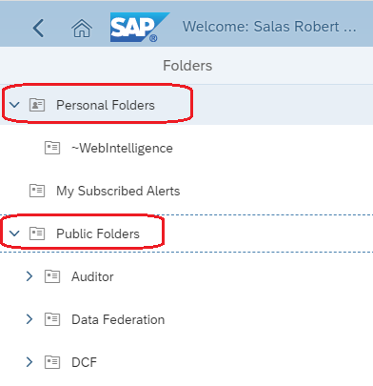
Left side navigation
Old WEBI had an accordion style menu, and only one could be visible at a time.
New WEBI has expand functionality, and multiple ‘folders’ can be viewed at the same time.

Slide 13
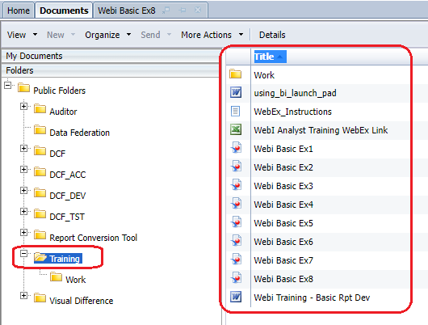
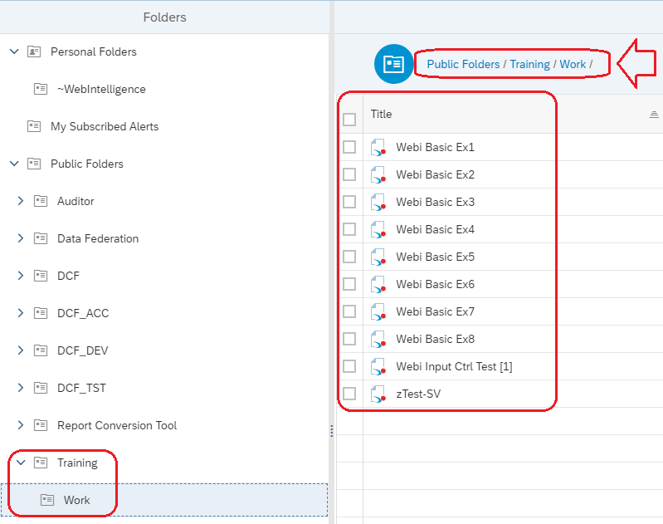
Folder path location
Old WEBI showed the entire folder structure at all times and all files available side by side.
New WEBI also utilizes a web navigation style series of hyperlinks (aka ‘breadcrumbs’) to allow easier navigation.

Slide 14
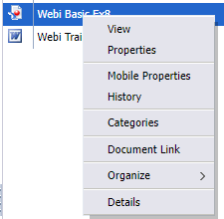
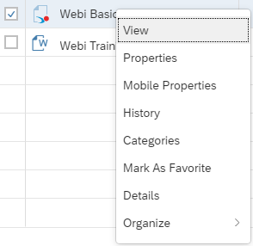
Right click menu is basically unchanged
Old WEBI right-click menu
New WEBI right-click menu
Note new: ‘Mark as Favorite’

Slide 15
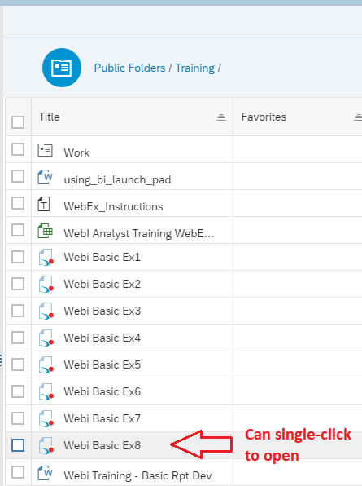
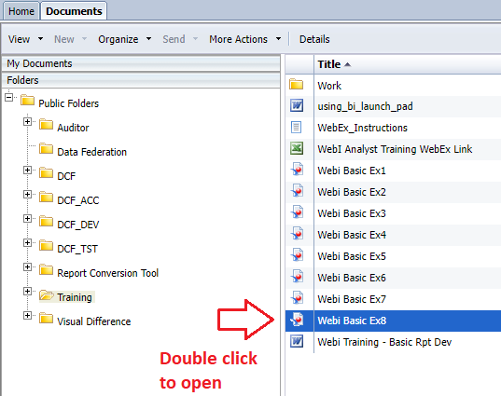
Selecting documents is now SINGLE CLICK
Old WEBI, double click WEBI documents to open.
In new WEBI, single-clicking will open the WEBI Document

Slide 16
Accessing open content
Old WEBI used tabs to indicate and access open reports/content.
New WEBI uses a central drop-down to list open content and access/navigate to it.

Slide 17
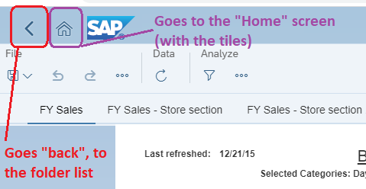
Accessing different content
Old WEBI used tabs to indicate and access the folder list of Documents.
New WEBI uses web style navigation icons to return to the home screen or folder list.

Slide 18
Menu tools and options
Old WEBI had the menu items always visible with an abundance of icons
New WEBI has only the basic icons of save, undo, redo, refresh available.
The remainder are collapsed into context menus.

Slide 19
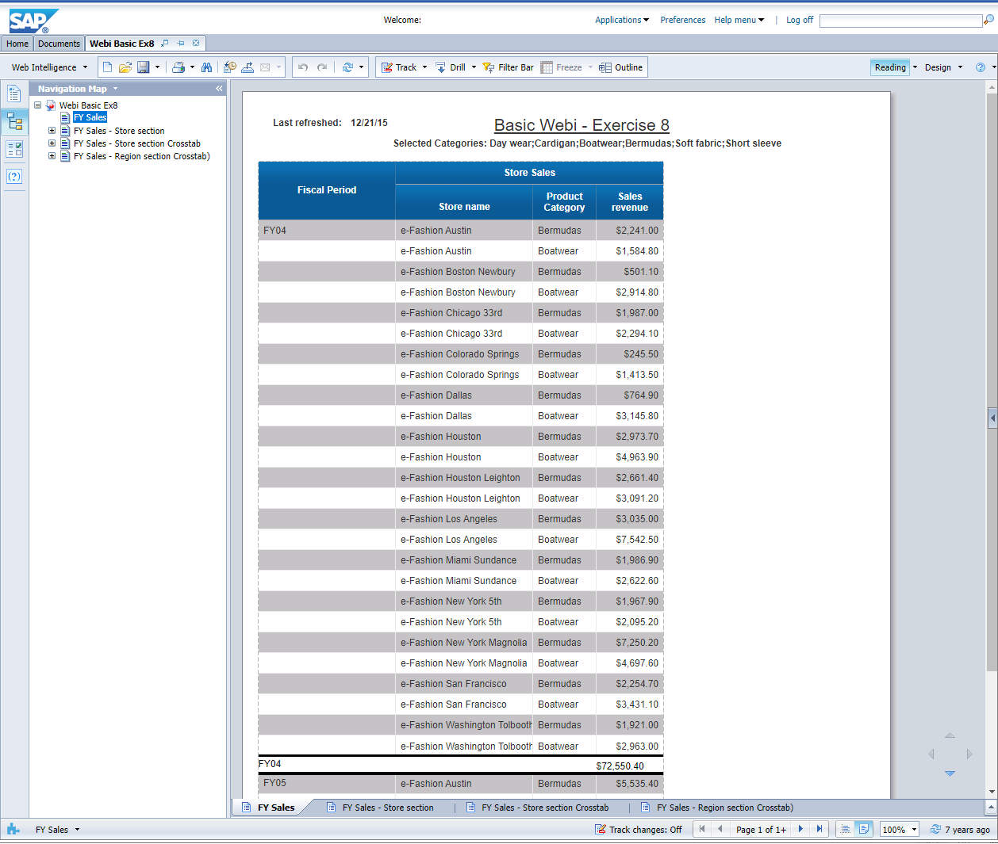
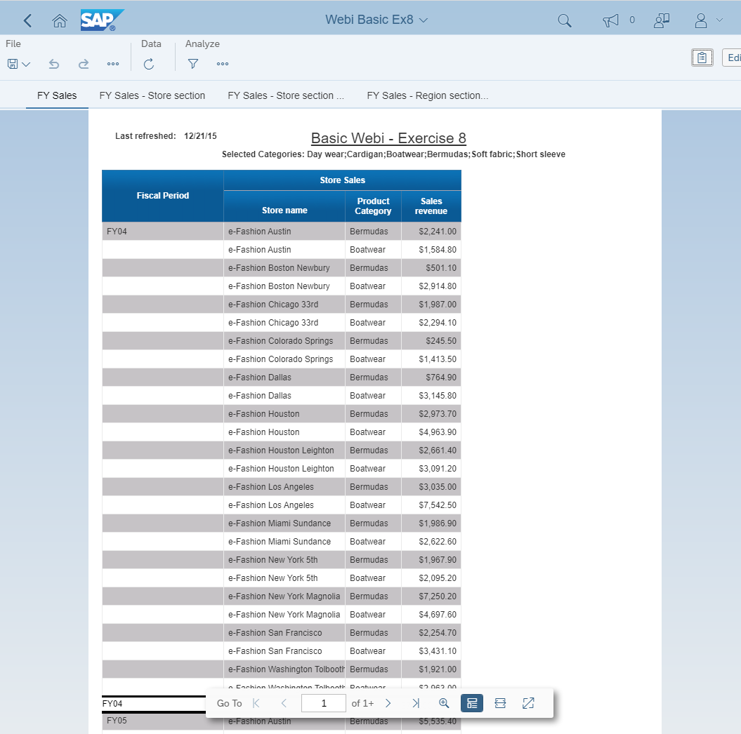
Document view is completely different

Slide 20
Old WEBI document view
Tabs of the report were at the bottom, and navigating multiple pages and zooming were controls in the page footer (and always available and visible).

Slide 21
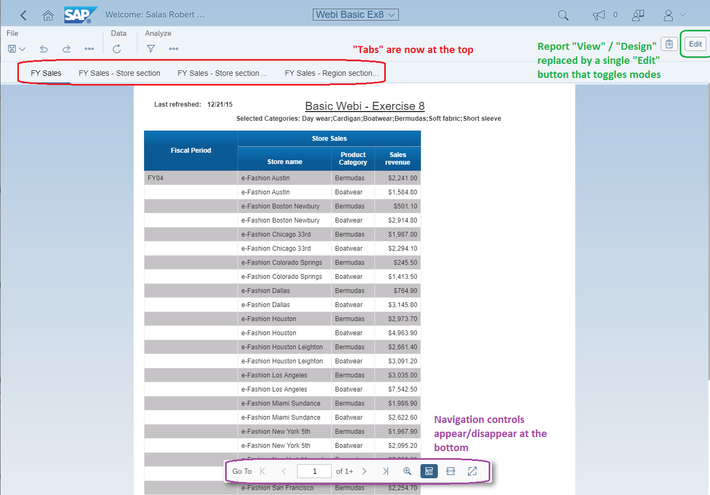
New WEBI document view

Slide 22
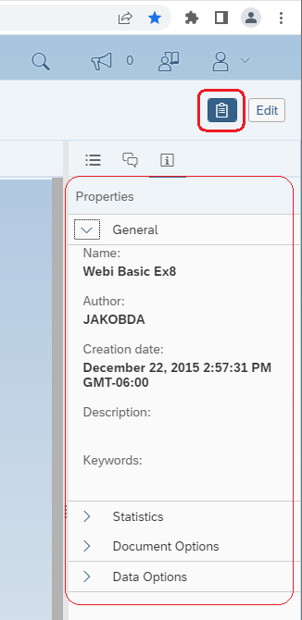
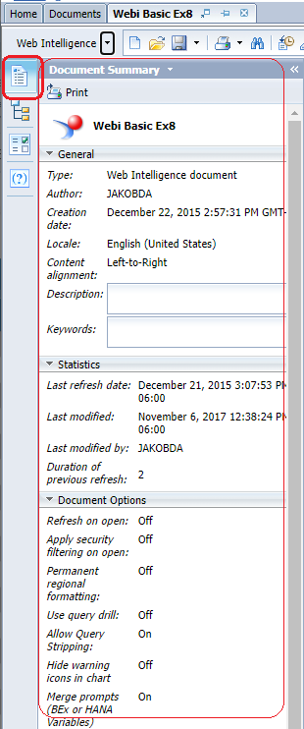
Report properties
Old WEBI Document properties were displayed on the left side, and all were displayed at once.
New WEBI, document properties are activated by clicking the clipboard icon, and the properties are displayed only for the selected expand category and are displayed on the right side of the screen.

Slide 23
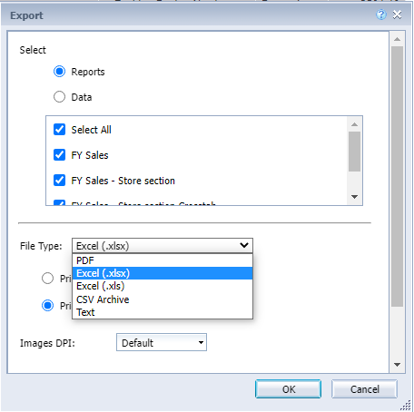
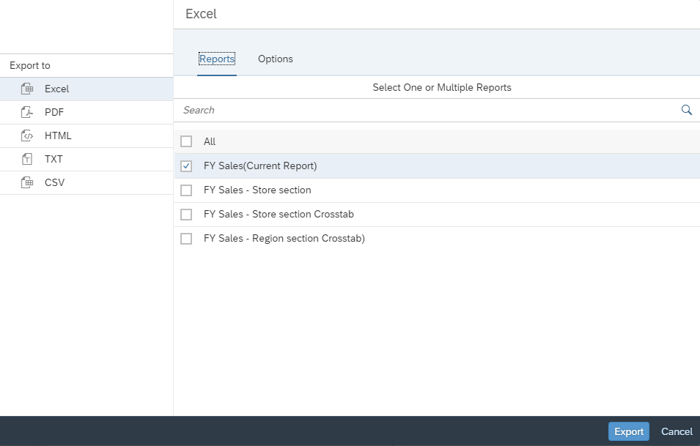
Exporting report / data
The options and functionality are basically the same, just a different look & feel to the window.
HTML is a new option. .xls is no longer available.

Slide 24
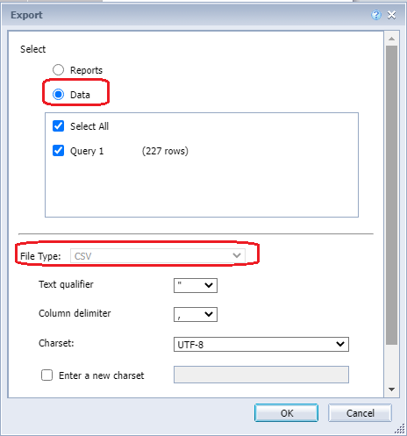
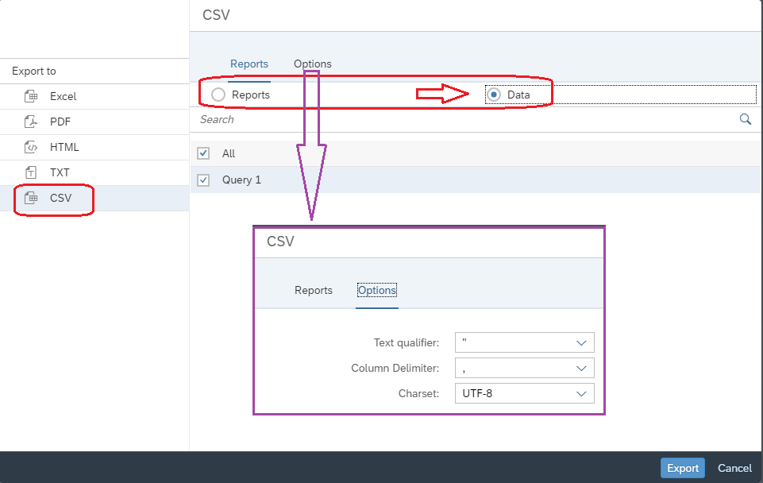
Exporting query / raw data
In old WEBI, selecting the “Data” radio button defaults the File Type to CSV.
In new WEBI the steps are reversed. Select “CSV” as the ‘Export to’ option and the radio button for Data will then appear and may be selected.
The text qualifier configuration can be accessed via ‘Options’.

Slide 25
More detailed documentation on 4.3s “Reading Mode”
https://blogs.sap.com/2020/12/14/sap-bi-4.3-sap-bi-4.3-sp1-whats-new-in-web-intelligence-and-semantic-layer-cumulative-version/#READING

Slide 26
Functional Differences -Ad hoc/Analyst Role- Old WEBI vs New WEBI

Slide 27
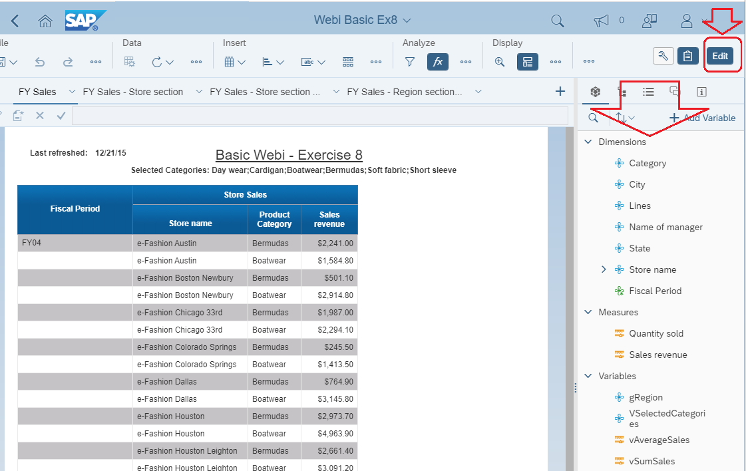
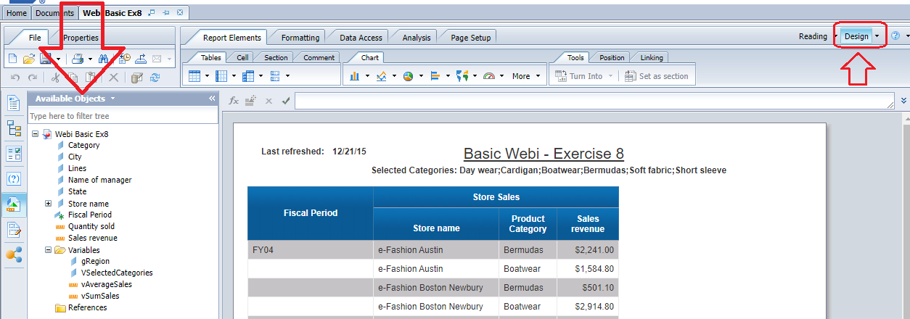
Putting report into ‘Design’ / ‘Edit’ mode
New WEBI activates ‘Edit’ and objects appear on the right side pane
Old WEBI activated ‘Design’ mode (vs. ‘Reading’ mode) Objects then appeared on the left side pane

Slide 28
Edit mode in new WEBI
In Edit mode, additional menu bar options become available as quick-access icons. Opening certain context menus makes them appear and change on the right side.

Slide 29
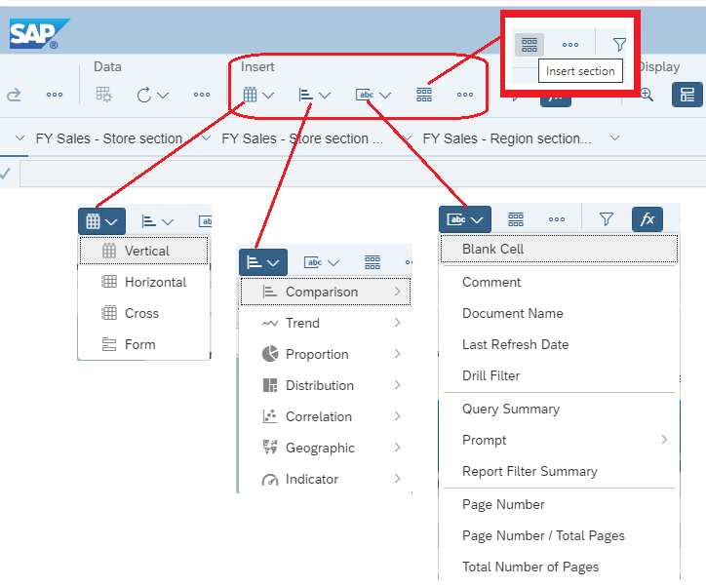
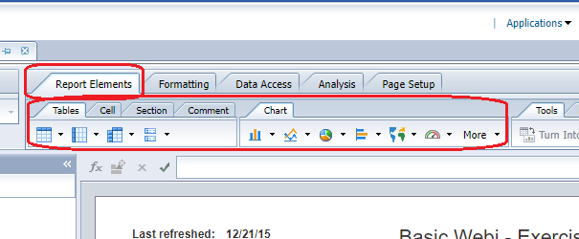
Report Elements
New WEBI displays menu drop-downs under “Insert” for each type of element.
Old WEBI displayed a “Report Elements” tab and showed tables and chart icons that could be added.

Slide 30
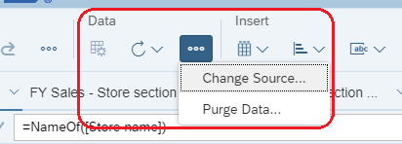
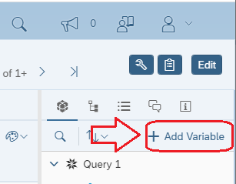
Data Access
Data Provider selections are in the “Data” area of the main menu.
The contents of the Data Access tab have been separated into different areas.
Adding a new Variable is on the Main side panel, under the Objects sub-menu.

Slide 31
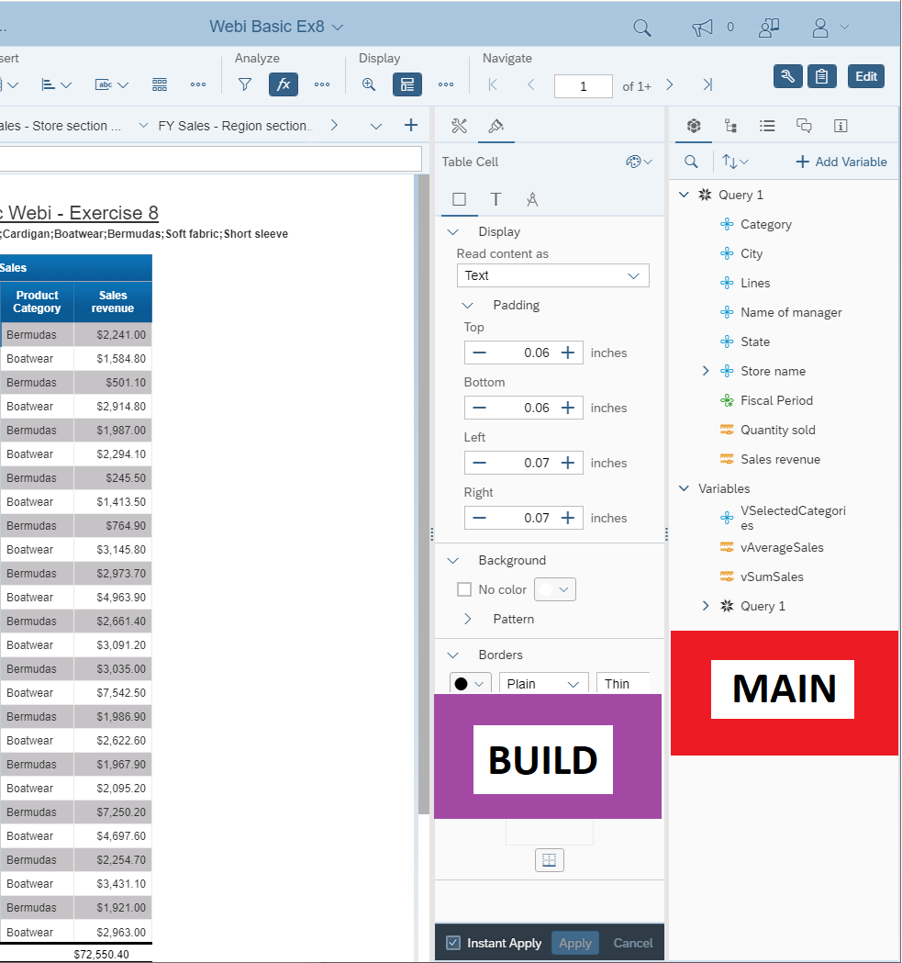
New WEBI side panels: Main panel & Build panel
Opening more content menus makes them appear on the right side.
The right-most menu is known as the “Main Side Panel” and is activated by the clipboard icon.
The other that appears is know as the “Build Side Panel” and is sensitive to what content or object is selected within he report. It is activated by the wrench icon.

Slide 32
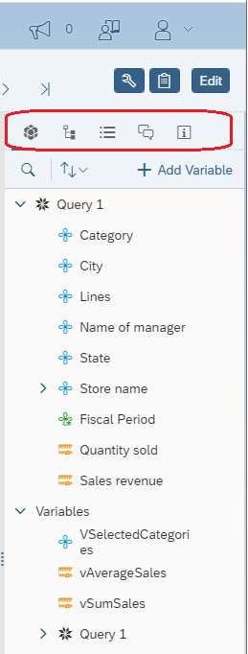
Main Side Panel
Activated by the clipboard icon, the main side panel controls the following:

Slide 33
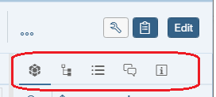
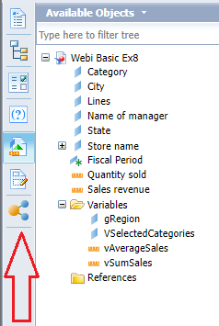
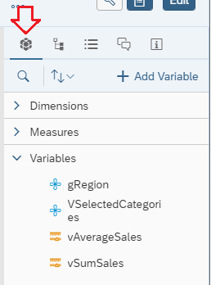
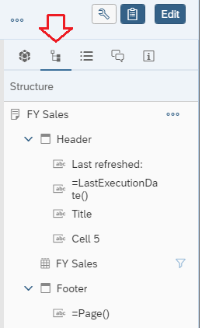
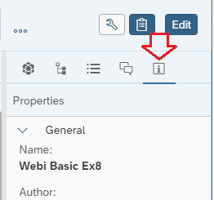
Report objects, controls, and properties
New WEBI has additional report objects and controls in the Main side panel
Old WEBI had the additional report objects and controls along the left side pane, vertically arranged

Slide 34
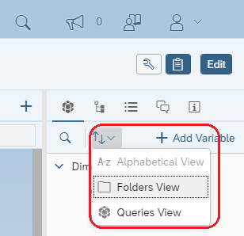
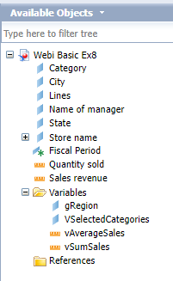
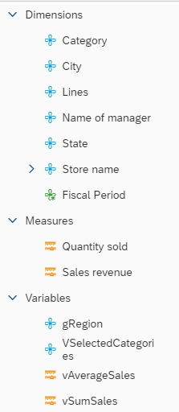
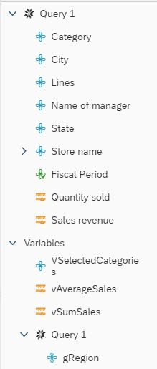
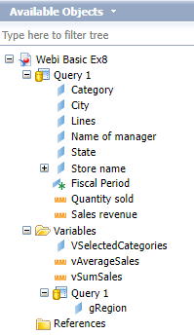
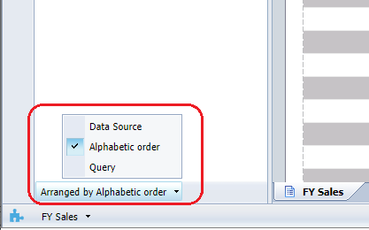
Folder vs Query view of available data objects
New WEBI has the selector for the Available Objects view in the Main side panel, accessed via the up/down arrow icon.
Old WEBI had the selector for the Available Objects view in the bottom left corner.

Slide 35
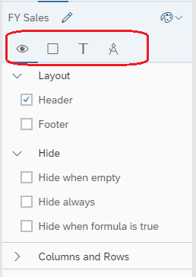
Build Side Panel
The Build side panel provides access to formatting options, for the worksheet, tables, cells, text and objects.
The available icons change, based on what specifically is selected within the report.

Slide 36
Formatting
Old WEBI displayed a “Formatting” tab and showed available formatting options at all times.
New WEBI has a series of context menus that must be selected.
The ‘wrench’ displays the Build side panel where formatting options can be accessed.

Slide 37
The Formatting sub-menus

Slide 38
Variables – Formula Editor
The Create Variable window is basically the same, with some very minor rearrangement.
However, new WEBI introduces auto-completion for object names as you type.

Slide 39
Sections
In new WEBI, the Section control is part of the ‘Insert’ menu area and is the grid-like icon.
A lasso-like icon will appears which you drop over the data table in which you want a section.
In old WEBI, the Section control was part of the Reports Elements tab, Tools tab and utilized whatever data element/cell was selected to create the section

Slide 40
Functional Differences -- Querying -- Old WEBI vs New WEBI

Slide 41
Creating a new WEBI Document / query
In old WEBI, the WebIntelligence application was launched from the Applications drop-down in the top-of-screen menu.
In new WEBI the Applications tiles are at the bottom of the Home screen lists of tiles.

Slide 42
Selecting a data source
In old WEBI it was necessary to click the “New” icon.
In new WEBI, the data source selection page opens immediately after clicking the tile.

Slide 43
Universe selection
The universe selection window/page is almost identical and functionally the same.

Slide 44
Query Panel
Almost no functional differences between old and new WEBI query panels.

Slide 45
Query Comparison
Essentially identical functionality.
Visual differences, but minimally.

Slide 46
Query Controls and Properties
Old and new WEBI contain the same query controls and properties, including the ability to view the generated SQL script.

Slide 47
Running Specific Query or All Queries
Although functionally identical, the location of the Run Queries option is changed.
In Old WEBI Run Queries is in the top right corner.
In new WEBI Run Queries is in the bottom right corner.

Slide 48
Purging data from the document
In old WEBI, purging the document of data query results was done through the Data Access tab, Data Providers, and Purge.
The queries to purge were directly listed and selectable, or “Purge All”
In new WEBI, Purge Data is on the main menu bar under ‘Data’.
A selection page will appear to choose the query(ies) to purge, and the Purge button tp execute the action.

Slide 49
More detailed documentation on WEBI 4.3’s “Edit Mode”
https://blogs.sap.com/2020/12/14/sap-bi-4.3-sap-bi-4.3-sp1-whats-new-in-web-intelligence-and-semantic-layer-cumulative-version/#EDIT

Slide 50
Connect with the BI Data Program Team!
Email any questions to the DCF DL BITS BI Data Program Team (dcfdldmsbitsbidataprogramteam@wisconsin.gov)
Join the BI_Partners Teams and receive all the latest and greatest information regarding BusinessObjects WEBI!
Visit us in Teams at this link: BI Partners Teams
Simply click the join a Team button on the bottom left of your Teams screen – enter the code: gciwv0c

