Slide 1
Breaking the Cycle Learning Series
Trauma Informed Care approach to a conversation with Domestic Violence survivors
November 11th 2021

Slide 2
Welcome & Introductions
Notes:
ALL
3 min - Introduce trainers (Tristan, Kelly, Erin)
Have participants type in chat name, agency, & role

Slide 3

Your Role
Isolation, Shame, Continued Violence
Safety & Healing
Notes:
ERIN - You were asked to attend this training today in recognition of the vital importance of the role that you play in the lives of DV survivors. You may be specifically administering the LIFE program, where the folks you serve by definition are all survivors of DV. You may be administering another DCF program like W2 where not everyone you serve is a DV survivor, but many may be.
Survivors are often coming to you a critical juncture in the road. Getting help and leaving an abusive relationship is the MOST DANGEROUS time for a victim. Your role at this critical fork in the road can lead them back to the isolation, shame, and continued violence in their relationship OR, if done well, can help guide them down the road toward safety and healing.
This may seem like a dramatic analogy, but it is true. We’ll walk through techniques today that will help you guide the people you serve on the road of safety and healing

Slide 4
Your Role
All things to all people
On-going support
DV expert
Determine validity of DV claims
Notes:
ERIN – So what is your role?
First of all you are NOT intended to be all things to all people. You’re not being asked to provide DV specific resources & expertise. You’re not there to provide on-going support to an individual around their DV needs. And… most importantly…It is not your role to determine the validity of someone’s claims of DV

Slide 5

Your Role
Listening Ear
Door Opener
Bridge to Safety & Healing
Believer
Notes:
ERIN – Instead… your role is to be a listening ear. This could be a survivor’s very first time reaching out for help or telling ANYONE about the abuse. This is a scary and important moment for them.
Be a door opener. You should be opening the door for survivors to talk about what they’ve been through and connect to the on-going support they need.
Be a believer. It is NOT your role to determine the validity of the DV claim. There is not one way a survivor will look, act, talk like, etc.
Finally, if you play the other parts of your role well, you are a bridge to safety and healing for the DV survivors you serve.

Slide 6

Learning Outcomes
Domestic Violence101
Notes:
KELLY
This training is not intended to replace or cover all the details you would receive in a domestic violence 101 course. As a LIFE or W2 worker, you will have the opportunity to attend a full 2 day session on this. Contact your supervisor to learn more about when those trainings will be offered.

Slide 7
Learning Outcomes
Trauma Informed Care 101
Notes:
KELLY
Likewise, this is not a Trauma Informed Care 101 training. We will very briefly review the 6 key principles of Trauma Informed Care but then move into the practical application of the those principles in conversations with the folks you will be working with.

Slide 8
Learning Outcomes
Understanding trauma-informed conversations when working with domestic violence survivors
Applying what we’ve learned from domestic violence survivors and their children to trauma-informed conversations
Practical application of trauma-informed techniques to use with domestic violence survivors
Notes:
KELLY

Slide 9
6 Guiding Principles to Trauma Informed care
1. Safety
2. Trustworthiness & Transparency
3. Peer Support
4. Collaboration & Mutuality
5. Empowerment, Voice, & Choice
6. Cultural Historical & Gender Issues
Notes:
KELLY – While this training is not trauma-informed 101, we will be anchoring our content around the 6 guiding principles to trauma-informed care. You’ll see each of these relevant principles show up throughout this training where it is applicable.
Safety – client feels safe physically & emotionally in conversation
Trustworthiness & Transparency – Clearly communicate roles, risks, and next steps
Peer Support – understanding others have gone through similar things, normalizing reaction to traumatic experience
Collaboration & Mutuality- Doing it with the client, not to the client
Empowerment, Voice, & Choice – taking client’s lead, providing choice
Cultural Historical & Gender Issues – understanding this context and how it influences how client responds to traumatic experience

Slide 10

Video Scenarios
TAKE 1
Notes:
KELLY - Play videos (not trauma-informed)
THINGS TO NOTICE – Missed Opportunity to Discuss DV scenario
The confidentiality information the staff person in this video scenario provided was accurate for an employee with confidential status. A reminder to defer to your employer’s policy and provide whatever that information is at the beginning of the conversation.
The client brings up a lot of concerning behavior by the ex that sounds like coercive control and domestic violence, but the worker doesn’t take the opportunity to ask more about the situation, explore her concerns, and connect to on-going DV resources. Perhaps this advocate:
Is unsure how to have the conversation about domestic violence but does feel very familiar and comfortable with starting the LIFE application process, so she defaults to that.
Is worried about the client’s reaction or damaging rapport if she focuses on the DV.
has a hard time discussing DV because of her own history and life experiences.
Is unsure what to say or what to suggest in terms of resources.
We will address all of these concerns during today’s training.
THINGS TO NOTICE – Judgmental scenario DCF
The confidentiality information the advocate provided was accurate for an employee with confidential status. A reminder to defer to your employer’s policy and provide whatever that information is at the beginning of the conversation.
The advocate doesn’t ask the client permission before giving or collecting any information.
The advocate down plays and seems to dis-believe the client’s concerns about domestic violence “So he never hit you or put his hands on you?” and “Yeah, a lot of couples fight.”
The advocate’s attempts at rapport building come off as judgmental. “Whew, that’s a lot!” and “You must be going crazy!”
Likewise, the advocate’s attempts at showing concern and providing psychoeducation around the impact of violence on children come off as judgmental and like she is blaming the mother for her ex-husband’s aggression. “It can be really traumatic for kids to see their parents fighting.” And “You should try not to fight in front of them.” This can be triggering for any parent, especially one whose abusive partner may belittle her parenting or place unnecessary blame on her or when she has very little control of when or where the fighting and violence happen.
The advocate doesn’t give any affirming statements or acknowledging that the client is doing well for herself and her children by coming in for help.
The advocate doesn’t ask the client what’s important to her. She instead jumped to suggest self-care and child services and continues to push this issue even when the client does not want to talk about it.

Slide 11
Conversations DV Survivors
Trauma-Informed Lens
Realize the reasons it’s hard
Recognize people’s reactions to the hard
Respond by honoring the hard – making space for it
Hard for Professionals
Hard for Survivors
Notes:
ERIN
We know that this conversation is hard for both professionals and survivors.
This isn’t bad! This is the key to trauma informed care approach

Slide 12

Conversations DV Survivors
Hard for Professionals
Notes:
ERIN – brainstorm w/participants what makes these conversations hard for professionals

Slide 13

Conversations DV Survivors
Nervous about mandated reporting responsibilities
Hard for Professionals
Notes:
ERIN
Worried about damaging rapport by disclosing to clients they are a mandated reporter
Don’t feel entirely sure how to report or who to involve when making a report
Worried about client’s reaction if a report must be made
Don’t want to hear something they’d be required to report… if you don’t ask, it doesn’t mean it isn’t happening
BUT a “head in the sand approach” doesn’t help anyone. Just because you’re not asking about hard things (like people being hurt or unsafe at home) doesn’t mean they aren’t happening and aren’t impacting the people you serve.

Slide 14

Discussing Mandated reporting
Set up boundaries and expectations for conversation - including why you would be mandated to report & what might happen once reported
  These will differ depending on your employer, role, & credentialing. Defer to your employer’s policy.
  Early & often
Transparency about risks vs. harm to rapport
Offer to connect to a confidential services
  Confidential advocate, Attorney, etc.
  Domestic Violence hotline – clients can reach out anonymously
2. Trustworthiness & Transparency
5. Empowerment, Voice, & Choice
National Domestic Violence Hotline
800-799-7233
Notes:
ERIN
We encourage folks to set up boundaries and expectations for the conversation up front, before diving into the client’s story and needs. In this mandated reporting “pre-amble” you would disclose whatever your specific status is in terms of mandated reporting, what types of information that you would be mandated to report, and what might happen once reported.
It’s important to note that this will differ depending on your employer, your role, and your credentialing. We are providing general advice to provide information up front at the start of a conversation, but knowing specifically what information to provide is up to you. Check with your supervisor or employer if you’re unsure.
In addition to providing this information early, before a client gets further into their story and reasons for seeking help, we also suggest often coming back to this. Even though a client heard it once, we know they didn’t necessarily retain it, especially for someone whose recently experienced a lot of trauma.
When discussing mandated reporting, many professionals worry about the balance of transparency and letting clients know right away vs. the potential harm to trust or rapport that might happen if they lead with that information. We believe that the benefits of transparency outweigh the risk of damaging rapport.
First, by being transparent, you are demonstrating that you are trustworthy and wouldn’t “go behind their back,” gathering and reporting information the client thought would be kept in confidence.
Second, by giving the client that information, you are essentially empowering them to choose what they want to do with all of the relevant information.
Lastly, if you disclose the fact that you have strict mandated reporting requirements and the client therefor does not feel comfortable talking with you about their children and their children’s needs, you can always offer to connect them to a confidential service.
I’ve shared Sojourner’s domestic violence hotline numbers here… but depending on where you’re located, you can find a local hotline number.

Slide 15

Conversations DV Survivors
Nervous about mandated reporting responsibilities
Fear of client reaction
  Shutting down
  Getting defensive or angry
  Client opting out of future services
Hard for Professionals
Notes:
ERIN
Another reason that conversations with domestic violence survivors is difficult for professionals is fear about a client’s reaction when these issues are brought up. No matter how well you do in introducing the topic in a trauma informed way, occasionally clients will react this way.
The key here is to look at these reactions through a trauma informed lens
Realize… this is a hard topic for this person
Recognize… this reaction is a trauma reaction. It’s not personal.
Respond…
using one of the talking points we’ll review later
Creating a feeling of safety in the conversation
but ultimately by taking the clients lead. Can come back to the conversation later.

Slide 16
SURVIVOR’s VOICES
1. Safety
“Someone who’s gonna be real with you. Honest with you, who’s gonna be supportive of you, you know? Because for me to feel safe sometimes I have a really hard time feeling comfortable. Just because it’s not what I’m used to. Before I got here with a counselor, healthy people was really foreign to me. I was like, ‘What is this?’”
“My counselor says ‘I need you to be OK first, before we start.” The fact that she genuinely wants to know you to know if you’re feeling better if there’s anything bothering you, you know? And so it makes you just wanna go to her,. Even if I had a need, I would just wait til she came so I could talk to her.”
  “You know gentle- being gentle and being mindful of peoples triggers. Not treating them like a game and not taking it seriously.”
Notes:
ERIN – When a person feels safe in the conversation, they are far less likely to have those trauma reactions that professionals fear.
Because we believe its essential to hear from the people we intend to serve first and foremost when learning how to help better, we have included direct quotes from both adult and youth survivors of family violence throughout this training.
Here are a few quotes from survivors about what makes them feel safe.

Slide 17
SURVIVOR’s VOICES
1. Safety
  “I don’t really know a lot of things about any of the people I encounter, so maybe talk a little bit about themselves like not deep or whatever, but their interests and kind of that understanding and more conversation instead of just grilling.”
  “Just showing true genuine, compassion and empathy.”
“I think most of the time when I ever talked to social workers, cops or CPS or whoever it was always cause of my behavior so it was never like, “why are you acting like this?” Or, you know, “what’s going on at home?” or “are you OK?” It was always like, “why would you do that?” or “why would you run away from your mom?” Kind of things like making me feel- like obviously in that situation I did do something wrong and you know there’s always more to it. So maybe some just being like, “Well, OK. Are you OK?”
“Sometimes when you do say something like not aggressively but more firm it could trigger a memory like, ‘Oh my God, he’s yelling at me. He’s gonna hit me; or she’s gonna hit me.” So being a little more gentle.”
Notes:
ERIN

Slide 18
Conversations DV Survivors
Nervous about mandated reporting responsibilities
Fear of client reaction
  Shutting down
  Getting defensive or angry
  Client opting out of future services
Your own triggers, trauma, & cultural/historical perspective
Hard for Professionals
Notes:
ERIN – another reason this conversation can be hard for professionals is that we are people too. We carry with us into this work our own trauma, our own triggers, and our own unique cultural and historical perspectives.
Tristan will talk more about this now.

Slide 19
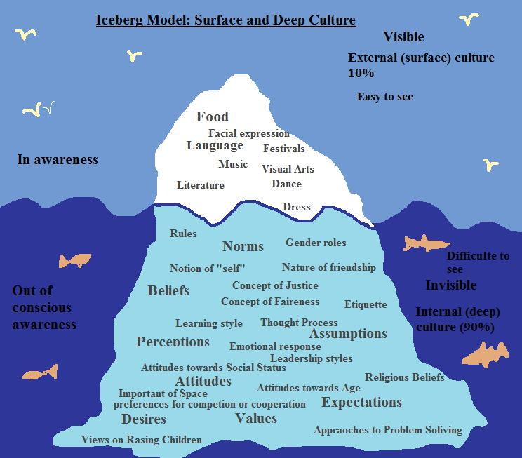
The Importance of honoring Culture
6. Cultural Historical & Gender Issues
Culture covers multiple pieces of our identity shapes our beliefs and perspectives.
The manifestation of systems of oppression both cause and trigger trauma and come in many forms.
The dominant culture determines the social norms and perpetuates systems of oppression and informs implicit bias.
Notes:
TRISTAN

Slide 20
Culturally Relevant frameworks
6. Cultural Historical & Gender Issues
Cultural sensitivity is being aware that cultural differences and similarities between people exist without assigning them a value – positive or negative, better or worse, right or wrong.
Cultural competence comprises behaviors, attitudes, and policies that can come together on a continuum that will ensure that a system, agency, program, or individual can function effectively and appropriately in diverse cultural interaction and settings. It ensures an understanding, appreciation, and respect of cultural differences and similarities within, among and between groups.
Teaching cultural competence to reduce health disparities. Health Promotion Practice, 7(3 Suppl.), 247S-255S. doi:10.1177/1524839906288697Selig, Tropiano, and Greene-Moton (2006)
Cultural humility is “a lifelong commitment to self-evaluation and critique, to redressing power imbalances . . . and to developing mutually beneficial and non-paternalistic partnerships with communities on behalf of individuals and defined populations”
Cultural humility versus cultural competence: A critical distinction in defining physician training outcomes in multicultural education. Journal of Health Care for the Poor and Underserved, 9, 117-125. Tervalon & Murray-Garcia, 1998
Notes:
TRISTAN

Slide 21
Culturally Relevant Concepts
6. Cultural Historical & Gender Issues
Othering- Othering is a term from the outgroup homogeneity bias and ingroup outgroup effect that refers to the idea that 1) the dominant group is the ideal group and 2) outgroups lack variability.
https://www.psychologytoday.com/us/blog/darwins-subterranean-world/201904/the-psychology-othering
Values/Morality- Moralism is, ‘a failure to recognize what moral thought or reflection requires (and does not require) of us’. This failure can take various forms. It can involve making judgements about people while failing to recognize their common humanity.
https://onlinelibrary.wiley.com/doi/full/10.1111/rati.12168
Implicit Bias- The foundational, unexamined beliefs we hold. Implicit bias is often validated by confirmation bias.
Evidence Based Practices- The impact of the dominant culture on academia and research structure the questions asked and the importance of the data collected. The practice of using race or other cultural identifiers as dummy variables can result in misleading findings.
Notes:
TRISTAN

Slide 22
SURVIVOR’s VOICES
6. Cultural Historical & Gender Issues
  “Understanding is key to save people. You got to really know someone so they don’t just ask you about all the bad stuff or what they think is important; like they ask you about you as a rounded individual. So like they ask you your interests; they have a conversation. And it’s not like, ‘We’re gonna zoom through the whole of you and we’re just gonna go to whatever it is we want to know, need to know you need help with.”
  “Hispanic culture is like ‘oh what will people say’ … so we’re very stuck on what people will say and it’s gonna look bad on us so when are we out in public you have to put up this sort of front like everything is perfectly fine and you’re happy even if you really feel like you need help from someone else”
  “My own brothers would like physically abuse their wives and they all live with my mom so it was kind of like a normal thing, you know?”
Notes:
TRISTAN

Slide 23
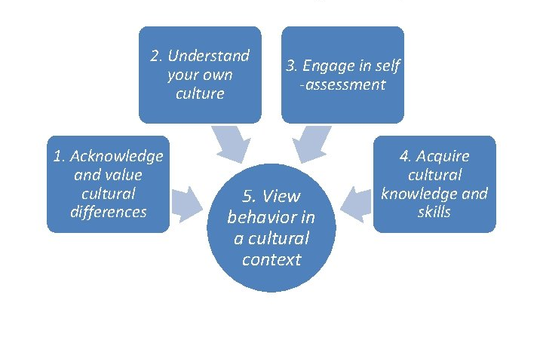
Ways to honor culture
6. Cultural Historical & Gender Issues
Acknowledge your own privilege.
  Intentional self-reflection to surface assumptions and identify bias.
  Intentional self-reflection to identify triggers and response strategies.
Take an intersectional approach.
Remember, no group is a monolith
Notes:
TRISTAN

Slide 24
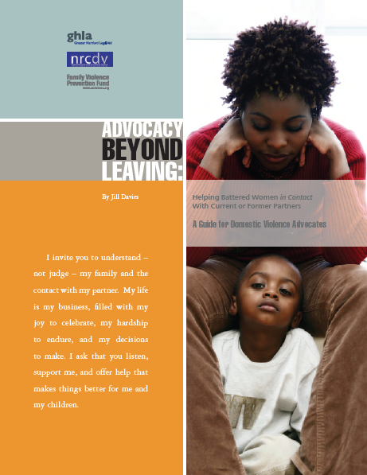
The importance of honoring culture
Your view of survivor’s safety and the risk to children can differ from the survivor’s view
“Maintaining a positive and open tone can be challenging, particularly when advocates have their own concerns about a victim’s safety or parenting.”
“More likely to be successful if you have her trust, respect her culture, and demonstrate that you understand and value her view of parenting”
  Taking “the long road approach.”
  Planting a seed vs. addressing all concerns immediately
6. Cultural Historical & Gender Issues
Notes:
TRISTAN
Source: Advocacy Beyond Leaving by Jill Davies

Slide 25
Conversations DV Survivors
Nervous about mandated reporting responsibilities
Fear of client reaction
  Shutting down
  Getting defensive or angry
  Client opting out of future services
Your own triggers, trauma, & cultural/historical perspective
Don’t know how to bring it up or what to do with a disclosure
  What to say?
  What resources / referrals to offer?
Hard for Professionals
Notes:
ERIN
- The final piece that we’ll cover under what makes these conversations hard for professionals is the “what next?” question. What do you say? What do you offer?

Slide 26
What to Say? Talking points
“What do you love about your kids? What about them makes you happy? What do they like to do? What are they good at?”
4. Collaboration & Mutuality
“What’s the kids’ relationship like with their dad? With your partner (if he’s not their dad)?”
“What do you want for yourself and your family? What does success look like for you? What do you want to work on?”
“Is there anything about your relationship that you don’t like or want to improve?”
“You’re here getting help. That takes tremendous bravery. How have you found the strength to take this step? What has been working well for you?”
“I sometimes hear from others that their partner can get very jealous and tries to control what they do. Do you ever worry about that?”
“Is there anything else you want to tell me we haven’t talked about?”
Notes:
ERIN – Since many professionals struggle with what to say both to bring up concerns about domestic violence in conversation and what to say in response to a disclosure… here are some talking points taken from Jill Davies “Advocacy Without Leaving”

Slide 27
What to Offer? Connecting to resources
Where DV survivors can get support
Family & Friends
School (student resources, social work, counseling)
Work (Human Resources, Employee Assistance Programs)
Faith Community
Community Agencies
  Social services, counseling, support groups, youth development programs, services for people who are older or have disabilities
DV Specific Agencies
  Including culturally specific programs
Notes:
ERIN – Once either you or the person you are serving has brought up domestic violence in conversation, another valid question professionals have is what to offer that person? Where to connect them for help?
We encourage you to think broadly about the types of help and support that you highlight in your conversations. All help does not have to be professional. In fact we know that many survivors only receive help and support from informal networks and connections in their personal lives. This is OK! And a vital thing to remind folks of.
You can also “think outside the box” in your suggestions and referrals to clients by encouraging them to look for support at their school (maybe they have a student resources center) or at work (does their employer offer an Employee Assistance Program)?
Like family and friends, many survivors find solace, support, and relief in their faith community. If faith and spirituality are an important part of the person’s life, make sure you suggest connecting to that community for support with DV.
When considering professional places to refer a client, you can also “think outside the box” in terms of connections to agencies that address issues beyond just the DV. Viewing clients from a holistic lens, we know that DV survivors are much more than just the violence in their lives. They are whole people with needs to be connected to recreation, and fun, and you can look to community agencies for some services that meet that diverse set of needs.
Lastly, of course, you can offer a referral to a DV service provider. Be sure that you consider your client’s individual identity when making these recommendations and don’t forget the often times smaller and less well known culturally specific organizations.

Slide 28
What to Offer? Connecting to resources
Tips for Making Referrals
Consider how the survivor identifies
Offer multiple options
Non-governmental DV / SA agencies are free and confidential
Can call hotlines anonymously
Safety strategies may include staying in the relationship
Emphasize that isolation and keeping abuse a secret increases danger; encourage the survivor to find someone who understands (personally or professionally) that they can talk to
Notes:
ERIN

Slide 29







What to Offer? Available resources
Statewide Resources
End Domestic Abuse WI
  608-255-0539
  www.endabusewi.org/get-help
WI Coalition Against Sexual Assault
  608-257-1516
  www.wcasa.org/survivors/service-providers
Deaf Unity
  help@deafunitywi.org
  Text 608-466-2881
Unidos
  800-510-9195
National Resources
National Domestic Violence Hotline
  800-799-7233
  live chat @ www.thehotline.org
RAINN, the National Sexual Assault Hotline
  800-656-HOPE (4673)
StrongHearts Native Helpline
  844-762-8483
  Live chat @ www.strongheartshelpline.org
National Immigrant Family Violence Institute
  www.nifvi.org/providers3.html
Notes:
ERIN – Professionals also struggle with talking about to clients about DV because they feel uncertain what to provide them with in terms of resources or referrals. Here are national, statewide, and Milwaukee specific suggestions

Slide 30




What to Offer? Available resources
Milwaukee Resources
Sojourner Family Peace Center
  www.familypeacecenter.org
  Hotline / Shelter: 414-933-2722
  Text line: 414-877-8100
  Restraining Order Clinic: 414-278-5079
Community Advocates / Milwaukee Women’s Center
  414-272-6199
  Older Abused Women’s Program
LGBTQ specific support
  Milwaukee LGBT Community Center 414-271-2656
  Diverse & Resilient 414-856-5428
Culturally specific support
  www.weareheremke.org
  Gerald L Ignace Indian Health Center
  HIR Wellness Institute (Healing Intergenerational Roots for All Nations)
  Milwaukee Muslim Women’s Coalition, Our Peaceful Home
  Hmong American Women’s Association 877-740-4292
  UMOS’s Latina Resource Center
Notes:
ERIN – Professionals also struggle with talking about to clients about DV because they feel uncertain what to provide them with in terms of resources or referrals. Here are national, statewide, and Milwaukee specific suggestions

Slide 31
Conversations DV Survivors
Hard for Professionals
Hard for Survivors
Notes:
ERIN - brainstorm w/participants reasons why this conversation is hard for survivors
Now that we’ve reviewed many of the reasons this conversation is hard for professionals, let’s brainstorm some reasons this is hard for domestic violence survivors

Slide 32

Conversations DV Survivors
Fear of unwanted systems involvement
  CPS
  Law Enforcement
“I’m a mandated reporter. That means….
Hard for Survivors
Notes:
ERIN
Many times survivors avoid brining up any concerns they have about what they and their children have experienced because they fear unwanted involvement by systems such as law enforcement or child protective services. Our earlier discussion about mandated reporting applies here. We advocate for being forthcoming with the person you’re working with exactly what your mandated reporting responsibilities are and what would happen if a report was made. A mandated reporting allows us to empower the client with information to make their own choice and trusting they’ll do what is best for themselves and their family.

Slide 33
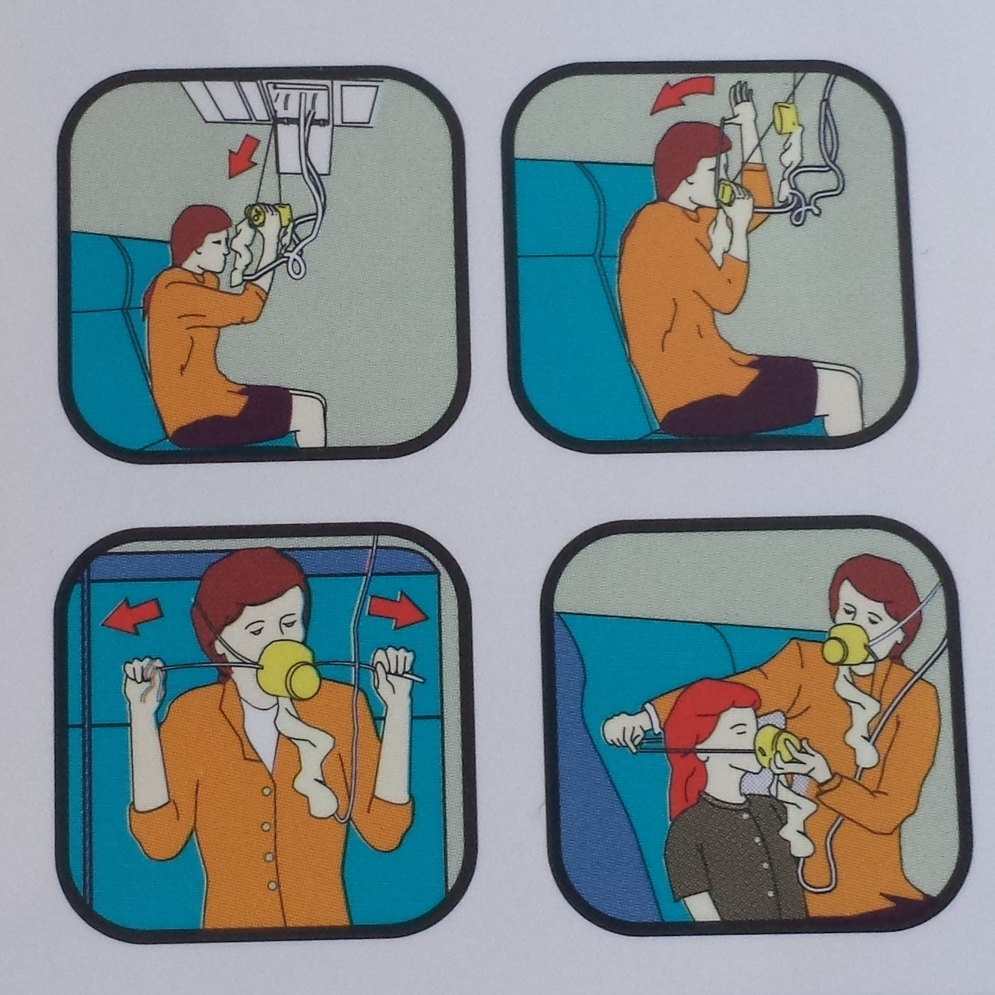
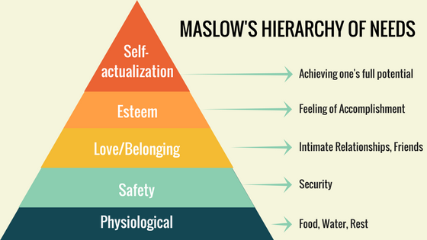
Conversations DV Survivors
Fear of unwanted systems involvement
  CPS
  Law Enforcement
Not ready – early on in safety & healing journey
Hard for Survivors
Notes:
ERIN
In other instances, the survivor comes to us still in the midst of chaos just starting their journey to safety and healing. They aren’t ready yet to tackle the impact the violence has had on their children yet because they and their children aren’t physically safe yet and they haven’t had a chance to begin their own healing.
This is similar to what flight attendants tell you to do in the event of a plane crash. “Put on your own mask before assisting others.”
The concept of Maslow’s hierarchy of needs is also relevant here. A person can’t focus on the social and emotional needs of themselves, let alone of others, before meeting their own physiological and safety needs.
Survivors who are parents often feel tremendous shame and guilt when facing the impact the abusive situation has had on their children. People often react to painful emotions like shame and guilt by avoiding them rather than facing them head on.
A common tactic used by many abusers is to use children against the victim, criticizing her parenting, blaming her for children’s behavior and reactions, and putting down her mothering.

Slide 34

Conversations DV Survivors
Fear of unwanted systems involvement
  CPS
  Law Enforcement
Not ready – early on in safety & healing journey
Shame & Guilt
Hard for Survivors
Notes:
ERIN
In other instances, the survivor comes to us still in the midst of chaos just starting their journey to safety and healing. They aren’t ready yet to tackle the impact the violence has had on their children yet because they and their children aren’t physically safe yet and they haven’t had a chance to begin their own healing.
This is similar to what flight attendants tell you to do in the event of a plane crash. “Put on your own mask before assisting others.”
The concept of Maslow’s hierarchy of needs is also relevant here. A person can’t focus on the social and emotional needs of themselves, let alone of others, before meeting their own physiological and safety needs.
Survivors who are parents often feel tremendous shame and guilt when facing the impact the abusive situation has had on their children. People often react to painful emotions like shame and guilt by avoiding them rather than facing them head on.
A common tactic used by many abusers is to use children against the victim, criticizing her parenting, blaming her for children’s behavior and reactions, and putting down her mothering.

Slide 35

Peer support & Connection
3. Peer Support
“Because I don’t even know people who could relate, you know? So I don’t even know who to talk to”
“I prefer the group, Yeah, the group. Because, I don’t know, just, I don’t like being kind of singled out.”
“We both go through the same things like what’s happening so we help each other out.”
Notes:
One great way to address many of these issues, the feelings of shame and guilt, the feeling criticized and disempowered in their parenting is to connect survivors to other survivors who have gone through similar things.

Slide 36

Conversations DV Survivors
Fear of unwanted systems involvement
  CPS
  Law Enforcement
Not ready – early on in safety & healing journey
Shame & Guilt
Concerns for children
Hard for Survivors
Notes:
ERIN
Many times survivors avoid brining up any concerns they have about what their children have experienced or concerns they have about their children because they fear unwanted involvement by systems such as law enforcement or child protective services. Our earlier discussion about mandated reporting applies here. We advocate for being forthcoming with the person you’re working with exactly what your mandated reporting responsibilities are and what would happen if a report was made. A mandated reporting preamble as well as brief psychoeducation about the impact of trauma on children allows us to empower the client with information to make their own choice and trusting they’ll do what is best for their children.
In other instances, the survivor comes to us still in the midst of chaos just starting their journey to safety and healing. They aren’t ready yet to tackle the impact the violence has had on their children yet because they and their children aren’t physically safe yet and they haven’t had a chance to begin their own healing.
This is similar to what flight attendants tell you to do in the event of a plane crash. “Put on your own mask before assisting others.”
The concept of Maslow’s hierarchy of needs is also relevant here. A person can’t focus on the social and emotional needs of themselves, let alone of others, before meeting their own physiological and safety needs.
Survivors who are parents often feel tremendous shame and guilt when facing the impact the abusive situation has had on their children. People often react to painful emotions like shame and guilt by avoiding them rather than facing them head on.
A common tactic used by many abusers is to use children against the victim, criticizing her parenting, blaming her for children’s behavior and reactions, and putting down her mothering.

Slide 37
Children = Motivator AND Reason for Hesitancy
Fear of CPS involvement
Knowing it may be safer for children to remain in relationship
Shame/guilt around children’s exposure
Deep love
Desire to break the cycle
Can act to protect child when they can’t act to protect themselves
Notes:
It is important to recognize that children serve both as a motivator for DV survivors to seek safety and healing as well as a legitimate reason for hesitancy in taking any action
When talking to survivors we very often hear children described as the motivation to leave the relationship.
DV survivors, like all parents, have a deep love for their children and want what’s best for them.
They often recognize and know that the exposure to violence is not the best for their children and express a deep desire to break the cycle, particularly if they experienced a lot of trauma in their own childhoods.
In many cases we hear survivors say they only left an abusive relationship because of their own children… not because of wanting to protect themselves.
Children and concern for them can also provide a lot of reasons that make DV survivors hesitant to leave a relationship or reach out for help
First, there is that fear that CPS will get involved in the family’s life and children will be removed.
Second, many survivors believe or know that staying in the relationship might be safer for the children. And, sometimes especially given what we know about the dangerousness of the time immediately after a survivor has left… this might be correct! At least in the short term.
Lastly, there is a tremendous amount of shame and guilt around children’s exposure to DV. They may feel like a bad parent for allowing their children to be exposed. They may not be able to face that guilt. These feelings are exacerbated by an abuser’s put downs and criticisms of a survivor’s parenting.

Slide 38
Advocacy Beyond Leaving
“Battered parents make decisions for their children in the context of their lives, considering all risk factors – not just domestic violence. For example, a battered mother might decide her child will be OK, even though he witnesses her boyfriend’s controlling behavior, as long as she can put food on the table, a roof over his head, and keep him in his current school – a decision that means she’ll need to stay with her current partner.”
Notes:
ERIN –

Slide 39
Advocacy Beyond Leaving
“Most parents are sensitive about their parenting and can shut down if the discussion tries to guilt them or seems too critical. A conversational tone that supports her parenting works best, particularly since so many victims are subjected to their partners’ relentless put downs and criticisms of their parenting.”
Notes:
ERIN – We hear from Jill Davies that…

Slide 40

Acknowledge & Celebrate
“I had to reach out cause I have my son. He only 6 months old. I can’t let him see all that. I can’t. I went through it all my life and I can’t let someone else see all that. So I ran. I’m in shelter right now so he’s safe and stable while I look for an apartment. I gotta just think of him right now.”
1. Safety
5. Empowerment, Voice, & Choice
“You’re here getting help. That takes incredible bravery.”
“You’re doing a great job!”
“They are so lucky to have you.”
“I can see how much you love them.”
Notes:
Another way to respond to feelings of guilt and shame, feeling overly criticized in their parenting is to take time to acknowledge and celebrate how much she already does to keep the children safe

Slide 41
Conversations DV Survivors
Fear of unwanted systems involvement
  CPS
  Law Enforcement
Not ready – early on in safety & healing journey
Shame & Guilt
Concern for children
Feeling they have no real options to stop the violence
  Abuser providing economically
  Survivor w/limited education & experience
  Co-parenting
  Immigrant status, disability, etc. limiting options
Hard for Survivors
Remember & Connect to Other Resources!
Notes:
ERIN

Slide 42

From Survivors – Why Asking is Important
5. Empowerment, Voice, & Choice
Youth & adults consistently tell us they are never asked about their experiences with family violence proactively… but only ever as a reaction after a serious incident.
Notes:
We’ve spent a lot of time talking about why this conversation is hard…. But it is incredibly important.
We’ve held close to 15 different focus group and individual conversations with survivors as part of the Breaking the Cycle Initiative. One theme that we’ve heard consistently in talking with both adult and youth survivors is that they have rarely been asked about their experience with domestic violence… until something really bad happens.
We wanted to share some word directly from survivors about why it is important to ask about the hard things.

Slide 43
From Survivors – Why Asking is Important
“What I really needed at that time with someone to actually take me seriously and be able to actually sit down and have a conversation with me because a lot of the times when you bring stuff up they don’t necessarily know how to talk with you, so they’re just beating around the bush. So you never really have that someone to just straight say, “ok, so this is what happened.” It was always just kinda like, “oh well you can color a picture” or “why don’t you draw it for me.” Instead of making the situation into a game I feel like that makes it harder just to say anything because then you’re not really taking yourself or the situation seriously at all.”
5. Empowerment, Voice, & Choice
Youth & adults consistently tell us they are never asked about their experiences with family violence proactively… but only ever as a reaction after a serious incident.
  “You don’t always see it in people and like you know sometimes you can pick up on it, but I think with some people you have to really have to know them to really realize that something’s wrong. It’s not always; it can be invisible. It does go under the radar a lot. It happens a lot more than people think.”

Slide 44
From Survivors – Why Asking is Important
“A lot of things went way under the radar until I was like 11 and that’s when I actually started like really acting out. But when I ended up telling my school counselor and my principal … but then nothing really happened besides one time I remember them doing a welfare check. They called the cops to the house and they did a welfare check and I ended up telling them that nothing happened. And that my me and my brother got into a snowball fight and he hit me in the face with a piece of ice. Because, I guess, I didn’t really have a chance to kind of sit down confidentially talk to somebody. Because I was scared, like if I told them that I would just get hurt worse.”
5. Empowerment, Voice, & Choice
Youth & adults consistently tell us they are never asked about their experiences with family violence proactively… but only ever as a reaction after a serious incident.
“For me [talking to a school counselor] was actually pretty helpful because it stopped me from blaming myself and hurting myself and putting self-doubts on myself.”

Slide 45
Video Scenarios
TAKE 2
Notes:
20 mins - KELLY - Play videos (trauma-informed) – Corrected scenarios using the trauma-informed techniques we’ve talked about in this training
THINGS TO NOTICE – Seized Opportunity to Discuss DV scenario
Again, the confidentiality information the advocate provided was accurate for a Sojourner employee. A reminder to defer to your employer’s policy and provide whatever that information is at the beginning of the conversation.
When the client brought up her DV concerns,
the advocate seizes that natural opportunity to ask more about the situation,
validated the client’s fears and her bravery,
asked the client what she wants,
provided information about what a DV agency may be able to help with and contact info.
Other clients may not naturally bring up their DV concern, necessarily, but simply comes in interested in the LIFE program. It is not your job to determine if they are telling the truth about the DV.
Ask a bit more about the situation and the client’s safety using the open ended questions and talking points provided in this training.
Your ultimate goal is to open the door to safety and healing resources for DV survivors in a way that feels inviting and safe for them.
Despite doing a great job seizing that opportunity, the client declines making the call to the DV agency with this staff person.
That’s ok! Because of the trust and rapport established, the client is far more likely to stay in contact and reach out again if they need help.
The client also accepted the contact info for the DV agency she’ll be able to reference and reach out to on her own time.
THINGS TO NOTICE – Non-judgmental trauma-informed scenario DCF
Again, the confidentiality information the staff worker provided was accurate for an employee with confidential status. A reminder to defer to your employer’s policy and provide whatever that information is at the beginning of the conversation.
The staff worker asks permission before giving or collecting any information. “May I share some information about confidentiality?” and “May I leave this hotline number with you?”
The staff worker builds rapport by sharing a minor personal detail (she has her own baby at home) but the attempts aren’t overly focused on the larger number of children the client has.
The staff worker starts by asking the client what’s important to her and what she wants to work on.
Before offering any psychoeducation or child-focused services, the staff worker acknowledges and celebrates the great job the client is already doing and the important first step she is taking in reaching out for help. “You sound like a good Mom who wants the best for her kids.” And “They are lucky to have you.”
The staff worker did a great job with all these pieces, and this client accepts the referral to a DV agency. This made sense for this client in this scenario. It’s important to remember that you should always take the clients lead.
Even if they don’t want a referral to a DV agency in that moment or want to make the call right then and there, it doesn’t mean the conversation was a failure.
Planting the seeds, building trust and rapport, and providing basic information to come back to later are all wonderful successes.

Slide 46
Conversations DV Survivors
Trauma-Informed Lens
Realize the reasons it’s hard
Recognize people’s reactions to the hard
Respond by honoring the hard – making space for it
Hard for Professionals
Hard for Survivors
Notes:
ERIN
We’ll end today’s training by reviewing what we said at the outset…. We know that conversations with DV survivors are hard for everyone involved for a great many valid reasons. Just because it’s hard, doesn’t mean we should avoid it. Rather, we should lean in. Remember the 3 Rs of trauma informed care.
Realize why this conversation is hard… there are many valid reasons we’ve reviewed today.
Recognize that’s people’s reactions which at first feel uncomfortable (like defensiveness) are just trauma reactions. They are understandable, predictable, and manageable.
Respond by honoring the hard. Use the techniques, talking points, and resources we’ve shared today to respond to survivors meaningfully and use this hard thing to walk them toward healing.

