Slide 1
Preparing for the Community Action Plan & Setting Targets
WISCAP Wednesday Training Series
August 10, 2022

Slide 2
What is the Community Action Plan?
Ensures the agency’s anti-poverty mission is clearly articulated
Describes strategies and steps to work towards results/outcomes for customers with low incomes
Describes how the CAA will meet the needs identified in the Community Needs Assessment
Provides direction for agency programs (services, strategies, & budgets)
In Wisconsin, the Community Action Plan is integrated into the annual CSBG Application

Slide 3
Community Action Plan Requirements
The Community Action Plan (CAP) is an integral part of the CSBG application that CAAs submit each year.
To comply with the CSBG Act: CAAs must complete a Community Action Plan as a condition to receive funding through a Community Services Block Grant.
CSBG funds must be used to support activities that remove obstacles and solve problems blocking achievement of self-sufficiency.
Each agency must do a comprehensive Community Needs Assessment (CNA) every 3 years to find out what obstacles and problems need to be addressed.
Then the CAA must develop a specific, short-range plan for using its resources.

Slide 5
What are the elements of the CAP?
The Community Action Plan sets the course for the CAA’s activities for the coming year.
Key agency staff must be included in the preparation of the plan.
The Board’s Program Committee (or other relevant committee) should be included in the process.
Board gives final approval of the plan.
Board approval should be recorded in your agency’s board meeting minutes

Slide 6
What are the elements of the CAP?
Agency Information (tab 4)
Other Funding Sources (tab 4a)
Community Needs Assessment (tab 5)
Agency Board of Directors (tab 6)
CSBG Requirements (tab 7)
Subcontracts (tab 8 – if applicable)
Coordination and Linkages (tab 9)
CSBG Budget (tab 11)
Program Summary (tab 12)
Program Budget (tab 13)
Signature Page (tab 14)
The CSBG Application for 2023 was emailed to all agencies on July 29!

Slide 7
Timeline
October 1
Community Needs Assessment (CNA) due to DCF
October & November
Develop CAP from CNA findings & anticipated resources, including setting targets and projecting outcomes
December 1
Board-approved CAP/CSBG Application due to DCF
January & February
Report out on outcomes via CSBG Annual Report Module 4, and assess target accuracy to inform next CAP cycle (ROMA)

Slide 8
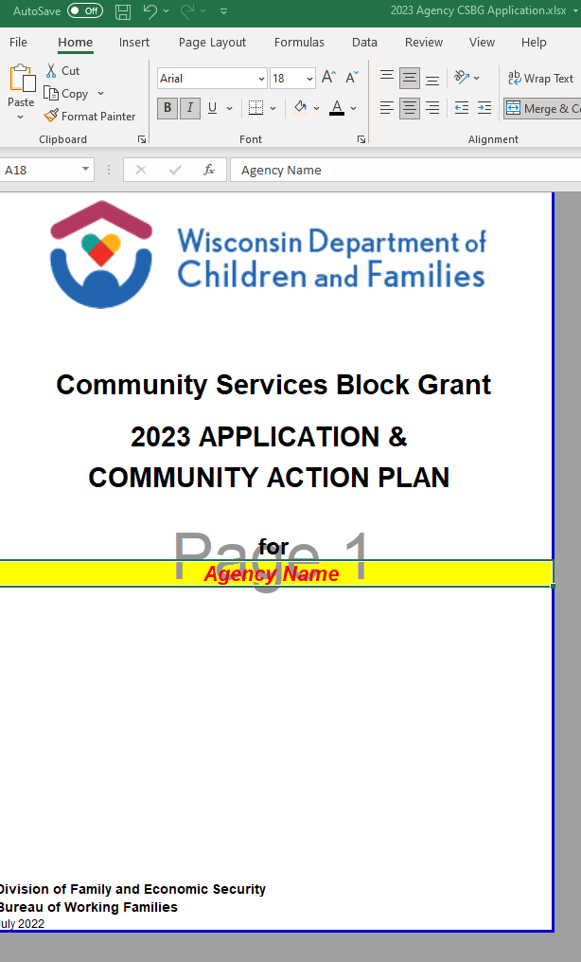
Walkthrough of the 2023 CSBG Application

Slide 9
Questions?
Thank you!
Anna Sainsbury anna.sainsbury@wisconsin.gov

